Slide 1

Session Two
Date
Location

Slide 2
Contact information:
Dave Vick
dave@vickassociates .com
480-758-4582
Vick & Associates, Inc.
8700 E. Vista Bonita Drive
Suite 240
Scottsdale, AZ 85255

Slide 3
Disclaimer (insurance only)
The Financial ABCs of Retirement Planning Workshop is an educational program, and is not intended to sell investment or insurance products, nor is it intended to provide tax or legal advice. Consult with your tax advisor and/or legal counsel for suitability for your specific situation.
Hypothetical and/or actual historical returns contained in this presentation are for informational purposes only and are not intended to be an offer, solicitation, or recommendation. Rates of return are not guaranteed and are for illustrative purposes only.
Projected rates do not reflect the actual or expected performance within any example or financial product.
Dave Vick is an Investment Advisor Representative with Redhawk Wealth Advisors, an SEC Registered Investment Advisor. Insurance and annuity products are offered through Vick & Associates, Inc.

Slide 4
Course Introduction:
This is a course that dives deep into the concepts of retirement planning from a financially conservative point of view. We will use the book, “Bat-Socks, Vegas and Conservative Investing,” and it’s accompanying workbook, “The Financial ABC’s of Retirement Planning,” as our guide through this vantage point. There are other retirement topics that are important, however our focus for this class is a financially conservative point of view.

Slide 5
Why Are We Here?
Do you know how all of your assets (stocks, bonds, mutual funds, annuities, REITS, Life Insurance, etc.) work together to achieve the amount of risk you want in your total portfolio?
How does your current portfolio protect you in a bear market?
How does the average person determine which assets to use in a conservative portfolio?
What is your plan to manage risk?
Do you need a degree in finance to know how to manage risk?
Notes:
How do your assets work together to accomplish what you want to accomplish in your retirement, and do you need a degree in finance to get it? Do all those guys who manage money know the answers? Lehman, Bear Stearns, Merrill Lynch?
Could the novice understand where assets fit together so they can sleep at night?

Slide 6
What Did You Get Out of Last Week?
What is Conservative Investing
Perilous Times to be an Investor
Wall Street (Investment Community) Disconnect
Technology has Created a New ‘Ball Game’
We Can’t Keep on Doing the Same Thing
Perhaps There is a Need for a New Model

Slide 7
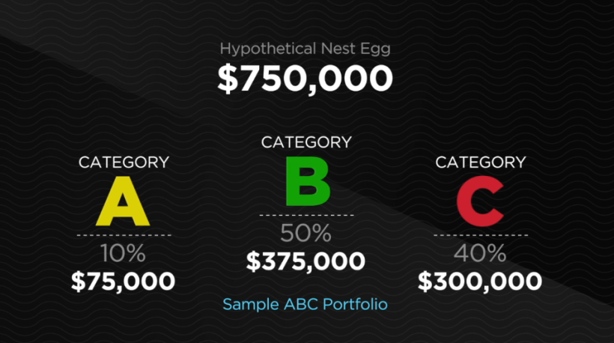
Review ABC Model: ABC Video

Slide 8

Who’s the king?
Chapter Six:
Yellow Money Savings

Slide 9

The goal of Yellow Money?
How much Liquidity is right for you?
The Two Yellow Money Categories
  Accessible with no penalties
  Accessible with minimal penalties
Notes:
Liquidity…how much cash should you have. Depends on what CDs are paying. Go with what you think about today. Financial planners would normally tell you to have enough for a year., Trip to take, college to fund, car to buy…need to keep money for that.

Slide 10
IS HAVING THE MAJORITY OF YOUR MONEY LIQUID IMPORTANT TO YOU?
If not, then how much is
right for you?
(No right or wrong answers)

Slide 11
“They are who we thought they were!”
Chapter Seven:
Green Money Premium

Slide 12
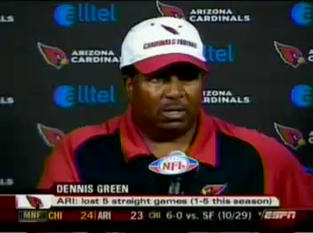

Slide 13
Fixed Income or Fixed Principal Assets?
  “This may come as a surprise to some, but bonds can lose value. Just ask those who held ENRON bonds, WorldCom bonds, Lehman Brothers, or Bear Stearns bonds.”
  “Bat-Socks, Vegas & Conservative Investing” by David P. Vick
  7.2 In the past, have you thought bonds guaranteed principal? Explain
Notes:
Have you or anyone you known ever lost money in bonds…know someone who lost 1.5MM in Lehman
Bond bubble, billions are going into bonds when interest rates are all time low…rush to safety in bonds that pay dirt and have one way to go.
2% bond, and interest rates go to 4%, what happens to the value of your bonds
Which is larger, stock or bond market…bond market four times, much large thud when it crashes.
Reverse dollar cost averaging

Slide 14
Fixed Income or Fixed Principal Assets?
What are Fixed Income Assets?
Do Fixed Income Assets have Protection of Principal?
Have you or anyone you know ever lost money in bonds?
What is a ‘Bond Bubble’?
Notes:
Have you or anyone you known ever lost money in bonds…know someone who lost 1.5MM in Lehman
Bond bubble, billions are going into bonds when interest rates are all time low…rush to safety in bonds that pay dirt and have one way to go.
2% bond, and interest rates go to 4%, what happens to the value of your bonds
Which is larger, stock or bond market…bond market four times, much large thud when it crashes.
Reverse dollar cost averaging

Slide 15
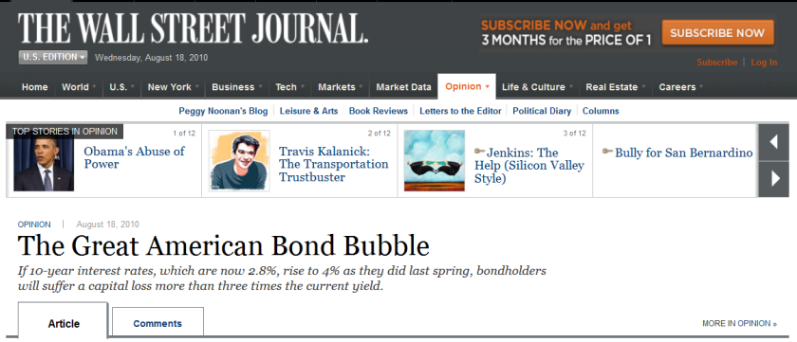
Fixed Income or Fixed Principal Assets?
What are Fixed Income Assets?
Do Fixed Income Assets have Protection of Principal?
Have you or anyone you know ever lost money in bonds?
What is the ‘Bond Bubble’?
Notes:
Have you or anyone you known ever lost money in bonds…know someone who lost 1.5MM in Lehman
Bond bubble, billions are going into bonds when interest rates are all time low…rush to safety in bonds that pay dirt and have one way to go.
2% bond, and interest rates go to 4%, what happens to the value of your bonds
Which is larger, stock or bond market…bond market four times, much large thud when it crashes.
Reverse dollar cost averaging

Slide 16
Is Protecting Your Principal, or some of your Principal, important to you?

Slide 17
Three Green Money Rules:
Green Money Rule #1:
It Protects Your Principal
Green Money Rule #2:
It Protects Your Gains
Green Money Rule #3:
It Protects Your Income
  7.3 How do the Green Money Rules help when forming a balanced, conservative portfolio?
Notes:
Why bonds don’t fit into that column

Slide 18
Types of ‘Green Money’ Assets
What is an Annuity? (p. 55)
“An annuity, technically, is a contract with an insurance company for an income payment either now or in the future. The word annuity means “payment.””
  “Bat-Socks, Vegas & Conservative Investing” by David P. Vick
Notes:
Page 56

Slide 19
Types of ‘Green Money’ Assets
What is an Annuity?
Different types of annuities:
Immediate Annuity
Deferred Annuity
Single Premium Deferred Annuity (SPDA)
Flexible Premium Deferred Annuity (FPDA)
Fixed Annuity
Fixed Indexed Annuity
Variable Annuity
Notes:
Page 56

Slide 20
Types of ‘Green Money’ Assets
Variable Annuities (p. 56)
Offers market returns with some protections.
“…the variable annuity puts the risk of the principal on the investor, while the fixed annuity puts the risk on the insurance company.”
  “Bat-Socks, Vegas & Conservative Investing” by David P. Vick
Notes:
Page 56

Slide 21
Types of ‘Green Money’ Assets
Variable Annuities (P. 56)
The company offers you the option to choose from a varied amount of side accounts which are much like mutual funds. In fact, though they are not technically mutual funds,…You will pay management fees inside these funds along with other fees and expenses typical of variable annuities. These expenses range from 1.25% to 5% depending on the amount options you choose for your variable annuity.”
  “Bat-Socks, Vegas & Conservative Investing” by David P. Vick
Notes:
Page 56

Slide 22
Types of ‘Green Money’ Assets
Variable Annuities (P. 56)
Sample variable annuity expenses:
M&E Charges 1.25%
Enhanced Death Benefit .75%
Income Benefit .75%
Fund Management Fees .65%
Total 3.4%
  “Bat-Socks, Vegas & Conservative Investing” by David P. Vick
  7.4-5 In what ways might it be an advantage or disadvantage to use a variable annuity in your portfolio?
Notes:
Page 56

Slide 23
Types of ‘Green Money’ Assets
Fixed Annuities (P. 57)
“…the main characteristic of a Fixed Annuity is the protection of your principal…The insurance company in a traditional fixed annuity announces the interest it will credit for the year in advance, much like a bank announces its interest rate on CD’s. It is compounded and tax-deferred...”
  “Bat-Socks, Vegas & Conservative Investing” by David P. Vick
Notes:
Page 56

Slide 24
Types of ‘Green Money’ Assets
Fixed Indexed Annuities (P. 57)
“An indexed annuity’s interest rate is tied to an index such as the S&P 500. If the index goes up, the owner of the annuity is credited with a portion of the increase in the index and those gains are retained in the contract. If the index goes down, both the principal and previous years gains are retained, and the owner of the annuity loses no ground.”
  “Bat-Socks, Vegas & Conservative Investing” by David P. Vick
Notes:
Page 56

Slide 25

An FIA Simple Four Year Graph
15%+
10%+
10%
5%
0%
5%
5% cap
Year One
Year Two
Year Three
Year Four
6%
-40%
15%
Items to Consider:
___Surrender Duration ___Liquidity Options ___Caps ___Income Riders ___Crediting Methods ___Other
Notes:
This four year graph shows a simple, base-model chassis of an index annuity. Let’s say that the market goes up 10% in the first year. The annuity company will cap your earnings in some manner, so let’s say the cap is 5%. Now, if the market went down the next year 40%, how much would you lose? Zero! So, would you be upset if the market went down 40% an you got zero? Of course not. Zero is your hero. In fact the 5% stays in the account unless you pull money out. In the third year, if the market went up 6% and the cap was still 5%, the company would give you 5% compounded on top of the first year’s earnings. In the fourth year, if the market went up a whopping 15%, and the cap was still at 5%, you would throw in another 5%. Now you are up 15 plus percent because of compounding while the market isn’t even back to where it started in year one.
Sounds too good to be true doesn’t it. So, let’s take a look at some negative aspects of the annuity. Once you deposit money in an annuity you will have limited liquidity, usually 10% a year of the account value, after the first year. The length of term can be anywhere from 6 to 16 years. You need to find out about caps and other riders that can limit or enhance your earning power, which is something we discuss on an individual basis.
Would you be upset if you received 0% when everyone around you lost 40%?
Sounds too good to be true? If you found it was true, would you want some of this>
Drawbacks…surrender charges
Liquidity options, 10% free.
Caps can go up and down…
How do you allocate money…25% fixed…want it to get something. Annual point to point….

Slide 26
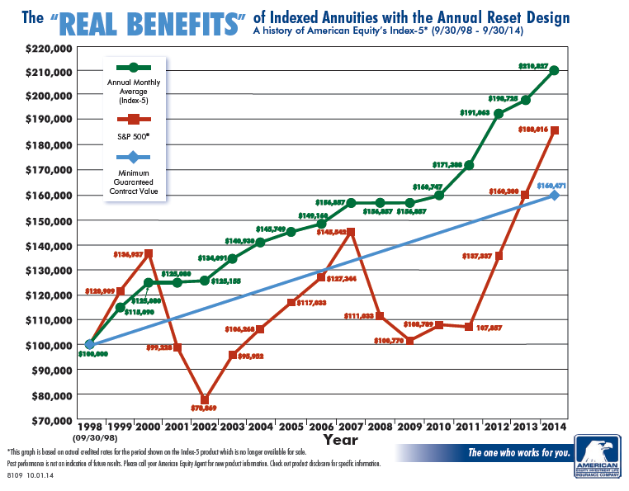
Actual FIA Historical Performance*
*DISCLOSURE: This is a Hypothetical Graph that reflects the actual interest crediting methods used by a specific insurance company from a time period beginning 09/30/1998 and ending on 09/30/2013. Individual results may vary and be dependent upon crediting methods, caps and participation rates. This is for illustration purposes only to show how a Fixed Index Annuity may have performed over a specific period of time.

Slide 27
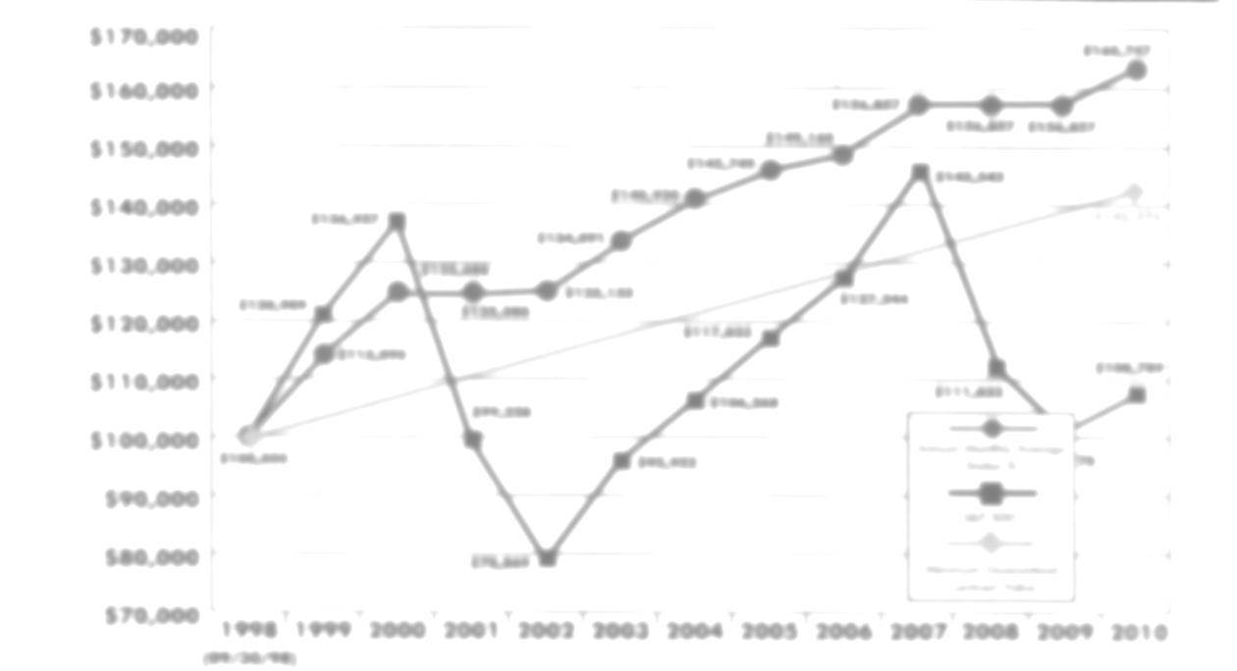
FIA Basics
7.6 How does the structure of an Indexed Annuity protect your principal and retain your gains?
7.7 Would you be upset with “0%” in year two?
7.8 Would you be upset if you did not get a greater return in year four when the market went up 15%?

Slide 28
FIA CREDITING METHODS
FIA Guarantees (p. 58)
“Fixed Indexed annuities are guaranteed by the issuing insurance company who provides a contractually stated guarantee in each annuity.”
  “Bat-Socks, Vegas & Conservative Investing” by David P. Vick
FIA Guarantee Example:
Premium $100,000
87% of Premium $87,000
Minimum Interest 2%
Number of Contract Years 10
Minimum Guaranteed Balance $106,053

Slide 29
FIA CREDITING METHODS
Annual Point to Point with a Cap
Annual Point to Point with Participation Rate
Monthly Point to Point with a Cap
Monthly Average with a Cap or Participation Rate
Multi-Year with a Mix of Interest and Percent of the Market
  7.10 Which of the crediting methods most appeal to you?

Slide 30
Additional FIA Points
Taxes
Fees with FIAs
Liquidity with FIAs
  7.12 Compare an Indexed Annuity’s liquidity to other assets?

Slide 31
Additional FIA Points
Diversified Portfolio of FIAs (p. 62)
Two reasons why diversifying FIAs could be a good idea?
We don’t know which index will perform better in any given year.
We don’t know which crediting method will perform better in any given year.

Slide 32
Additional FIA Points
Diversified Portfolio of FIAs (p. 62)
While carriers provide differences in indexes that can include “volatility control” or stocks/bonds, precious metals, and more, you might also want to consider the following:
Strength of the carriers
American Company or Foreign Domiciled
Length of contracts
Quality of home office service
Guaranteed Withdrawal Benefits
Additional riders for Long Term Care & Terminal Illness
Death Benefits

Slide 33
Additional FIA Points
Diversified Portfolio of FIAs (p. 62)
There are benefits to a single contract as well, like simplicity and receiving statements from one source. After all, the older we get the more we tend to forget.

Slide 34
Additional FIA Points
Planning for Income - Pension Payments
“Basically, there are two ways to get money out of an annuity. You either “annuitize” or “withdraw.” The major difference is what happens to the account value when you choose either of these two options.”
  “Bat-Socks, Vegas & Conservative Investing” by David P. Vick

Slide 35
Additional FIA Points
Guaranteed Withdrawal Benefits
Accumulation Value
The current value of your annuity’s cash account which includes any bonus and all interest credits to date, less any withdrawals.
Income Account Value
The current value of your annuity’s income account which includes any bonus and all interest credits to date, less any withdrawals. Note: there is no cash value here.

Slide 36
Additional FIA Points
Guaranteed Withdrawal Benefits
Current Surrender Value
The current value of your annuity’s cash account which includes any bonus and all interest credits to date, less any withdrawals, and minus any surrender charges that would apply if you chose to liquidate.
Guaranteed Minimum Surrender Value
The current value of your annuity’s cash account which includes any bonus and the minimum guaranteed interest credits to date, less any withdrawals, and minus any surrender charges that would apply if you chose to liquidate.”

Slide 37
Additional FIA Points
Guaranteed Withdrawal Benefits
Guaranteed Withdrawal Percentage:
Ages 60 – 69 4-5%
Ages 70 – 79 5-6%
Ages 80 & up 6-7%
Disclosure: Past performance is no guarantee future results. Crediting rates including caps for FIA’s can change and are determined by the insurance companies at the time of issue. Future performance cannot be predicted or guaranteed. FIA’s are not registered as a security with the SEC and is not invested directly in any stock, bond, or security investment. FIA products, features, and benefits vary by state.
Annuity Contracts are products of the insurance industry and are not guaranteed by any bank or insured by the FDIC. When purchasing a fixed indexed annuity, you own an annuity contract backed by the insurance company, you are not purchasing shares of stocks or indexes. Product features such as interest rates, caps, and participation rates may vary by product and state and may be subject to change. Surrender charges may apply for early withdrawals. Be sure to review the specific product disclosure for more details. Guarantees are based on the financial strength and claims paying ability of the insurance company.
This information is not intended to give tax, legal, or investment advice. Please seek advice from a qualified professional on these matters.
Lifetime income benefit riders are used to calculate lifetime payments only. The income account value is not available for cash surrender or in a death benefit. Excess withdrawals may reduce lifetime income and may incur surrender charges. Fees may apply. Guarantees based on the financial strength and claims paying ability of the insurance company. See specific product disclosure for more details.

Slide 38
Additional FIA Points
Guaranteed Withdrawal Benefits
Guaranteed Withdrawal Benefit (GWB) Example:
Guaranteed Income Account Growth Rate: 6.5%
Bonus: 8%
Premium: $100,000
Age at Issue: 60
Age Withdrawals Chosen: 70
Guaranteed Withdrawal Percent: 6%
Income Account Value: $202,731
Guaranteed Annual Withdrawal Benefit: $12,164

Slide 39
Additional FIA Points
7.16 In what ways would you see a GWB enhancing your situation?

Slide 40
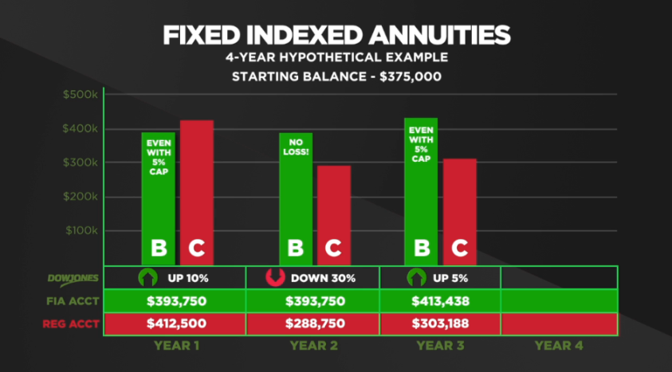
Review Dave Vick’s FIA Video

Slide 41
What is your take on the value of Green Money Column B?
Do you think it is important to protect a portion of your assets or income?

Slide 42

“how’s the weather?”
Chapter Eight:
Red Money Investing

Slide 43
Red Money Language
Systematic Risk, Volatility, and Variance
  “…the risk or uncertainty associated with the entire market, or an entire segment of a market, “systematic risk.” (1) In other words, investing in the market in general is uncertain all the time.”
  “Bat-Socks, Vegas & Conservative Investing” by David P. Vick
  8.2 How does “systematic risk” make you feel?
p. 69
Notes:
DNA of the market…risk runs through every asset of the market (systematically), cannot hold a market asset without an element of risk.
Beta…measure of risk against an index…Beta of one is as volatile as S&P. Up ten you go 10. 1.5…50% more volatile. Typical growth fund is 1.3 to 1.6%
R squared is the policeman, how reliable is the Beta number….90 and up reliable, under 70 unreliable…SD is wobble factor,
It all means nothing.

Slide 44
Red Money Language
Systematic Risk, Volatility, and Variance
  “…Wall Street measures risk associated with the market is through “volatility.” People who study the market look at historical returns of a stock or index and plot them on a graph. They look to see how the dots on the graph relate to each other over time and in relationship to historical events. The further apart the dots on the graph, the higher the volatility. The higher the volatility, the riskier the investment.”
  “Bat-Socks, Vegas & Conservative Investing” by David P. Vick
p.70
Notes:
DNA of the market…risk runs through every asset of the market (systematically), cannot hold a market asset without an element of risk.
Beta…measure of risk against an index…Beta of one is as volatile as S&P. Up ten you go 10. 1.5…50% more volatile. Typical growth fund is 1.3 to 1.6%
R squared is the policeman, how reliable is the Beta number….90 and up reliable, under 70 unreliable…SD is wobble factor,
It all means nothing.

Slide 45
Red Money Language
Systematic Risk, Volatility, and Variance
  “Wall Street uses “variance” to describe the difference between where the returns are from an average return of the same asset or a corresponding index.”
  “Bat-Socks, Vegas & Conservative Investing” by David P. Vick
p.70
Notes:
DNA of the market…risk runs through every asset of the market (systematically), cannot hold a market asset without an element of risk.
Beta…measure of risk against an index…Beta of one is as volatile as S&P. Up ten you go 10. 1.5…50% more volatile. Typical growth fund is 1.3 to 1.6%
R squared is the policeman, how reliable is the Beta number….90 and up reliable, under 70 unreliable…SD is wobble factor,
It all means nothing.

Slide 46
Red Money Language
Beta, Alpha, Standard Deviation, and R-Squared
  “Beta is a measure of risk or volatility as it relates to an index. Let’s say a mutual fund you own has a Beta of 1 to the S&P 500 Index. This fund would then tend to go up about the same as the S&P and down about the same. If the Beta was 1.5, the fund would be 50% more volatile than the S&P. If the Beta was .5 then the fund would be 50% less volatile than the S&P.”
  “Bat-Socks, Vegas & Conservative Investing” by David P. Vick
p.70
Notes:
DNA of the market…risk runs through every asset of the market (systematically), cannot hold a market asset without an element of risk.
Beta…measure of risk against an index…Beta of one is as volatile as S&P. Up ten you go 10. 1.5…50% more volatile. Typical growth fund is 1.3 to 1.6%
R squared is the policeman, how reliable is the Beta number….90 and up reliable, under 70 unreliable…SD is wobble factor,
It all means nothing.

Slide 47
Red Money Language
Beta, Alpha, Standard Deviation, and R-Squared
“Alpha, another well-used Wall Street term, is used to measure how much the fund’s performance is better than the correlated benchmark index. If the fund’s Alpha is 5, it outperformed its benchmark index by 5%.”
  “Bat-Socks, Vegas & Conservative Investing” by David P. Vick
p.70
Notes:
DNA of the market…risk runs through every asset of the market (systematically), cannot hold a market asset without an element of risk.
Beta…measure of risk against an index…Beta of one is as volatile as S&P. Up ten you go 10. 1.5…50% more volatile. Typical growth fund is 1.3 to 1.6%
R squared is the policeman, how reliable is the Beta number….90 and up reliable, under 70 unreliable…SD is wobble factor,
It all means nothing.

Slide 48
Red Money Language
Beta, Alpha, Standard Deviation, and R-Squared
“Standard Deviation is the “wobble factor”, showing us how much a fund wobbles back and forth from its average return. The more it wobbles, the higher the risk.
Technically, Standard Deviation measures how a fund’s performance over time is different from its average return. (2) The greater the difference, the higher the volatility. The higher the volatility, the more uncertainty in future returns.”
  “Bat-Socks, Vegas & Conservative Investing” by David P. Vick
p.70
Notes:
DNA of the market…risk runs through every asset of the market (systematically), cannot hold a market asset without an element of risk.
Beta…measure of risk against an index…Beta of one is as volatile as S&P. Up ten you go 10. 1.5…50% more volatile. Typical growth fund is 1.3 to 1.6%
R squared is the policeman, how reliable is the Beta number….90 and up reliable, under 70 unreliable…SD is wobble factor,
It all means nothing.

Slide 49
Red Money Language
Beta, Alpha, Standard Deviation, and R-Squared
“This measurement grades the accuracy of the assets movements that can be related to a benchmark index. If the grade is low, 70 or less, the Beta is probably not reliable. If the grade is higher than 85, the Beta might be considered to be more dependable. R-Squared sheds light on the veracity of risk measurements.”
  “Bat-Socks, Vegas & Conservative Investing” by David P. Vick
p.70
Notes:
DNA of the market…risk runs through every asset of the market (systematically), cannot hold a market asset without an element of risk.
Beta…measure of risk against an index…Beta of one is as volatile as S&P. Up ten you go 10. 1.5…50% more volatile. Typical growth fund is 1.3 to 1.6%
R squared is the policeman, how reliable is the Beta number….90 and up reliable, under 70 unreliable…SD is wobble factor,
It all means nothing.

Slide 50
  “Hulbert’s data shows that
  more than 84 percent of mutual Funds underperform
  the market over a 5-year period. Over ten years, that number rises to 90 percent.”
Morningstar Publications

Slide 51
Stock Market: 84 Percent Of Stock Funds Underperformed In 2011, Reaching Decade Lows
Huffington Post
3/12/12
About 84 percent of U.S. stock funds that are actively managed, rather than passively tracking an index, underperformed versus the Standard & Poor's indexes representing the market segment the funds invest in. That's according to S&P Indices, which on Monday released its 10th annual fund performance scorecard.
The market researcher found that fund performance was better over the past several years than in 2011, although a majority of funds still fell short. Over three years, from 2009 through 2011, about 56 percent of stock funds underperformed relative to S&P benchmarks. Over five years, 61 percent underperformed.
Going back 10 years, the average percentage of funds underperforming has been about 57 percent.
http://www.huffingtonpost.com/2012/03/12/stock-market-mutual-fund-fail_n_1340665.html

Slide 52
Stock Type Risk vs. Bond Type Risk
“…the question for Column C Red Risk Money is this: what percent of your Red Risk Money do you want in stock-type risk and what percent do you want in bond-type risk?”
“Bat-Socks, Vegas & Conservative Investing” by David P. Vick

Slide 53
Stock Type Risk vs. Bond Type Risk
“I also have a rule for Red Money that unless you have over two million dollars in investible assets you probably want to stay away from individual stocks… Unless you are market savvy you don’t want in this game as a conservative investor.”
  “Bat-Socks, Vegas & Conservative Investing” by David P. Vick
8.10 Do you agree or disagree with this statement? Why?

Slide 54
WHO CHOOSES YOUR ASSETS?
Yourself, through self-directed accounts?
Financial Advisor/Broker?
Charles Swab, Fidelity Investments, etc.?
Registered Investment Advisor?
Why?

Slide 55
Buy and Hold vs. Tactical Management
“There are two styles of management that you might choose from: tactical or “buy & hold.” Simply put, tactical management is active, daily management. In a “buy & hold” style, the manager chooses the sectors of the market, how much to weight each sector and then uses the best fund managers available.”
“Bat-Socks, Vegas & Conservative Investing” by David P. Vick

Slide 56
Buy and Hold vs. Tactical Management
8.13 What are the positives and negatives about the “Buy and Hold” Style?

Slide 57
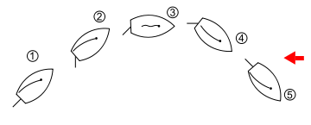
What is Tactical
Tacking or coming about is a sailing maneuver by which a sailing vessel (which is sailing approximately into the wind) turns its bow through the wind so that the direction from which the wind blows changes from one side to the other.

Slide 58
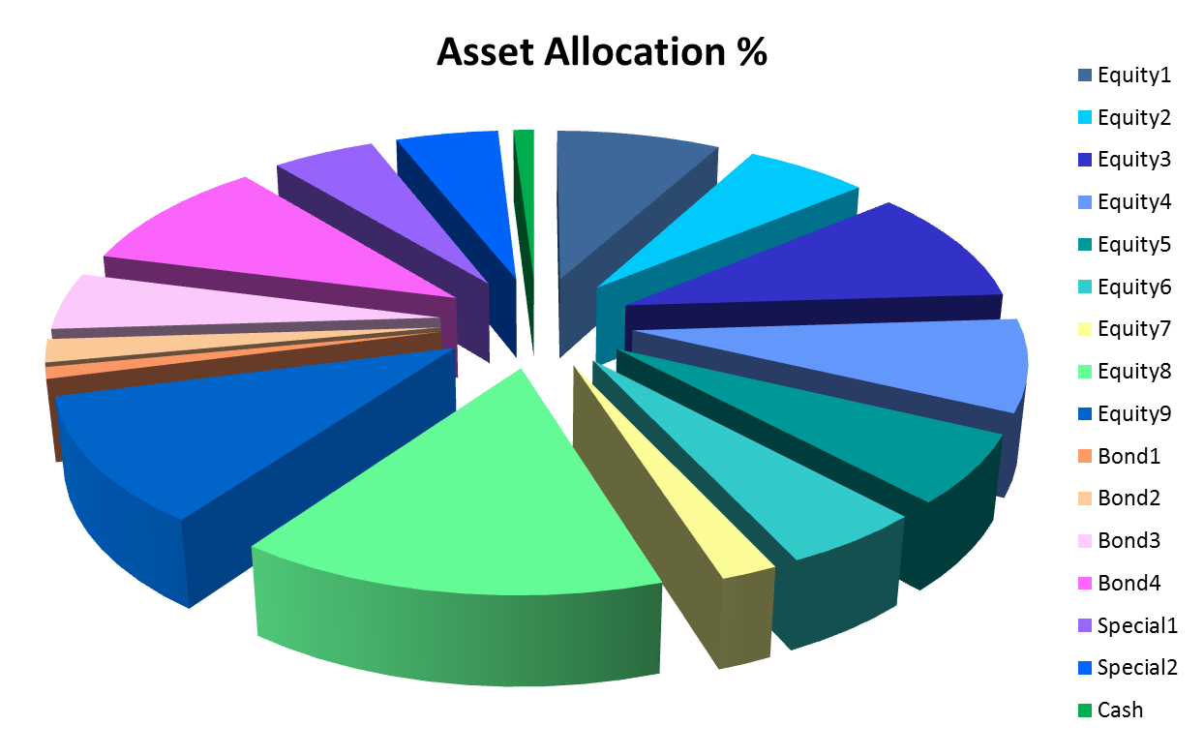
Strategic Allocation, Tactical Management

Slide 59
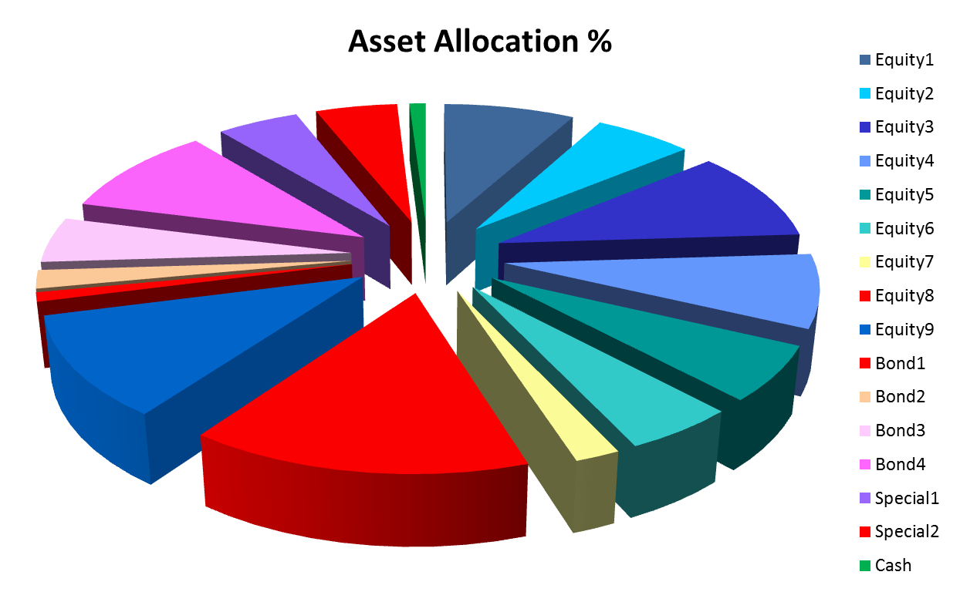
All in or all out signal

Slide 60
All in or all out signal

Slide 61

Tactical Management Style
How does tactical management differ from Buy and Hold’ Strategy?
Do you feel that Tactical Management may be the future of investing, as the author suggested?

Slide 62
What is the value of Red Money when planning for retirement?

Slide 63
A negative neighbor
Chapter Nine:
What if it happened again?

Slide 64
WHAT IF IT HAPPENS AGAIN?
“The way to make money is to buy when blood is running in the streets.” John D. Rockefeller
“We simply attempt to be fearful when others are greedy and to be greedy with others are fearful” Warren Buffett

Slide 65

The Anatomy of a Bear
Every 3 years you have a bear market.
Every 8 years you have a significant bear market.
If you hold your money for 17 years you won’t have a problem.
“The Anatomy of a Bear” Napier 2005

Slide 66
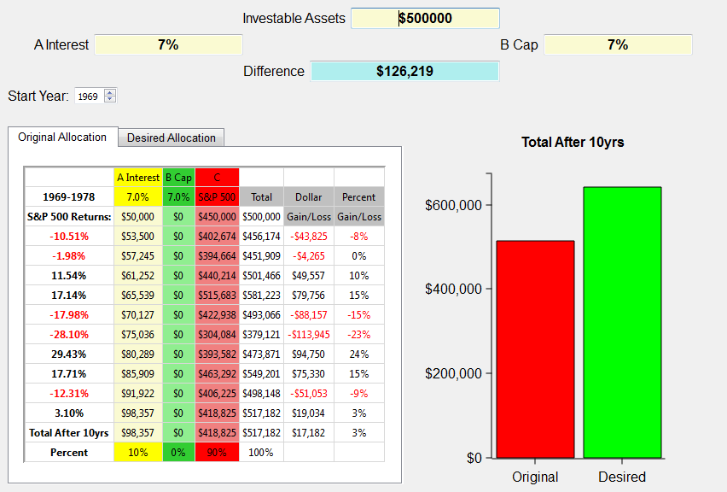
What if a bear market happens again? 1969 through 1978
Notes:
The illustration above shows the S&P 500 returns for the years 1969 through 1978 on the left. The investible assets are $500,000. This example uses the same criteria for caps in the index annuities, but uses the 7% average CD rate for the decade. Wouldn’t you love that again! We use the broad market index to approximate what investing in the market in general was like over that period of time..
The chart shows at the end of the ten year period this investor would have gained a little over $17,000. Look at all the red years in that decade! 5 out of 10 years were negative!
So, let’s take a look at the ABC allotment.

Slide 67
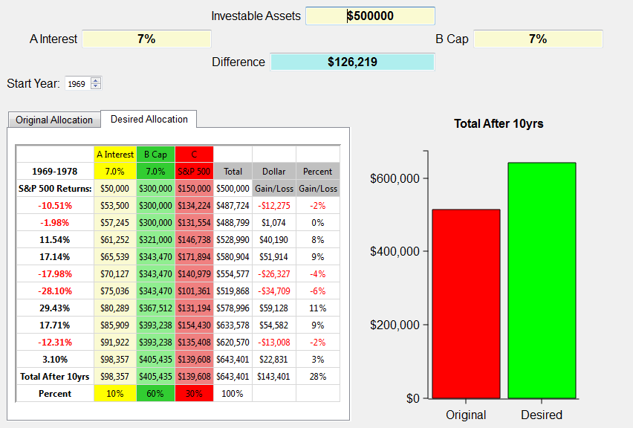
What if a bear market happens again? 1969 through 1978
$126,219
Notes:
The ABC allotment of 10/60/30 grows to over $143,000, which is a $126,219 difference! That’s with 5 out 10 years negative! Very positive toward the ABC bear market strategy for retirement.
Now let’s take a look at a really nasty decade. One we’re all familiar with.
Next slide.

Slide 68
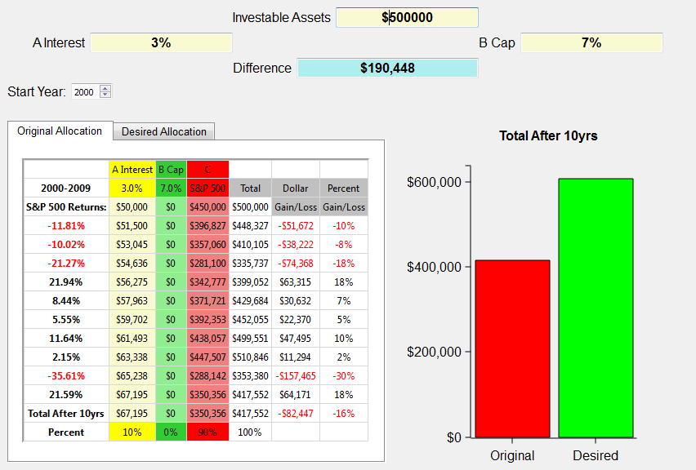
What if a bear market happens again? 2000 through 2009
Notes:
The illustration above shows the S&P 500 returns for the years 2000 through 2009 on the left. The investible assets are $500,000. This example shows a typical investor who has about 10% in cash earning an average of 3% and 90% allocated to the market represented by the S&P 500. We use the broad market index to approximate what investing in the market in general was like over that period of time. Certainly an investor could have been in more or less risk than illustrated here. Yet, the illustration shows in general terms how the market performed from 2000-2009. Notice, there are no monies allocated to Column B, which are Index Annuities.
The chart shows at the end of the ten year period this investor would have lost close to $100,000. I don’t know about you, but a 20% loss in the market is devastating when it comes to retirement! Imagine if you were 52 years old in 2000 and planning to retire when most people retire at age 62. Would you do what many have had to do, which is work another 3-5 years in hopes of recovering those assets needed to retire?
And what if it happens again? What if the next ten years aren’t any better than this decade? Can you afford to lose another 20% or possibly more? Can you continue to push off your retirement indefinitely?
When I show this graph to clients they tell me, “Yep, that’s about what happened to us.” Yet, the same clients will surprisingly stay in this broken down Wall Street model attempting to recover with a hope and a prayer.
There has to be a better way, and I believe there is.
Next slide.

Slide 69
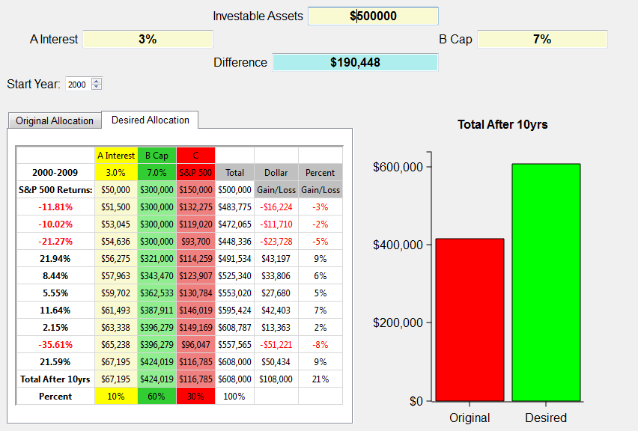
What if a bear market happens again? 2000 through 2009
  9.3 What if the next ten years saw a 20% loss in the market, how would it affect your retirement?
$190,448
Notes:
Using the 10/60/30 ABC split, this person gains $108,000 instead of losing over $80,000! Now that’s a strategy that works for retirement years. IT does so because it obeys Warren Buffet’s first rule of investing, “Never lose any money.” BTW, that happens to be rules number 2 and 3 also. And it has to be true, especially for retirees or those heading into retirement.
Simply putting some of your money in the green money column protects you from those down years and now with the tremendous guaranteed income payouts the green money column is even more a must for retirees. We don’t want you to get totally out of the red, or growth money assets, but it’s obvious that the green money column is perfect for conservative clients looking for alternatives to Wall Street’s roller coaster rides.

Slide 70

Dave Vick Video:
What if we do it again?
http://www.planningwithabc.org

Slide 71
What Do You Think?
9.4 Do you see the markets over the next decade doing better, or worse, or about the same as the decade?
9.5 Considering the ABC Model’s performance in a bear market, is it something that you would use in your portfolio?

Slide 72
The cowboy preacher
Chapter Ten:
The Retirees Biggest Need:
Income Planning

Slide 73
THE BIGGEST NEED… INCOME
“In 1933, Congress passed the Social Security bill that enabled people who were age 65 to receive income checks monthly from the government starting in 1935. It was originally intended as a supplement to income for the elderly, yet has turned into the major source of income for many retirees. It is interesting to note the average retirement age in 1910 was 74 years old, and the average in 2006 was age 62.”
“Bat-Socks, Vegas & Conservative Investing” by David P. Vick
p. 83
Notes:
Retire at 62, when is the last one expected to die?

Slide 74
THE BIGGEST NEED… INCOME
“…according to government actuarial tables a male age 62 is expected to live to just about 80 years old. If he reaches 75 he’s expected to reach age 85, and if he reaches age 85 he’s expected to live until age 90 plus. Women of those ages (never ask though) are expected to live another year and a half to two years longer than their male counter parts.”
“Bat-Socks, Vegas & Conservative Investing” by David P. Vick
p. 83
Notes:
Retire at 62, when is the last one expected to die?

Slide 75
THE BIGGEST NEED… INCOME
10.3 What is your plan to make your income last up to three decades?
10.4 How would your income plan account for the threat of market losses?
p. 83
Notes:
Retire at 62, when is the last one expected to die?

Slide 76

Dave Vick Video:
Accumulation vs. Distribution
http://www.planningwithabc.org

Slide 77
Accumulation on $500,000
Inverse Returns Effect
Hypothetical Index - Beginning Value $500,000
Annual End of Year Inverse End of Year
Year Return Value Return Value
1 28% $640,000 -38% $310,000
2 -10% $576,000 -12% $272,800
3 15% $662,400 2% $278,256
4 17% $775,008 15% $319,994
5 1% $782,758 26% $403,193
6 26% $986,275 1% $407,225
7 15% $1,134,216 17% $479,453
8 2% $1,156,901 15% $547,921
9 -12% $1,018,073 -10% $493,129
10 -38% $631,205 28% $631,205
Notes:
Commutative principle of multiplication, as long as you don’t take anything out of the equation. But have having said that if you are 62 and getting read to retire…what happens.

Slide 78
Income on $500,000
Inverse Returns Effect
Hypothetical Index -Beginning Value $500,000
Withdrawal $35,000 Inflation 3%
Annual Annual End of Year
Year Return Withdrawal Value
1 28% $35,000 $605,000
2 -10% $36,050 $508,450
3 15% $37,132 $547,586
4 17% $38,245 $602,430
5 1% $39,393 $569,062
6 26% $40,575 $676,443
7 15% $41,792 $736,118
8 2% $43,046 $707,795
9 -12% $44,337 $578,522
10 -38% $45,667 $313,017
Notes:
Need to plan for 30 years, if you screw up the first 10 years, Wal-Mart is going to need greeters.
Graphs out ther in the market you tell me…4% drops off in about 30 years…what that tells me is you will guestimate the return, hope withdrawals work and hope and pray you don’t run out of money. Or you could guarantee it. Which would you prefer. Problem with you…you believe what I just said is too good to be true. But I know its true as a financial planner. Companies put these out in contracts…sign and guarantee it, and you are contractually guaranteed. Do mutual funds to that? No they give you a prospectus and you get to pray.

Slide 79
Income on $500,000
Inverse Returns Effect
Hypothetical Index
Beginning Value $500,000 Withdrawal $35,000 Inflation 3%
Annual Annual End of Year
Year Return Withdrawal Value
1 -38% $35,000 $275,000
2 -12% $36,050 $205,950
3 2% $37,132 $172,938
4 15% $38,245 $160,633
5 26% $39,393 $163,004
6 1% $40,575 $124,060
7 17% $41,792 $103,358
8 15% $43,046 $75,816
9 -10% $44,337 $23,898
10 28% $45,667 -$15,078
Notes:
Need to plan for 30 years, if you screw up the first 10 years, Wal-Mart is going to need greeters.
Graphs out ther in the market you tell me…4% drops off in about 30 years…what that tells me is you will guestimate the return, hope withdrawals work and hope and pray you don’t run out of money. Or you could guarantee it. Which would you prefer. Problem with you…you believe what I just said is too good to be true. But I know its true as a financial planner. Companies put these out in contracts…sign and guarantee it, and you are contractually guaranteed. Do mutual funds to that? No they give you a prospectus and you get to pray.

Slide 80
Green Money Income Plans
Split Annuities – What are they? What is appealing about them? What is not?
Guaranteed Withdrawal Benefits – Again, what are they? Why would they be good? What could be the downside?

Slide 81
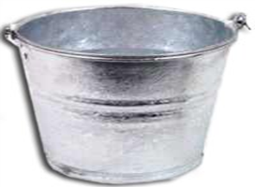
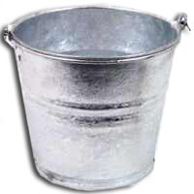
Split Annuity $500,000
10 Year Income Bucket
10 Year Growth Bucket
$215,000
$285,000
Plus 8% Bonus,
GWB 6.5%
$2,106 per month, or
$25,271 per year for 10 years. Value after 10 years $0.00
Guaranteed Income Account Value: $577,783. Could yield between $28,000 to $40,000 for life.

Slide 82

Maximum Income, but Delayed?
$500,000
8% Bonus
6.5% GWB
10th Year Guaranteed Income Account: $1,013,654 (Pays out between $35,000 - $70,000 per year for Life)

Slide 83
  Key Questions:
  10.7 Is guaranteeing income important to you in retirement? Explain?
10.8 What do you like most about the Split Annuity concepts?
10.9 What do you like most about the Split Annuity concepts?

Slide 84
I should have listened
Chapter Eleven:
Problems with 401(k) Plans

Slide 85
I Should Have Listened – Seven Problems with Your 401(k)
Problem #1 – Is your 401(k) compliant? Is it at risk by IRS Standards?
Problem #2 – Roth Accounts in a 401(k) have issues. Do you have a DRAC?
Problem #3 – Limited Choices. Does your plan have the choices you wish they had? What choices would you like to add to your plan? Are you confident in choosing assets? What’s your experience?

Slide 86
I Should Have Listened – Seven Problems with Your 401(k)
Problem #4 – The 20% withholding trap
Problem # 5 – Limited Beneficiary Options. When was the last time you checked the beneficiaries on your qualified plans? How would you arrange them?
Problem #6 – Required Minimum Distribution Errors. Rules, Rules, Rules?
Problem # 7 – 401(k)s: The Non-Stretch Plan. Do you desire to leave Qualified $ to family?

Slide 87
Understanding Your 401(k) Options
Consider In-Service, Non-Hardship Withdrawals to:
Create Better Income Solutions
More Investment Options
Plan Consolidations
More Beneficiary Options
Stretch IRA
Protect Principal
Get Professional help

Slide 88
Key Question:
Is Having More Options and Control of your 401(k) Important to you Right Now? In Retirement?

Slide 89

You need a sherpa
Chapter Twelve:

Slide 90
You Probably Need a Sherpa
  12.1 What are the qualities you look for in an advisor?
  12.2 What are your expectations for communication with your financial advisor?

Slide 91
You Probably Need a Sherpa
Business Temperaments
Relational/Relational
Relational/Business
Business/Relational
Business/Business
  12.5 What type of business
  temperament do you think
  you are? Explain.
Notes:
“How do you determine what the “kind of person” is the planner you would like to work with? First, you have to know a little about yourself. In doing so, I think Tim Templeton’s description of four business temperaments in his book The Referral of a Lifetime (3) might be helpful. I’ll attempt to describe them, though the labels are Tim’s:
Relational/Relational: These are folks who start and end with the love of relationships. They are people-people inside and out. Somehow business just happens.
Relational/Business: R/B people have an easy time developing relationships, but when the topic turns to business, they quickly get in to tactical mode.
Business/Relational: B/R people may be a little uncomfortable with relationships upfront and use “business talk” as a way to get started. However, once people become their clients, the relationships are long and fulfilling. They have very loyal clients.
Business/Business: B/B people are those who are not relationally motivated on the front end or the back end of a business relationship. They are business all the time and somehow relationships happen. It’s wrong to think that this is not the kind of person you would want simply because of the business nature of the advisor. There are people who need financial advice that are B/B also, and the R/R person irritates them to no end! (4)”

Slide 92
You Probably Need a Sherpa
Trust
‘Likeability’
Competence
Understands the ABCs
Longevity – are they going to be around when you need them?
Client-Partner?
Notes:
Need to work with someone that knows the terrain, longevity, you like and trust.
What happens if you die or retire?...You find another advisor. What happens when your doctor dies? Plenty of ABC advisors all over the country.
What is a client partner…go through the list of questions. If you advisor partners with you, you should partner with him…make his business a success. Talk him up. Now I hate asking for referrals and I don’t, but we have little get togethers, we are having one next week, come on down and bring some friends.

Slide 93
You Probably Need a Sherpa
Questions You Might Ask a Potential Advisor
  What is your area of specialty? Do you have an area of focus?
  What is your investment philosophy?
  How long have you been a planner?
  If you haven’t been in the business long, who do you have as a mentor or back-up planner to help you plan?
  What licenses do you hold? Why those licenses?
  Do you have a planning team that includes attorneys or accountants or other advisors?
  Can I speak with 3-4 of your clients?
  Are you familiar with the ABC Model of Investing and do you use it in your planning?
  How do you make use of Fixed Index Annuities in your practice?

Slide 94
You Probably Need a Sherpa
Questions You Might Ask a Potential Advisor
  Do you consider yourself a “safe money specialist?”
  Tell me about the manner in which you communicate with your clients.
    Do you have client events?
    Do you have a newsletter?
  Do you conduct regular reviews with your clients, and if so, how often?
  If I have a question after I become a client of yours, whom do I speak with?
  What types of assets do you use in planning?
  Can I visit your next client event?
  Are there any fees in working with you?
  Tell me about the planning process.
  Have you ever had any regulatory actions taken against you?
  12.8 Which questions do you think are important. What other questions might you ask a potential advisor?

Slide 95

DEAL OR NO DEAL
Chapter Thirteen:

Slide 96
Deal or No Deal
  13.1 What key elements are involved for you when making a financial decision?

Slide 97
Three Elements of a Financial Decision
Logic – In what ways does your current plan make sense to you?
Belief/biases – Are you aware of any bias you hold regarding your investments? Media Bias? Do you have any beliefs about assets or groups of assets that need to be changed?
Emotions -
Greed
Confidence
Denial
Despair
Despair
Notes:
Logic: First, is the area of logic—the science of reasoning. In other words, it’s how we “make sense” of something. We have an innate need to reasonably work through an issue with facts and details. We need to rationally decide on an issue.
Beliefs: Secondly, beliefs can be the stimulus for either a good or bad buying decision. What you believe about a topic will eventually determine how you feel about it. Counselors spend hours and hours trying to discover the beliefs of their patients driving their behaviors. For instance, if you have an underlying belief that money is evil, you will continually battle the idea of making more of it. If you believe money is king, then you won’t be satisfied until you’ve tried every avenue leaving no stone unturned, including shady investment schemes, to try and get rich. Beliefs matter.
Emotions: every study in academia shows buying is an emotional decision. Make no mistake about it. When you are planning your retirement and choosing conservative methods and financial tools, your emotions are fully engaged.
In fact, there are whole divisions within universities that study the emotional dynamics of investing labeled “behavioral finance,” along with the impact of emotions on economies. John W. Rogers, Jr. emphasizes the point in his column “The Patient Investor” on Forbes.com:”
“…behavioral academics are on the firmest ground citing the madness-of-crowds phenomenon. Most people make the same mistakes over and over. The most prevalent one is to pile in at the peak with everyone else. Since fitting in is easier than sticking out, investors flock together even when the results turn out bad.” (3)

Slide 98
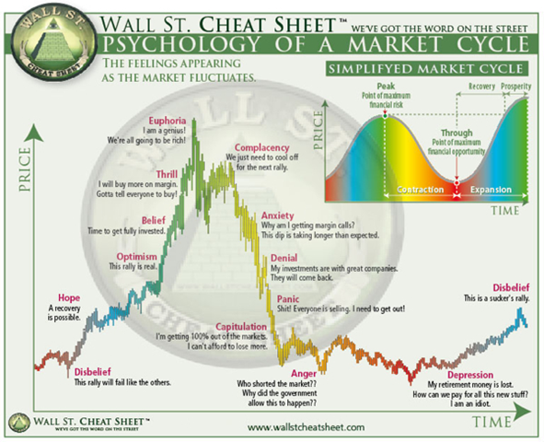

Slide 99
Key Question:
In what ways do you think an ABC Plan can help you avoid the emotional ups and downs of investing?

Slide 100
Process, Process, Process
Investigation
Recommendation
Implementation
Review and Adjust
Notes:
This is a process you should take your advisor through…you should be in control of the process, not your advisor. You want your advisor to meet with you…not once very five years. How many of you have had an advisor that when everything goes wrong they go dark?
In battling emotional investing, you need a process to work through to protect yourself from making a potentially devastating purchasing decision. I suggest a process of investigation, recommendation, and implementation, followed by a healthy dose of review and adjustments. This process should help you work through your emotions, challenge your beliefs, and reasonably pursue a financial decision. The process should give you the time to make an informed decision.
Different planners plan differently. You can set your own pace in a decision making process by establishing the ground rules at the beginning of your work with an advisor. Knowing a simple planning system you can use with advisors will be helpful.
The first planning step is “investigation.” During this step, you will discover all the risk, leaks, and gaps in your current financial plan. You should fill out a financial review form listing all your assets (appendix chapter one) and income. The financial review form can help you see your assets as a whole and how they relate to each other. You will want to list the concerns you have about your assets, your goals, and of course decide on the ABC Allocation you believe best fits you. You will want to pay close attention to the time horizon you have for your goals. This is crucial when it comes to deciding on the assets you use in your plan. An advisor can help you think through possible solutions to the concerns and goals you have.
Second, either develop for yourself or receive from an advisor a plan which includes everything your goals set out to accomplish. This plan should be detailed and involve assets and income from specific sources. The plan should include what you want to accomplish in at least the next five years with an ability to adjust as necessary.
Third, implement your plan when you have worked out the details and you are confident it is a solution to problems—one that will accomplish your goals. It will involve a lot of paperwork and is best done in a separate meeting so you have time to go over the details with your advisor. You will most likely have to make transfers into different companies, which will create a conservation attempt in some form, by the current company holding your money. Just remember, it’s your money, not theirs. This is something they often forget.
Lastly, you will want to review the plan once all the monies are transferred to make sure they are where you wanted them to be and in the amounts you had determined for your plan. I would suggest you review the plan at least every six months to make sure you are on the right path. If you have assets in Column C, the Red Risk portion, you will want some type of a review quarterly. Remember your goals and especially your time horizon. For conservative investors this is not a sprint, but a marathon.”
“Given the right process, your emotions will be given the opportunity to be led by your beliefs, which will be challenged by the truth, leading to a logical conclusion.

Slide 101
Process, Process, Process
  13.10 How important to you is using a good financial decision making process? Explain.
Notes:
This is a process you should take your advisor through…you should be in control of the process, not your advisor. You want your advisor to meet with you…not once very five years. How many ofyou have had an advisor that when everything goes wrong they go dark?
We generally meet twice a year, client events once a month and big events twice a year.

Slide 102

Seven steps to an abc plan
Chapter Fourteen:

Slide 103
Seven Steps to an ABC Plan
Step One – Get Your Assets Together (App. One)
Step Two – Write Down Retirement Goals and Budgets
Step Three – ABC Your Assets (Know your Risk Tolerance, App. Three)
Step Four – Choose an Advisor
Step Five – Process, Process, Process
Step Six – Review and Adjust
Step Seven – Sleep at Night!

Slide 104
In what ways have you resonated with the Financial ABC’s of Retirement Planning?
Please complete our Evaluation Form…
Notes:
Test and evaluation form…
Option one: call admin and set up time
Option two: have may calendar here, put your name in the calendar.
Have an event next week…love to have you.

Slide 105
Contact information:
Dave Vick
dave@vickassociates .com
480-758-4582
Vick & Associates, Inc.
8700 E. Vista Bonita Drive
Suite 240
Scottsdale, AZ 85255

Slide 106
Thank you for Attending!

