Slide 1
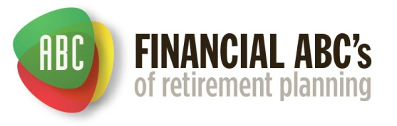
Session One
Date
Location

Slide 2
Contact information:
Dave Vick
dave@vickassociates.com
480-758-4582
Vick & Associates, Inc.
8700 E. Vista Bonita Drive
Suite 240
Scottsdale, AZ 85255

Slide 3
Disclaimer
The Principles of Retirement Planning Workshop is an educational program, and is not intended to sell investment or insurance products, nor is it intended to provide tax or legal advice. Consult with your tax advisor and/or legal counsel for suitability for your specific situation.
Hypothetical and/or actual historical returns contained in this presentation are for informational purposes only and are not intended to be an offer, solicitation, or recommendation. Rates of return are not guaranteed and are for illustrative purposes only.
Projected rates do not reflect the actual or expected performance within any example or financial product.
Dave Vick is an Investment Advisor Representative with Redhawk Wealth Advisors, an SEC Registered Investment Advisor. Insurance and annuity products are offered through Vick & Associates, Inc.

Slide 4
Course Introduction:
Attendance is good, but participation is better.
You have my dedicated time for the next three weeks.
We will start and stop on time with 10 minute breaks on the hour.
Course based on “Bat-Socks, Vegas & Conservative Investing.
Includes Principles of Retirement Planning Workbook.
ABC Planning Model Concepts – DVD by the author.
Fill out Workshop Goals sheet.

Slide 5
Course Introduction:
This is a course that dives deep into the concepts of retirement planning from a financially conservative point of view. We will use the book “Bat-Socks, Vegas and Conservative Investing” and it’s accompanying workbook “The Principles of Retirement Planning” as our guide through this vantage point. There are other retirement topics that are important, however we will focus for this class on a financially conservative point of view.

Slide 6

Conservative Investing
Chapter One:

Slide 7
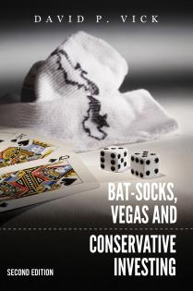
Bat-Socks…
1.1 How would you describe a planning “fad?”
1.3 How would you define conservative retirement planning?

Slide 8
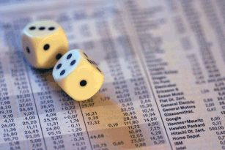
Risk
Types of Risk– p.13
1.8 Take the Risk Assessment Questionnaire located in Appendix 3 at home this week.
Risk vs. Reward
Upset-ness
Risk Tolerance Scale – p.13

Slide 9
1.11 What are the highest interest rates you remember receiving on bank assets?
January
3.36%
1.69%
1.13%
1.69%
3.67%
5.22%
5.15%
2.73%
.49%
.32%
.31%
Source MoneyCafe.com 2012
January
1980 11.47%
13.38%
15.60%
11.84%
9.16%
10.26%
8.02%
6.36%
6.95%
7.92%
9.00%

Slide 10
Life in the Slow Lane
“Simply put, conservative investing is a long-term strategy to manage risk in such a way as to conserve principal while maintaining buying power. What are lower-risk assets? Well, they could be anything.
The real question is, “how do you manage risk?”
1.15 What do you think the author means when he says, “The real question is how you manage risk?

Slide 11
What the heck just happened?
Chapter Two:

Slide 12
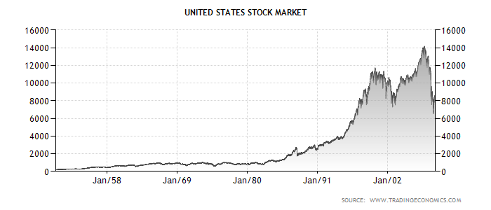
What the Heck Just Happened? Investing Paradigm Shifts
Welcome to the M Times
Notes:
Paradigm shifts and what the heck just happened
Standing on Dow, day RR was elected, looking back 30 years,
Bottom of Dow in 1932…27 years before it comes back
Looking back at Dow.
Now year President Obama took office…what do I see? Wall

Slide 13
Looking back from Reagan
Notes:
What the heck just happened.
Questions, is it a paradigm shift of our society, our culture, our investing mentality?
M times…looks like an M, bottom in March of 09
Is that the norm? Don’t kknow
Go back in history…gambling in 1950s, 60s…positive or negative
Today, what is the outlook…positive, most popular shows on cable TV Gambling
Celebrity apprentice…Gambling Champion
Look at page 19 in your workbook
Person to read definition of investing…how does that feel…all of it back with return, or some of it…downside?
Person to read gambling…think of your 401k…which definition most resembles the 401k? That’s where we are.
Look at stats in book…
What the heck just happened?

Slide 14
Welcome to the M Times
Looking backward from Obama
Notes:
What the heck just happened.
Questions, is it a paradigm shift of our society, our culture, our investing mentality?
M times…looks like an M, bottom in March of 09
Is that the norm? Don’t kknow
Go back in history…gambling in 1950s, 60s…positive or negative
Today, what is the outlook…positive, most popular shows on cable TV Gambling
Celebrity apprentice…Gambling Champion
Look at page 19 in your workbook
Person to read definition of investing…how does that feel…all of it back with return, or some of it…downside?
Person to read gambling…think of your 401k…which definition most resembles the 401k? That’s where we are.
Look at stats in book…
What the heck just happened?

Slide 15
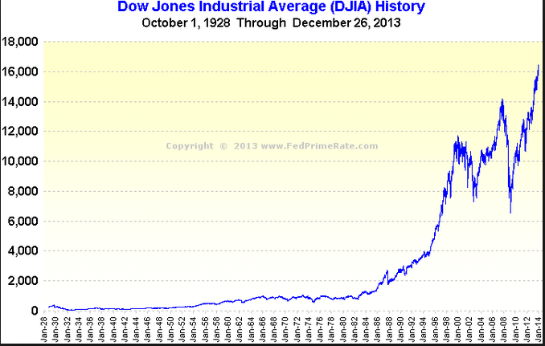
W
hat’s Next?
Notes:
Looking at the DOW graph since 2009 we see the point of volatility made even clearer. The graph now looks like a W with the DOW now over 16000. The question is What’s Next? We know there’ll be a correction, but when? Will it be small or large? What’s the trend? What do you think?

Slide 16

The Times They Are A Changin’
Gambling vs. Investing
401(K) Plans
Supply vs. Demand
Changing Technology
The Bears are Growling

Slide 17
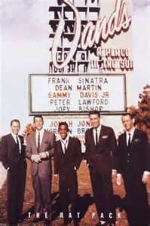
Changing perceptions…
2.3 What was the American perception of gambling in the 1950’s and 1960’s? Was it positive or negative?

Slide 18

To Invest (p.19)
“In⋅vest” verb
to commit (money) in order to earn a financial return.
2.4 What does the dictionary’s definition of invest imply to you?

Slide 19
To Gamble (p.19)
“gam· ble” verb
a: to play a game for money or property
b: to bet on an uncertain outcome; to stake something on a contingency: take a chance
2.5 Which definition above is more in line with our current financial planning culture? Why?

Slide 20
Facts on Gambling (p.19)
Gambling is a $90 billion a year industry.
1988— only legal in Nevada and New Jersey.
1994 – Operating in 23 states.
2000 – Over 34 million people visited Las Vegas.
2000 – Over 127 million in casinos nationally.
2003 – Operating in 48 states
Industry take - $750 per participant or $250 per person in U.S. People or dollars?
Blind Faith, 2003 Ed Winslow

Slide 21
Gambling Today!
Business Insider Reports:
“The University of Las Vegas found that the 23 Vegas casinos bringing in over $72 million each in the 2013 fiscal year ended up with over $5 billion of their visitors' money, altogether. That's an average of over $630,000 a day, per casino.”
http://www.businessinsider.com/how-casinos-make-you-spend-money-2014-8#ixzz3Tk8GnJpL

Slide 22

Gambling’s Influence?
2.6 What changes would the conservative planner make in their portfolio when influenced by a gambling culture?

Slide 23
401(k) Plans (p.20)
“…Section 401(k). It took effect in 1980, and by 1983 more than half of large companies were setting up 401k plans, a little more than 17,000.(6) Half way through the 1980’s, there were less than 8 million people investing in 401ks with about $100 billion invested. By 2006, there were seventy million participants and more than $3 trillion invested.”
Bat-Socks, Vegas & Conservative Investing, 2012, David P. Vick

Slide 24
Changing Technology
Commercialization of the Internet - 1995
Investing is done at the speed of information
The speed of information is the speed of the internet
Millions of dollars are made or lost in Nano-seconds.

Slide 25
The Bears are Growling (p.20)
“In 1884 Charles Dow began publishing his “Dow Jones Averages” in the Customer’s Afternoon Letter, which was the forerunner of The Wall Street Journal. In 1896, he changed the name to the Dow Jones Industrial Average, which consisted of twelve industrial stocks, a departure from the original nine railroad stocks,

Slide 26
The Bears are Growling (p.20)
and two industrial stocks. The first index containing the “Rails,” as people referred to it, continued to rival the industrial average’s for the next 20 years.”
The Anatomy of a Bear” Napier 2005

Slide 27

We Live in Perilous Times!
On Average:
Every 3 years you have a bear market.
Every 8 years you have a significant bear market.
If you hold your money for 17 years you won’t have a problem.
“The Anatomy of a Bear” Napier 2005
Notes:
Things at the bottom of each bear…4 bear bottoms…when is the bottom, bear market every 3 years, stinker every 8 years, hold money for 17 years, you wont have problems, what’s wrong with that
Current bear trend 2000…bottom in 2014, start new cycle. Large interest rates cycle through as well…long time between. Russell Napier, Anatomy of a Bear
What came out of that…Federal Reserve, IRS…Huge recession through 1921…govt Nationalized the Railroads…two big averages; like the S&P and Dow…what would happen if you nationalized all the companies in the dow…What is that like today…huge changes as result of bear markets…have no idea where this will take us…where is your money? What kind of investor…how we survive as conservative investors in times like these.
If everything you knew about your money turned out not to be true, when would you want to know.
Over next 10 years are going to be more like the last decade, less like, or just the same? How many say it is going to be like it or worse? Where is yoiur money? Even if you get your money back, you lose the purchasing power…in 10 years you need 50% more money for same buying power.
So what does that mean? I don’t know, but I do look at speed of information, I look at recent trends, and I look at what we can predict, and I ask, is this the new norm. If you decided it was, how would you invest as you go forward? Maybe better way to handle than we’ve been handling.

Slide 28
We Live in Perilous Times!
2.9 What similarities are there to the government involvement during the first 20 years of the twentieth century and the last 10 years?
2.11 If you are unsure of the changes that will come out of a large Bear market, how would you plan differently?
Notes:
Things at the bottom of each bear…4 bear bottoms…when is the bottom, bear market every 3 years, stinker every 8 years, hold money for 17 years, you wont have problems, what’s wrong with that
Current bear trend 2000…bottom in 2014, start new cycle. Large interest rates cycle through as well…long time between. Russell Napier, Anatomy of a Bear
What came out of that…Federal Reserve, IRS…Huge recession through 1921…govt Nationalized the Railroads…two big averages; like the S&P and Dow…what would happen if you nationalized all the companies in the dow…What is that like today…huge changes as result of bear markets…have no idea where this will take us…where is your money? What kind of investor…how we survive as conservative investors in times like these.
If everything you knew about your money turned out not to be true, when would you want to know.
Over next 10 years are going to be more like the last decade, less like, or just the same? How many say it is going to be like it or worse? Where is yoiur money? Even if you get your money back, you lose the purchasing power…in 10 years you need 50% more money for same buying power.
So what does that mean? I don’t know, but I do look at speed of information, I look at recent trends, and I look at what we can predict, and I ask, is this the new norm. If you decided it was, how would you invest as you go forward? Maybe better way to handle than we’ve been handling.

Slide 29
Santa & Six Wall Street Myths
Chapter Three:
Myths or Maxims:
You Decide

Slide 30
Six Wall Street Myths
You haven’t lost until you sell.
3.2 Do you sometimes suspect a broker’s motives? If so, in what ways?
Notes:
Myth or maxim? Most people believe it. The author thinks this is a tax reality made into a Wall Street myth. If you had a gain of 5, you realize gain. If you lose 5, and sell it, what have you done…realized the loss. For tax purposes this is the truth.
Everyw week I have people come into my office and we look at them…last month you had 400,000 and now you have $350,000. Did you put the money in a CD? Wife says he lost it. So lets look at that, last month you had xx, this month you have how much. How much does it say you have. Wouldn’t it be smarter investing to say I have what I have today? Would nt you rather deal with reality in investing? Wall street doesn’t want you to believe this is real…unless you made money. I have what I have…it that’s the truth, wouldn’t it be a better plan to start with that number when crafting a new plan. That’s what the author thinks…what do you thin.

Slide 31
Six Wall Street Myths
2. The Large Wire Houses (Wall Street and it’s big firms and media outlets) are the Best Place to get Professional Advice.
3.5 Why do you believe people planning for retirement would be attracted to large wire house firms?
Notes:
Myth or Maxim. Name me a bunch of big firms. Merrill Lynch, Lehman, Goldman Sachs (like having the casino teach you to play blackjack, or IRS how to do taxes). Where will they make more money; that’s what they will sell you. So that eliminates all of the independent advisors who are beholden to no one. Everyone is biased. Media outlets; Cramer, Bob Brinker, Dave Ramsey, Suze Orman. Are these people the best place for you to get advice? They know your situation, right. They know what you want and need, right. What is their number one priority: creating controversy. And that’s where you are getting your advice because you don’t trust that guy down the block.

Slide 32

Six Wall Street Myths
Notes:
Myth or Maxim. Name me a bunch of big firms. Merrill Lynch, Lehman, Goldman Sachs (like having the casino teach you to play blackjack, or IRS how to do taxes). Where will they make more money; that’s what they will sell you. So that eliminates all of the independent advisors who are beholden to no one. Everyone is biased. Media outlets; Cramer, Bob Brinker, Dave Ramsey, Suze Orman. Are these people the best place for you to get advice? They know your situation, right. They know what you want and need, right. What is their number one priority: creating controversy. And that’s where you are getting your advice because you don’t trust that guy down the block.

Slide 33
Six Wall Street Myths
A Diversified Portfolio of Stocks, Bonds, and Mutual Funds are Safe Over the Long Haul.

Slide 34
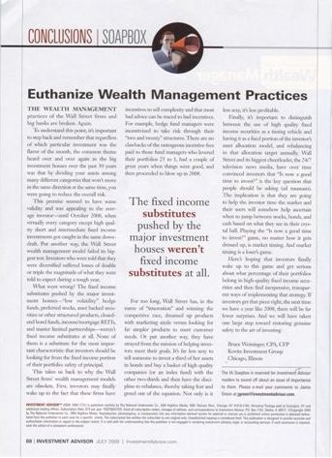
A Diversified Portfolio of Stocks, Bonds, and Mutual Funds are Safe Over the Long Haul.
Myth #3
FAILED
Investment Advisor Magazine, July 2009
Notes:
Here’s what the editor of Investment Advisor magazine, an industry journal written to advisors, says about this myth. He says “Euthanize Wealth Management Practices”… they’ve FAILED!

Slide 35
If a theory fails it’s biggest test ever…?
Listen to the editor for Investment Advisor Magazine (July 2009 emphasis mine):
“The wealth management practices of Wall Street firms and big banks are broken. Again.
To understand this point, it’s important to step back and remember that regardless of which particular investment was the flavor of the month, the common theme heard over and over again in the big investment houses over the past 30 years was that by dividing your assets among many different categories that won’t move in the same direction at the same time, you were going to reduce the overall risk.
This premise seemed to have some validity and was appealing to the average investor – until October 2008, when virtually every category except high quality short and intermediate fixed income investments got caught in the same downward draft. Put another way, the Wall Street wealth management model failed its biggest test. Investors who were told that they were diversified suffered losses of double or triple the magnitude of what they were told to expect during a tough year.
What went wrong? The fixed income substitutes pushed by the major investment houses – “low volatility” hedge funds, preferred stocks, asset backed securities or other structured products, closed-end bond funds, income/mortgage REITs, and master limited partnerships - weren’t fixed income substitutes at all. None of them is a substitute for the most important characteristic that investors should be looking for from the fixed income portion of their portfolios: safety of principal.
Notes:
Here’s what he says about the broken Wall Street system that many of you still take advice from. Read the slide.

Slide 36
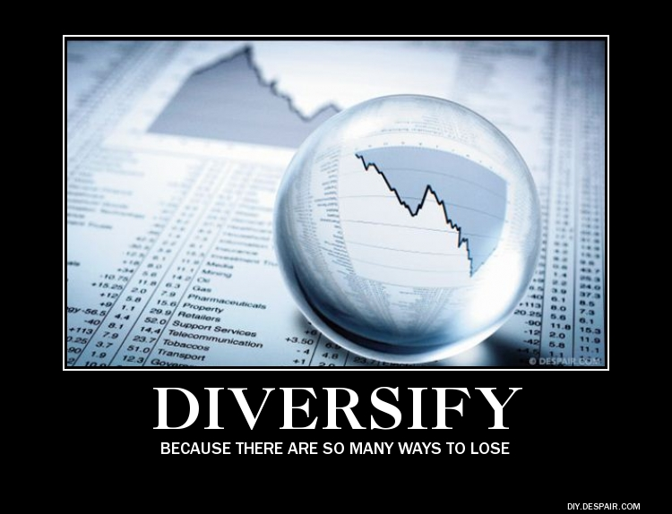

Slide 37
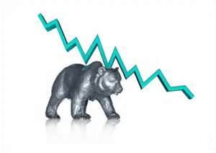
Six Wall Street Myths
3.10 As a conservative person planning for retirement, what lessons could you learn from the severe market losses in a year like 2008?

Slide 38
Six Wall Street Myths
3.10 As a conservative person planning for retirement, what lessons could you learn from the severe market losses in a year like 2008?

Slide 39
Six Wall Street Myths
Buy and Hold is an effective conservative strategy.

Slide 40
Six Wall Street Myths
The reality is, if you invested $100 in the S&P 500:
01/01/2000 $100
12/31/2000 $90
12/31/2001 $75
12/31/2002 $58
12/31/2003 $73
12/31/2004 $80
12/31/2005 $82
12/31/2006 $93
12/31/2007 $97
12/31/2008 $60
12/31/2009 $74
12/31/2010 $84
12/31/2011 $84
12/31/2012 $95
12/31/2013 $124
12/31/2014 $131
That’s only 2.3 % a year for the last 15 years, and a pretty wild ride!
Stats from YahooFinance.com 7/8/2014
Notes:
Look at bottom of page 27. Are you comfortable with buy and hold…speed of information.

Slide 41
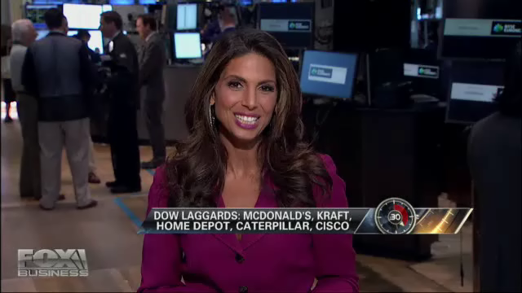
The Truth Behind 'Buy and Hold'
Fox Business News – June 27th, 2012
Lubos Pastor of the University of Chicago Booth School of Business explains why the 'buy-and-hold' strategy adopted in the 1990's doesn’t work anymore.

Slide 42
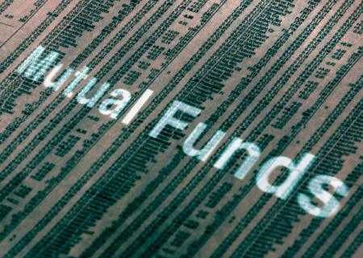
Six Wall Street Myths
Just buy a No-Load Index Fund.
Notes:
Bob Brinker does it his whole show (recommends specific funds)…really, that’s the answer to what we’ve just gone through? Is that the best you can do? What happened to the indexes in 2008? Are you sick and tired of being sick and tired?

Slide 43
“Just buy an index fund”
S&P 500 Index
January 3rd, 2000
1455.22
December 31st, 2009
1115.10
-23.37% LOSS!!
Myth #5
Stats from YahooFinance.com 1/7/2013
Notes:
Take a look at the first decade of the 21st century and we begin to wonder at the wisdom of just buying an index fund. That strategy would have netted you a greater than 23% loss!

Slide 44
“Just buy an index fund”
S&P 500 Index
January 1st, 2000
1469.25
December 31st, 2014
2058.90
40% Gain
Less than 2.3% a year return over 15 years!
Myth #5
Stats from YahooFinance.com 7/8/2014
Notes:
Let’s fast forward to the last 10 years. We have a gain of 2.3% a year! CD’s would have returned more than that and with none of the sleepless nights!

Slide 45
Six Wall Street Myths
If you average 2.3% per year, imagine having to withdraw the typical 4% per year for income needs over the last 15 years, and what that would do to your portfolio.
3.14 Would you be willing to gamble your retirement on the above illustrations not happening again?

Slide 46

Six Wall Street Myths
Index Annuities are Dangerous!
Notes:
Bob Brinker does it his whole show (recommends specific funds)…really, that’s the answer to what we’ve just gone through? Is that the best you can do? What happened to the indexes in 2008? Are you sick and tired of being sick and tired?

Slide 47


They’re like great white sharks…they’ll jump out of the water and swallow you whole!
Notes:
People who hold this position would have you believe that these assets are so horrible they are like great white sharks, they’ll jump out of the water and swallow you whole!

Slide 48
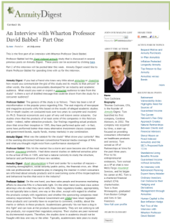
“Index Annuities are dangerous”
David F. Babbel
Professor of Insurance and Finance
The Wharton School of Business
University of Pennsylvania
Myth #6
Quotes from Tom Cochrane’s Blog on AnnuityDigest.com 8/4/09 & 9/3/09
Notes:
While I know there is a lot of negative press out there in the media about index annuities, I’m fairly confident that much of it is a result of a business war waged between the insurance industry and the securities industry over money. Which means that much of what is written has a bias toward one industry or another. So, it would be nice to have a comment from a reliable source that doesn’t have a “dog in the fight” so to speak. Professor David Babbel from the Wharton School of Business at the University of Pennsylvania is just such a voice.

Slide 49
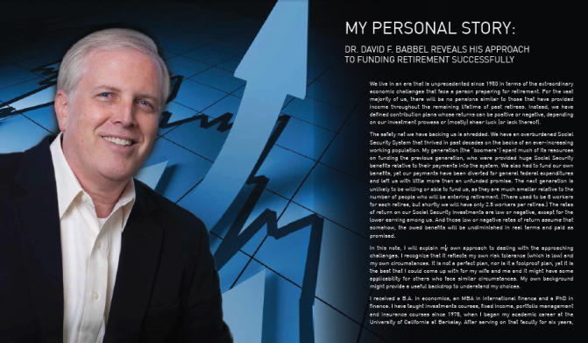
Dr. David babbel: my personal story
Dr. David Babbel reveals his approach to funding retirement successfully.

Slide 50

Six Wall Street Myths
3.16 Do you believe a rational person would choose an Indexed Annuity? Why or Why not?

Slide 51
Jump in, the water’s fine!
Chapter Four:
The Need
for a New Model

Slide 52
The Need for a New Investing Model
Status Quo Bias (p.31)
“Most real decisions, unlike those of economics texts, have a status quo alternative—that is, doing nothing or maintaining one's current or previous decision. A series of decision-making experiments shows that individuals disproportionately stick with the status quo. Data on the selections of health plans and retirement programs…reveal that the status quo bias is substantial in important real decisions.”
Samuelson, William, Boston University and Zeckhauser, Richard, Harvard University. “Status Quo Bias in Decision Making.” Journal of Risk and Uncertainty. 1:7-59 (1988) Kluwer Academic Publishers, Boston
4.2 Is it possible that staying with the same plan you have had for years, without making adjustments, might create adverse results for your retirement? If so, how?

Slide 53
The Need for a New Investing Model
Status Quo Bias (p.31)
Wall Street is Disconnected with Main Street
“Typically, Ma & Pa Lunchbucket are conservative investors who would like a plan designed specifically around their risk tolerance. What they actually receive is a diversified portfolio of market assets and asset classes managed in a “buy and hold” strategy with little movement over the years.”
“Bat-Socks, Vegas & Conservative Investing” Dave Vick
Notes:
Typically, Ma & Pa Lunchbucket are conservative investors who would like a plan designed specifically around their risk tolerance. What they actually receive is a diversified portfolio of market assets and asset classes managed in a “buy and hold” strategy with little movement over the years. Ma & Pa’s “unique” portfolio consists of a basket of proprietary mutual funds, a variable annuity and possibly some blue chip stock, maybe even a bond or two. The mutual funds will be C-shares, which allow the broker to make a 1% trailer commission on Ma & Pa’s assets with no motivation to change them over the years. They may receive one or two B-share funds, which carry penalties if you sell out of them too early, so you will be discouraged from leaving his services.

Slide 54
The Need for a New Investing Model
What are A, B, & C mutual fund shares?
Mutual fund share classes are a way for the broker to receive commissions and the mutual fund company to structure expenses.
A-Shares have an up-front load which is deducted from your initial investment and a small trailer commission called a 12b1 fee. A–shares usually have lower expenses.
B-Shares have a back-end charge for early redemption and a trailer commission called a 12b1 fee. If you redeem your fund in a certain period of time, usually 5 to 8 years, you have a deferred sales charge. B-shares usually have higher expenses, but convert to A-shares at a certain point in time, thus reducing their expenses.
C-Shares usually have a 1% ongoing load every year. Commonly they have a small back-end charge that disappears after a year, lower expenses than B-shares, but higher expenses than A-shares. Typically good for short term investors.
4.5 Do fees affect your decisions about which assets you would choose? Explain.
Notes:
The second problem with Wall Street is it is too complicated. Wall Street forces you to rely on the professional to not just acquire the investments needed, but to decide for you what conservative looks like in a plan. The professional broker is swimming in the water saying, “Jump in!” Understandably, most conservative investors do not have a clue when it comes to evaluating and choosing stocks, bonds, mutual funds, annuities, or even know what a REIT is. They don’t even know the majority of money markets are not FDIC insured! They are standing at the edge of the investing dock, anxiously wondering if this chattering teethed broker in the water knows what he’s talking about with no way of being sure

Slide 55
The Need for a New Investing Model
Status Quo Bias (p.31)
Wall Street is Disconnected with Main Street
Information Overload
4.7 Which represents how much you rely on financial commentators for your financial information. Explain your answer.
Not at all
Not much
A little bit
Somewhat
A lot
Listen Daily

Slide 56
The Need for a New Investing Model
Status Quo Bias (p.31)
Wall Street is Disconnected with Main Street
Information Overload
4.9 Do you believe the financial services community could use a new model to help consumers develop their financial plan? Explain.

Slide 57
The Need for a New Investing Model
Status Quo Bias (p.31)
Wall Street is Disconnected with Main Street
Information Overload
Long-Term Market Returns

Slide 58

Market Returns
S&P 500
1975-2014
30 Year – 8.8%
20 Year – 7.7%
15 Year – 2.3%
10 Year – 5.4%
5 Year – 12.6%
* Source: S&P500 and DJIA historical returns from financial.yahoo.com, as of 12/31/2014. DJIA returns from 1985 through 2014

Slide 59
What if the Market Corrected?
S&P 500
1975-2014
-30% Loss This Year
30 Year – 8.8%
20 Year – 7.7%
15 Year – 2.3%
10 Year – 5.4%
5 Year – 12.6%
6.6%
4.1%
0.7%
1.4%
2.7%
* Source: S&P500 and DJIA historical returns from financial.yahoo.com, as of 12/31/2014. DJIA returns from 1985 through 2014

Slide 60
Your Homework!
FOR NEXT WEEK
READ CHAPTERS 1-9
ALSO… ☺
Complete Appendix One, Asset
Review Forms; Appendix Two,
Retirement Budget Worksheet;
and Appendix Three, Risk Tolerance Questionnaire

Slide 61
CONTACT INFORMATION
Dave Vick
dave@vickassociates.com
480-758-4582
Vick & Associates, Inc.
8700 E. Vista Bonita Drive
Suite 240
Scottsdale, AZ 85255

Slide 62
Thank you for Attending!

