Slide 1

Session Two
Date
Location

Slide 2
Contact information:
Dave Vick
dave@vickassociates.com
480-758-4582
Vick & Associates, Inc.
8700 E. Vista Bonita Drive
Suite 240
Scottsdale, AZ 85255

Slide 3
Disclaimer
The Principles of Retirement Planning Workshop is an educational program, and is not intended to sell investment or insurance products, nor is it intended to provide tax or legal advice. Consult with your tax advisor and/or legal counsel for suitability for your specific situation.
Hypothetical and/or actual historical returns contained in this presentation are for informational purposes only and are not intended to be an offer, solicitation, or recommendation. Rates of return are not guaranteed and are for illustrative purposes only.
Projected rates do not reflect the actual or expected performance within any example or financial product.
Dave Vick is an Investment Advisor Representative with Redhawk Wealth Advisors, an SEC Registered Investment Advisor. Insurance and annuity products are offered through Vick & Associates, Inc.

Slide 4
Course Introduction:
This is a course that dives deep into the concepts of retirement planning from a financially conservative point of view. We will use the book “Bat-Socks, Vegas and Conservative Investing” and it’s accompanying workbook “The Principles of Retirement Planning” as our guide through this vantage point. There are other retirement topics that are important, however we will focus for this class on a financially conservative point of view.

Slide 5
Why Are We Here?
Do you know how all of your assets (stocks, bonds, mutual funds, annuities, REITS, Life Insurance, etc.) work together to achieve the amount of risk you want in your total portfolio?
How does your current portfolio protect you in a bear market?
How does the average person determine which assets to use in a conservative portfolio?
What is your plan to manage risk?
Do you need a degree in finance to know how to manage risk?
Notes:
How do your assets work together to accomplish what you want to accomplish in your retirement, and do you need a degree in finance to get it? Do all those guys who manage money know the answers? Lehman, Bear Stearns, Merrill Lynch?
Could the novice understand where assets fit together so they can sleep at night?

Slide 6
What Did You Get Out of Last Week?
What is Conservative Investing
Perilous Times to be an Investor
Wall Street (Investment Community) Disconnect
Technology has Created a New ‘Ball Game’
We Can’t Keep on Doing the Same Thing
Perhaps There is a Need for a New Model

Slide 7

The ABC planning model: simplicity at its best
Chapter Five:
The New Model

Slide 8
The ABC Model Defined
Wall Street Pyramids and Risk Tolerance
“Wall Street’s typical model of investing starts with the “Pyramid of Assets” and moves on to “Asset Allocation” models, which seem anything but easy or simple to understand…these models depend on the broker knowing your “risk tolerance,” which is the degree of uneasiness an investor is willing to experience when there is volatility in their portfolio.”
“Bat-Socks, Vegas & Conservative Investing” by David P. Vick
Notes:
Most of you have seen that wall street pyramid
…slide, then, that’s why we ask these questions

Slide 9
The ABC Model Defined
A Conservative Investor’s Dilemma
“First, is their money safe from market losses, and second, are they beating CD’s? They want that “in between space” of bank-type savings and market risk assets.”
“Bat-Socks, Vegas & Conservative Investing” by David P. Vick
5.1 Do you the conservative planner, know how to allocate your money to avoid the volatility which costs you sleepless nights?
5.2 How do you currently determine which assets to use and why you might use them?
Notes:
Most of you have seen that wall street pyramid
…slide, then, that’s why we ask these questions

Slide 10
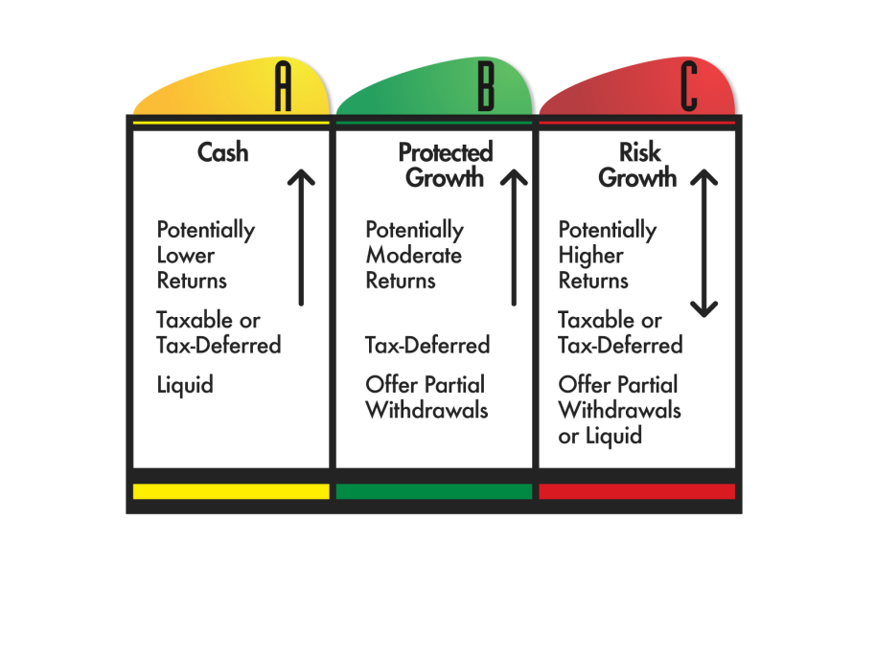
The ABC Model of Investing-
Cash Assets
Notes:
This model; we use it in our practice…I live and breath by it.
Biggest thing…will help you allocate how much risk you want in a portfolio, and not leave it up to a broker to decide. Because its and individual choice; not mine, not your brokers, not Dave Ramseys…yours.
Three types of categories we put your assets in.

Slide 11
The ABC Model of Investing-
Fixed Principal Assets
  5.6 What are some of the negative aspects of annuities you have heard about?
  5.7 What are some of the positive aspects of annuities you have heard about?
5.8 When a planner uses the term “Fixed Income Asset” what do you believe about the primary characteristic of that asset?

Slide 12
The ABC Model of Investing-
Risk Assets
  5.9 What are some of the negative aspects of Column C that concern you as you plan for retirement?
5.10 What are some of the positive aspects of Column C that could help you as you plan for retirement?
Notes:
Conservative

Slide 13
SAMPLE CONSERVATIVE MODEL
10%
60%
30%
Notes:
Conservative

Slide 14
SAMPLE MODERATE/AGGRESSIVE MODEL
10%
30%
60%
Notes:
Moderate…which one is right? It depends on you.

Slide 15
Create Your Own ABC Portfolio (p. 44)
10%
?
30%
60%
?
?
Notes:
Moderate…which one is right? It depends on you.

Slide 16
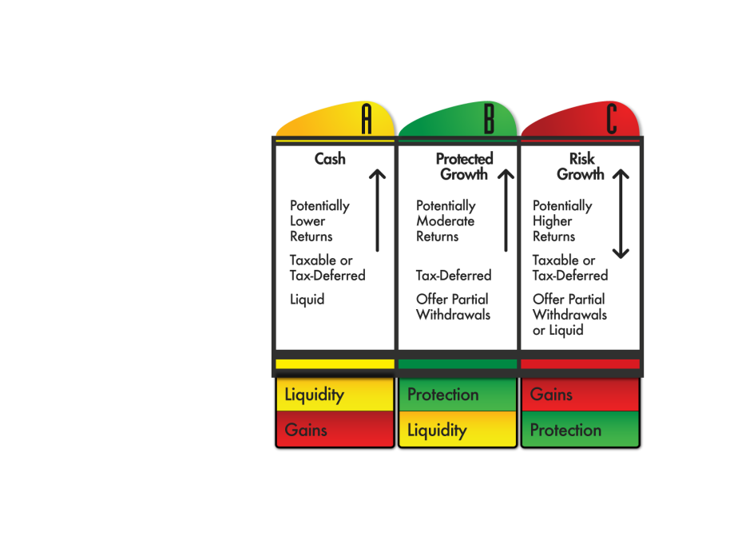
What is Your Greatest Priority?
What are you willing to give up?
Gains?
Liquidity?
Protection?
5.12 How do the “risk-reward” trade-offs impact your planning choices?
Notes:
If we are going to have another bad decade, how much money would you want to have at risk if that could happen. Really? What if we have another decade like the 90s. Now, looking at that again, how much money would you like to have there?
You know what, I don’t care…

Slide 17

Let’s Review…
Rule of 100
5.14 Think through your current financial plan. In what ways would this help you re-allocate your portfolio? In what ways would it not help you plan?
  5.16 In what ways would the ABC Planning Model help you in your financial planning?

Slide 18
Understanding cash assets
Chapter Six:
Yellow Money Savings

Slide 19

The goal of Yellow Money?
How much Liquidity is right for you?
The Two Yellow Money Categories
  Accessible with no penalties
  Accessible with minimal penalties
Notes:
Liquidity…how much cash should you have. Depends on what CDs are paying. Go with what you think about today. Financial planners would normally tell you to have enough for a year., Trip to take, college to fund, car to buy…need to keep money for that.

Slide 20
IS HAVING THE MAJORITY OF YOUR MONEY LIQUID IMPORTANT TO YOU?
If not, then how much is
right for you?
(No right or wrong answers)

Slide 21
Understanding annuities
Chapter Seven:
Green Money Premium

Slide 22
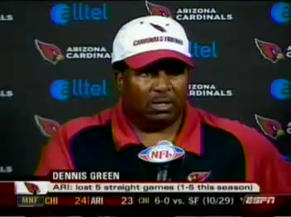

Slide 23
Fixed Income or Fixed Principal Assets?
  “This may come as a surprise to some, but bonds can lose value. Just ask those who held ENRON bonds, WorldCom bonds, Lehman Brothers, or Bear Stearns bonds.”
  “Bat-Socks, Vegas & Conservative Investing” by David P. Vick
  7.2 In the past, have you thought bonds guaranteed principal? Explain
Notes:
Have you or anyone you known ever lost money in bonds…know someone who lost 1.5MM in Lehman
Bond bubble, billions are going into bonds when interest rates are all time low…rush to safety in bonds that pay dirt and have one way to go.
2% bond, and interest rates go to 4%, what happens to the value of your bonds
Which is larger, stock or bond market…bond market four times, much large thud when it crashes.
Reverse dollar cost averaging

Slide 24
Fixed Income or Fixed Principal Assets?
What are Fixed Income Assets?
Do Fixed Income Assets have Protection of Principal?
Have you or anyone you know ever lost money in bonds?
What is a ‘Bond Bubble’?
Notes:
Have you or anyone you known ever lost money in bonds…know someone who lost 1.5MM in Lehman
Bond bubble, billions are going into bonds when interest rates are all time low…rush to safety in bonds that pay dirt and have one way to go.
2% bond, and interest rates go to 4%, what happens to the value of your bonds
Which is larger, stock or bond market…bond market four times, much large thud when it crashes.
Reverse dollar cost averaging

Slide 25
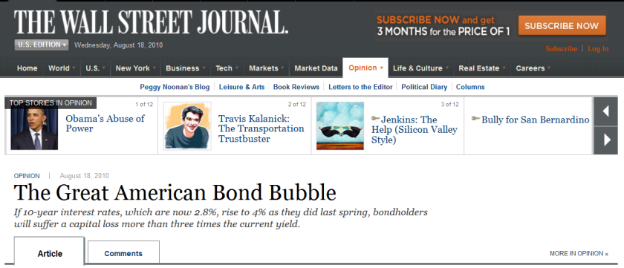
Fixed Income or Fixed Principal Assets?
What are Fixed Income Assets?
Do Fixed Income Assets have Protection of Principal?
Have you or anyone you know ever lost money in bonds?
What is the ‘Bond Bubble’?
Notes:
Have you or anyone you known ever lost money in bonds…know someone who lost 1.5MM in Lehman
Bond bubble, billions are going into bonds when interest rates are all time low…rush to safety in bonds that pay dirt and have one way to go.
2% bond, and interest rates go to 4%, what happens to the value of your bonds
Which is larger, stock or bond market…bond market four times, much large thud when it crashes.
Reverse dollar cost averaging

Slide 26
Is Protecting Your Principal, or some of your Principal, important to you?

Slide 27
Three Green Money Rules:
Green Money Rule #1:
It Protects Your Principal
Green Money Rule #2:
It Protects Your Gains
Green Money Rule #3:
It Protects Your Income
  7.3 How do the Green Money Rules help when forming a balanced, conservative portfolio?
Notes:
Why bonds don’t fit into that column

Slide 28
Types of ‘Green Money’ Assets
What is an Annuity? (p. 55)
“An annuity, technically, is a contract with an insurance company for an income payment either now or in the future. The word annuity means “payment.””
  “Bat-Socks, Vegas & Conservative Investing” by David P. Vick
Notes:
Page 56

Slide 29
Types of ‘Green Money’ Assets
What is an Annuity?
Different types of annuities:
Immediate Annuity
Deferred Annuity
Single Premium Deferred Annuity (SPDA)
Flexible Premium Deferred Annuity (FPDA)
Fixed Annuity
Fixed Indexed Annuity
Variable Annuity
Notes:
Page 56

Slide 30
Types of ‘Green Money’ Assets
Variable Annuities (p. 56)
Offers market returns with some protections.
“…the variable annuity puts the risk of the principal on the investor, while the fixed annuity puts the risk on the insurance company.”
  “Bat-Socks, Vegas & Conservative Investing” by David P. Vick
Notes:
Page 56

Slide 31
Types of ‘Green Money’ Assets
Variable Annuities (P. 56)
The company offers you the option to choose from a varied amount of side accounts which are much like mutual funds. In fact, though they are not technically mutual funds,…You will pay management fees inside these funds along with other fees and expenses typical of variable annuities. These expenses range from 1.25% to 5% depending on the amount options you choose for your variable annuity.”
  “Bat-Socks, Vegas & Conservative Investing” by David P. Vick
Notes:
Page 56

Slide 32
Types of ‘Green Money’ Assets
Variable Annuities (P. 56)
Sample variable annuity expenses:
M&E Charges 1.25%
Enhanced Death Benefit .75%
Income Benefit .75%
Fund Management Fees .65%
Total 3.4%
  “Bat-Socks, Vegas & Conservative Investing” by David P. Vick
  7.4-5 In what ways might it be an advantage or disadvantage to use a variable annuity in your portfolio?
Notes:
Page 56

Slide 33
Types of ‘Green Money’ Assets
Fixed Annuities (P. 57)
“…the main characteristic of a Fixed Annuity is the protection of your principal…The insurance company in a traditional fixed annuity announces the interest it will credit for the year in advance, much like a bank announces its interest rate on CD’s. It is compounded and tax-deferred...”
  “Bat-Socks, Vegas & Conservative Investing” by David P. Vick
Notes:
Page 56

Slide 34
Types of ‘Green Money’ Assets
Fixed Indexed Annuities (P. 57)
“An indexed annuity’s interest rate is tied to an index such as the S&P 500. If the index goes up, the owner of the annuity is credited with a portion of the increase in the index and those gains are retained in the contract. If the index goes down, both the principal and previous years gains are retained, and the owner of the annuity loses no ground.”
  “Bat-Socks, Vegas & Conservative Investing” by David P. Vick
Notes:
Page 56

Slide 35

An FIA Simple Four Year Graph
15%+
10%+
10%
5%
0%
5%
5% cap
Year One
Year Two
Year Three
Year Four
6%
-40%
15%
Items to Consider:
___Surrender Duration ___Liquidity Options ___Caps ___Income Riders ___Crediting Methods ___Other
Notes:
This four year graph shows a simple, base-model chassis of an index annuity. Let’s say that the market goes up 10% in the first year. The annuity company will cap your earnings in some manner, so let’s say the cap is 5%. Now, if the market went down the next year 40%, how much would you lose? Zero! So, would you be upset if the market went down 40% an you got zero? Of course not. Zero is your hero. In fact the 5% stays in the account unless you pull money out. In the third year, if the market went up 6% and the cap was still 5%, the company would give you 5% compounded on top of the first year’s earnings. In the fourth year, if the market went up a whopping 15%, and the cap was still at 5%, you would throw in another 5%. Now you are up 15 plus percent because of compounding while the market isn’t even back to where it started in year one.
Sounds too good to be true doesn’t it. So, let’s take a look at some negative aspects of the annuity. Once you deposit money in an annuity you will have limited liquidity, usually 10% a year of the account value, after the first year. The length of term can be anywhere from 6 to 16 years. You need to find out about caps and other riders that can limit or enhance your earning power, which is something we discuss on an individual basis.
Would you be upset if you received 0% when everyone around you lost 40%?
Sounds too good to be true? If you found it was true, would you want some of this>
Drawbacks…surrender charges
Liquidity options, 10% free.
Caps can go up and down…
How do you allocate money…25% fixed…want it to get something. Annual point to point….

Slide 36
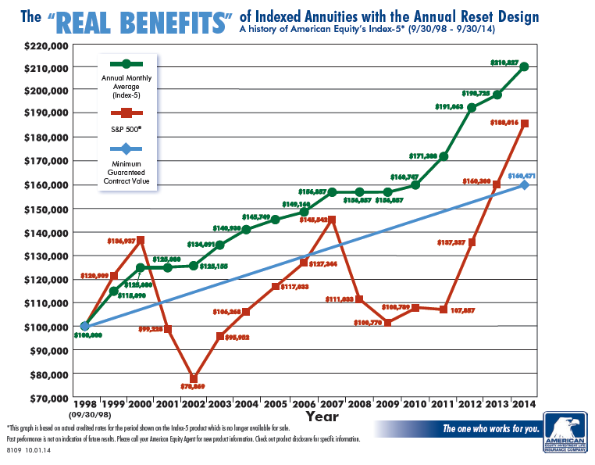
Actual FIA Historical Performance*
*DISCLOSURE: This is a Hypothetical Graph that reflects the actual interest crediting methods used by a specific insurance company from a time period beginning 09/30/1998 and ending on 09/30/2013. Individual results may vary and be dependent upon crediting methods, caps and participation rates. This is for illustration purposes only to show how a Fixed Index Annuity may have performed over a specific period of time.

Slide 37
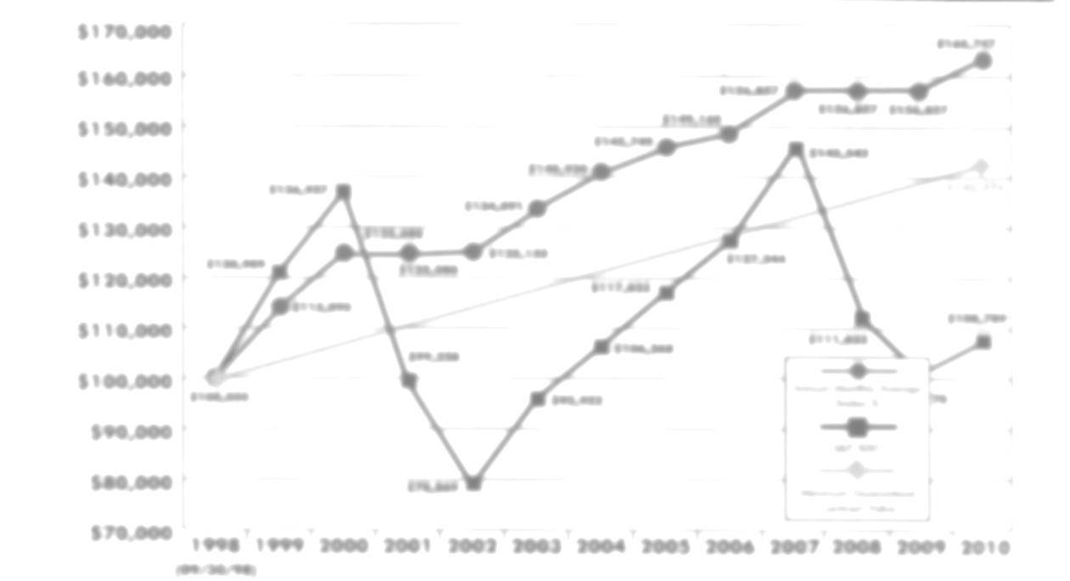
FIA Basics
7.6 How does the structure of an Indexed Annuity protect your principal and retain your gains?
7.7 Would you be upset with “0%” in year two?
7.8 Would you be upset if you did not get a greater return in year four when the market went up 15%?

Slide 38
FIA CREDITING METHODS
FIA Guarantees (p. 58)
“Fixed Indexed annuities are guaranteed by the issuing insurance company who provides a contractually stated guarantee in each annuity.”
  “Bat-Socks, Vegas & Conservative Investing” by David P. Vick
FIA Guarantee Example:
Premium $100,000
87% of Premium $87,000
Minimum Interest 2%
Number of Contract Years 10
Minimum Guaranteed Balance $106,053

Slide 39
FIA CREDITING METHODS
Annual Point to Point with a Cap
Annual Point to Point with Participation Rate
Monthly Point to Point with a Cap
Monthly Average with a Cap or Participation Rate
Multi-Year with a Mix of Interest and Percent of the Market
  7.10 Which of the crediting methods most appeal to you?

Slide 40
Additional FIA Points
Taxes
Fees with FIAs
Liquidity with FIAs
  7.12 Compare an Indexed Annuity’s liquidity to other assets?

Slide 41
Additional FIA Points
Diversified Portfolio of FIAs (p. 62)
Two reasons why diversifying FIAs could be a good idea?
We don’t know which index will perform better in any given year.
We don’t know which crediting method will perform better in any given year.

Slide 42
Additional FIA Points
Diversified Portfolio of FIAs (p. 62)
While carriers provide differences in indexes that can include “volatility control” or stocks/bonds, precious metals, and more, you might also want to consider the following:
Strength of the carriers
American Company or Foreign Domiciled
Length of contracts
Quality of home office service
Guaranteed Withdrawal Benefits
Additional riders for Long Term Care & Terminal Illness
Death Benefits

Slide 43
Additional FIA Points
Diversified Portfolio of FIAs (p. 62)
There are benefits to a single contract as well, like simplicity and receiving statements from one source. After all, the older we get the more we tend to forget.

Slide 44
Additional FIA Points
Planning for Income - Pension Payments
“Basically, there are two ways to get money out of an annuity. You either “annuitize” or “withdraw.” The major difference is what happens to the account value when you choose either of these two options.”
  “Bat-Socks, Vegas & Conservative Investing” by David P. Vick

Slide 45
Additional FIA Points
Guaranteed Withdrawal Benefits
Accumulation Value
The current value of your annuity’s cash account which includes any bonus and all interest credits to date, less any withdrawals.
Income Account Value
The current value of your annuity’s income account which includes any bonus and all interest credits to date, less any withdrawals. Note: there is no cash value here.

Slide 46
Additional FIA Points
Guaranteed Withdrawal Benefits
Current Surrender Value
The current value of your annuity’s cash account which includes any bonus and all interest credits to date, less any withdrawals, and minus any surrender charges that would apply if you chose to liquidate.
Guaranteed Minimum Surrender Value
The current value of your annuity’s cash account which includes any bonus and the minimum guaranteed interest credits to date, less any withdrawals, and minus any surrender charges that would apply if you chose to liquidate.”

Slide 47
Additional FIA Points
Guaranteed Withdrawal Benefits
Guaranteed Withdrawal Percentage:
Ages 60 – 69 4-5%
Ages 70 – 79 5-6%
Ages 80 & up 6-7%
Disclosure: Past performance is no guarantee future results. Crediting rates including caps for FIA’s can change and are determined by the insurance companies at the time of issue. Future performance cannot be predicted or guaranteed. FIA’s are not registered as a security with the SEC and is not invested directly in any stock, bond, or security investment. FIA products, features, and benefits vary by state.
Annuity Contracts are products of the insurance industry and are not guaranteed by any bank or insured by the FDIC. When purchasing a fixed indexed annuity, you own an annuity contract backed by the insurance company, you are not purchasing shares of stocks or indexes. Product features such as interest rates, caps, and participation rates may vary by product and state and may be subject to change. Surrender charges may apply for early withdrawals. Be sure to review the specific product disclosure for more details. Guarantees are based on the financial strength and claims paying ability of the insurance company.
This information is not intended to give tax, legal, or investment advice. Please seek advice from a qualified professional on these matters.
Lifetime income benefit riders are used to calculate lifetime payments only. The income account value is not available for cash surrender or in a death benefit. Excess withdrawals may reduce lifetime income and may incur surrender charges. Fees may apply. Guarantees based on the financial strength and claims paying ability of the insurance company. See specific product disclosure for more details.

Slide 48
Additional FIA Points
Guaranteed Withdrawal Benefits
Guaranteed Withdrawal Benefit (GWB) Example:
Guaranteed Income Account Growth Rate: 6.5%
Bonus: 8%
Premium: $100,000
Age at Issue: 60
Age Withdrawals Chosen: 70
Guaranteed Withdrawal Percent: 6%
Income Account Value: $202,731
Guaranteed Annual Withdrawal Benefit: $12,164

Slide 49
Additional FIA Points
7.16 In what ways would you see a GWB enhancing your situation?

Slide 50
What is your take on the value of Green Money Column B?
Do you think it is important to protect a portion of your assets or income?

Slide 51
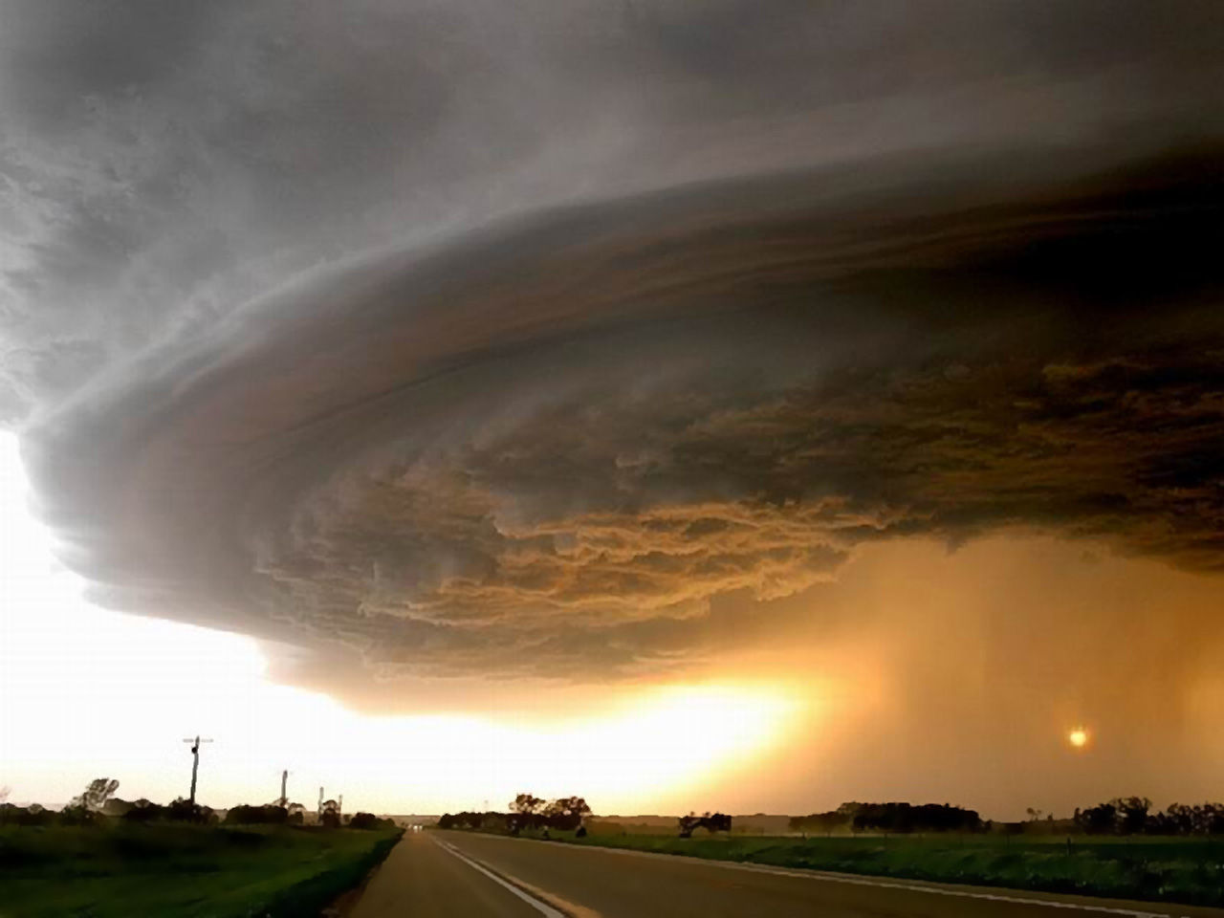
Understanding growth assets
Chapter Eight:
Red Money Investing

Slide 52
Red Money Language
Systematic Risk, Volatility, and Variance
  “…the risk or uncertainty associated with the entire market, or an entire segment of a market, “systematic risk.” (1) In other words, investing in the market in general is uncertain all the time.”
  “Bat-Socks, Vegas & Conservative Investing” by David P. Vick
  8.2 How does “systematic risk” make you feel?
p. 69
Notes:
DNA of the market…risk runs through every asset of the market (systematically), cannot hold a market asset without an element of risk.
Beta…measure of risk against an index…Beta of one is as volatile as S&P. Up ten you go 10. 1.5…50% more volatile. Typical growth fund is 1.3 to 1.6%
R squared is the policeman, how reliable is the Beta number….90 and up reliable, under 70 unreliable…SD is wobble factor,
It all means nothing.

Slide 53
Red Money Language
Systematic Risk, Volatility, and Variance
  “…Wall Street measures risk associated with the market is through “volatility.” People who study the market look at historical returns of a stock or index and plot them on a graph. They look to see how the dots on the graph relate to each other over time and in relationship to historical events. The further apart the dots on the graph, the higher the volatility. The higher the volatility, the riskier the investment.”
  “Bat-Socks, Vegas & Conservative Investing” by David P. Vick
p.70
Notes:
DNA of the market…risk runs through every asset of the market (systematically), cannot hold a market asset without an element of risk.
Beta…measure of risk against an index…Beta of one is as volatile as S&P. Up ten you go 10. 1.5…50% more volatile. Typical growth fund is 1.3 to 1.6%
R squared is the policeman, how reliable is the Beta number….90 and up reliable, under 70 unreliable…SD is wobble factor,
It all means nothing.

Slide 54
Red Money Language
Systematic Risk, Volatility, and Variance
  “Wall Street uses “variance” to describe the difference between where the returns are from an average return of the same asset or a corresponding index.”
  “Bat-Socks, Vegas & Conservative Investing” by David P. Vick
p.70
Notes:
DNA of the market…risk runs through every asset of the market (systematically), cannot hold a market asset without an element of risk.
Beta…measure of risk against an index…Beta of one is as volatile as S&P. Up ten you go 10. 1.5…50% more volatile. Typical growth fund is 1.3 to 1.6%
R squared is the policeman, how reliable is the Beta number….90 and up reliable, under 70 unreliable…SD is wobble factor,
It all means nothing.

Slide 55
Red Money Language
Beta, Alpha, Standard Deviation, and R-Squared
  “Beta is a measure of risk or volatility as it relates to an index. Let’s say a mutual fund you own has a Beta of 1 to the S&P 500 Index. This fund would then tend to go up about the same as the S&P and down about the same. If the Beta was 1.5, the fund would be 50% more volatile than the S&P. If the Beta was .5 then the fund would be 50% less volatile than the S&P.”
  “Bat-Socks, Vegas & Conservative Investing” by David P. Vick
p.70
Notes:
DNA of the market…risk runs through every asset of the market (systematically), cannot hold a market asset without an element of risk.
Beta…measure of risk against an index…Beta of one is as volatile as S&P. Up ten you go 10. 1.5…50% more volatile. Typical growth fund is 1.3 to 1.6%
R squared is the policeman, how reliable is the Beta number….90 and up reliable, under 70 unreliable…SD is wobble factor,
It all means nothing.

Slide 56
Red Money Language
Beta, Alpha, Standard Deviation, and R-Squared
“Alpha, another well-used Wall Street term, is used to measure how much the fund’s performance is better than the correlated benchmark index. If the fund’s Alpha is 5, it outperformed its benchmark index by 5%.”
  “Bat-Socks, Vegas & Conservative Investing” by David P. Vick
p.70
Notes:
DNA of the market…risk runs through every asset of the market (systematically), cannot hold a market asset without an element of risk.
Beta…measure of risk against an index…Beta of one is as volatile as S&P. Up ten you go 10. 1.5…50% more volatile. Typical growth fund is 1.3 to 1.6%
R squared is the policeman, how reliable is the Beta number….90 and up reliable, under 70 unreliable…SD is wobble factor,
It all means nothing.

Slide 57
Red Money Language
Beta, Alpha, Standard Deviation, and R-Squared
“Standard Deviation is the “wobble factor”, showing us how much a fund wobbles back and forth from its average return. The more it wobbles, the higher the risk.
Technically, Standard Deviation measures how a fund’s performance over time is different from its average return. (2) The greater the difference, the higher the volatility. The higher the volatility, the more uncertainty in future returns.”
  “Bat-Socks, Vegas & Conservative Investing” by David P. Vick
p.70
Notes:
DNA of the market…risk runs through every asset of the market (systematically), cannot hold a market asset without an element of risk.
Beta…measure of risk against an index…Beta of one is as volatile as S&P. Up ten you go 10. 1.5…50% more volatile. Typical growth fund is 1.3 to 1.6%
R squared is the policeman, how reliable is the Beta number….90 and up reliable, under 70 unreliable…SD is wobble factor,
It all means nothing.

Slide 58
Red Money Language
Beta, Alpha, Standard Deviation, and R-Squared
“This measurement grades the accuracy of the assets movements that can be related to a benchmark index. If the grade is low, 70 or less, the Beta is probably not reliable. If the grade is higher than 85, the Beta might be considered to be more dependable. R-Squared sheds light on the veracity of risk measurements.”
  “Bat-Socks, Vegas & Conservative Investing” by David P. Vick
p.70
Notes:
DNA of the market…risk runs through every asset of the market (systematically), cannot hold a market asset without an element of risk.
Beta…measure of risk against an index…Beta of one is as volatile as S&P. Up ten you go 10. 1.5…50% more volatile. Typical growth fund is 1.3 to 1.6%
R squared is the policeman, how reliable is the Beta number….90 and up reliable, under 70 unreliable…SD is wobble factor,
It all means nothing.

Slide 59
  “Hulbert’s data shows that
  more than 84 percent of mutual Funds underperform
  the market over a 5-year period. Over ten years, that number rises to 90 percent.”
Morningstar Publications

Slide 60
Stock Type Risk vs. Bond Type Risk
“…the question for Column C Red Risk Money is this: what percent of your Red Risk Money do you want in stock-type risk and what percent do you want in bond-type risk?”
“Bat-Socks, Vegas & Conservative Investing” by David P. Vick

Slide 61
Stock Type Risk vs. Bond Type Risk
“I also have a rule for Red Money that unless you have over two million dollars in investible assets you probably want to stay away from individual stocks… Unless you are market savvy you don’t want in this game as a conservative investor.”
  “Bat-Socks, Vegas & Conservative Investing” by David P. Vick
8.10 Do you agree or disagree with this statement? Why?

Slide 62
WHO CHOOSES YOUR ASSETS?
Yourself, through self-directed accounts?
Financial Advisor/Broker?
Charles Swab, Fidelity Investments, etc.?
Registered Investment Advisor?
Why?

Slide 63
Buy and Hold vs. Tactical Management
“There are two styles of management that you might choose from: tactical or “buy & hold.” Simply put, tactical management is active, daily management. In a “buy & hold” style, the manager chooses the sectors of the market, how much to weight each sector and then uses the best fund managers available.”
“Bat-Socks, Vegas & Conservative Investing” by David P. Vick

Slide 64
Buy and Hold vs. Tactical Management
8.13 What are the positives and negatives about the “Buy and Hold” Style?

Slide 65
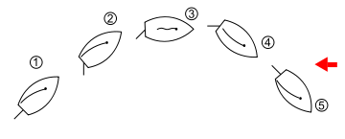
What is Tactical
Tacking or coming about is a sailing maneuver by which a sailing vessel (which is sailing approximately into the wind) turns its bow through the wind so that the direction from which the wind blows changes from one side to the other.

Slide 66
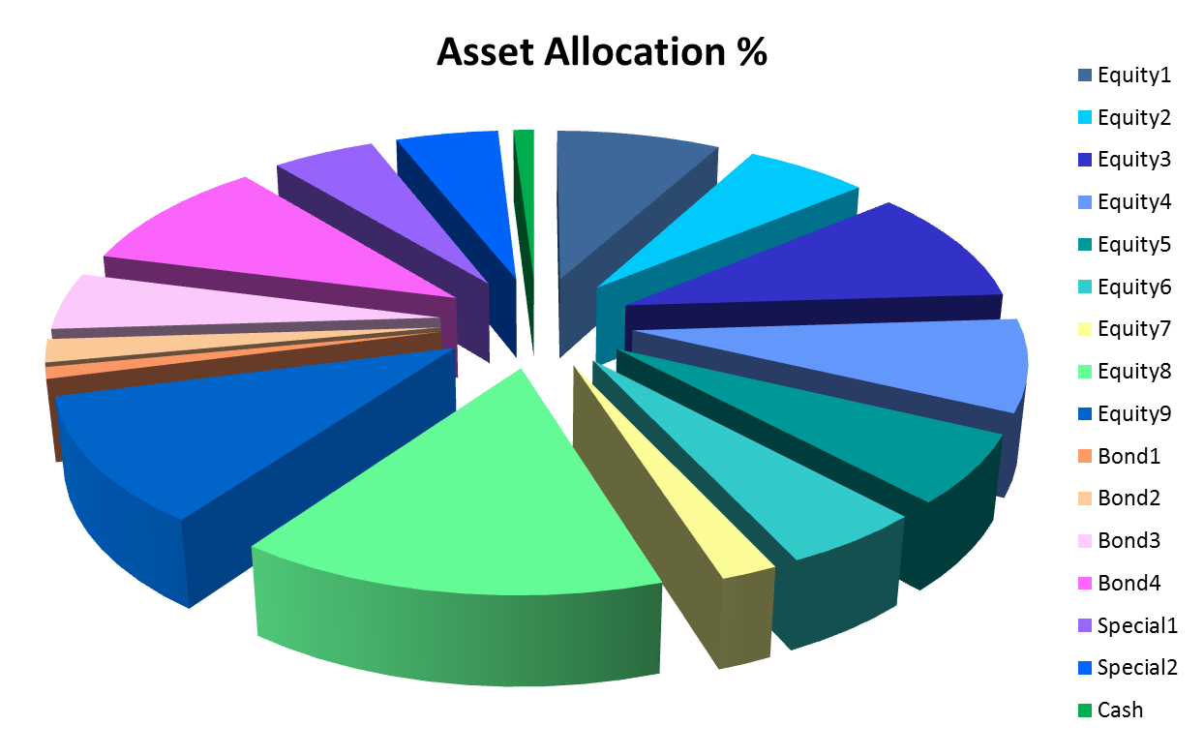
Strategic Allocation, Tactical Management

Slide 67
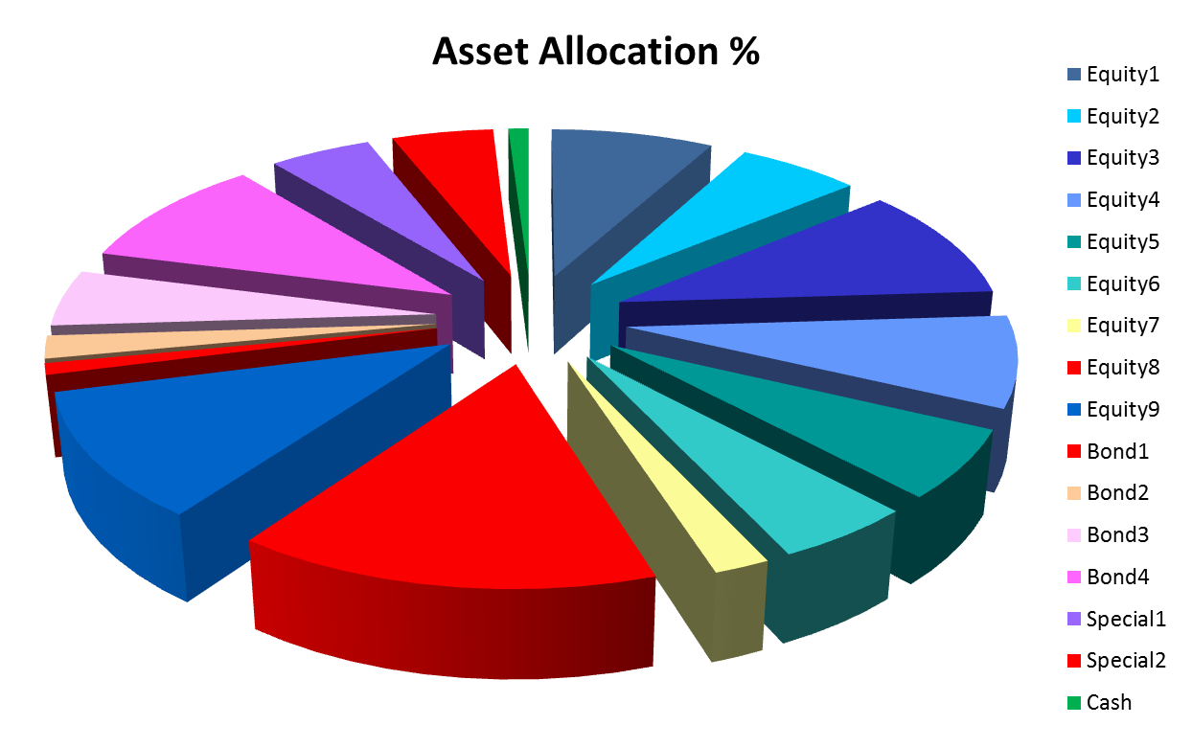
All in or all out signal

Slide 68
All in or all out signal

Slide 69

Tactical Management Style
How does tactical management differ from Buy and Hold’ Strategy?
Do you feel that Tactical Management may be the future of investing, as the author suggested?

Slide 70
What is the value of Red Money when planning for retirement?

Slide 71
Managing volatility in retirement
Chapter Nine:
What if it happened again?

Slide 72
WHAT IF IT HAPPENS AGAIN?
“The way to make money is to buy when blood is running in the streets.” John D. Rockefeller
“We simply attempt to be fearful when others are greedy and to be greedy with others are fearful” Warren Buffett

Slide 73

The Anatomy of a Bear
Every 3 years you have a bear market.
Every 8 years you have a significant bear market.
If you hold your money for 17 years you won’t have a problem.
“The Anatomy of a Bear” Napier 2005

Slide 74
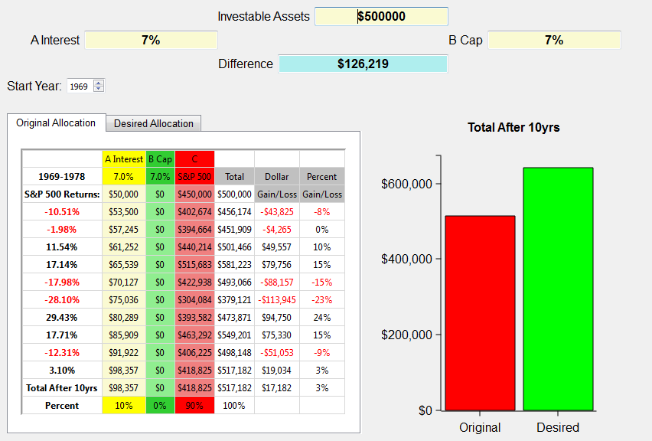
What if a bear market happens again? 1969 through 1978
Notes:
The illustration above shows the S&P 500 returns for the years 1969 through 1978 on the left. The investible assets are $500,000. This example uses the same criteria for caps in the index annuities, but uses the 7% average CD rate for the decade. Wouldn’t you love that again! We use the broad market index to approximate what investing in the market in general was like over that period of time..
The chart shows at the end of the ten year period this investor would have gained a little over $17,000. Look at all the red years in that decade! 5 out of 10 years were negative!
So, let’s take a look at the ABC allotment.

Slide 75
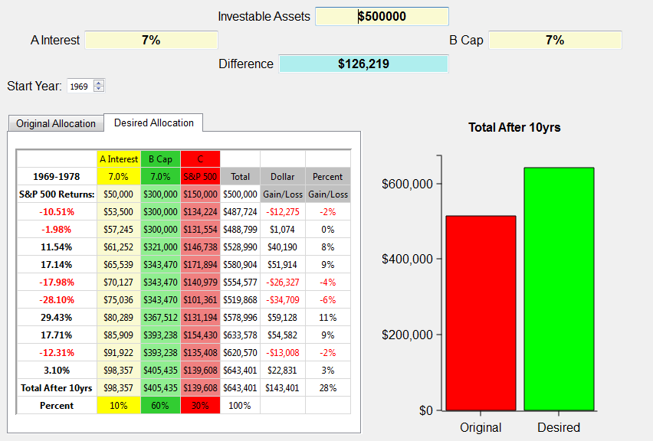
What if a bear market happens again? 1969 through 1978
$126,219
Notes:
The ABC allotment of 10/60/30 grows to over $143,000, which is a $126,219 difference! That’s with 5 out 10 years negative! Very positive toward the ABC bear market strategy for retirement.
Now let’s take a look at a really nasty decade. One we’re all familiar with.
Next slide.

Slide 76
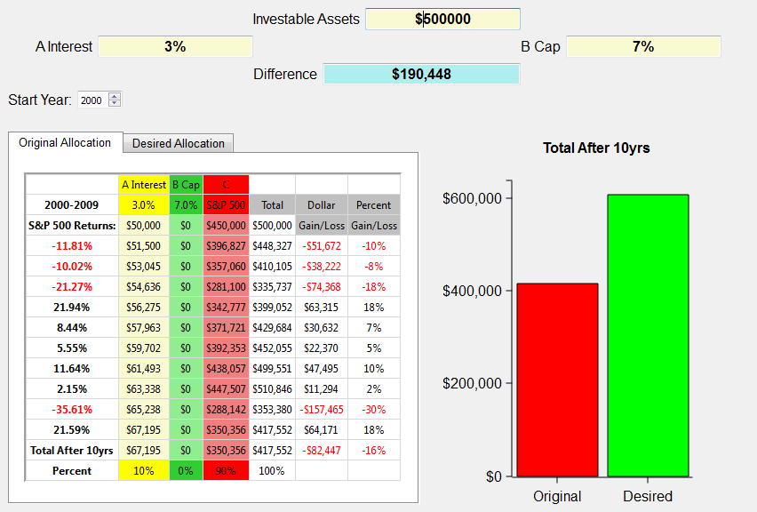
What if a bear market happens again? 2000 through 2009
Notes:
The illustration above shows the S&P 500 returns for the years 2000 through 2009 on the left. The investible assets are $500,000. This example shows a typical investor who has about 10% in cash earning an average of 3% and 90% allocated to the market represented by the S&P 500. We use the broad market index to approximate what investing in the market in general was like over that period of time. Certainly an investor could have been in more or less risk than illustrated here. Yet, the illustration shows in general terms how the market performed from 2000-2009. Notice, there are no monies allocated to Column B, which are Index Annuities.
The chart shows at the end of the ten year period this investor would have lost close to $100,000. I don’t know about you, but a 20% loss in the market is devastating when it comes to retirement! Imagine if you were 52 years old in 2000 and planning to retire when most people retire at age 62. Would you do what many have had to do, which is work another 3-5 years in hopes of recovering those assets needed to retire?
And what if it happens again? What if the next ten years aren’t any better than this decade? Can you afford to lose another 20% or possibly more? Can you continue to push off your retirement indefinitely?
When I show this graph to clients they tell me, “Yep, that’s about what happened to us.” Yet, the same clients will surprisingly stay in this broken down Wall Street model attempting to recover with a hope and a prayer.
There has to be a better way, and I believe there is.
Next slide.

Slide 77
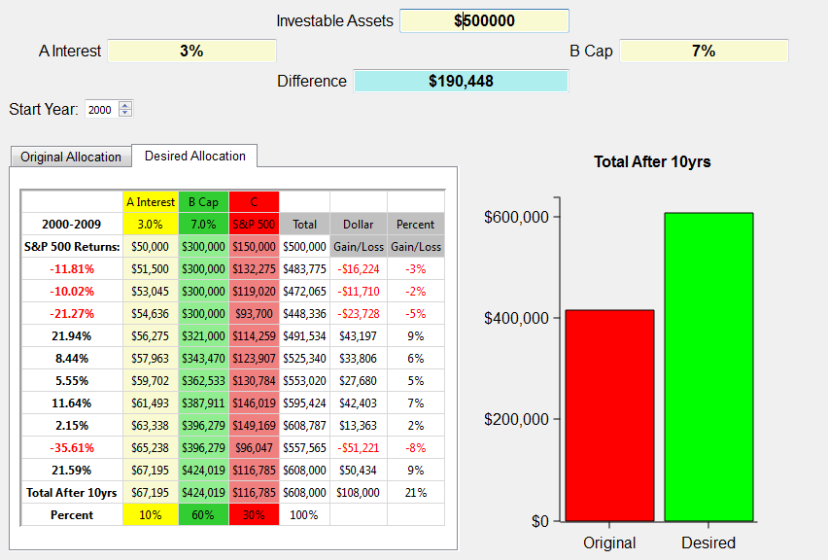
What if a bear market happens again? 2000 through 2009
  9.3 What if the next ten years saw a 20% loss in the market, how would it affect your retirement?
$190,448
Notes:
Using the 10/60/30 ABC split, this person gains $108,000 instead of losing over $80,000! Now that’s a strategy that works for retirement years. IT does so because it obeys Warren Buffet’s first rule of investing, “Never lose any money.” BTW, that happens to be rules number 2 and 3 also. And it has to be true, especially for retirees or those heading into retirement.
Simply putting some of your money in the green money column protects you from those down years and now with the tremendous guaranteed income payouts the green money column is even more a must for retirees. We don’t want you to get totally out of the red, or growth money assets, but it’s obvious that the green money column is perfect for conservative clients looking for alternatives to Wall Street’s roller coaster rides.

Slide 78

Dave Vick Video:
What if we do it again?

Slide 79
What Do You Think?
9.4 Do you see the markets over the next decade doing better, or worse, or about the same as the decade?
9.5 Considering the ABC Model’s performance in a bear market, is it something that you would use in your portfolio?

Slide 80
Next Week
Date
6:30PM – 8:30PM
Read Chapters 10 – 14
Also…
Complete Appendix One, Asset Review Forms; Appendix Two, Retirement Budget Worksheet, and Appendix Three (if not already done)

Slide 81
CONTACT INFORMATION
Dave Vick
dave@vickassociates.com
480-758-4582
Vick & Associates, Inc.
8700 E. Vista Bonita Drive
Suite 240
Scottsdale, AZ 85255

Slide 82
Thank you for Attending!

