Slide 1

Session One
February 25, 2016
Scottsdale Community College
Notes:
Introduction
We want to sincerely thank you for your time and effort to participate in this workshop. Our hope is that you would, at the end of our time together, not only learn some ideas on how to accomplish your retirement goals, but also have had a good time doing it.
The ABC Planning Model was developed by David P. Vick, a financial planner, author, and speaker who trains financial planners across the country. Mr. Vick created the workshop for people age 50 and up who would like to have an alternate to the typical Wall Street approach to retirement planning. For most conservative people planning for retirement, Wall Street’s approach usually involves more risk than people either know they have or want to have in their portfolios. We’ll use much of Mr. Vick’s material on conservative investing and apply it to retirement planning.
While this course covers many different topics and assets, one stands out as needing a little more attention for the conservative person financially: an annuity. There has been much written in the media negatively concerning annuities. Recently, though, writers have seemed to come forward with a more educated and reasoned approach. This course makes no apologies for the use of annuities in financial planning, in fact answers the question “Where do index annuities fit in a client’s total portfolio of assets.” Since, financial planners from large to small firms nationwide are making a more prominent use of these products this course helps to define how those planning for retirement can make best use of them.
The financial planner who is teaching this course may or may not be licensed to sell securities. If they are not licensed, then according to the ABC Model their focus is in what we call the Green Money Column of fixed principal assets. They in essence are Green Money specialists, which is a term you will come to appreciate. This means they may educate you on some of the topics pertaining to securities; however they will not be advising you or evaluating your security portfolio. Rather, they will be helping you evaluate where the Green Money assets fit into your total portfolio. If however, they are securities licensed they will be able to help you in all phases of the ABC Planning Model.
The course is designed around the ABC Planning Concepts in Mr. Vick’s book, “Bat-Socks, Vegas, and Conservative Investing” which you will receive as a resource for this course. The book covers some of the following topics:
Who is a Conservative Retirement Planner?
What is Conservative Planning?
Risk Assessment
Wall Street is Broken
Six Wall Street Myths
ABC Planning Model
Three Green Money Rules
Income Planning
Laddered Maturities of Annuities
Seven Problems with a 401k
What if it Happened Again
How to Find a Financial Planner
Elements of a Financial Decision
Seven Steps to an ABC Plan
Developing a Retirement Budget
This workshop is designed in six sections which follow the chapters laid out in the book. At the end of our time together you will hopefully have made your very own retirement plan based on the ABC Model. This course is not a solicitation to sell any products or services. You paid a fee and have received the workbook, book, DVDs and hours of instruction from a professional. You may enjoy the training and hopefully it assists you in your pursuit of a conservative planning strategy.
However, though we know you have many options as far as financial planners are concerned and it is certainly not a requirement of this course, the instructor may offer an individualized retirement strategy session. This strategy session provides a way for you to apply what you’ve learned in class to your specific retirement needs. We would encourage your participation in the strategy sessions. Of course, though you are under no obligation, it is the instructor’s hope that you would use their services to help you accomplish the success you desire in retirement planning.
Again, we appreciate your participation in this course of study and hope you enjoy it thoroughly.

Slide 2
Contact information:
Dave Vick
dave@vickassociates .com
480-758-4582
Vick & Associates, Inc.
8700 E. Vista Bonita Drive
Suite 240
Scottsdale, AZ 85255
Notes:
Tell the students that they are welcome to contact you after class. Set up here the concept that their tuition entitles them to a strategy session and how that works.

Slide 3
Disclaimer (insurance only)
The Principles of Retirement Planning Workshop is an educational program, and is not intended to sell investment or insurance products, nor is it intended to provide tax or legal advice. Consult with your tax advisor and/or legal counsel for suitability for your specific situation.
Hypothetical and/or actual historical returns contained in this presentation are for informational purposes only and are not intended to be an offer, solicitation, or recommendation. Rates of return are not guaranteed and are for illustrative purposes only.
Projected rates do not reflect the actual or expected performance within any example or financial product.
Insurance and annuity products discussed at any optional strategy sessions are offered through Vick & Associates, Inc. Investment advice offered through First American National RIA.

Slide 4
Course Introduction:
Attendance is good, but participation is better.
You tuition entitles you to an ABC Planning Strategy.
We will start and stop on time with 10 minute breaks on the hour.
Course based on “Bat-Socks, Vegas & Conservative Investing.
Includes the Financial ABCs of Retirement Planning Workbook.
ABC Planning Model Concepts – DVD
Fill out Workshop Goals sheet.
Notes:
Read slide

Slide 5
Course Introduction:
This is a course that dives into the concepts of retirement planning from a financially conservative point of view. We will use the book, “Bat-Socks, Vegas and Conservative Investing,” and it’s accompanying workbook, “The Financial ABCs of Retirement Planning,” as our guide. There are other retirement topics that are important, however our focus for this class is on how to build financially conservative retirement plan.
Notes:
Read slide

Slide 6

Bat-SOCKS & VEGAS
CONSERVATIVE RETIREMENT PLANNING
Notes:
Read Slide

Slide 7
Questions for your retirement portfolio
Do you know how all of your assets (stocks, bonds, mutual funds, annuities, REITS, Life Insurance, etc.) work together to achieve the amount of risk you want in your total portfolio?
How does your current portfolio protect you in a bear market?
How does the average person determine which assets to use in a conservative portfolio?
What is your plan to manage risk?
Do you need a degree in finance to
know how to manage risk?
p. 9
Notes:
How do your assets work together to accomplish what you want to accomplish in your retirement, and do you need a degree in finance to get it? Could the novice understand where assets fit together so they can sleep at night? Is it possible for the average American to develop a conservative retirement plan of their own making and use a professional to help carry out the plan and add his/her insights?

Slide 8
#1 What’s Coming Next?
When?
  Napier –before 2014-16
How deep?
  20% by definition
How long?
  Ave. Bear 3 yrs
  Ave. major Bear – 17 yrs.
Market Cycle
p. 9
Notes:
Questions for your retirement portfolio
Do you know how all of your assets (stocks, bonds, mutual funds, annuities, REITS, Life Insurance, etc.) work together to achieve the amount of Risk you want in your total portfolio?
How does your current portfolio protect you in a bear market?
How does the average person determine which assets to use in a conservative portfolio?
What is your plan to manage risk?
Do you need a degree in finance to know how to manage risk?
Market Cycles
The market moves up and down in “boom/bust cycles” and generally, over time increases in value. If you pulled out one of these cycles it would start and end with low points in the market, with a high-point in the middle.
Put an X where you believe we are in the current market cycle?
What do you believe will happen next in the market?
What don’t we know?
When?
How deep?
How long?
Theoretically, people wish to follow the old adage “buy low, sell high.” When the market is heading up, they’ll want to capture the upward movement of the market and when it goes down, they’ll want some protection for both their gains and their principal.
Conservative investing is not like wearing Bat-socks. It’s not a fad. It’s not something you do for a few months and then try the next mutual fund flavor of the month. Conservative investing is core investing. Its long-haul investing.
There is a basic need for those who use this strategy, which is simply the need to sleep at night. They don’t want to worry about losing money. They are not after quick market gains and fast money schemes.
How would you describe a planning ‘fad’?
How would you define conservative retirement planning?

Slide 9
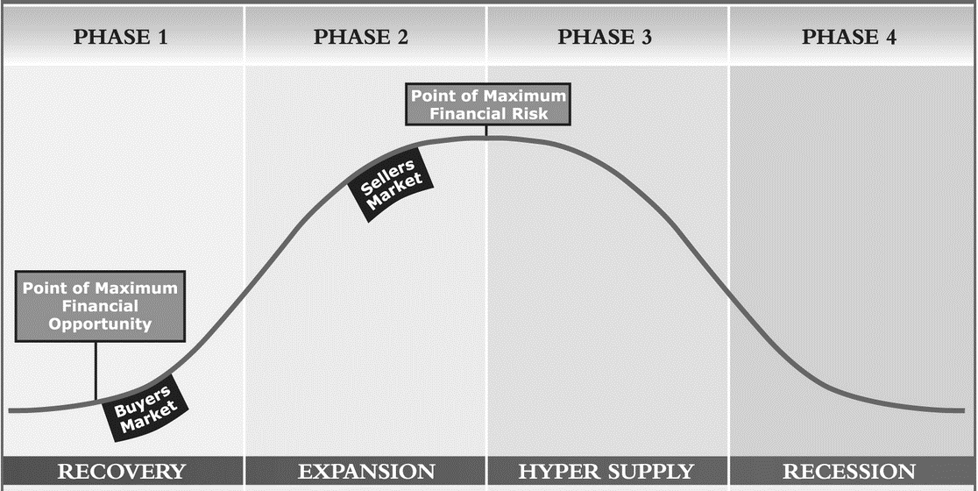
#1 What’s Coming Next?
Market Cycle
p. 9
Notes:
It’s also important to note the Point of Maximum Financial Opportunity and the Maximum Point of Financial Risk.

Slide 10

Bat-Socks…
How would you define conservative retirement planning?
Notes:
Ask the class this question.

Slide 11

Risk
Types of Risk
There are many types of risk. Here’s a short list:
Market risk
Business risk
Purchasing power risk (inflation)
Sovereign risk
Interest rate risk
Reinvestment risk
Liquidity risk
Country risk
Systematic risk
Unsystematic risk
Event risk
Political risk
Price risk
p. 11
Notes:
“Wall Street, however, disconnects with Main Street by defining risk as “the chance that your actual return will be different than what you expected.”(1) In other words, they define risk as the potential for your assets to gain or lose. Conservative investors laugh at the thought of gaining money as a risk. Instead a conservative investor defines risk as the potential to lose money. It’s not a matter of return on your principal, but return of your principal. A conservative investor’s aversion to risk, then, is how they feel about losing more than they expected.”
Risk vs. Reward
“One of the fundamental ideas in finance is the concept of risk vs. reward. It is generally assumed that the greater the risk, the greater the potential return. For instance, a U.S. Treasury bond pays out less of a return than a corporate bond because the U.S. Government is less likely to go bankrupt than a corporation…the risk associated with the corporate bond pushes the issuer of that bond to offer a higher return.”
Types of Risk
There are many types of risk. Here’s a short list:
Market risk
Business risk
Purchasing power risk (inflation)
Sovereign risk
Interest rate risk
Reinvestment risk
Liquidity risk
Country risk
Systematic risk
Unsystematic risk
Event risk
Political risk
Price risk

Slide 12
Risk
Risk vs. Reward
The fundamental idea in investing is the concept of risk vs. reward. It is generally assumed that the greater the risk, the greater the potential return.
p. 11
Notes:
“Wall Street, however, disconnects with Main Street by defining risk as “the chance that your actual return will be different than what you expected.”(1) In other words, they define risk as the potential for your assets to gain or lose. Conservative investors laugh at the thought of gaining money as a risk. Instead a conservative investor defines risk as the potential to lose money. It’s not a matter of return on your principal, but return of your principal. A conservative investor’s aversion to risk, then, is how they feel about losing more than they expected.”
Risk vs. Reward
“One of the fundamental ideas in finance is the concept of risk vs. reward. It is generally assumed that the greater the risk, the greater the potential return. For instance, a U.S. Treasury bond pays out less of a return than a corporate bond because the U.S. Government is less likely to go bankrupt than a corporation…the risk associated with the corporate bond pushes the issuer of that bond to offer a higher return.”
Types of Risk
There are many types of risk. Here’s a short list:
Market risk
Business risk
Purchasing power risk (inflation)
Sovereign risk
Interest rate risk
Reinvestment risk
Liquidity risk
Country risk
Systematic risk
Unsystematic risk
Event risk
Political risk
Price risk

Slide 13
Risk
Risk Tolerance
Basically, how you feel about an adverse effect in your portfolio is your personal Risk Tolerance.
When you lose you get upset because you weren’t in control. The degree of your “upset-ness” is the degree of your conservative nature.”
p. 11-12
Notes:
“Wall Street, however, disconnects with Main Street by defining risk as “the chance that your actual return will be different than what you expected.”(1) In other words, they define risk as the potential for your assets to gain or lose. Conservative investors laugh at the thought of gaining money as a risk. Instead a conservative investor defines risk as the potential to lose money. It’s not a matter of return on your principal, but return of your principal. A conservative investor’s aversion to risk, then, is how they feel about losing more than they expected.”
Risk vs. Reward
“One of the fundamental ideas in finance is the concept of risk vs. reward. It is generally assumed that the greater the risk, the greater the potential return. For instance, a U.S. Treasury bond pays out less of a return than a corporate bond because the U.S. Government is less likely to go bankrupt than a corporation…the risk associated with the corporate bond pushes the issuer of that bond to offer a higher return.”
Types of Risk
There are many types of risk. Here’s a short list:
Market risk
Business risk
Purchasing power risk (inflation)
Sovereign risk
Interest rate risk
Reinvestment risk
Liquidity risk
Country risk
Systematic risk
Unsystematic risk
Event risk
Political risk
Price risk

Slide 14
Life in the Slow Lane
Simply put, conservative investing is a long-term strategy to manage risk in such a way as to conserve principal while maintaining buying power. What are lower-risk assets?
The real question is, “how do you manage risk?
p. 12
Notes:
Life in the Slow Lane
Simply put, conservative investing is a long-term strategy to manage risk in such a way as to conserve principal while maintaining buying power. What are lower-risk assets?
The real question is, “how do you manage risk?

Slide 15
Paradigm shifts in the markets
Notes:
Let’s take a look at some possible reasons for shifts in the way markets have performed over the last few decades.

Slide 16
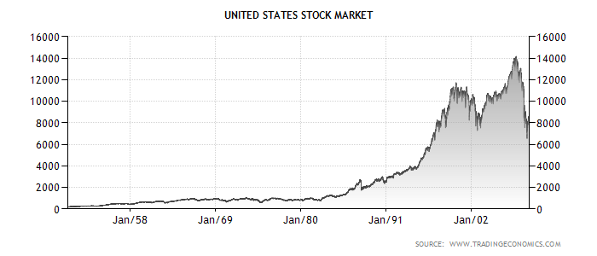
What the Heck Just Happened?
Investing Paradigm Shifts
Welcome to the M Times
p. 14
Notes:
When we look over the last 30 to 40 years in the financial planning community, there seems to be large paradigm shifts in the American culture that have affected the way they plan for retirement. Recognizing these changes in the way our culture views their retirement savings can be a key to successful retirement.
“What is a paradigm shift? You can think of it as a sort of transformation, a changing of one way of thinking to another. Some might even call it a revolution or a metamorphosis.”
How would you think paradigm shifts in culture and history affect retirement planning?
“There are also very interesting alterations in “investing paradigms” which have taken place over the last 30 to 40 years. Changes of this magnitude usually take a long time to blossom. I believe our perspective on investing has changed because of a cultural transformation in America and the effect of bear markets—especially big bear markets—on future economies.”

Slide 17
Looking back from Reagan
p. 15
Notes:
“If you were an investor in 1980, when President Ronald Reagan was elected, what did you see? I mean, if you could literally stand on a time line of the DOW in 1980 and peer backward over the last ten to twenty years, what would you see that would affect how you invested going forward? The 70’s were turbulent financial years with investors largely investing in bonds, large cap mutual funds, and blue chip stocks. The 70’s were the up and down years of a mid-term bear market that started in the fall of 1965 and didn’t recover until the fall of 1982, covering 17 restless years. Who can forget long gas lines and double-digit inflation? That’s what you saw looking back from 1980.
The prevalent investor strategy at the beginning of the 80’s was unmistakably conservative. They looked for safety and dividends. They weren’t “speculative” in nature, but desired small, consistent gains along with dividends. Not much risk.”

Slide 18
Welcome to the M Times
Looking backward from Obama
p. 15
Notes:
Looking Back at the Dow from 1980
“If you were an investor in 1980, when President Ronald Reagan was elected, what did you see? I mean, if you could literally stand on a time line of the DOW in 1980 and peer backward over the last ten to twenty years, what would you see that would affect how you invested going forward? The 70’s were turbulent financial years with investors largely investing in bonds, large cap mutual funds, and blue chip stocks. The 70’s were the up and down years of a mid-term bear market that started in the fall of 1965 and didn’t recover until the fall of 1982, covering 17 restless years. Who can forget long gas lines and double-digit inflation? That’s what you saw looking back from 1980.
The prevalent investor strategy at the beginning of the 80’s was unmistakably conservative. They looked for safety and dividends. They weren’t “speculative” in nature, but desired small, consistent gains along with dividends. Not much risk.”
“In contrast, what was the view of an investor looking back on the market when President Obama took office in 2009? Again, if you could stand on a DOW timeline and look back, what would you see?
An investor looking back on the last 20 years in the DOW would see a huge M in the graph the closer it got to his time—the “irrational exuberance” of the 1990’s Bull market, followed by a tech bubble bursting into a near 50% loss from 2000-2002, followed by a 5-year Dow run up with the peak of the second half of the “M” in October of 2007, followed by the housing bubble, bank bubble, finance bubble, and whatever other bubble was out there, bursting into flames by the low point of March 2009.”
What is your reaction to the high volatility of the M-times, especially when you think of planning for your retirement?
What the heck just happened.
Questions, is it a paradigm shift of our society, our culture, our investing mentality?
M times…looks like an M, bottom in March of 09
Is that the norm? Don’t kknow
Go back in history…gambling in 1950s, 60s…positive or negative
Today, what is the outlook…positive, most popular shows on cable TV Gambling
Celebrity apprentice…Gambling Champion
Look at page 19 in your workbook
Person to read definition of investing…how does that feel…all of it back with return, or some of it…downside?
Person to read gambling…think of your 401k…which definition most resembles the 401k? That’s where we are.
Look at stats in book…
What the heck just happened?

Slide 19
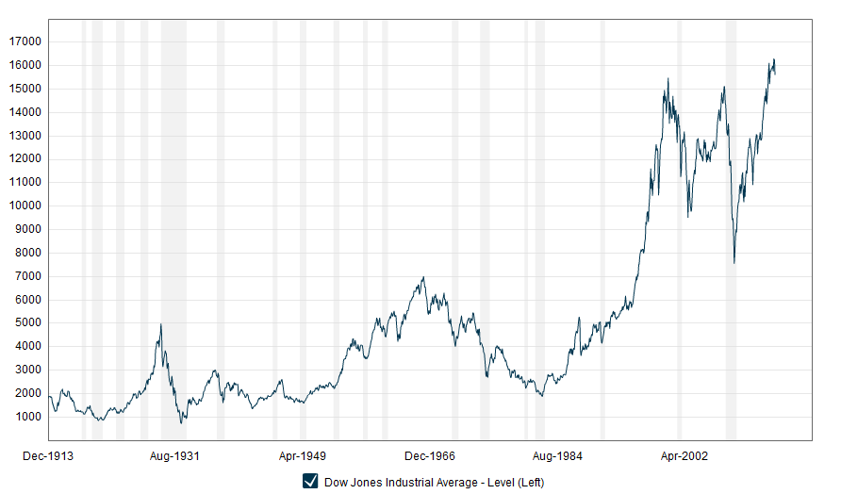
W
hat’s Next?
p. 16
Notes:
Looking at the DOW graph since 2009 we see the point of volatility made even clearer. The graph now looks like a W with the DOW now over 16000. The question is What’s Next? We know there’ll be a correction, but when? Will it be small or large? What’s the trend? What do you think?

Slide 20

The Times They Are A Changin’
Gambling vs. Investing
401(K) Plans
Supply vs. Demand
Changing Technology
The Bears are Growling
p. 17
Notes:
The Times They Are A Changin’
When we look at the “M-Times” and the “What’s Next” DOW graphs we begin to ask ourselves what are the causes behind the paradigm shifts in the last 30-40 years?
Gambling vs. Investing
401(K) Plans
Supply vs. Demand
Changing Technology
The Bears are Growling

Slide 21

Changing perceptions…
  What was the American perception of gambling in the 1950’s and 1960’s? Was it positive or negative?
p. 17
Notes:
Ask the class this question.

Slide 22

To Invest
“In⋅vest” verb
to commit (money) in order to earn a financial return.
p. 17
Notes:
Read slide ask the students’ interpretation of the meaning of invest. Does it sound like you get your principal back, plus a gain?

Slide 23
To Gamble
“gam· ble” verb
a: to play a game for money or property
b: to bet on an uncertain outcome; to stake something on a contingency: take a chance
  Which definition better describes your 401k or other investments? Why?
p. 17
Notes:
Read slide and ask the question.

Slide 24
Facts on Gambling (p.19)
Gambling is a $90 billion a year industry.
1988— only legal in Nevada and New Jersey.
1994 – Operating in 23 states.
2000 – Over 34 million people visited Las Vegas.
2000 – Over 127 million in casinos nationally.
2003 – Operating in 48 states.
Industry take - $750 per participant or $250 per person in U.S. People or dollars?
Blind Faith, 2003 Ed Winslow
p. 17-18
Notes:
Facts on Gambling
In his book titled Blind Faith, published in 2003 Ed Winslow makes an interesting case for the cultural changes brought on by the cultural acceptance of gambling over the last thirty years. Take a look at the facts on Gambling:
Gambling is a $90 billion a year industry.
1988— only legal in Nevada and New Jersey.
1994 – Operating in 23 states.
2000 – Over 34 million people visited Las Vegas.
2000 – Over 127 million in casinos nationally.
2003 – Operating in 48 states.
Industry take - $750 per participant or $250 per person in U.S. People or dollars? (4)

Slide 25
Gambling Today!
Business Insider Reports:
“The University of Las Vegas found that the 23 Vegas casinos bringing in over $72 million each in the 2013 fiscal year ended up with over $5 billion of their visitors' money, altogether. That's an average of over $630,000 a day, per casino.”
http://www.businessinsider.com/how-casinos-make-you-spend-money-2014-8#ixzz3Tk8GnJpL
p. 18
Notes:
Gambling Today!
Business Insider Reports:
“The University of Las Vegas found that the 23 Vegas casinos bringing in over $72 million each in the 2013 fiscal year ended up with over $5 billion of their visitors' money, altogether. That's an average of over $630,000 a day, per casino.” (5)
If you’ve been to Vegas in the last 10 years, you surely can’t miss the fact it is a retiree’s haven. The very people who, when they were growing up, thought of gambling as evil, have now made Risk City their number one travel destination. Not only that, but some of the most popular cable TV shows are televised gambling events. You can watch it on television and play it online 24 hours a day. It is in our 21st century American blood. The acceptance of gambling represents a definite cultural shift and has doubtlessly had an effect on not only the way we invest, but if we invest at all!

Slide 26
401(k) Plans
“…Section 401(k). It took effect in 1980, and by 1983 more than half of large companies were setting up 401k plans, a little more than 17,000.(6) Half way through the 1980’s, there were less than 8 million people investing in 401ks with about $100 billion invested. By 2006, there were seventy million participants and more than $3 trillion invested.”
Bat-Socks, Vegas & Conservative Investing, 2012, David P. Vick
p. 18
Notes:
Read slide

Slide 27
Changing Technology
Commercialization of the Internet - 1995
Investing is done at the speed of information.
The speed of information is the speed of the internet.
Millions of dollars are made or lost in Nano-seconds.
p. 18-19
Notes:
Read slide

Slide 28

We Live in Perilous Times!
On Average:
Every 3 years you have a bear market.
Every 8 years you have a significant bear market.
If you hold your money for 17 years you won’t have a problem.
“The Anatomy of a Bear” Napier 2005
p. 19
Notes:
In 1884 Charles Dow began publishing his “Dow Jones Averages” in the Customer’s Afternoon Letter, which was the forerunner of The Wall Street Journal. In 1896, he changed the name to the Dow Jones Industrial Average, which consisted of twelve industrial stocks, a departure from the original nine railroad stocks, and two industrial stocks. The first index containing the “Rails,” as people referred to it, continued to rival the industrial average’s for the next 20 years.(9)
Russell Napier, in his book The Anatomy of a Bear tells us these two main indexes, the Dow Jones Industrials and the “Rails” Stock index, were the two main indexes at the turn of the 1900’s. During the hard financial times from 1900-1914 and the start of World War I, Napier tells us that the government nationalized the railroads, and guess what happened to that stock index. Right, it virtually went away when the government devalued the rail stocks by their takeover. (10) That was a huge alteration in the market.
Another event that caused a deviation in the market was the creation of the Federal Reserve in 1914. The Fed was created to make our currency “elastic.”(11) In other words, to “inflate” the money supply during a recession or depression, the fed would print more money tied very loosely to the gold standard hoping it would grow the economy. That created incredible changes in the financial markets coming out of 1921.
You should have a solid plan to manage risk that matches your conservative risk tolerance. Remember, the question is not how much money you should have in a mutual fund or even the fund’s 3, 5, and 10 year returns, but how you manage risk. That’s the question!

Slide 29
Wall Street Myths and a conservative mindset
Myths or Maxims:
You Decide
Notes:
Myths or Maxims: You Decide
One way Webster's dictionary defines myth is by describing it as a popular belief that has come about by “an unfounded or false notion.” Maxim on the other hand, is defined by Webster's as a general truth, or a fundamental principle.

Slide 30
Six Wall Street Myths
You haven’t lost until you sell.
  Do you sometimes suspect a broker’s motives? If so, in what ways?
p. 22
Notes:
The author thinks this is a tax reality made into a Wall Street myth. If you had a gain of 5, you realize gain. If you lose 5, and sell it, what have you done…realized the loss. For tax purposes this is the truth.
Every week I have people come into my office and we look at them…last month you had 400,000 and now you have $350,000. Did you put the money in a CD? Wife says he lost it. So lets look at that, last month you had xx, this month you have how much. How much does it say you have. Wouldn’t it be smarter investing to say I have what I have today? Would nt you rather deal with reality in investing? Wall street doesn’t want you to believe this is real…unless you made money. I have what I have…it that’s the truth, wouldn’t it be a better plan to start with that number when crafting a new plan. That’s what the author thinks…what do you thin.

Slide 31
Six Wall Street Myths
2. The Large Wire Houses (Wall Street and it’s big firms and media outlets) are the Best Place to get Professional Advice.
  Why do you believe people planning for retirement would be attracted to large wire house firms?
p. 22
Notes:
Myth or Maxim. Name me a bunch of big firms. Merrill Lynch, Lehman, Goldman Sachs (like having the casino teach you to play blackjack, or IRS how to do taxes). Where will they make more money; that’s what they will sell you. So that eliminates all of the independent advisors who are beholden to no one. Everyone is biased. Media outlets; Cramer, Bob Brinker, Dave Ramsey, Suze Orman. Are these people the best place for you to get advice? They know your situation, right. They know what you want and need, right. What is their number one priority: creating controversy. And that’s where you are getting your advice because you don’t trust that guy down the block.

Slide 32
Six Wall Street Myths
A Diversified Portfolio of Stocks, Bonds, and Mutual Funds are Safe Over the Long Haul.
p. 22
Notes:
Read slide

Slide 33
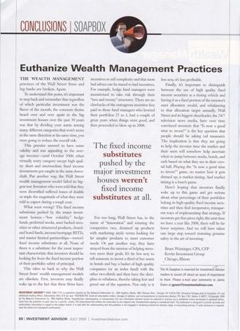
A Diversified Portfolio of Stocks, Bonds, and Mutual Funds are Safe Over the Long Haul.
Myth #3
FAILED
Investment Advisor Magazine, July 2009
p. 22-23
Notes:
Here’s what the editor of Investment Advisor magazine, an industry journal written to advisors, says about this myth. He says “Euthanize Wealth Management Practices”… they’ve FAILED!

Slide 34
If a theory fails it’s biggest test ever…?
Listen to the editor for Investment Advisor Magazine (July 2009 emphasis mine):
“The wealth management practices of Wall Street firms and big banks are broken. Again.
To understand this point, it’s important to step back and remember that regardless of which particular investment was the flavor of the month, the common theme heard over and over again in the big investment houses over the past 30 years was that by dividing your assets among many different categories that won’t move in the same direction at the same time, you were going to reduce the overall risk.
This premise seemed to have some validity and was appealing to the average investor – until October 2008, when virtually every category except high quality short and intermediate fixed income investments got caught in the same downward draft. Put another way, the Wall Street wealth management model failed its biggest test. Investors who were told that they were diversified suffered losses of double or triple the magnitude of what they were told to expect during a tough year.
What went wrong? The fixed income substitutes pushed by the major investment houses – “low volatility” hedge funds, preferred stocks, asset backed securities or other structured products, closed-end bond funds, income/mortgage REITs, and master limited partnerships - weren’t fixed income substitutes at all. None of them is a substitute for the most important characteristic that investors should be looking for from the fixed income portion of their portfolios: safety of principal.
p. 22-23
Notes:
“Wide diversification is only required when investors do not understand what they are doing.” Warren Buffett (1)
Basically, diversification implies you can reduce your overall risk by investing in assets which move in different directions over time and in response to market conditions. You might buy individual stocks and bonds, large cap and small cap, domestic and foreign, financial sector and manufacturing sectors, hoping that if one asset class goes south the other area will go north. This has been the practice for Wall Street firms for decades, based on years of studies.
If a theory fails it’s biggest test ever…?
Listen to the editor for Investment Advisor Magazine (emphasis mine):
“The wealth management practices of Wall Street firms and big banks are broken. Again.
To understand this point, it’s important to step back and remember that regardless of which particular investment was the flavor of the month, the common theme heard over and over again in the big investment houses over the past 30 years was that by dividing your assets among many different categories that won’t move in the same direction at the same time, you were going to reduce the overall risk.
This premise seemed to have some validity and was appealing to the average investor – until October 2008, when virtually every category except high quality short and intermediate fixed income investments got caught in the same downward draft. Put another way, the Wall Street wealth management model failed its biggest test. Investors who were told that they were diversified suffered losses of double or triple the magnitude of what they were told to expect during a tough year.
What went wrong? The fixed income substitutes pushed by the major investment houses – “low volatility” hedge funds, preferred stocks, asset backed securities or other structured products, closed-end bond funds, income/mortgage REITs, and master limited partnerships - weren’t fixed income substitutes at all. None of them is a substitute for the most important characteristic that investors should be looking for from the fixed income portion of their portfolios: safety of principal.” (2)
As a conservative person planning for retirement, what lessons could you learn from severe market corrections like 2000-02 & 2008?

Slide 35


Slide 36

Six Wall Street Myths
  As a conservative person planning for retirement, what lessons could you learn from severe market corrections like 2000-02 & 2008?

Slide 37
Six Wall Street Myths
Buy and Hold is an effective conservative strategy.
p. 23
Notes:
The simple reason “buy & hold” is better named “buy & hope” is because it lacks the ability to respond to markets in a timely manner. I will be covering much of this in chapter 8, but tactical management, in my opinion, is a more up-to-date management style for conservative investors. The average broker or investment advisor does the best he can by picking stocks, bonds and mutual funds that fit a client’s risk tolerance. Then for the most part, they sit on those assets come hell or high water, only liquidating in extreme situations. The reasons they change assets are to try to find “relative strength” in a sector or underpriced assets in a growing segment of the economy. Some use outside sources to get counsel on where they should invest next. These sources are investment advisors themselves trying to figure out the market. Usually what happens is the advisor picks a hot mutual fund manager and hopes he continues his track record. The whole system seems to look at returns over 1 year, 3 years, and 5 years to see who has the best record, or which fund or stock is “on the rise.
The problem with this mentality is it doesn’t have a solid plan for how to manage risk. The markets do two things very well: they go up and they go down. Volatility is inherent in the markets. How you deal with volatility and risk should be the focus, not trying to compare returns. Comparing returns is tempting and you can make a case that certain fund managers have done well over time. Yet, everybody lost in 2008. When fear and panic set in, a buy and hold strategy will kill a retiree’s portfolio. A fund manager has to pick stocks and in an environment like 2008 where the normal logic went out of the market, the fund manager was lost. He certainly couldn’t sell everything, that’s just not how they do it. And so they sat and painfully watched as their mutual funds value plummeted.

Slide 38
Six Wall Street Myths
The reality is, if you invested $100 in the S&P 500:
  01/01/2000 $100
  12/31/2000 $90
  12/31/2001 $75
  12/31/2002 $58
  12/31/2003 $73
  12/31/2004 $80
  12/31/2005 $82
  12/31/2006 $93
  12/31/2007 $97
  12/31/2008 $60
  12/31/2009 $74
  12/31/2010 $84
  12/31/2011 $84
  12/31/2012 $95
  12/31/2013 $124
  12/31/2014 $131
  12/31/2015 $131
  That’s less than an average $2 a year for the last 16 years. What happened to the 4% withdrawal rule in these years?
Stats from YahooFinance.com 1/9/2016
p. 24
Notes:
Are you comfortable with buy and hold? That’s less than an average $2 a year for the last 16 years. What happened to the 4% withdrawal rule in these years?

Slide 39

Six Wall Street Myths
Just buy a No-Load Index Fund.
p. 25
Notes:
Let’s say you were a conservative-minded investor in 2000 that didn’t buy into the tech-bubble and invested heavily in the S&P 500 Index. You listened to John Bogle, founder of Vanguard, and purchased no-load, low expense index funds from several sources, investing $500,000. You were 55 years old and looking to retire in January 1, 2010, at age 65. Here is what happened to you.

Slide 40
“Just buy an index fund”
S&P 500 Index
January 3rd, 2000
  1455.22
December 31st, 2009
  1115.10
That’s a -23% LOSS!!
Myth #5
Stats from YahooFinance.com 1/7/2016
p. 25
Notes:
Take a look at the first decade of the 21st century and we begin to wonder at the wisdom of just buying an index fund. That strategy would have netted you a greater than 23% loss!

Slide 41
“Just buy an index fund”
S&P 500 Index
January 3rd, 2000
  1455.22
December 31st, 2015
  2043.94
That’s a 40% Gain
Less than 2.5% a year return over 16 years!
Myth #5
Stats from YahooFinance.com 1/7/2016
p. 25
Notes:
Let’s fast forward a few years. We have a gain of 2.5% a year! CD’s would have returned more than that and with none of the sleepless nights!

Slide 42
Six Wall Street Myths
  If you average 2.5% per year, imagine having to withdraw the typical 4% per year for income needs over the last 16 years, and what that would do to your portfolio.
  Would you be willing to gamble your retirement on the above illustrations not happening again?
p. 25
Notes:
If you average 2.5% per year, imagine having to withdraw the typical 4% per year for income needs over the last 16 years, and what that would do to your portfolio.
Would you be willing to gamble your retirement on the above illustrations not happening again?

Slide 43

Six Wall Street Myths
Index Annuities are Dangerous!
p. 25
Notes:
Read slide

Slide 44


They’re like great white sharks…they’ll jump out of the water and swallow you whole!
Notes:
People who hold this position would have you believe that these assets are so horrible they are like great white sharks, they’ll jump out of the water and swallow you whole!

Slide 45

Dr. David babbel: my personal story
  Dr. David Babbel reveals his approach to funding retirement successfully.
Notes:
Pass out Dr. Babbel’s article and comment.

Slide 46
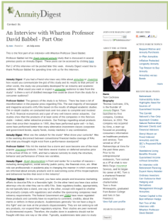
“Index Annuities are dangerous”
David F. Babbel
Professor of Insurance and Finance
The Wharton School of Business
University of Pennsylvania
Myth #6
p. 26
Quotes from Tom Cochrane’s Blog on AnnuityDigest.com 8/4/09 & 9/3/09
Notes:
While I know there is a lot of negative press out there in the media about index annuities, I’m fairly confident that much of it is a result of a business war waged between the insurance industry and the securities industry over money. Which means that much of what is written has a bias toward one industry or another. So, it would be nice to have a comment from a reliable source that doesn’t have a “dog in the fight” so to speak. Professor David Babbel from the Wharton School of Business at the University of Pennsylvania is just such a voice.

Slide 47
The ABC planning model: simplicity at its best
The New Model
Notes:
Wall Street’s typical model of investing starts with the “Pyramid of Assets” and moves on to “Asset Allocation” models, which seem anything but easy or simple to understand… , these models depend on the broker knowing your “risk tolerance,” which is the degree of uneasiness an investor is willing to experience when there is volatility in their portfolio.

Slide 48
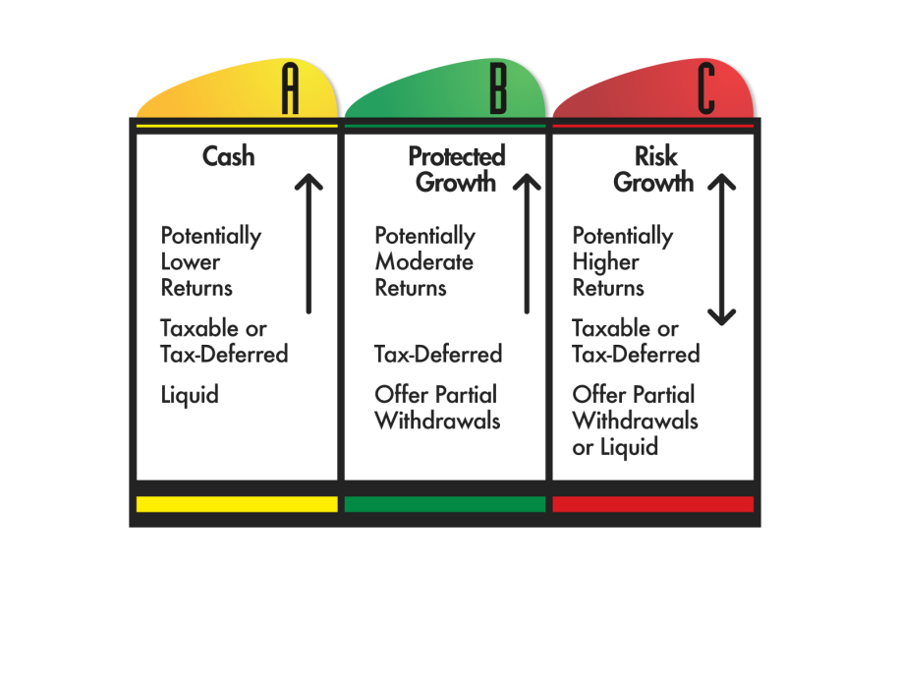
The ABC Model of Investing-
Cash Assets
p. 28

Slide 49
The ABC Model of Investing-
Fixed Principal Assets
p. 28

Slide 50
The ABC Model of Investing-
Growth Assets
p. 28
Notes:
Add in Growth Assets

Slide 51
SAMPLE CONSERVATIVE MODEL
10%
60%
30%
p. 28
Notes:
Conservative

Slide 52
SAMPLE MODERATE/AGGRESSIVE MODEL
10%
30%
60%
p. 28
Notes:
Moderate…which one is right? It depends on you.

Slide 53
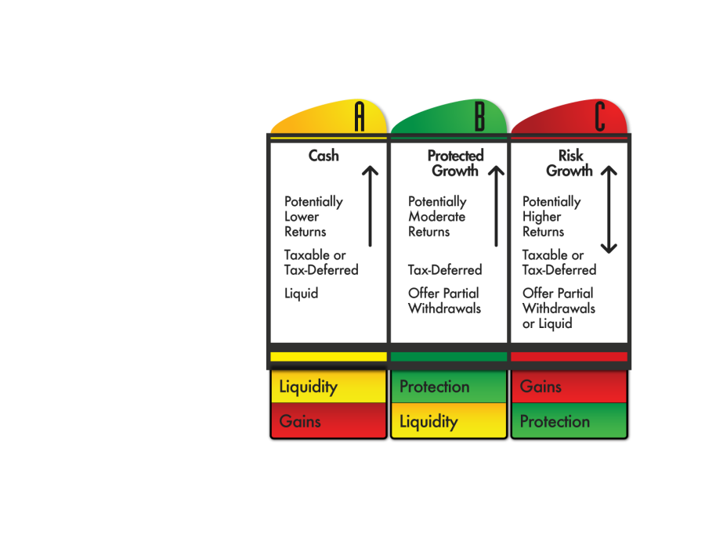
What is Your Greatest Priority?
What are you willing to give up?
Gains?
Liquidity?
Protection?
p. 29
Notes:
What is Your Greatest Priority!
Everyone wants the perfect investment, one that has double-digit gains, always liquid and always protected. It’s a great investment! The problem is…it doesn’t exist. In order to set the right expectations on your assets you have to prioritize what you want with what you’ve invested.
Whenever setting priorities the question is always, “What are you willing to give up to get what you want?” If you want to lose weight, you’ll have to give up some eating habits and begin some exercise habits. You know what to expect when you stop overeating and start to exercise. It’s the same way with your money. You simply decide what you’re willing to give up with some parts of your money in order to get what you want.
The three major areas people have to prioritize is their desire for gains, their need for liquidity and their hope for a protection against market losses. The ABC Planning Model helps you determine how much of your money you want chasing gains, what percent you need liquid and which dollars you can’t afford to lose.
For those dollars you want liquid, you typically give up gains. For those dollars you want protected, you give up some liquidity. And for those dollars you want to chase gains, you give up protection. Once you know what to expect with your money you can get more out of it and feel better about it.

Slide 54
Create Your Own ABC Model
p. 30
Notes:
Start with column (A) and ask yourself how much emergency money or liquidity you need. In other words, don’t worry much about returns, but concentrate on liquidity. How much money do you need available immediately? How much money would you need in the next six months to live on if your current income went away? You can express it in a percentage or a specific dollar amount. Your number will be personal to you.
Second, you could ask yourself how much money you want at risk in the market and what type of market risk you want. Do you want Stock-type risk or Bond-type risk? As a conservative investor you probably don’t want options or aggressive risk oriented assets. Keep it simple here. Decide how much money you want at risk, and then decide what type of risk. The more conservative you are, the more you will gravitate toward bond-type risk. The more moderate you are, you’ll probably have a higher percentage in this column and most of it will be in stock related assets such as mutual funds, ETF’s, or managed accounts.
Again, just ask how much money you’re willing to expose to losses. If you can’t stand the thought of losing a penny, your answer to this question is zero! Go ahead and take a stab at it. Got your number? Let’s move on.
Once you have the percentage you want in Columns A and C, simply add them together and subtract from 100 to get your B Column percent. It’s that easy. You now have percentages in each column and can make adjustments. For instance, if you feel you have too much at risk simply put more in Columns A or B. Or if you feel you have too much tied up in Column B and don’t want any more risk, then simply add more to Column A. Play with the numbers until you think you have what you want

Slide 55
What if you don’t have a clue?
RULE OF 100
100
-65 Age (Yellow & Green Money)
35% Percent of Red Risk Assets
$500,000
Column A Column B Column C
10% 55% 35%
$60,000 $330,000 $210,000
p. 31
Notes:
Rule of 100
You might not have a clue how much money you want in each column and need a little guidance. It might be helpful to picture money as being either GREEN or RED—GREEN for Safe and RED for Risk. GREEN Safe money is money not exposed to risk in the market. RED Risk money is just that, money in the market.
It might also help to picture my friend Steve the Sleepless Investor. He’s a 65-year-old retired salesman with $600,000 of investible assets. Steve’s advisor suggests an often used formula called the Rule of 100 to help him determine how much he wants in Columns A, B, and C. Very simply he used the formula below of 100 minus his age, to determine how much money he wants in Green protected accounts and Red risk accounts.
RULE OF 100
100
-65 Age
35% Percent of Red Risk Assets
$500,000 Example
Column A Column B Column C
10% 55% 35%
$60,000 $330,000 $210,000

Slide 56
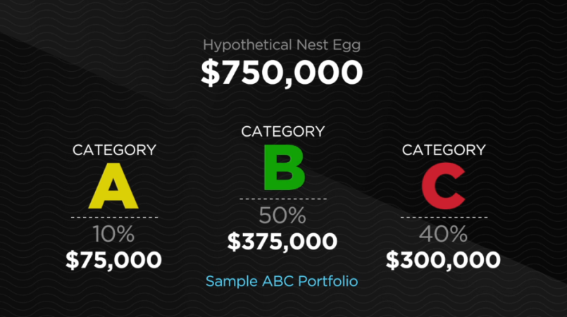
ABC Video as Review
Notes:
Let’s review: Show the ABC concept DVD

Slide 57
Understanding annuities
Green Money Premium
Notes:
Green Money Premium
In the investing community, the term Fixed Income Asset can refer to a number of financial vehicles like Asset Backed Securities and even Derivatives. The most common Fixed Income Asset is a Bond. Choosing the right assets for Column B is crucial to a balanced, conservative portfolio. Assets should have what you think they should have, if you choose the right ones. You should gain security through the one element most investors think of when they hear the word “fixed” as it relates to an asset, which is protection of your principal. So, let’s use the term Fixed Principal Asset to describe the financial vehicles we will use in Column B.

Slide 58

Fixed Income or Fixed Principal Assets?
What are Fixed Income Assets?
Do Fixed Income Assets have Protection of Principal?
Have you or anyone you know ever lost money in bonds?
What is a ‘Bond Bubble’?
p. 33
Notes:
Fixed Income or Fixed Principal Assets?
What are Fixed Income Assets?
Do Fixed Income Assets have Protection of Principal
Have you or anyone you know ever lost money in bonds?
What is a ‘bond bubble’?
In the investing community, the term Fixed Income Asset can refer to a number of financial vehicles like Asset Backed Securities and even Derivatives. The most common Fixed Income Asset is a Bond. This illustrates how disconnected Wall Street is from Main Street. When Wall Street uses the term Fixed Income Asset, the average person believes their principal is guaranteed. In fact, a bond IS a fixed income asset because the phrase refers to the “income” being fixed. However, people don’t hear “fixed income,” they hear “fixed” and believe their principal is protected when in reality it isn’t.
This may come as a surprise to some, but bonds can lose value. Just ask those who held ENRON bonds, WorldCom bonds, Lehman Brothers, or Bear Stearns bonds. If you are holding California bonds you might be just a little nervous, too. You are told that if you hold the bond till maturity you will get your money back. There are NO GUARANTEES!
Choosing the right assets for Column B is crucial to a balanced, conservative portfolio. Assets should have what you think they should have, if you choose the right ones. You should gain security through the one element most investors think of when they hear the word “fixed” as it relates to an asset, which is protection of your principal. So, let’s use the term Fixed Principal Asset to describe the financial vehicles we will use in Column B.
Is Protecting Your Principal, or some of your Principal, important to you?

Slide 59

Is Protecting Your Principal, or some of your Principal, important to you?
Notes:
Let the audience discuss the question.

Slide 60
Three Green Money Rules:
Green Money Rule #1:
It Protects Your Principal
Green Money Rule #2:
It Protects Your Gains
Green Money Rule #3:
It Protects Your Income
  7.3 How do the Green Money Rules help when forming a balanced, conservative portfolio?
p. 34
Notes:
Three Green Money Rules for Choosing Assets in Column B
Green Money Rule #1: Protect Your Principal
Any asset in this category must have protection of principal if you follow the asset’s rules. In other words, if you stay to term you must be guaranteed your principal in return.
Green Money Rule #2: Protect Your Gains
Over the contract term any gains you receive in this asset class are secured, unless of course you decide to withdraw the dollars and spend them.
Green Money Rule #3: Protect Your Income
Assets in Column B must have the ability to guarantee income in some manner.
It’s a common misconception amongst investors that Bonds would fit in Column B. They don’t. The reason is simple. There are no bonds that obey all three Green Money Rules! They are not who we thought they were! Bonds belong in Column C.
There is an asset that obeys all three rules. It is a Fixed Indexed Annuity (FIA) or even just a Fixed Annuity. An Indexed Annuity is a contract with an insurance company for an income, funded by an initial premium, whose interest is linked in some manner to an index in the stock or bond market. Principal is guaranteed, gains are retained, and an income stream is guaranteed in the form of an annuity payment or guaranteed withdrawal benefits.

Slide 61
Types of ‘Green Money’ Assets
What is an Annuity?
“An annuity, technically, is a contract with an insurance company for an income payment either now or in the future. The word annuity means “payment.”
  “Bat-Socks, Vegas & Conservative Investing” by David P. Vick
p. 35
Notes:
“An annuity, technically, is a contract with an insurance company for an income payment either now or in the future. The word annuity means “payment.” It’s all about the payments to you! If the payment is now, the annuity is called an “immediate annuity.” If the income payment to you is in the future, then the annuity is called a “deferred annuity” because the payment is deferred. It can be a Single Premium Deferred Annuity (SPDA) or a Flexible Premium Deferred Annuity (FPDA). You can purchase the annuity with a single lump sum as in a SPDA or make premium payments in a FPDA. By the way, they call the deposits into an annuity “premiums” because you are purchasing a guaranteed payment. They don’t call them deposits as in a Certificate of Deposit or an investment as in a stock or mutual fund.
For our purposes in Column B Green Money strategies, we will only be talking about Deferred Annuities. Remember, this is an annuity where your payment from the insurance company is deferred until you choose to receive it.”

Slide 62
Types of ‘Green Money’ Assets
What is an Annuity?
Different types of annuities:
Immediate Annuity
Deferred Annuity
Single Premium Deferred Annuity (SPDA)
Flexible Premium Deferred Annuity (FPDA)
Fixed Annuity
Fixed Indexed Annuity
Variable Annuity
p. 35
Notes:
Take some time to discuss each.
An annuity, technically, is a contract with an insurance company for an income payment either now or in the future. The word annuity means “payment.” It’s all about the payments to you! If the payment is now, the annuity is called an “immediate annuity.” If the income payment to you is in the future, then the annuity is called a “deferred annuity” because the payment is deferred. It can be a Single Premium Deferred Annuity (SPDA) or a Flexible Premium Deferred Annuity (FPDA). You can purchase the annuity with a single lump sum as in a SPDA or make premium payments in a FPDA. By the way, they call the deposits into an annuity “premiums” because you are purchasing a guaranteed payment. They don’t call them deposits as in a Certificate of Deposit or an investment as in a stock or mutual fund.
For our purposes in Column B Green Money strategies, we will only be talking about Deferred Annuities. Remember, this is an annuity where your payment from the insurance company is deferred until you choose to receive it.

Slide 63
Types of ‘Green Money’ Assets
Variable Annuities
Offers market returns with some protections.
“…the variable annuity puts the risk of the principal on the investor, while the fixed annuity puts the risk on the insurance company.”
  “Bat-Socks, Vegas & Conservative Investing” by David P. Vick
p. 35
Notes:
“…the variable annuity puts the risk of the principal on the investor, while the fixed annuity puts the risk on the insurance company.”

Slide 64
Types of ‘Green Money’ Assets
Variable Annuities
“The company offers you the option to choose from a varied amount of side accounts which are much like mutual funds. In fact, though they are not technically mutual funds,…You will pay management fees inside these funds along with other fees and expenses typical of variable annuities. These expenses range from 1.25% to 5% depending on the amount of options you choose for your variable annuity.”
  “Bat-Socks, Vegas & Conservative Investing” by David P. Vick
p. 36
Notes:
Read slide
When you purchase a variable annuity, your premiums go into a fund at the insurance company. The company offers you the option to choose from a varied amount of side accounts which are much like mutual funds. In fact, though they are not technically mutual funds, they are managed by the same managers and are after the same results. You might have portfolio options like American Funds, T. Rowe Price, Janus, Fidelity, ING, etc. They would typically give you a range of fund strategies from Growth to Value, and Emerging Markets to Domestic, and even some Bond Funds. You will pay management fees inside these funds along with other fees and expenses typical of variable annuities. These expenses range from 1.25% to 5% depending on the amount options you choose for your variable annuity.

Slide 65
Types of ‘Green Money’ Assets
Variable Annuities
Sample variable annuity expenses:
M&E Charges 1.25%
Enhanced Death Benefit .75%
Income Benefit .75%
Fund Management Fees .65%
Total 3.4%
  “Bat-Socks, Vegas & Conservative Investing” by David P. Vick
p. 36
Notes:
When you purchase a variable annuity, your premiums go into a fund at the insurance company. The company offers you the option to choose from a varied amount of side accounts which are much like mutual funds. In fact, though they are not technically mutual funds, they are managed by the same managers and are after the same results. You might have portfolio options like American Funds, T. Rowe Price, Janus, Fidelity, ING, etc. They would typically give you a range of fund strategies from Growth to Value, and Emerging Markets to Domestic, and even some Bond Funds. You will pay management fees inside these funds along with other fees and expenses typical of variable annuities. These expenses range from 1.25% to 5% depending on the amount options you choose for your variable annuity.
For instance, you will always have what’s called a Mortality and Expense Fee (M&E) of around 1.15% to 1.5%. These fees pay for the death benefit and general expenses inside the annuity that an insurance company incurs. Add to that an enhanced death benefit that guarantees not only your deposit, but increases your benefit to heirs in some manner. The cost varies, but might be .75%. Then you might want to choose a popular guaranteed income option or withdrawal benefit. These options might cost an additional .75%. If you add up where we are so far it looks like this:
M&E Charges 1.25%
Enhanced Death Benefit .75%
Income Benefit .75%
Fund Management Fees .65%
Total 3.4%
You can see how these expenses might add up rather quickly as they provide increasing benefits. Also, because it’s a variable annuity, your account statements will fluctuate and you can lose principal. Your potential for a higher gain than a traditional fixed annuity is greater, yet your exposure is more significant.”
“…it is definitely not a Column B Green Money Asset. It breaks Rule #1, Protect Your Principal. So, if you are going to use it, you should think of it as a Column C Red Money asset.”
While variable annuities are a risk oriented asset they can also provide some income and death benefit protections that other securities can’t.

Slide 66
Types of ‘Green Money’ Assets
Fixed Annuities
“…the main characteristic of a Fixed Annuity is the protection of your principal…The insurance company in a traditional fixed annuity announces the interest it will credit for the year in advance, much like a bank announces its interest rate on CD’s. It is compounded and tax-deferred...”
  “Bat-Socks, Vegas & Conservative Investing” by David P. Vick
p. 36
Notes:
“Cleary then, the main characteristic of a Fixed Annuity is the protection of your principal. How then does a fixed annuity gain in value? Unlike a Variable Annuity, a Fixed Annuity guarantees principal and credits interest to your account, normally on an annual basis. It’s this interest crediting that separates traditional fixed annuities from fixed indexed annuities.
“The insurance company in a traditional fixed annuity announces the interest it will credit for the year in advance, much like a bank announces its interest rate on CD’s. It is compounded and tax-deferred. The subtle contrast in an indexed annuity is how the company determines the amount of interest to credit. An indexed annuity’s interest rate is tied to an index such as the S&P 500. If the index goes up, the owner of the annuity is credited with a portion of the increase in the index and those gains are retained in the contract. If the index goes down, both the principal and previous years gains are retained, and the owner of the annuity loses no ground.”

Slide 67
Types of ‘Green Money’ Assets
Fixed Indexed Annuities
“An indexed annuity’s interest rate is tied to an index such as the S&P 500. If the index goes up, the owner of the annuity is credited with a portion of the increase in the index and those gains are retained in the contract. If the index goes down, both the principal and previous years gains are retained, and the owner of the annuity loses no ground.”
  “Bat-Socks, Vegas & Conservative Investing” by David P. Vick
p. 36
Notes:
Read slide

Slide 68
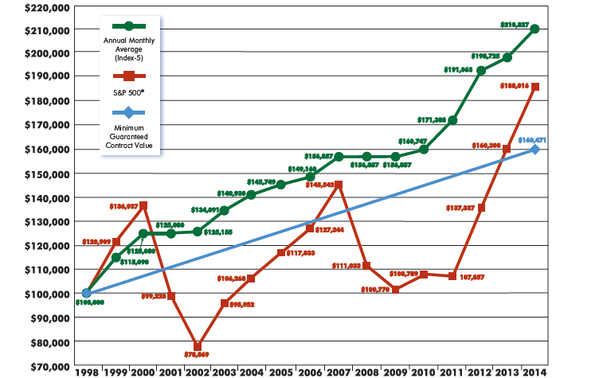
Actual FIA Historical Performance*
Fixed Index Annuity
*DISCLOSURE: This is a Hypothetical Graph that reflects the actual interest crediting methods used by a specific insurance company from a time period beginning 09/30/1998 and ending on 09/30/2014. Individual results may vary and be dependent upon crediting methods, caps and participation rates. This is for illustration purposes only to show how a Fixed Index Annuity may have performed over a specific period of time.
Notes:
Work through the Real Benefits slide as an illustration, highlighting the “bubbles” of the market and how the annuity performed.

Slide 69
FIA CREDITING METHODS
Annual Point to Point with a Cap
Annual Point to Point with Participation Rate
Annual Point to Point with a Spread
Monthly Point to Point with a Cap
Monthly Average with a Cap or Participation Rate
Multi-Year with a Mix of Interest and Percent of the Market
p. 37
Notes:
How Does an FIA Credit Interest?
“Indexed Annuities have a wide range of options the contract owner can select from to link the interest rate to the market. These options are called “crediting methods” and can usually be changed annually. The owner of the contract selects which crediting option or options they want to use each year, deciding what percent of the total account value to put into each crediting method. Somewhere around the anniversary date, the insurance company allows the owner to change the allotment of values in the crediting options.”
Below is a sample of Index Annuity crediting methods:
Fixed Rate – Indexed annuities usually carry an option of a one year fixed interest rate. They announce the rate each year and also have a minimum guaranteed rate this strategy can never go under.
S&P 500 Annual Point to Point with a Cap – In this method, the interest is tied to the S&P 500 for the contract year and is given a cap on how much interest can be credited. The “point” referred to is the anniversary date of the contract. So, between the first anniversary date (point #1) and twelve months later (point #2), the insurance company looks at how the S&P 500 performed.
For example, if the market moved 10% in a year with a 5% Cap you would receive a 5% interest credit. In other words you would get 100% of the upward movement in the market up to 5%. If the market goes up 5% you get 5%. If it goes up 20% you get 5%. It’s important to note that caps can change and they usually come with contractual minimum guaranteed caps. For instance, the lowest cap the insurance company can use for the year might be 1.5%.
One of the most attractive features of this type of indexed crediting is the company will reset the point at where the annuity calculates the interest each year. So, if the S&P 500 Index was at 1000 on your first anniversary date, the company would use that number as the starting point to figure that year’s interest. If the index finished the year below 1000, say 850, your annuity would “reset” the starting point to 850 and calculate from there for the following year. In that way you are only looking at individual anniversary years rather than trying to beat the annuity’s first year starting point five years down the road. This function is called “annual reset” and works in the favor of the contract holder.
Imagine if you didn’t have this feature in your indexed annuity, and had to rely on a ten-year window. If that had happened from 2000 to 2010 you would have had virtually no gain in your asset! So, annual reset or even bi-annual reset is an incredible feature.
S&P 500 Annual Point to Point with a Participation Rate – This option is a take on the first method, but instead of using a cap the company will issue a rate at which your contract can “participate” in the gain of the market. So, if you have a 50% participation rate and the market went up 10%, you would receive 5%, if it went up 20% you would receive 10%. Again the insurance company has a minimum guaranteed participation rate at which they can never go lower.
S&P 500 Monthly Point to Point with a Cap – Here is a variation of annual point to point with the insurance company looking at individual months to determine the gain in your contract rather than years. The company will issue a cap on each month at the beginning of the contract year. They will then look at each month individually, adding them up at the end of the year to determine the rate of return. It is important to know that the Cap is an “upside” cap. There is no downside cap. Let me illustrate. Assuming a monthly cap of 2% let’s look at a 12-month cycle:
S&P Monthly Point to Point with Cap Example:
Contract S&P500 Annuity
Month Return Percent
1 2% 2%
2 3% 2%
3 1% 1%
4 -3% -3%
5 0% 0%
6 -1% -1%
7 1% 1%
8 2% 2%
9 5% 2%
10 1% 1%
11 3% 2%
12 0% 0%
Total 14% 9%
Notice in the graph above that in months 2, 9, and 11 the market went up more than 2% and the annuity was only credited with the 2%. Actually, it wasn’t credited during the year. The company waits to total the numbers until the end of the year and then credit the interest to the contract. In year 4 the market went down more than the 2% cap and the whole negative number was put into the equation. If this ever created a situation where at the end of the year the total was negative, the annuity would get 0%. This is good if the market actually had a down year and you didn’t lose anything, yet it can also create a lower return in a year that has a significant volatility between the months that wipes out gains for the year. This method has the potential to credit much higher gains in a market trending upward, but can create zeros in volatile years. When the market has a down year, Zero is your Hero!
S&P 500 Monthly Average with a Cap or Participation Rate - As illustrated with the first two crediting methods, this method uses a cap and/or a participation rate. Yet, different from the monthly point to point, it averages the twelve months between anniversaries. If the market is really hot in the first three quarters yet suffers losses in the last quarter, this method saves the year. Very simply, the insurance company keeps a record of the percentages of the movement in the market on a monthly basis, then divides by 12, applies the cap or participation rate for the final result. This is historically the least effective method.
Multi-Year with a Mix of Interest and a Percentage of the Market – One of the great innovations in the indexed annuity business is the invention of a new multi-year strategy that combines a percentage of the market with an interest rate. This is one of the few index annuities that charge a fee, but the fee is different than the fees on a variable annuity. The difference is the variable annuity charges fees regardless of annual performance and is on the entire account value. This indexed annuity has fees only on the gain in the annuity. If there’s no gain there’s no fee. The back testing on these types of annuities has been very promising. They are popular because of their innovation and fewer moving parts.
While Multi-Year annuities don’t make use of an “annual reset” feature, they usually offer a two to five year reset period. Purchasing two to five year options in the market are generally less expensive than shorter term options. Thus the insurance company has the ability to pass through more interest to the contract holder.
Other crediting methods include the use of additional indexes such as the Dow Jones Industrial Index, Russell 2000, S&P MidCap 400, EuroDow, Hang Seng (China) Index, US Treasury, Barclay’s Aggregate Bond Index, as examples. Companies use one, two, and three year monthly point to point strategies, multi-year monthly averaging, high water mark, and vesting schedules as alternatives for crediting methods. An excellent resource for researching crediting methods is Jack Marrion’s website www.IndexAnnuity.org. He lists various companies and their current rates.”
Annual Point to Point with a Spread – This option is similar to the Annual Point to Point with a cap, but instead of using a cap the company will issue a “spread” which is a rate you subtract from the total return of the index you are linked to. So, if you have a 2% Spread and your index goes up 8% for the year, you would simply subtract the 2% Spread from the index return, resulting in a 6% interest credit for the year. While Spread rates can change, the insurance company has a minimum guaranteed Spread rate at which they can never go higher.
Any Fees in FIA’s?
“…the cost is accounted for internally within the insurance company in most cases. Some of the newer versions of multi-year crediting methods come with fees on the gains as mentioned above, but other than that the only fees associated with indexed annuities are related to added benefits such as income riders. There are no mortality and expense fees or enhanced death benefit fees in most index annuities.”
“First, the money you put into an indexed annuity with an insurance company is generally invested in high grade bonds, mostly government bonds. These bonds pay an interest rate to the insurance company. Let’s say the bond yields 6%. The insurance company takes a portion of the interest for its profit and expenses and then there is what’s called “excess interest.
In an indexed annuity, the excess interest is invested in call options in the market index related to the annuity crediting method chosen. Call options are contracts that give the holder the right to buy a security at a specified time in the future. The call option is valuable if the security it’s tied to goes up and worthless if it goes down in the contracted time frame. This process allows the insurance carrier to build in profit, pay for costs such as an agent, and provide an attractive benefit to the contract holder.”
How About Liquidity?
“If the benefit of an indexed annuity is a potential for a higher gain than other fixed assets then the drawback is its long term nature. In order for the insurance company to create a win-win situation for themselves and the client, the money has to stay put for a while so the underlying investments have time to work the way they are designed. This is the reason that annuity companies have surrender penalties associated with early withdrawals. These surrender penalties usually decline on an annual basis, say over a 5 to 10 year period. There are annuities with longer surrender periods.
Remember, these penalties are for any monies liquidated in excess of the penalty free withdrawal options or for total early withdrawal. Early withdrawal means you might have had an annuity with ten years of declining surrender penalties and totally liquidated in the third year, thus creating a penalty. A ten-year declining surrender period might start with a ten percent penalty in the first year and decline one percent a year for ten years. In the eleventh year you could withdraw all the money in your annuity without any penalty.”
“…most indexed annuities have the ability for the contract holder to withdraw 10% of the cash value on an annual basis through penalty free withdrawals. The companies also provide the availability for annuity payment options at certain points over the contract years. That means you can turn the asset into a guaranteed income stream that you can’t outlive.”

Slide 70
Additional FIA Points
Diversified Portfolio of FIAs
Two reasons why diversifying FIAs could be a good idea?
We don’t know which index will perform better in any given year.
We don’t know which crediting method will perform better in any given year.
p. 38
Notes:
A good strategy to consider when using FIAs in retirement planning is to make use of multiple contracts with different companies to diversify crediting methods, indexes, and strengths of various carriers.
Two reasons why diversifying FIAs could be a good idea?
We don’t know which index will perform better in any given year.
We don’t know which crediting method will perform better in any given year.
While carriers provide differences in indexes that can include “volatility control” or stocks/bonds, precious metals, and more, you might also want to consider the following:
Strength of the carriers
American Company or Foreign Domiciled
Length of contracts
Quality of home office service
Guaranteed Withdrawal Benefits
Additional riders for Long Term Care & Terminal Illness
Death Benefits
All of these differences in contracts, companies and crediting can be a benefit when you use a diversified portfolio of FIAs, rather than a single contract. Of course, there are benefits to a single contract as well, like simplicity and receiving statements from one source. After all, the older we get the more we tend to forget.

Slide 71
Additional FIA Points
Diversified Portfolio of FIAs (p. 62)
While carriers provide differences in indexes that can include “volatility control” or stocks/bonds, precious metals, and more, you might also want to consider the following:
Strength of the carriers
American Company or Foreign Domiciled
Length of contracts
Quality of home office service
Guaranteed Withdrawal Benefits
Additional riders for Long Term Care & Terminal Illness
Death Benefits
p. 38

Slide 72
Additional FIA Points
Planning for Income - Pension Payments
There are two ways to get money out of an annuity. You either “annuitize” or “withdraw.” The major difference is what happens to the account value when you choose either of these two options.
p. 39
Notes:
Planning for Income with an Indexed Annuity
“Income guarantees are the latest phase of indexed annuity innovation. Companies seem to be coming out with new guaranteed income or withdrawal benefits every month.”
“Basically, there are two ways to get money out of an annuity. You either “annuitize” or “withdraw.” The major difference is what happens to the account value when you choose either of these two options. You could probably understand annuitization best if you think of it as a pension payment. When you retire from a company, sometimes you are offered a choice between a lump sum and a monthly payment. If you take the lump sum, you receive a one-time cash payment of your retirement benefits from that company, and typically you invest it to create the income you desire. Yet, if you opt for the pension payments your company will send you a monthly check for the rest of your life or for the rest of you and your spouse’s lives in some manner.”
“You can receive payments guaranteed in various manners from an annuity. A common falsehood propagated by an uneducated press is once you choose payments from an annuity company and die, say after just two payments, the company will keep the rest of your money. While this is one option in an annuity contract (called “life only”), it is certainly not the only option and is definitely the least used for obvious reasons.”
“You can choose a joint-life option for you and your wife, which creates a payment for the both of you until…well, you know... you expire. You can even choose to have a certain amount of years guaranteed in addition to payments for the rest of your life. For example, you may want to guarantee payments for the first 10 years to you or your heirs. If you lived past the ten years, you would receive payments for as long as you live. You could guarantee payments for not only the first 10 years, but 15, 20, or more years. This method is called “life with a ten-year certain” or “20-year certain and life.” Keep in mind that the more you have the company guarantee, the smaller the payments. That’s why “life only” payments get chosen because they are usually the highest dollar amount.”

Slide 73
Additional FIA Points
Guaranteed Withdrawal Benefits
Accumulation Value
The current value of your annuity’s cash account which includes any bonus and all interest credits to date, less any withdrawals.
Income Account Value
The current value of your annuity’s income account which includes any bonus and all interest credits to date, less any withdrawals. Note: there is no cash value here.
p. 39
Notes:
Guaranteed Withdrawal Benefits
“…probably the cutting edge of annuity development are the “Guaranteed Income Benefits” or “Guaranteed Withdrawal Benefits.” These offer the best of both worlds, the availability of your cash account to stay liquid and a guaranteed income stream. Here’s how it works.
First, you need to understand that insurance companies have the ability to account for the money in your contract in various ways, at the same time. Here are a few examples of accounts in a typical indexed annuity:
Accumulation Value
The current value of your annuity’s cash account which includes any bonus and all interest credits to date, less any withdrawals.
Income Account Value
The current value of your annuity’s income account which includes any bonus and all interest credits to date, less any withdrawals. Note: there is no cash value here.

Slide 74
Additional FIA Points
Guaranteed Withdrawal Benefits
Current Surrender Value
The current value of your annuity’s cash account which includes any bonus and all interest credits to date, less any withdrawals, and minus any surrender charges that would apply if you chose to liquidate.
Guaranteed Minimum Surrender Value
The current value of your annuity’s cash account which includes any bonus and the minimum guaranteed interest credits to date, less any withdrawals, and minus any surrender charges that would apply if you chose to liquidate.”
p. 39
Notes:
Current Surrender Value
The current value of your annuity’s cash account which includes any bonus and all interest credits to date, less any withdrawals, and minus any surrender charges that would apply if you chose to liquidate.
Guaranteed Minimum Surrender Value
The current value of your annuity’s cash account which includes any bonus and the minimum guaranteed interest credits to date, less any withdrawals, and minus any surrender charges that would apply if you chose to liquidate.”
What are the two main differences between the Accumulation Value and the Income Account Value?

Slide 75
Additional FIA Points
Guaranteed Withdrawal Benefits
Guaranteed Withdrawal Percentage:
Ages 60 – 69 4-5%
Ages 70 – 79 5-6%
Ages 80 & up 6-7%
Disclosure: Past performance is no guarantee future results. Crediting rates including caps for FIA’s can change and are determined by the insurance companies at the time of issue. Future performance cannot be predicted or guaranteed. FIA’s are not registered as a security with the SEC and is not invested directly in any stock, bond, or security investment. FIA products, features, and benefits vary by state.
Annuity Contracts are products of the insurance industry and are not guaranteed by any bank or insured by the FDIC. When purchasing a fixed indexed annuity, you own an annuity contract backed by the insurance company, you are not purchasing shares of stocks or indexes. Product features such as interest rates, caps, and participation rates may vary by product and state and may be subject to change. Surrender charges may apply for early withdrawals. Be sure to review the specific product disclosure for more details. Guarantees are based on the financial strength and claims paying ability of the insurance company.
This information is not intended to give tax, legal, or investment advice. Please seek advice from a qualified professional on these matters.
Lifetime income benefit riders are used to calculate lifetime payments only. The income account value is not available for cash surrender or in a death benefit. Excess withdrawals may reduce lifetime income and may incur surrender charges. Fees may apply. Guarantees based on the financial strength and claims paying ability of the insurance company. See specific product disclosure for more details.
Notes:
“An insurance company utilizing a guaranteed withdrawal benefit (GWB) offers a rider, (an amendment to your contract), which you can choose to accept or reject. These riders come with fees so you surely want the option to choose. The rider has two elements. It comes with a guaranteed interest rate and a guaranteed withdrawal percentage. The interest rate is credited to your initial premium and bonus each year for a declared number of years. This interest rate will increase your “income account value” only, and not your “accumulation value.” In other words, it is not for cash value growth, but rather calculates the account value from which you may withdraw a guaranteed amount.
The withdrawal percentage is also guaranteed in your rider. It may range from 3% to 7%, depending on your age. In other words, you are guaranteed a lifetime of withdrawals based on the percentage stated at the age you choose to start withdrawals. For instance, the guaranteed income account growth rate might be 6.5%, and if you were to withdraw funds starting at age 70 you would be able to withdraw 5% of the accrued value. Some companies now offer inflation protection on the withdrawals, increasing them by 3% per year or some other formula for the growth of the withdrawal. Typically the withdrawal percentages increase with age, as illustrated below, and are different for each company:
Guaranteed Withdrawal Percentage:
Ages 60 – 69 4-5%
Ages 70 – 79 5-6%
Ages 80 & up 6-7%
Let’s combine the guaranteed growth rate and the guaranteed withdrawal percent to see how it works:

Slide 76
Additional FIA Points
Guaranteed Withdrawal Benefits
Guaranteed Withdrawal Benefit (GWB) Example:
Guaranteed Income Account Growth Rate: 6.5%
Bonus: 8%
Premium: $100,000
Age at Issue: 60
Age Withdrawals Chosen: 70
Guaranteed Withdrawal Percent: 6%
Income Account Value: $202,731
Guaranteed Annual Withdrawal Benefit: $12,164
Notes:
Guaranteed Withdrawal Benefit (GWB) Example:
Guaranteed Income Account Growth Rate: 6.5%
Bonus: 8%
Premium: $100,000
Age at Issue: 60
Age Withdrawals Chosen: 70
Guaranteed Withdrawal Percent: 6%
Income Account Value: $202,731
Guaranteed Annual Withdrawal Benefit: $12,164
The $12,164 annual withdrawal is guaranteed for life, no matter what happens to the accumulation value, which by the way would continue to earn interest credits attached to the indexes chosen. In order to match this feat, you would have to find an asset that returned a shade over 7.7% every year for the rest of your life, assuming a 15% net tax rate! That’s the incredible power of a guaranteed withdrawal benefit”
In what ways would you see a GWB enhancing your retirement strategies?
How would you explain the Green Money Column B to a friend?
Disclosure: Past performance is no guarantee future results. Crediting rates including caps for FIA’s can change and are determined by the insurance companies at the time of issue. Future performance cannot be predicted or guaranteed. FIA’s are not registered as a security with the SEC and is not invested directly in any stock, bond, or security investment. FIA products, features, and benefits vary by state.
Annuity Contracts are products of the insurance industry and are not guaranteed by any bank or insured by the FDIC. When purchasing a fixed indexed annuity, you own an annuity contract backed by the insurance company, you are not purchasing shares of stocks or indexes. Product features such as interest rates, caps, and participation rates may vary by product and state and may be subject to change. Surrender charges may apply for early withdrawals. Be sure to review the specific product disclosure for more details. Guarantees are based on the financial strength and claims paying ability of the insurance company.
This information is not intended to give tax, legal, or investment advice. Please seek advice from a qualified professional on these matters.
Lifetime income benefit riders are used to calculate lifetime payments only. The income account value is not available for cash surrender or in a death benefit. Excess withdrawals may reduce lifetime income and may incur surrender charges. Fees may apply. Guarantees based on the financial strength and claims paying ability of the insurance company. See specific product disclosure for more details.

Slide 77
Disclosure
Disclosure: Past performance is no guarantee future results. Crediting rates including caps for FIA’s can change and are determined by the insurance companies at the time of issue. Future performance cannot be predicted or guaranteed. FIA’s are not registered as a security with the SEC and is not invested directly in any stock, bond, or security investment. FIA products, features, and benefits vary by state.
Annuity Contracts are products of the insurance industry and are not guaranteed by any bank or insured by the FDIC. When purchasing a fixed indexed annuity, you own an annuity contract backed by the insurance company, you are not purchasing shares of stocks or indexes. Product features such as interest rates, caps, and participation rates may vary by product and state and may be subject to change. Surrender charges may apply for early withdrawals. Be sure to review the specific product disclosure for more details. Guarantees are based on the financial strength and claims paying ability of the insurance company.
This information is not intended to give tax, legal, or investment advice. Please seek advice from a qualified professional on these matters.
Lifetime income benefit riders are used to calculate lifetime payments only. The income account value is not available for cash surrender or in a death benefit. Excess withdrawals may reduce lifetime income and may incur surrender charges. Fees may apply. Guarantees based on the financial strength and claims paying ability of the insurance company. See specific product disclosure for more details.
Notes:
Disclosure: Past performance is no guarantee future results. Crediting rates including caps for FIA’s can change and are determined by the insurance companies at the time of issue. Future performance cannot be predicted or guaranteed. FIA’s are not registered as a security with the SEC and is not invested directly in any stock, bond, or security investment. FIA products, features, and benefits vary by state.
Annuity Contracts are products of the insurance industry and are not guaranteed by any bank or insured by the FDIC. When purchasing a fixed indexed annuity, you own an annuity contract backed by the insurance company, you are not purchasing shares of stocks or indexes. Product features such as interest rates, caps, and participation rates may vary by product and state and may be subject to change. Surrender charges may apply for early withdrawals. Be sure to review the specific product disclosure for more details. Guarantees are based on the financial strength and claims paying ability of the insurance company.
This information is not intended to give tax, legal, or investment advice. Please seek advice from a qualified professional on these matters.
Lifetime income benefit riders are used to calculate lifetime payments only. The income account value is not available for cash surrender or in a death benefit. Excess withdrawals may reduce lifetime income and may incur surrender charges. Fees may apply. Guarantees based on the financial strength and claims paying ability of the insurance company. See specific product disclosure for more details.

Slide 78
In what ways would you think it is important to protect a portion of your assets or income?
Notes:
Discuss question with clients

Slide 79

Understanding growth assets
Red Money Investing
Notes:
“Red Money investing relies on forecasts, past correlations, analytical studies, common sense, and a little luck. If you are counting on fair weather, you may just get a hurricane instead. Red Money investing is where the weather of risk changes constantly. Column C is the only place where the clouds of market risk could blow in or the unseasonable heat and humidity of volatility might flare up.”
If you haven’t done so already, now would be a good time to take the Risk Tolerance Questionnaire found in the Appendix.

Slide 80
  “Hulbert’s data shows that
  more than 84 percent of mutual Funds underperform
  the market over a 5-year period. Over ten years, that number rises to 90 percent.”
Morningstar Publications
p. 42
Notes:
Read slide

Slide 81
Buy and Hold vs. Tactical Management
“There are two styles of management that you might choose from: tactical or “buy & hold.” Simply put, tactical management is active, daily management. In a “buy & hold” style, the manager chooses the sectors of the market, how much to weight each sector and then uses the best fund managers available.”
“Bat-Socks, Vegas & Conservative Investing” by David P. Vick
p. 42

Slide 82

What is Tactical
Tacking or coming about is a sailing maneuver by which a sailing vessel (which is sailing approximately into the wind) turns its bow through the wind so that the direction from which the wind blows changes from one side to the other.
p. 42

Slide 83
What is Tactical
Webster’s Definition of tactical
“2a : of or relating to tactics: as (1) : of or relating to small-scale actions serving a larger purpose (2) : made or carried out with only a limited or immediate end in view b : adroit in planning or maneuvering to accomplish a purpose”
p. 43

Slide 84
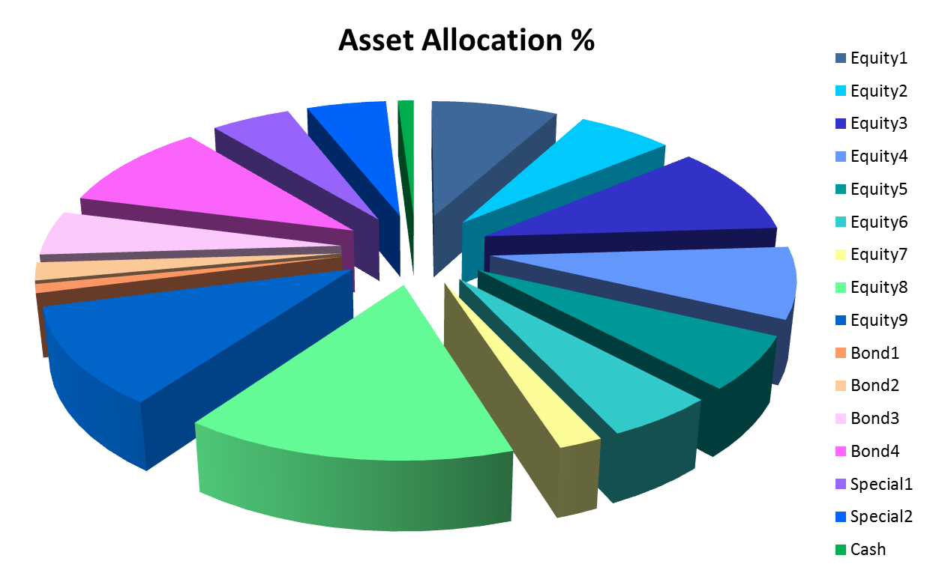
Strategic Allocation, Tactical Management
p. 43

Slide 85
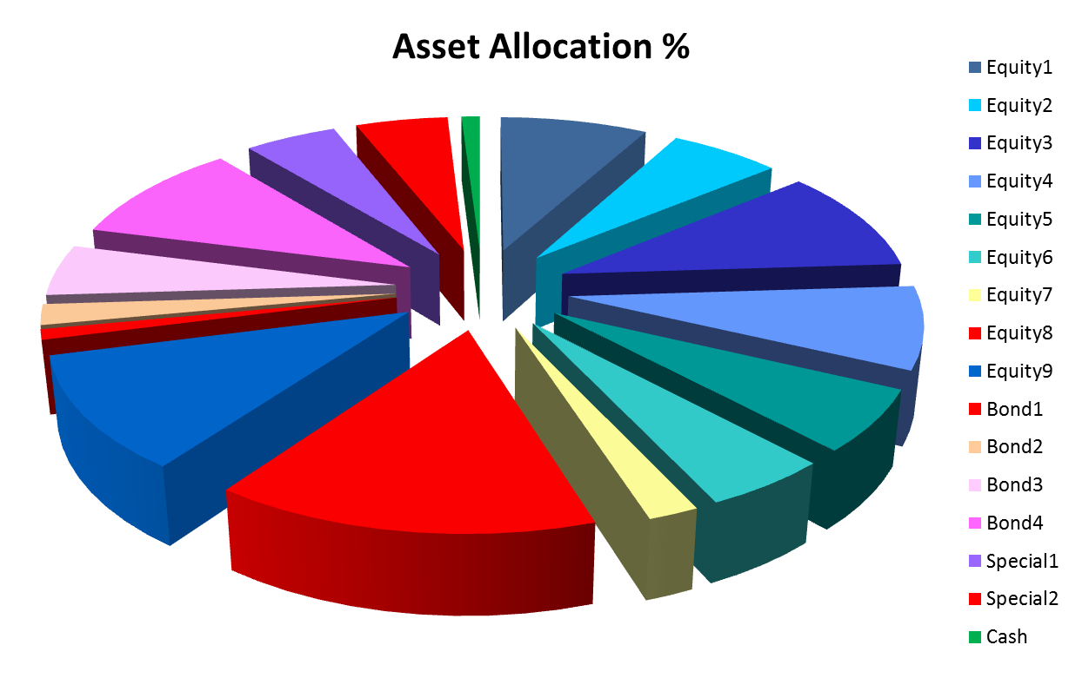
All in or all out signal

Slide 86
All in or all out signal

Slide 87
Tactical Management Style
How does tactical management differ from Buy and Hold’ Strategy?
Do you feel that Tactical Management may be the future of investing, as the author suggested?

Slide 88

Tactical Management Style
How does tactical management differ from Buy and Hold’ Strategy?
Do you feel that Tactical Management may be the future of investing, as the author suggested?
p. 44

Slide 89
Managing volatility in retirement
What if it happened again?
Notes:
What if the worst bear market in history happened again?
“What would the worst bear market in history do to your portfolio, which carries with it your lifestyle in retirement?”
Most would argue the worst bear market started with the Crash of 1929 and didn’t recover from its market high, until the fall of 1954 a 25-year bear.”
“It is generally accepted that a bear market is a 20% drop in the broad market indexes such as the Dow Jones Industrial Average or the S&P 500 over a two month period. Bear markets are a time of deep pessimism, falling stock prices, and usually high volatility. A bear is not to be confused with a correction. The correction is usually a short period of time, something less than two months, while a bear market is two months or longer. (1)
There were two very large and very long bear markets in the twentieth century. As I previously mentioned the 1929 crash which lasted to 1954, and then the 1965-1982 bear market. Most seniors remember both and boomers definitely remember the gas lines of the 70’s bear market. Russell Napier in his book The Anatomy of a Bear says on average every three years there’s a bear market, every eight years there’s a stinker of a bear market, and big bears last an average of 17 years. Napier also says the bear market that started in 2000 wouldn’t end until 2011-2014, probably closer to the latter, with the Dow at less than 5000. (2)”
“The way to make money is to buy when blood is running in the streets.”John D. Rockefeller” (3)

Slide 90
WHAT IF IT HAPPENS AGAIN?
“The way to make money is to buy when blood is running in the streets.” John D. Rockefeller
“We simply attempt to be fearful when others are greedy and to be greedy with others are fearful” Warren Buffett
p. 47

Slide 91
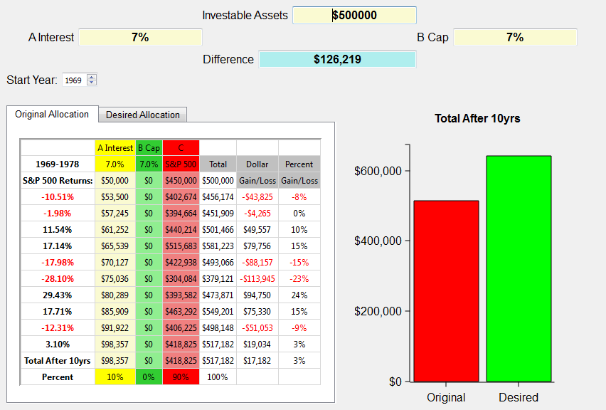
What if a bear market happens again? 1969 through 1978
p. 48
Notes:
The illustration above shows the S&P 500 returns for the years 1969 through 1978 on the left. The investible assets are $500,000. This example uses the same criteria for caps in the index annuities, but uses the 7% average CD rate for the decade. Wouldn’t you love that again! We use the broad market index to approximate what investing in the market in general was like over that period of time..
The chart shows at the end of the ten year period this investor would have gained a little over $17,000. Look at all the red years in that decade! 5 out of 10 years were negative!
So, let’s take a look at the ABC allotment.

Slide 92
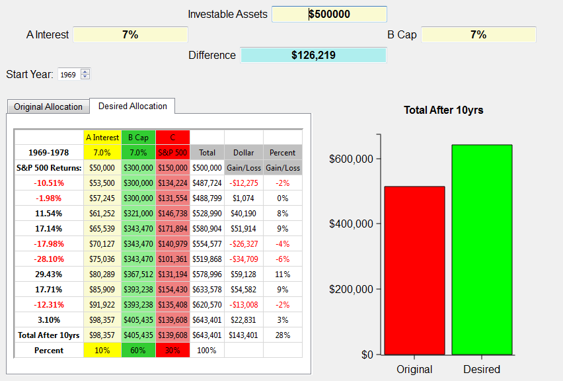
What if a bear market happens again? 1969 through 1978
$126,219
p. 48
Notes:
The ABC allotment of 10/60/30 grows to over $143,000, which is a $126,219 difference! That’s with 5 out 10 years negative! Very positive toward the ABC bear market strategy for retirement.
Now let’s take a look at a really nasty decade. One we’re all familiar with.
Next slide.

Slide 93
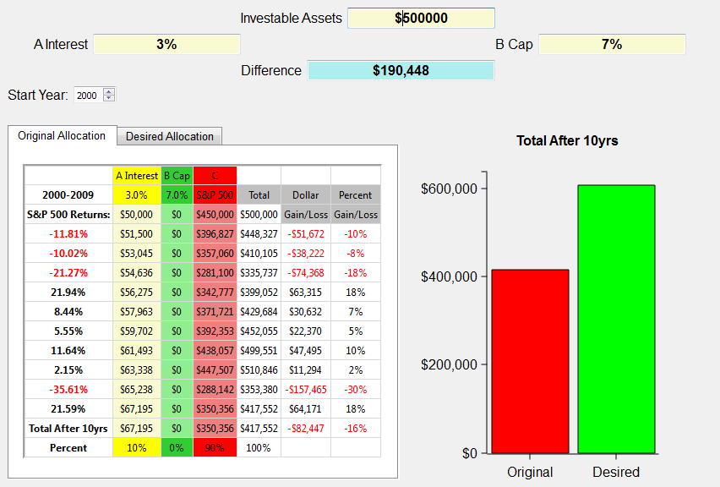
What if a bear market happens again? 2000 through 2009
p. 50
Notes:
The illustration above shows the S&P 500 returns for the years 2000 through 2009 on the left. The investible assets are $500,000. This example shows a typical investor who has about 10% in cash earning an average of 3% and 90% allocated to the market represented by the S&P 500. We use the broad market index to approximate what investing in the market in general was like over that period of time. Certainly an investor could have been in more or less risk than illustrated here. Yet, the illustration shows in general terms how the market performed from 2000-2009. Notice, there are no monies allocated to Column B, which are Index Annuities.
The chart shows at the end of the ten year period this investor would have lost close to $100,000. I don’t know about you, but a 20% loss in the market is devastating when it comes to retirement! Imagine if you were 52 years old in 2000 and planning to retire when most people retire at age 62. Would you do what many have had to do, which is work another 3-5 years in hopes of recovering those assets needed to retire?
And what if it happens again? What if the next ten years aren’t any better than this decade? Can you afford to lose another 20% or possibly more? Can you continue to push off your retirement indefinitely?
When I show this graph to clients they tell me, “Yep, that’s about what happened to us.” Yet, the same clients will surprisingly stay in this broken down Wall Street model attempting to recover with a hope and a prayer.
There has to be a better way, and I believe there is.
Next slide.

Slide 94
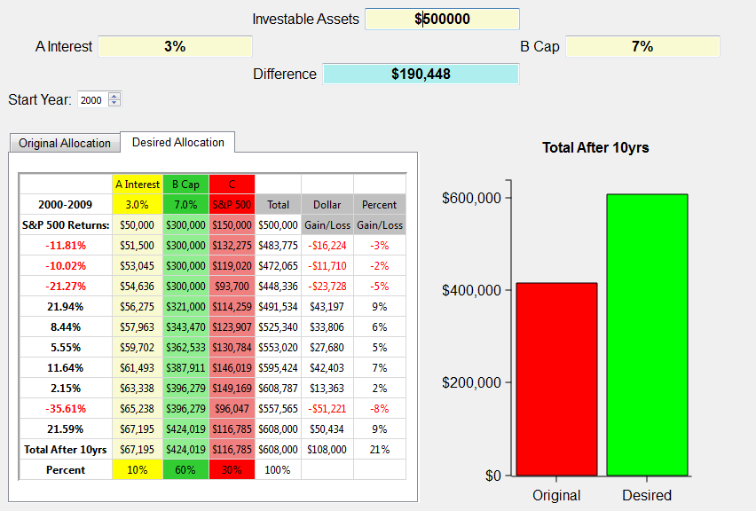
What if a bear market happens again? 2000 through 2009
  9.3 What if the next ten years saw a 20% loss in the market, how would it affect your retirement?
$190,448
p. 51
Notes:
Using the 10/60/30 ABC split, this person gains $108,000 instead of losing over $80,000! Now that’s a strategy that works for retirement years. IT does so because it obeys Warren Buffet’s first rule of investing, “Never lose any money.” BTW, that happens to be rules number 2 and 3 also. And it has to be true, especially for retirees or those heading into retirement.
Simply putting some of your money in the green money column protects you from those down years and now with the tremendous guaranteed income payouts the green money column is even more a must for retirees. We don’t want you to get totally out of the red, or growth money assets, but it’s obvious that the green money column is perfect for conservative clients looking for alternatives to Wall Street’s roller coaster rides.

Slide 95

Dave Vick Video:
What if we do it again?

Slide 96
Challenges to Retirement Income Planning
The Retirees Biggest Need:
Funding Your Quality of Life!
Notes:
The Biggest Need for Retirees:
Income Planning
“The concept of retirement in America grew out of the reforms made in the great depression; the most significant of course was Social Security. In 1933, Congress passed the Social Security bill that enabled people who were age 65 to receive income checks monthly from the government starting in 1935. It was originally intended as a supplement to income for the elderly, yet has turned into the major source of income for many retirees. It is interesting to note the average retirement age in 1910 was 74 years old, and the average in 2006 was age 62.

Slide 97
THE BIGGEST NEED… INCOME
“In 1933, Congress passed the Social Security bill that enabled people who were age 65 to receive income checks monthly from the government starting in 1935. It was originally intended as a supplement to income for the elderly, yet has turned into the major source of income for many retirees. It is interesting to note the average retirement age in 1910 was 74 years old, and the average in 2006 was age 62.”
“Bat-Socks, Vegas & Conservative Investing” by David P. Vick
p. 53
Notes:
Read slide

Slide 98
THE BIGGEST NEED… INCOME
According to government actuarial tables a male age 62 is expected to live to just about 83.9 years old. If he reaches 75 he’s expected to reach age 86.9, and if he reaches age 85 he’s expected to live until age 91.3. Women of those ages are expected to live another year and a half to two years longer than their male counter parts.
“Bat-Socks, Vegas & Conservative Investing” by David P. Vick
https://www.socialsecurity.gov/OACT/population/longevity.html
p. 53
Notes:
According to government actuarial tables a male age 62 is expected to live to just about 83.9 years old. If he reaches 75 he’s expected to reach age 86.9, and if he reaches age 85 he’s expected to live until age 91.3. Women of those ages are expected to live another year and a half to two years longer than their male counter parts. (2)

Slide 99

Dave Vick Video:
Accumulation vs. Distribution

Slide 100
Accumulation of $500,000
Inverse Returns Effect
Hypothetical Index - Beginning Value $500,000
Annual End of Year Inverse End of Year
Year Return Value Return Value
1 28% $640,000 -38% $310,000
2 -10% $576,000 -12% $272,800
3 15% $662,400 2% $278,256
4 17% $775,008 15% $319,994
5 1% $782,758 26% $403,193
6 26% $986,275 1% $407,225
7 15% $1,134,216 17% $479,453
8 2% $1,156,901 15% $547,921
9 -12% $1,018,073 -10% $493,129
10 -38% $631,205 28% $631,205
p. 54
Notes:
Retirement happens in thirds. Remember, with life expectancies for couples in retirement lasting 20 to 30 years you have to fund retirement for three decades to be safe. We are living longer and it doesn’t get any cheaper as time passes by. This makes it important to know the difference between investing for accumulation and investing for distribution.
To Illustrate, we have created a hypothetical 10-year market index. If you started in the first year with $500,000 and put that money in the sample index, at the end of 10 years you would have $631,205, assuming no withdrawals.
Question: If you inverted the index over the same 10-year period of time, so the 10th year return would flip to be the first year return, the 9th year would be the second year return and so on would the final dollar amount be the same? Now, most people when first asked this question intuitively say “no” thinking they would have to have a different number at the end of 10 years.
Wrong. The commutative principal of multiplication states that when multiplying numbers, you can put them in any order and the result will be the same (see illustration below).
Hypothetical Index -Beginning Value $500,000
Annual End of Year Inverse End of Year
Year Return Value Return Value
1 28% $640,000 -38% $310,000
2 -10% $576,000 -12% $272,800
3 15% $662,400 2% $278,256
4 17% $775,008 15% $319,994
5 1% $782,758 26% $403,193
6 26% $986,275 1% $407,225
7 15% $1,134,216 17% $479,453
8 2% $1,156,901 15% $547,921
9 -12% $1,018,073 -10% $493,129
10 -38% $631,205 28% $631,205

Slide 101
Income on $500,000
Inverse Returns Effect
Hypothetical Index - Beginning Value $500,000
Withdrawal $35,000 Inflation 3%
Annual Annual End of Year
Year Return Withdrawal Value
1 28% $35,000 $605,000
2 -10% $36,050 $508,450
3 15% $37,132 $547,586
4 17% $38,245 $602,430
5 1% $39,393 $569,062
6 26% $40,575 $676,443
7 15% $41,792 $736,118
8 2% $43,046 $707,795
9 -12% $44,337 $578,522
10 -38% $45,667 $313,017
p. 55
Notes:
Income on $500,000: Inverse Returns Effect
Starting again in the first year with the $500,000, let’s use the same 10-year hypothetical index returns, and account for an income stream for retirement. If we take out $35,000 a year and use a 3% rate of inflation, each year we would see the withdrawal grow to cover rising expenses until in the 10th year the withdrawal is $45,667. If we use the same index returns we end up with $313,017. Not bad! It seems to really work.
.
Hypothetical Index -Beginning Value $500,000
Withdrawal $35,000 Inflation 3%
Annual Annual End of Year
Year Return Withdrawal Value
1 28% $35,000 $605,000
2 -10% $36,050 $508,450
3 15% $37,132 $547,586
4 17% $38,245 $602,430
5 1% $39,393 $569,062
6 26% $40,575 $676,443
7 15% $41,792 $736,118
8 2% $43,046 $707,795
9 -12% $44,337 $578,522
10 -38% $45,667 $313,017
However, if we invert the returns again, so year 10 is now year one and so on, we run out of money in year eleven! That’s incredible isn’t it? One way it works for 10 years, but simply invert the numbers as below, and you run out of money in ten years. If you are retired, you are headed back to work!

Slide 102
Income on $500,000
Inverse Returns Effect
Hypothetical Index - Beginning Value $500,000
Withdrawal $35,000 Inflation 3%
Annual Annual End of Year
Year Return Withdrawal Value
1 -38% $35,000 $275,000
2 -12% $36,050 $205,950
3 2% $37,132 $172,938
4 15% $38,245 $160,633
5 26% $39,393 $163,004
6 1% $40,575 $124,060
7 17% $41,792 $103,358
8 15% $43,046 $75,816
9 -10% $44,337 $23,898
10 28% $45,667 -$15,078
p. 55-56
Notes:
Income on $500,000: Inverse Returns Effect
Starting again in the first year with the $500,000, let’s use the same 10-year hypothetical index returns, and account for an income stream for retirement. If we take out $35,000 a year and use a 3% rate of inflation, each year we would see the withdrawal grow to cover rising expenses until in the 10th year the withdrawal is $45,667. If we use the same index returns we end up with $313,017. Not bad! It seems to really work.
.
Hypothetical Index -Beginning Value $500,000
Withdrawal $35,000 Inflation 3%
Annual Annual End of Year
Year Return Withdrawal Value
1 28% $35,000 $605,000
2 -10% $36,050 $508,450
3 15% $37,132 $547,586
4 17% $38,245 $602,430
5 1% $39,393 $569,062
6 26% $40,575 $676,443
7 15% $41,792 $736,118
8 2% $43,046 $707,795
9 -12% $44,337 $578,522
10 -38% $45,667 $313,017
However, if we invert the returns again, so year 10 is now year one and so on, we run out of money in year eleven! That’s incredible isn’t it? One way it works for 10 years, but simply invert the numbers as below, and you run out of money in ten years. If you are retired, you are headed back to work!

Slide 103
Green Money Income Plans
Guaranteed Withdrawal Benefits

Slide 104

Income is Greater the Longer You Wait
$500,000
8% Bonus
6.5% GWB
10th Year Guaranteed Income Account: $1,013,654 (Pays out between $35,000 - $70,000 per year for Life)
p. 57
Notes:
Green Money Income Plans
Guaranteed Withdrawal Benefits – GWB are designed to provide a guaranteed income stream without Annuitization, thus providing more options during retirement. The example below shows a premium of $500,000 being put into an annuity with an 8% bonus and a 6.5% roll-up rate (income account growth rate IAGR). Remember, there is no cash in the income account, it is simply a calculator account used to determine a payment. In this case, depending on the age of the policy holder the payments would range from $35-$70,000.
Maximum Income, but Delayed?
$500,000
8% Bonus
6.5% GWB
10th Year Guaranteed Income Account: $1,013,654 (Pays out between $35,000 - $70,000 per year for Life)
Key Questions:
Is guaranteeing income important to you in retirement? Explain?
What do you like most about the Split Annuity concepts?
What do you like least about the Split Annuity concepts?

Slide 105
  Is guaranteeing income important to you in retirement? Explain?

Slide 106
Challenges with
401k plans
Understanding Your Options
Notes:
Challenges with 401k Plans: Understanding Your Options
A 401(k) plan is a great place to be while you’re employed, but once you retire or maybe a little before, it may be time to investigate other options.
While you are still working, and especially if your employer is matching your deposits or part of your deposits, a 401(k) plan is a great place to be. Once you retire, though, there might be some better options and even before you retire you may want to look at your alternatives. Let’s take a look at seven possible problems with 401(k) plans.

Slide 107
I Should Have Listened – Seven Problems with Your 401(k)
Problem #1 – Is your 401(k) compliant? Is it at risk by IRS Standards?
Problem #2 – Roth Accounts in a 401(k) have issues. Do you have a DRAC?
Problem #3 – Limited Choices. Does your plan have the choices you wish they had? What choices would you like to add to your plan? Are you confident in choosing assets? What’s your experience?
p. 60-63
Notes:
Seven Problems with Your 401(k)
Problem #1 – Is your 401(k) compliant? Is it at risk by IRS Standards?
Is your employer or former employer’s 401k plan compliant? Will it stay compliant throughout your retirement years? You would think this is an “automatic yes,” but apparently not. The IRS on its website reports that beginning in 2002, they started to examine Form 5500 returns for 401(k) plans in various geographical areas throughout the country. They analyzed these returns and identified issues in detail.
“The issues identified in the examination of 401(k) plans within the various market segments mirrored those identified in 401(k) plans as a whole. The cause of these errors varied from case-to-case. However, the overwhelming identified cause of an error occurring in 401(k) plans within the completed market segments was the Failure to Follow the Terms of the Plan.” (3)
The rather astounding discovery of the IRS analysis was that the employer failed to follow the rules of its own plan documents. The IRS even lists the top ten reasons for plan failure right on their website.(4)
The question is how do you know your company is following the rules? Do you simply trust your company as most do? It would seem important for a successful retirement that your assets reside in a secure environment where they are free from the kind of exposure listed on the IRS Website. The reason is simple: failure of a 401(k) plan triggers total taxation of plan benefits for everyone in the plan!
Granted, this doesn’t happen often because the IRS will allow the sponsoring company a certain amount of leeway to make corrections. Investigating other options for some or all of your money out of your 401(k) might make sense.
Problem #2 – Roth Accounts in a 401(k) have issues. Do you have a DRAC?
A Roth opened inside a 401(k) account is referred to as a DRAC, a Designated Retirement Account, and has to follow a different set of rules than a normal Roth IRA.
Monies deposited in a Roth IRA are tax-free once the account has passed it’s “non-exclusion” period of 5 years. Money can be withdrawn prior to the five years on a FIFO (First In, First Out) basis, which simply means your principal is taken out first. Yet after the 5-year period, all monies withdrawn are tax free.” (5)
The IRS also considers the Roth beginning date for any Roth contributions as January 1st of the year in which the account was opened. For example, if you opened a Roth on November 15th of 2010, the start date of the “non-exclusion” period would be January 1st of 2010. The client could then start taking tax-free withdrawals from the account January 1st, 2015. Opening a contributory Roth account begins the 5-year “non-exclusion” period for all ensuing Roth accounts, unless they’re in a 401(k). If a Roth is a DRAC, then each new Roth opened inside other 401(k) plans with subsequent employers start a new 5-year period before tax-free money can be withdrawn.(6)
A Roth account inside a 401(k) plan is also subject to the same rules as the 401(k) plan. There is one rule that is especially troublesome for a Roth inside a 401(k). A Roth inside a 401(k) is subject to the Required Minimum Distribution rules. In other words, you would be required to start taking income out of your Roth at age 70 and a half just like a regular IRA.(7) This is not true with a Roth outside a 401(k) plan.
The lifetime RMD rules can only be prevented by rolling the DRAC to a Roth IRA outside the 401(k) plan. The DRAC 5-year non-exclusion period does not carry over to the new Roth IRA. Opening a Roth account, outside a DRAC will begin the 5 year “non-exclusion” period for all ensuing contributory Roth accounts opened at later dates, as Natalie Choate says in her book, Life and Death Planning for Retirement Benefits:
“The Five-Year Period (called in the statute the “nonexclusion period”) for all of a participant’s Roth IRAs begins on January 1 of the first year for which a contribution was made to any Roth IRA maintained for that participant.”(8)
In other words, if you opened a Roth on November 11th, 2015, the beginning date for figuring in the 5-year non-exclusion period for all other Roth accounts started after 2015 would then become January 1st, 2015.” (9)
Problem #3 – Limited Choices.
Does your plan have the choices you wish they had? What choices would you like to add to your plan? Are you confident in choosing assets?
One of the greatest problems with 401(k) plans are the limited investment choices, especially when it comes to conservative investing. While larger company plans offer a variety of mutual fund companies and a few money markets they pale in comparison to the universe of options available outside a 401(k). Smaller companies have even fewer choices, some with only one family of funds.
This is a conservative investor’s nightmare when it comes to finding assets that limit volatility. Remember Warren Buffet’s first rule of investing? Don’t lose any money! Rule number two? Never forget rule number one.”

Slide 108
I Should Have Listened – Seven Problems with Your 401(k)
Problem #4 – The 20% withholding trap
Problem # 5 – Limited Beneficiary Options. When was the last time you checked the beneficiaries on your qualified plans? How would you arrange them?
Problem #6 – Required Minimum Distribution Errors. Rules, Rules, Rules!
Problem # 7 – 401(k)s: The Non-Stretch Plan. Do you want your family to receive the most from your 401(k)?
p. 63-65
Notes:
Problem #4 – The 20% withholding trap
First you have to understand what a “distributive rollover” is. You have probably heard you can receive money from a pre-tax dollar plan, put the money in your account and have 60 days to find a new plan and deposit the assets. That is called a distributive rollover because they distributed the money to you. However, with 401(k) plans the IRS rules require the plan to withhold (for federal tax) 20%. NO EXCEPTIONS! Since you don’t receive the 20%, it is taxed at the end of the year as a distribution. Not only that, but you can only rollover once every 12 months.
How to avoid the 20% trap? Don’t have the company make the check out to you, but rather have the plan make the check out to the company you want to invest with. Make use of what’s called a “Trustee-to-Trustee Transfer.” You never see the check; it is sent directly to the next company. No withholding.
In some instances, a plan will make the check out to the new company, but send it to you. Don’t worry, this won’t trigger any withholding. Simply forward the check on to the company you want to invest with.
Problem # 5 – Limited Beneficiary Options.
When was the last time you checked the beneficiaries on your qualified plans? How would you arrange them?
If your spouse is the only option listed on your 401(k), you might be leaving out some heirs. Most people would like the money in their plan to go to their spouse, but what happens if you and your spouse die in a tragic remodeling accident? Where would the money go? The state you live in has planned for this, but you probably don’t want the state to control this decision. The problem is many plans only have one place for a beneficiary or the participant never filled out a beneficiary form.
To solve this problem, check your beneficiary designations on your plan to make sure you have listed at least one person to receive your money at your demise. You would be surprised at how many people have missed this step completely and die with no beneficiaries listed.
We would suggest you conduct a beneficiary review with a financial professional or legal counsel. They can run through your beneficiary options with you. It’s important to not only list a primary beneficiary, but also “contingent” and “tertiary” beneficiaries. A primary beneficiary receives all the Plan assets when you pass away. If you and your primary beneficiary pass away together in an accident, your listed “contingent” beneficiary or beneficiaries would inherit plan assets. Generally, folks list their spouse as a primary beneficiary, followed by their children. You might have one primary and three contingent beneficiaries. The most common way to list contingent beneficiaries are by percentages. Just remember that the percentages have to add up to 100%.
You can also list “tertiary” beneficiaries, which are people who receive plan assets if you and your contingent beneficiaries die in a plane crash on your way to a family vacation. That would mean you and your immediate family was most likely taken out of the inheritance picture. Then, you might want to list grandchildren, nieces, nephews, brothers, sisters, or parents.
Tertiary beneficiaries can be used in many ways to pass on assets in complex estate plans to help with taxation. If you don’t think of it ahead of time, your children won’t have helpful options come tax time. For instance, if one of your children wanted to “disclaim” their share of the inheritance and let their kids, your grandchildren, inherit the plan assets so they could avoid a heavy tax, you would have to plan out the option in advance.
Think of it this way. Primary beneficiaries are first level inheritors; contingent beneficiaries are second level inheritors; and tertiary beneficiaries are third level inheritors.”
Problem #6 – Required Minimum Distribution Errors.
If you had a 401(k), and an IRA could you take a required minimum distribution out of one of them to cover the amount needed for both plans?
Many people along with many advisors make the same mistake of saying “yes.” That’s correct. “Yes” is a wrong answer. You must take a Required Minimum Distribution from each type of plan. A 401(k) RMD cannot cover other qualified plan RMD requirements. This may well be the most common mistake made amongst plan holders.
Yet, if you were to hold three separate IRA’s, you could take one Required Minimum Distribution from just one of the accounts sufficient to cover all three accounts. This would allow you to take a distribution from an underperforming asset leaving more money in better performing assets.
Problem # 7 – 401(k)s: The Non-Stretch Plan.
Do you want your family to receive the most from your 401(k)? A Stretch or Multi-Generational IRA plan is a plan in which your assets are passed to beneficiaries who leave them in the plan and simply take Required Minimum Distributions based on their IRS life expectancy tables. This allows the assets to grow tax-deferred over generations. Many 401(k) plans don’t allow for this advantageous strategy.
How a Stretch IRA Works*
Example: Papa John is 70 years old and is married to Jane, who is 66 years old. They have a 35-year-old daughter Jamie. John, the father, has accumulated $300,000 in his IRA. He begins his required minimum distributions when he reaches age 70 ½ based on his life expectancy of 13 years.
Beginning balance: $300,000
Total RMD’s before taxes: $199,081
Total RMD’s after taxes: $143,338
Years of RMD payments: 13
Jane, his spouse, is his sole beneficiary. She inherits John’s IRA when she is 79. She rolls the IRA balance into her own IRA. Jane names her daughter Jamie as the sole beneficiary. Jane takes her Required Minimum Distributions on her life expectancy of approximately 10 years.
IRA Jane inherited from John: $326,331
Jane’s total RMD’s before taxes: $205,864
Jane’s total RMD’s after taxes: $148,222
Jane’s total years of RMD’s: 10
Jamie inherits her mother’s IRA when she is 58. Instead of cashing out, she begins Required Minimum Distributions based on her life expectancy of approximately 25 years. Jamie designates her son, Jimmy, as her sole beneficiary.
IRA Jamie inherited from Jane: $285,399
Jamie’s total RMD’s before taxes: $537,137
Jamie’s total RMD’s after taxes: $386,738
Jamie’s total years of RMD’s: 10
Jimmy inherits his mother Jamie’s IRA and decides to cash it in to pay off his debts.
IRA Jimmy inherited from Jamie: $121,128
Jimmy’s total before taxes: $121,128
Jimmy’s total after taxes: $87,212
Over three generations, John's $300,000 IRA paid his family over $1,063,209 before taxes! Unless this kind of opportunity for your family isn’t important to you, you might want to make sure your retirement account is at a place where a Stretch IRA is possible.
*Note: This illustration assumes a 6% average annual total return and does not represent the performance of any specific investment. There is no guarantee of a 6% average annual return. The differences between actual and hypothetical results can result in significant differences between this illustration and the actual required distributions. The examples don't take into consideration estate taxes, but assumes a federal income tax rate of 28%. RMD's are calculated using life expectancy factors from the Uniform Lifetime Table for IRA owners and Single Life Expectancy Table for non-spouse beneficiaries (IRS Publication 590).

Slide 109
Understanding Your 401(k) Options
Consider In-Service, Non-Hardship Withdrawals to:
Create Better Income Solutions
More Investment Options
Plan Consolidations
More Beneficiary Options
Stretch IRA
Protect Principal
Get Professional help
p. 67-68
Notes:
Once you understand that your 401(k) plan may not be the best place to leave retirement money, it’s important to know your options. First, you can stay put and enjoy the same portfolio of funds that you may have liked, the same tax-deferred growth, and litigation protection for up to a million dollars.
Many Plans have what is called an “In-Service, Non-Hardship Distribution” clause which allows you the availability of some, if not all, of your plan funds prior to retirement, post age 59 and a half. The IRS allows you to rollover your plan assets into a qualified IRA plan without taxation or a penalty so there is no reason for your employer’s plan not to allow it. It is usually an oversight, if anything.
“Employers and 401(k) plan administrators don't advertise this fact, but most workers 59 and a half and older, and even some younger ones, can roll over 401(k) funds while they're still working…70% of companies--and 89% of those with 5,000 or more employees--allow these in-service withdrawals, the Profit Sharing/401k Council of America found in a 2006 survey of 1,000 firms….As for younger folks, the law permits them to get in-service distributions of money rolled over from previous 401(k)s; of employer (but not employee) pretax contributions; of employee after-tax contributions; and of account earnings contributing to the plan…” (10)
There are many advantages of In-Service, Non-Hardship Distributions.
Create Income Solutions. As mentioned in the previous chapter, you can create numerous plans for guaranteeing retirement income using annuities that aren’t available in most 401(k) plans.
More Investment Options. The options of the investment universe open up to you outside a 401(k) plan. This is especially true for the conservative investor seeking to put a portion of their retirement assets in protected vehicles.
Qualified Plan Consolidation. If you don’t want to continue receiving statements from various IRA’s, 401(k)’s, 403(b)’s or other plans representing the companies you worked with and want to consolidate them altogether under one roof it is available only outside your 401(k) plan.
More Beneficiary Options. Much like the lack of investment options for conservative investors, the 401(k) plan offers limited opportunities for serious estate planning.
Availability of a Stretch IRA. Not using a Stretch IRA or Multi-Generational IRA format can cost your family millions.
Get Some Professional Help. There is also a universe of professionals available to you outside your 401(k) Plan. Find a planner who understands the ABC Planning Model and get the liquidity, protection, and growth you desire for the money you plan to live on the rest of your life.

Slide 110

Finding a “perfect fit”
Advisor
Notes:
Tell the Sherpa story In Bat-Socks.

Slide 111
You Probably Need a Sherpa
  What are the qualities you look for in an advisor?
  What are your expectations for communication with your financial advisor?
p. 70
Notes:
What are the qualities you look for in an advisor?
What are your expectations for communication with your financial advisor?
How do you find a Sherpa, a financial planner that fits what you need? Many in the financial industry and academia will give you a laundry list of questions, qualities, and designations that will make you feel very insecure. Typically, there are three important characteristics to consider when looking for a planner: trust, like-ability, and competence.”
Trust
Obviously one of the key characteristics, if not the most essential quality of a planner, is integrity. The planner must be someone you can trust not only with your most personal financial information, but detailed family matters that impact your finances. You must be able to trust their ability to remain confidential, not sharing your personal information with other clients or those outside their practice who might profit from your information.
Trust is something that is earned over time in a relationship. Business is relational top to bottom. Trust in a relationship is earned when people do what they say they are going to do when they say they are going to do it. Trust is earned when planners anticipate the needs of a client and communicate on a regular basis. One of the sure keys to a trustworthy advisor is his method and amount of communication with his clients.
Like-ability
The question is, is he or she the kind of person you would want to work with? You really don’t want to dread the communication from your planner.
How important do you think it is to “like” the planner you are working with?
How do you determine what the “kind of person” is the planner you would like to work with? First, you have to know a little about yourself. In doing so, I think Tim Templeton’s description of four business temperaments in his book The Referral of a Lifetime (3) might be helpful. I’ll attempt to describe them, though the labels are Tim’s:
Relational/Relational: These are folks who start and end with the love of relationships. They are people-people inside and out. Somehow business just happens.
Relational/Business: R/B people have an easy time developing relationships, but when the topic turns to business, they quickly get in to tactical mode.
Business/Relational: B/R people may be a little uncomfortable with relationships upfront and use “business talk” as a way to get started. However, once people become their clients, the relationships are long and fulfilling.
Business/Business: B/B people are those who are not relationally motivated on the front end or the back end of a business relationship. They are business all the time and somehow relationships happen. (4)
The key to finding a compatible advisor is to identify what type you are and then find the planner who fits your mold. Be aware that you will typically be a good fit with 3 out of the 4 temperaments.
Competence
By competence, we mean they have acquired enough experience, knowledge, skill and wisdom to do the task you need done. Visiting the advisor’s workshops and client events are ways of hearing them espouse their philosophy and financial planning techniques.
What are the steps you would take to determine an advisor’s competence?
There are varying levels of financial planning in the industry. The Board of Certified Financial Planners considers three types of financial planning, all of which require different levels of information and training, yet all require the advisor to be diligent in his efforts and knowledgeable about the tasks.
The first is a single-issue plan. In other words, you need one facet of your finances dealt with in a competent manner, such as life insurance, or an annuity. You find a planner with an expertise in that asset and use them for your planning needs.
Second, you have a multi-strategy approach combining several types of assets in a financial plan. The plan may include mutual funds, managed accounts, or insurance products.
Lastly, you might need a comprehensive plan that involves everything you do financially. Life insurance, annuities, health insurance, property casualty insurance, tax planning, mutual funds, stocks, bonds, and even a trust might be needed to accomplish your planning desires. For this, you would need an advisor who would quarterback a team of professionals.
The CFP Board considers all of these valid types of financial plans. Obviously, these three types of planning require varying degrees of competence. (5)”
Find someone you trust and are compatible with, and who like the famous football Coach Vince Lombardi said, is chasing perfection and catching a little excellence along the way.

Slide 112
You Probably Need a Sherpa
Questions You Might Ask a Potential Advisor
  What is your area of specialty? Do you have an area of focus?
  What is your investment philosophy?
  How long have you been a planner?
  If you haven’t been in the business long, who do you have as a mentor or back-up planner to help you plan?
  What licenses do you hold? Why those licenses?
  Do you have a planning team that includes attorneys or accountants or other advisors?
  Can I speak with a few of your clients?
  Are you familiar with the ABC Model of Investing and do you use it in your planning?
p. 73
Notes:
Read through list of questions

Slide 113
You Probably Need a Sherpa
Questions You Might Ask a Potential Advisor
  Do you consider yourself a “safe money specialist?”
  Tell me about the manner in which you communicate with your clients.
    Do you have client events?
    Do you have a newsletter?
  Do you conduct regular reviews with your clients, and if so, how often?
  If I have a question after I become a client of yours, whom do I speak with?
  What types of assets do you use in planning?
  Can I visit your next client event?
  Are there any fees in working with you?
  Tell me about the planning process.
  Have you ever had any regulatory actions taken against you?
  Which questions do you think are important? What other questions might you ask a potential advisor?
Notes:
Read through list of questions

Slide 114

How to work through a financial decision

Slide 115
Three Elements of a Financial Decision
Logic – In what ways does your current plan make sense to you?
Belief/biases – Are you aware of any bias you hold regarding your investments? Media Bias? Do you have any beliefs about assets or groups of assets that need to be changed?
Emotions -
Greed
Confidence
Denial
Despair
Despair
p. 75
Notes:
Logic: First, is the area of logic—the science of reasoning. In other words, it’s how we “make sense” of something. We have an innate need to reasonably work through an issue with facts and details. We need to rationally decide on an issue. In what ways does your current plan make sense to you?
Beliefs: Secondly, beliefs can be the stimulus for either a good or bad buying decision. What you believe about a topic will eventually determine how you feel about it. Counselors spend hours and hours trying to discover the beliefs of their patients driving their behaviors. For instance, if you have an underlying belief that money is evil, you will continually battle the idea of making more of it. If you believe money is king, then you won’t be satisfied until you’ve tried every avenue leaving no stone unturned, including shady investment schemes, to try and get rich. Beliefs matter.
Are you aware of any bias you hold regarding your investments? Media Bias? Do you have any beliefs about assets or groups of assets that need to be changed?
Emotions: Every study in academia shows buying is an emotional decision. Make no mistake about it. When you are planning your retirement and choosing conservative methods and financial tools, your emotions are fully engaged.
In fact, there are whole divisions within universities that study the emotional dynamics of investing labeled “behavioral finance,” along with the impact of emotions on economies. John W. Rogers, Jr. emphasizes the point in his column “The Patient Investor” on Forbes.com:
“…behavioral academics are on the firmest ground citing the madness-of-crowds phenomenon. Most people make the same mistakes over and over. The most prevalent one is to pile in at the peak with everyone else. Since fitting in is easier than sticking out, investors flock together even when the results turn out bad.” (3)

Slide 116
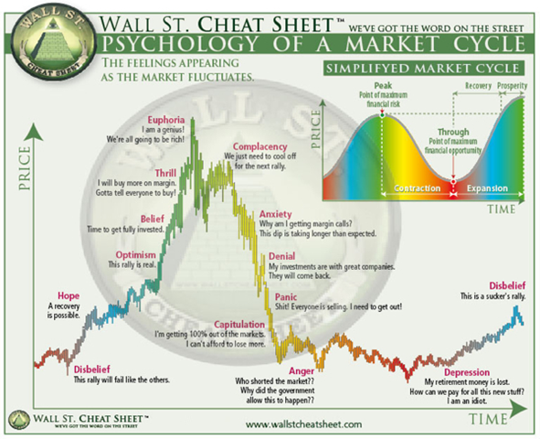
Notes:
Read through the slide with the group

Slide 117
Process, Process, Process
Investigation
Recommendation
Implementation
Review and Adjust
p. 76
Notes:
Process, Process, Process
Investigation
Recommendation
Implementation
Review and Adjust
This is a process you could take your advisor through…you should be in control of the process, not your advisor. You want your advisor to meet with you…not when they want to sell you something. Have you ever had an advisor that when everything goes wrong they go dark?
In battling emotional investing, you need a process to work through to protect yourself from making a potentially devastating purchasing decision. We suggest a process of investigation, recommendation, and implementation, followed by a healthy dose of review and adjustments. This process should help you work through your emotions, challenge your beliefs, and reasonably pursue a financial decision. The process should give you the time to make an informed decision.
Different planners plan differently. You can set your own pace in a decision making process by establishing the ground rules at the beginning of your work with an advisor. Knowing a simple planning system you can use with advisors will be helpful.
The first planning step is “investigation.” During this step, you will discover all the risk, leaks, and gaps in your current financial plan. You should fill out a financial review form listing all your assets (appendix chapter one) and income. The financial review form can help you see your assets as a whole and how they relate to each other. You will want to list the concerns you have about your assets, your goals, and of course decide on the ABC Allocation you believe best fits you. You will want to pay close attention to the time horizon you have for your goals. This is crucial when it comes to deciding on the assets you use in your plan. An advisor can help you think through possible solutions to the concerns and goals you have.
Second, either develop for yourself or receive from an advisor a plan which includes everything your goals set out to accomplish. This plan should be detailed and involve assets and income from specific sources. The plan should include what you want to accomplish in various time frames: five, ten, fifteen, twenty, thirty years and more, with an ability to adjust as necessary.
Third, implement your plan when you have worked out the details and you are confident it is a solution to problems—one that will accomplish your goals. It will involve a lot of paperwork and is best done in a separate meeting so you have time to go over the details with your advisor. You will most likely have to make transfers into different companies, which will create a conservation attempt in some form, by the current company holding your money. Just remember, it’s your money, not theirs. This is something they often forget.
Lastly, you will want to review the plan once all the monies are transferred to make sure they are where you wanted them to be and in the amounts you had determined for your plan. We suggest you review the plan at least every six months to make sure you are on the right path. If you have assets in Column C, the Red Risk portion, you will want some type of a review quarterly. Remember your goals and especially your time horizon. For conservative investors this is not a sprint, but a marathon.
With the right process, your emotions will be given the opportunity to be led by your beliefs, which will be challenged by the truth, leading to a logical conclusion.

Slide 118

Seven steps to creating your own retirement plan

Slide 119
Seven Steps to an ABC Plan
Step One – Get Your Assets Together (App. One)
Step Two – Write Down Retirement Goals and Budgets
Step Three – ABC Your Assets (Know your liquidity, protection & growth goals)
Step Four – Choose an Advisor
Step Five – Process, Process, Process
Step Six – Review and Adjust
Step Seven – Sleep at Night!
p. 79-81
Notes:
Step One: Get Your Assets Together
Begin by gathering your most recent asset statements. The following is a partial list of statements to gather:
Brokerage accounts
Mutual funds
IRA, 401(k), 403(b) and other qualified plans
Annuities
Bank accounts, including CD’s, savings, and money market accounts
Stock certificates
Bonds, including government savings bonds
Life Insurance
Precious Metals
Real Estate
Take the statements to your advisor and they will gladly make you copies. Use one of the Asset Review Forms in Appendix One to assist you in arranging your finances so you can see the “big picture.”
Step Two: Write Down Retirement Goals & Budgets
Using the forms in Appendixes One and Two to write down your thoughts will help organize your thinking before seeing an advisor. You will want to write down the greatest concerns you have about your assets and your goals for the near and far future.
Write down some of the things that worry you most about your financial situation. If you can’t think of any big worries, then remember everyone has a “pebble in the shoe.” In other words, something which may be small, but it irritates you. If you have a pebble in the shoe financially, now is the time to deal with it. It may be a certain asset like a bond, or mutual fund you’ve had a long time and isn’t a lot of money, but it has frustrated you the whole time you have had it.
Written goals are a sure way to guarantee you will be able to know if you are on track with your investments. You will want to write down immediate goals, 1 year, 3 year, 5 year and even longer goals. You can always adjust your goals.
Step Three: ABC Your Assets
Choose which types of assets you would want to invest in going forward. Pretend every asset is moveable and changeable, and then ask yourself if you could make a new plan starting today, what would that plan look like? You will want to distinguish your investible assets from your non-liquid assets. For instance, you might have invested in a rental home, which isn’t a liquid asset, as opposed to a stock or mutual fund. Be sure and get a total of “investible assets” before trying to ABC them.
Remember there are three categories of assets Yellow, Green, and Red. What percent of your assets do you need in cash for emergencies, coming events, and if your income dries up for six months to a year? This is Yellow Column A money. Next, what percent do you want to focus on growth in the market with either bond-type risk or stock-type risk? This is Red Column C money. Finally, add the two percentages you just wrote down and subtract it from 100, and this is the amount of money you want in the Green Column B. Keep in mind, the three Green Money rules which reduce market risk in your portfolio. Make use of the last page of the Financial Review Form in Appendix One.”
Step Four: Choose an Advisor
Deciding to take this step of finding an advisor means you are serious about your planning needs and want a conservative advisor.
Look over the questions to ask an advisor and take them with you to interview your prospective advisor. You might very well be in a class going over this material and the advisor you’ve spent time with seems to your liking. Run through the questions with him or her. Once you are satisfied that they understand conservative investing and they have demonstrated a competence, go ahead to Step Five.
Step Five: Process, Process, Process
Now is the time to work through a planning process with the advisor. If they are trained in the ABC’s, then he or she is familiar with the steps of Investigate, Recommend, Implement, Review and Adjust. These steps will help you challenge your fictional beliefs, and work through your emotions while travelling down a logical path to financial success.
A plan will come with two facets: overview and detail. You will want to understand the “big picture” of your plan while also digging into details.
Step Six: Review & Adjust
Once you have implemented your plan with the advisor, decide on a schedule of reviews that meets your needs best. Get on their calendar right away, as it will give you confidence knowing you have the opportunity to review the plan again and see if it is going according to the projections and parameters you originally laid out.
Step Seven: Sleep Easy
You can actually enjoy a good night’s rest knowing that your ABC Plan has just the right amount of liquidity, protection and attention to growth you are after.
In the end, conservative retirement planning is long-haul, core investing with just the right amount of protection and risk tailored to your temperament.
In what ways have you resonated with the Financial ABC’s of Retirement Planning?

Slide 120
In what ways have you resonated with the Financial ABC’s of Retirement Planning?
Please complete our Evaluation Form…
Notes:
Test and evaluation form…
One: Sign up for strategy sessions
Two: Show an event calendar here.
Have an event in the next 2 weeks to invite them to.

Slide 121
Contact information:
Dave Vick
dave@vickassociates.com
480-758-4582
Vick & Associates, Inc.
8700 E. Vista Bonita Drive
Suite 240
Scottsdale, AZ 85255

Slide 122

Thank you for Attending!

