Slide 1
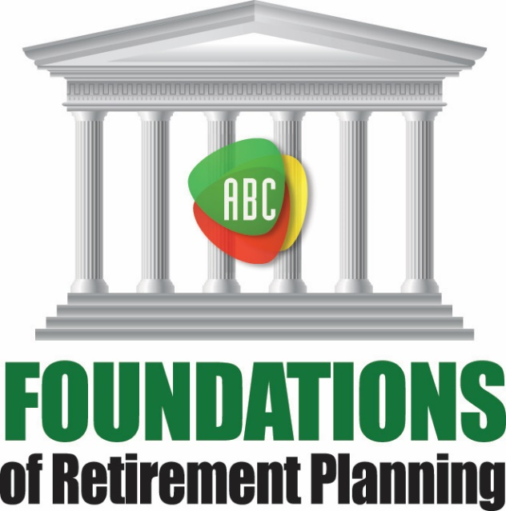
A Course Focusing on the Foundations of
Retirement Planning

Slide 2
Foundations of Retirement Planning
This discussion is offered free of charge. It is designed to be educational in nature and is not intended to provide tax or legal advice. Consult with your tax advisor and/or legal counsel for suitability for your specific situation.
This presentation is not endorsed or approved by the Social Security Office or any other Government Agency.
Hypothetical and/or actual historical returns contained in this presentation are for informational purposes only and are not intended to be an offer, solicitation, or recommendation. Rates of return are not guaranteed and are for illustrative purposes only.
Projected rates do not reflect the actual or expected performance within any example or financial product.
Notes:
First to cover some basics…(Read slide).

Slide 3
Contact Information
Dave Vick
dave@vickassociates.com
480-758-4582
8700 E. Vista Bonita Drive
Suite 240
Scottsdale, AZ 85255
Notes:
Give a short introduction to yourself and handout your simple, one sheet BIO.

Slide 4
Disclosure
Their may be financial advice offered as a result of this course, including life insurance and annuity products, along with
investment advice which is offered through
FAN Advisors
an SEC Registered Investment Adviser.
Insurance products are sold through
Vick & Associates, Inc.
Notes:
Include your disclosure and read.

Slide 5
Course Introduction
Attendance is good, but participation is better.
You have my dedicated time for the next week.
You tuition entitles you to an optional one hour strategy session.
We will start and stop on time with 10 minute breaks on the hour.
Course based on “Bat-Socks, Vegas & Conservative Investing.”
Includes Foundations of Retirement Planning Workbook.
ABC Planning Model – Concepts DVD by the author.
Fill out Workshop Goals sheet.

Slide 6

Changing Landscapes
77 Million Boomers

Slide 7

77 Million Boomers Retiring
Who?
Born between 1946 and 1964
Started turning 65 on December 1st, 2010
Every 8 seconds another Boomer turns 65
Effecting:
Social Security
Medicare
Medicaid
Healthcare costs
Nursing care costs
Notes:
77 Million Boomers Retiring
Baby Boomers are those folks born between 1946 and 1964. 77 million Boomers started turning 65 on December 1st, 2010. Once it started, and every 8 seconds following, another baby boomer would turn 65 putting a tremendous pressure on the US Government entitlement programs, specifically Medicare and Social Security. (1)
“USA Today: First of 77 Million Baby Boomers Start Turning 65” John Yedinak, Reverse Mortgage Daily, 11/23/10 http://reversemortgagedaily.com/2010/11/23/usa-today-first-of-77-million-baby-boomers-start-turning-65/

Slide 8
By The Numbers
Boomers who:
53% Don’t feel comfortable enough to retire.
73% Plan to work past their retirement years.
41% Believe they will need to scale back
31% Believe they will struggle financially.
62% Have lost money in one of these four areas:
  42% Workplace retirement savings plan
  41% Personal investments outside of IRA/workplace savings
  32% In IRAs
  29% Real estate
p. 9
Notes:
By The Numbers
53% Boomers who don’t feel comfortable enough to retire on the money they’ve saved. (2)
73% Boomers who plan to work past their retirement years. (3)
41% Boomers who believe they will need to scale back and 31% believe they will struggle financially. Some believe that their struggle will come from being tied down in too much equity investments. (4)
62% Boomers who have lost money in one of these four areas: (5)
42% Workplace retirement savings plan
41% Personal investments outside of IRA/workplace savings
32% In IRAs
29% Real estate
Boomers Less Optimistic
“About two-thirds of Baby Boomers say they're less optimistic about the future of the USA than when they turned 21, and less optimistic about retirement than they were 10 years ago, according to a USA TODAY/Gallup Poll…” (6)
Corporate Defined Benefit Plans Disappearing
“Pension Freezes Continue Among Fortune 1000 Companies in 1010” (7)
Defined benefit plans (DBP) are plans designed to pay a monthly benefit for employees entering retirement, funded by the employee’s municipality or corporation and calculated by a formula using age, wage and length of service.
In 2011 DBP plans had only $2.4 trillion in all of America compared to $3.5 trillion held in 401(k) plans in 2012. (8)

Slide 9
By The Numbers
“The top problem for the broadly defined group of middle-aged Americans -- those aged 30 to 64 -- is not having enough money for retirement. For this group, about seven in 10 worry about not having enough money for retirement.”
More Americans Worried about Having Enough for Retirement
Notes:
“The top problem for the broadly defined group of middle-aged Americans -- those aged 30 to 64 -- is not having enough money for retirement. For this group, about seven in 10 worry about not having enough money for retirement.”
A firm majority of Americans, 59%, are worried about not having enough money for retirement, surpassing eight other financial matters. A majority of Americans have reported being "very" or "moderately" worried about retirement savings every year since 2001, illustrating that saving for retirement disquiets Americans in both good and bad economic times.
http://www.gallup.com/poll/168626/retirement-remains-americans-top-financial-worry.aspx

Slide 10

Eight Challenges to Retirement Income
^{Section Two}

Slide 11
Life Expectancy
Eight Challenges to Retirement Income
p. 13

Slide 12
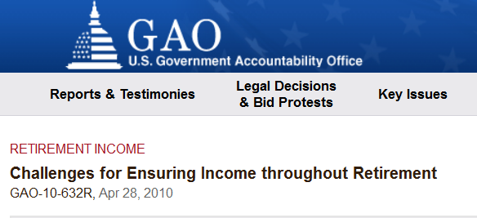
Life Expectancy
Average healthy couple expected to have the last one live to age 91.
Have to fund “your quality” of life for three decades.
http://www.gao.gov/products/GAO-10-632R

Slide 13
Life Expectancy
Question: What was the age of the oldest person you know of in your family history?

Slide 14
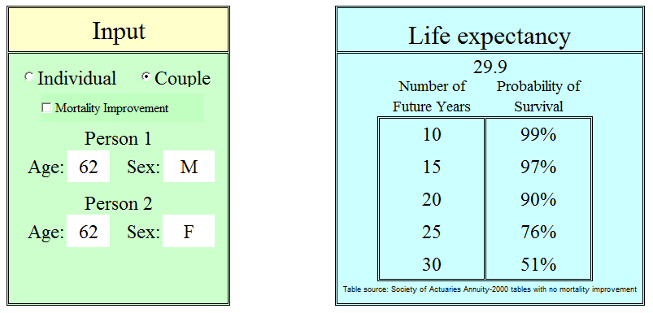
Life Expectancy
Social Security 2010 Tables
http://www.soa.org/Research/Software-Tools/research-simple-life-calculator.aspx
Notes:
According to the Social Security 2010 tables the average healthy 62 year old couple has a 27 percent chance for one of the two to live to see their 92nd birthday.
According to the Society of Actuaries Annuity 2000 tables the average healthy 62 year old couple has a 51 percent chance for one of the two to live to see their 92nd birthday.
In other words, a 62 year old couple has somewhere between a 27% to 51% chance of living three decades in retirement, depending of course on your health and which study you read. That means:
You’ll have to fund life in retirement for three decades.
Even more, you’ll want to fund “your quality” of life for those three decades. (2)

Slide 15
By the Numbers
52% of the oldest Baby Boomers, 67 and up, have retired…of the 52%:
  86% currently collecting Social Security benefits
    43% started collecting earlier than anticipated.
  13% are taking care of parents or relatives.
  82% say their health is good to excellent.
  54% say they retired early due to a job loss or health issues.
The average retirement age increased from 66 years-old to 71 years old between 2008 and 2013. (3)
Notes:
Healthcare Creating Longer Retirements and Larger Bills
By the Numbers
According to Metlife’s Mature Life Institute, the oldest of the Baby Boomers have now retired, yet they don’t view themselves as “old”, at least not until age 78.5.
52% of the oldest Baby Boomers, 67 and up, have retired, which is 19% more than in 2007 and 45% more than 2011.
Of the 52%:
86% are currently collecting Social Security benefits, of which 43% started collecting earlier than anticipated.
13% are taking care of parents or relatives.
82% say their health is good to excellent.
54% say they retired early due to a job loss or health issues.
The average retirement age increased from 66 years-old to 71 years old between 2008 and 2013. (3)
The 52% number above reveals that, of those boomers who’ve reached age 67, close to half are still working. The reasons they have chosen to continue working are unclear, yet it could easily be due to a longer life expectancy or simply a desire to stay fulfilled at work. It is important to note that only 39% of Baby Boomers expect to retire when they had planned. This was not anticipated and caused largely by factors outside the Boomers’ control.
According to a Feb. 5, 2013 article in ABC News online, Boomers will suffer more from high blood pressure, high cholesterol and diabetes than the previous generation, according to a study in JAMA Internal Medicine. The fact that Boomers are less likely to be obese and to exercise adds to their struggles.
“Despite their longer life expectancy over previous generations, U.S. baby boomers have higher rates of chronic disease, more disability, and lower self-rated health than members of the previous generation at the same age,” the study authors wrote. “On a positive note, baby boomers are less likely to smoke cigarettes and experience lower rates of emphysema and [heart attacks] than the previous generation.”(4)

Slide 16
Inadequate Savings
Eight Challenges to Retirement Income

Slide 17
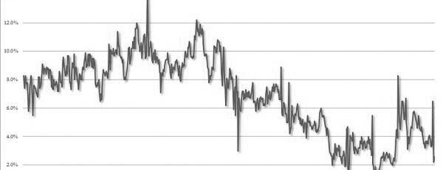
Inadequate Savings
The savings rate:
in the 1970s and 1980s - 5% to 7% of their income for retirement.
21st Century between 1% and 4%.
The personal savings rates since 2007 was 2.6%
p. 17
Notes:
Conceptually, a savings rate is a percentage of money that you deduct from your disposable income to invest in assets designated to establish a nest egg for retirement. These monies are usually put in bank accounts, annuities, stocks, bonds, and mutual funds. These accounts can be set-up as qualified or non-qualified retirement savings.
The savings rate in the U.S has been on a steady decline since the 1970s and 1980s when people put away 5% to 7% of their income for retirement. In the 21st Century, the rate has declined to a range between 1% and 4%. The personal savings rates since 2007 is 2.6%. (6)

Slide 18

Inadequate Savings
…the average disposable income is hovering around $40,000 since 2007 and the savings rate has been 5.4% since then, that means that people on average have been putting away $2,160 a year for retirement.
Question: Does that seem like enough?
Notes:
So, if the average disposable income is hovering around $40,000 since 2007 (http://www.oecdbetterlifeindex.org/topics/income/) and the savings rate has been 5.4% since then (http://www.tradingeconomics.com/united-states/personal-savings), that means that people on average have been putting away $849 a year for retirement. It’s easy to see how people are concerned about funding their retirement. (8)
Savings is a way to build future income. It projects the type of lifestyle you can count on in retirement. Inadequate savings directly relates to an inadequate income in retirement.
Question: Does that seem like enough?

Slide 19

Stationary Wages & Loads of Debt
Reasons why saving for retirement so hard:
Easy access to consumer debt
Spending habits beyond their means
Wages stationary for the last decade
Financing college educations
Market down turns 2000-2002, 2008-2009
Disappearing pensions
Companies doing away with healthcare benefits for retirees
Notes:
Ask: What are the reasons people preparing for retirement have had such a hard time saving?
Stationary Wages, Loads of Debt
There are a number of reasons why saving for retirement has been such a challenge for Baby Boomers. Below is a short list.
Easy access to consumer debt
Spending habits beyond their means
Wages largely stationary for the last decade
Financing expensive college educations for their children
Market down turns 2000-2002, 2008-2009
Disappearing pensions
Companies doing away with healthcare benefits for retirees
“To some extent, boomers are more encumbered by debt because their wages remained relatively stagnant for years, says Christian Weller, a public policy professor at the University of Massachusetts at Boston and a senior fellow at the Center for American Progress, a research group in Washington…Add to that their penchant to spend beyond their means while saving less than what's considered adequate for retirement, and a questionable outlook emerges.” (9)

Slide 20
Inflation
Eight Challenges to Retirement Income

Slide 21

Does inflation matter?
Inflation Rate | 1.86% | 2.20% | 2.49% | 3.33%
Car | 10 Years | 20 Years | 30 Years | 40 Years
$25,000 | $30,053 | $38,633 | $52,286 | $92,682
Notes:
When planning for retirement you have to consider the possibilities of providing income for expenses for 30 to 40 years. The graphs below show what would happen if the 30 year 2.9% average inflation rate and 40 year 4.3% average inflation rate was used when purchasing a $25,000 item such as a car.

Slide 22
Does inflation matter?
Inflation Rate | 2.90% | 2.90% | 2.90% | 4.30%
NH | 10 Years | 20 Years | 30 Years | 40 Years
$80,000 | $96,189 | $123,625 | $167,315 | $296,584
Inflation is a
“long life penalty!”
Notes:
CNN Money, an online publication, reported on April 9th, 2013 that nursing home costs had risen to $80,000 a year. (10). Imagine the inflation on a projected nursing home stay in 30 to 40 years.

Slide 23
Inflation as a Market Risk
Inflation Creates Uncertainty
Inflation causes an overall uncertainty to future values.
Well-diversified portfolios adapt well to inflationary risk
A popular strategy is to invest in precious metals like gold and silver to offset the decline in currency values during an inflationary period.
p. 23
Notes:
Inflation as a Market Risk
You’ve imagined the headlines, “Inflation Causes Mass Panic!” You’ve seen the lines of cars piling out of gas stations. Inflation can happen in wartime, in peacetime, in fact, just about any time. It affects consumer prices and is a negative force when planning for retirement. The government’s debt ceiling keeps rising, so you can expect more inflation over the years. Life in general has uncertainty.
Inflation Creates Uncertainty
Inflation causes an overall uncertainty to future values. This is the risk that inflation will undermine the performance of an investment. Simply put, costs go down on a product, the value of the company depreciates, and share values plummet. Watch out for inflationary risk with stocks, but also watch its effects on long-term investments.
Well-diversified portfolios adapt well to inflationary risk. You can invest in stocks, bonds, mutual funds, annuities, or invest in your favorite NFL team. A popular strategy in current years is to invest in precious metals like gold and silver. These tend to offset the decline in currency values during an inflationary period.
In the end, diversifying your investments gives you the best chance for market risk protection. Here are some more important facts to consider when planning for inflation:
Inflation can erode a portfolio’s purchasing power at an average inflation of 3% to 4% per year.
The value of a portfolio is cut in half every 23 years at a 3% inflation rate.
A long –term perspective is critical. Short run asset classes can be a good inflation hedge, but effects of inflation can be devastating on cumulative basis.
A portfolio should not be all long-term investments like annuities or bonds. Keeping up with inflation may require you to take some risk with a smaller percentage of your portfolio.
You could also invest in precious metals, which might offset a declining currency during inflationary times.
Increasing your cash flow by the rate of inflation is necessary for an effective retirement income plan.

Slide 24
Inflation
Question: What were the lowest gas prices you remember?
Question: What is the highest price of gas you’ve ever paid?
Question: What was the price of the very first house you ever bought? What would that house sell for today?

Slide 25
Inflation as a Market Risk
When planning for inflation consider the following:
Inflation can erode a portfolio’s purchasing power at an average inflation of 3% to 4% per year.
The value of a portfolio is cut in half every 23 years at a 3% inflation rate.
A long –term perspective is critical.
Keeping up with inflation may require you to take some risk with a smaller percentage of your portfolio.
Increasing your cash flow by the rate of inflation is necessary for an effective retirement income plan.
Notes:
Inflation as a Market Risk
You’ve imagined the headlines, “Inflation Causes Mass Panic!” You’ve seen the lines of cars piling out of gas stations. Inflation can happen in wartime, in peacetime, in fact, just about any time. It affects consumer prices and is a negative force when planning for retirement. The government’s debt ceiling keeps rising, so you can expect more inflation over the years. Life in general has uncertainty.
Inflation Creates Uncertainty
Inflation causes an overall uncertainty to future values. This is the risk that inflation will undermine the performance of an investment. Simply put, costs go down on a product, the value of the company depreciates, and share values plummet. Watch out for inflationary risk with stocks, but also watch its effects on long-term investments.
Well-diversified portfolios adapt well to inflationary risk. You can invest in stocks, bonds, mutual funds, annuities, or invest in your favorite NFL team. A popular strategy in current years is to invest in precious metals like gold and silver. These tend to offset the decline in currency values during an inflationary period.
In the end, diversifying your investments gives you the best chance for market risk protection. Here are some more important facts to consider when planning for inflation:
Inflation can erode a portfolio’s purchasing power at an average inflation of 3% to 4% per year.
The value of a portfolio is cut in half every 23 years at a 3% inflation rate.
A long –term perspective is critical. Short run asset classes can be a good inflation hedge, but effects of inflation can be devastating on cumulative basis.
A portfolio should not be all long-term investments like annuities or bonds. Keeping up with inflation may require you to take some risk with a smaller percentage of your portfolio.
You could also invest in precious metals, which might offset a declining currency during inflationary times.
Increasing your cash flow by the rate of inflation is necessary for an effective retirement income plan.

Slide 26
Taxation
Eight Challenges to Retirement Income
p. 25

Slide 27
Taxation
94%
80%
70%
59%
15% & 28%
By the Numbers
Highest historical tax rate, 1944-1945
Highest top marginal tax rate from 1940 – 1963, except for years 1944-45
Highest top marginal tax rate from 1970 – 1980
Historical average of the top marginal tax rates
The only two marginal tax brackets from 1988 – 1990
Notes:
By the Numbers
94% Highest historical tax rate, 1944-1945
80% Highest top marginal tax rate from 1940 – 1963, except for years 1944-45
70% Highest top marginal tax rate from 1970 – 1980
59% Historical average of the top marginal tax rates
15% & 28% The only two marginal tax brackets from 1988 – 1990

Slide 28
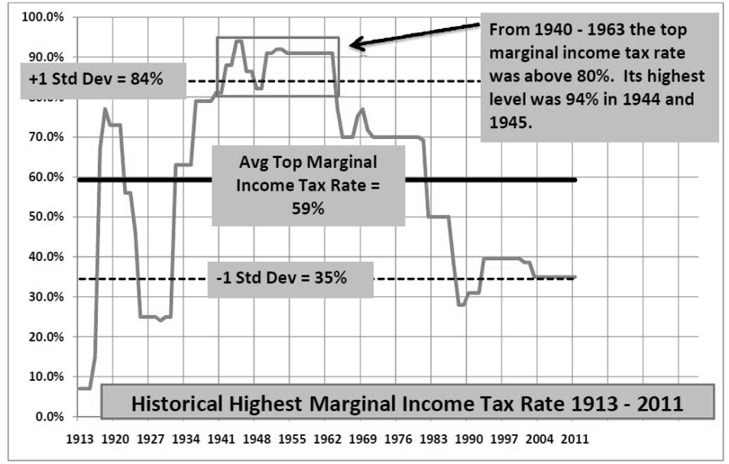
Notes:
Will you pay more or less taxes in retirement?
The retired are still taxed, of course they are. The $69 question is, “will you pay more taxes as you live longer in retirement?” The typical answer is yes, but a little historical perspective here would be helpful.
We currently live in a time with historically low tax rates. From 1913 to 2012, we’ve seen the highest marginal rates from 7% to 94% with the average being 59%
Our current highest marginal rate is 39.6% and as you can see below, has increased from 2012. So, it’s reasonable to assume taxes will be going up over the next 30 to 40 years.

Slide 29
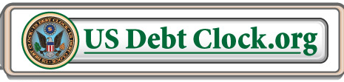
Reasons Taxes May Increase
Reasons Taxes May Increase
Reduce the Federal Deficit
Notes:
Reasons Taxes May Increase
The obvious reason here is that the more government spends, the more they need to raise funds to cover their spending. Right or wrong, it just is the way it is and will greatly affect your retirement. Here are four items that might cause the government to spend more:
Reduce the Federal Deficit – currently just under $17 trillion and rising
Healthcare costs – CBSNews.com reported on April 15th, 2013, “The government is expected to collect more than $1 trillion in tax revenue over 10 years and dole out more than $1 trillion in subsidies...‘This is a major new venture and like anything, no one can predict exactly how it’s going to work,’ Paul Van de Water, a senior fellow at the Center on Budget and Policy Priorities, explained to CBSNews.com”
Aging Population Entitlements – Social Security dips into funds starting in 2020 and runs out of money in 2043. Forbes online magazine reported on June 12, 2013, “However, beginning in 2010, deficits have been the rule. The deficits in the past few years were as follows: $49 billion in 2010; $45 billion in 2011; and $55 billion in 2012. The Trustees expect the deficit to average $75 billion each fiscal year from 2013 to 2018 before rising sharply. Congress must continue to issue more debt just to meet Social Security’s current obligations. This is very significant as expenditures for Social Security and Medicare accounted for 38% of the federal budget in fiscal year 2012.” (13)
One thing is certain, you will be paying taxes every year and it doesn’t matter who the president is or what laws congress passes. It’s better to be prepared with strategies that can make your portfolio adapt.
In retirement, you earn through investments, real estate, stock and bond dividends, pensions, or part-time and even full-time work. You will pay capital gains tax on investments like stocks and bonds, and ordinary income taxes on the rest. If you think taxes stop there, guess again. Even your Social Security is up for tax considerations.
As you worked, you avoided paying taxes on monies you saved for retirement in your 401(k)’s, and other pre-tax dollar accounts. Any retirement income taken from those accounts becomes 100% taxable.
When you budget for your retirement, it’s vital to be proactive about your taxes. It’s important to develop an income plan that minimizes taxation as you grow older. For example, if tax rates are low now, maybe it’s a good time to spend the qualified monies first while letting your Social Security benefits defer at an 8% growth rate until age 70. You could even convert some of the IRA and 401(k) monies into a Roth IRA to acquire tax-free income down the road when taxes are sure to be higher. This way you may even be able to limit the taxation on your Social Security.

Slide 30
Reasons Taxes May Increase
Reasons Taxes May Increase
Reduce the Federal Deficit
Healthcare costs
Regarding new healthcare costs, CBSNews.com reported, “The government is expected to collect more than $1 trillion in tax revenue over 10 years and dole out more than $1 trillion in subsidies...
CBSNews.com reported on April 15th, 2013
Notes:
Reasons Taxes May Increase
The obvious reason here is that the more government spends, the more they need to raise funds to cover their spending. Right or wrong, it just is the way it is and will greatly affect your retirement. Here are four items that might cause the government to spend more:
Reduce the Federal Deficit – currently just under $17 trillion and rising
Healthcare costs – CBSNews.com reported on April 15th, 2013, “The government is expected to collect more than $1 trillion in tax revenue over 10 years and dole out more than $1 trillion in subsidies...‘This is a major new venture and like anything, no one can predict exactly how it’s going to work,’ Paul Van de Water, a senior fellow at the Center on Budget and Policy Priorities, explained to CBSNews.com”
Aging Population Entitlements – Social Security dips into funds starting in 2020 and runs out of money in 2043. Forbes online magazine reported on June 12, 2013, “However, beginning in 2010, deficits have been the rule. The deficits in the past few years were as follows: $49 billion in 2010; $45 billion in 2011; and $55 billion in 2012. The Trustees expect the deficit to average $75 billion each fiscal year from 2013 to 2018 before rising sharply. Congress must continue to issue more debt just to meet Social Security’s current obligations. This is very significant as expenditures for Social Security and Medicare accounted for 38% of the federal budget in fiscal year 2012.” (13)
One thing is certain, you will be paying taxes every year and it doesn’t matter who the president is or what laws congress passes. It’s better to be prepared with strategies that can make your portfolio adapt.
In retirement, you earn through investments, real estate, stock and bond dividends, pensions, or part-time and even full-time work. You will pay capital gains tax on investments like stocks and bonds, and ordinary income taxes on the rest. If you think taxes stop there, guess again. Even your Social Security is up for tax considerations.
As you worked, you avoided paying taxes on monies you saved for retirement in your 401(k)’s, and other pre-tax dollar accounts. Any retirement income taken from those accounts becomes 100% taxable.
When you budget for your retirement, it’s vital to be proactive about your taxes. It’s important to develop an income plan that minimizes taxation as you grow older. For example, if tax rates are low now, maybe it’s a good time to spend the qualified monies first while letting your Social Security benefits defer at an 8% growth rate until age 70. You could even convert some of the IRA and 401(k) monies into a Roth IRA to acquire tax-free income down the road when taxes are sure to be higher. This way you may even be able to limit the taxation on your Social Security.

Slide 31
Reasons Taxes May Increase
Reasons Taxes May Increase
Reduce the Federal Deficit
Healthcare costs
Aging Population Entitlements –
  Social Security dips into funds starting in 2020 and runs out of money in 2033.
Notes:
Reasons Taxes May Increase
The obvious reason here is that the more government spends, the more they need to raise funds to cover their spending. Right or wrong, it just is the way it is and will greatly affect your retirement. Here are four items that might cause the government to spend more:
Reduce the Federal Deficit – currently just under $17 trillion and rising
Healthcare costs – CBSNews.com reported on April 15th, 2013, “The government is expected to collect more than $1 trillion in tax revenue over 10 years and dole out more than $1 trillion in subsidies...‘This is a major new venture and like anything, no one can predict exactly how it’s going to work,’ Paul Van de Water, a senior fellow at the Center on Budget and Policy Priorities, explained to CBSNews.com”
Aging Population Entitlements – Social Security dips into funds starting in 2020 and runs out of money in 2043. Forbes online magazine reported on June 12, 2013, “However, beginning in 2010, deficits have been the rule. The deficits in the past few years were as follows: $49 billion in 2010; $45 billion in 2011; and $55 billion in 2012. The Trustees expect the deficit to average $75 billion each fiscal year from 2013 to 2018 before rising sharply. Congress must continue to issue more debt just to meet Social Security’s current obligations. This is very significant as expenditures for Social Security and Medicare accounted for 38% of the federal budget in fiscal year 2012.” (13)
One thing is certain, you will be paying taxes every year and it doesn’t matter who the president is or what laws congress passes. It’s better to be prepared with strategies that can make your portfolio adapt.
In retirement, you earn through investments, real estate, stock and bond dividends, pensions, or part-time and even full-time work. You will pay capital gains tax on investments like stocks and bonds, and ordinary income taxes on the rest. If you think taxes stop there, guess again. Even your Social Security is up for tax considerations.
As you worked, you avoided paying taxes on monies you saved for retirement in your 401(k)’s, and other pre-tax dollar accounts. Any retirement income taken from those accounts becomes 100% taxable.
When you budget for your retirement, it’s vital to be proactive about your taxes. It’s important to develop an income plan that minimizes taxation as you grow older. For example, if tax rates are low now, maybe it’s a good time to spend the qualified monies first while letting your Social Security benefits defer at an 8% growth rate until age 70. You could even convert some of the IRA and 401(k) monies into a Roth IRA to acquire tax-free income down the road when taxes are sure to be higher. This way you may even be able to limit the taxation on your Social Security.

Slide 32

Taxation
Question: Do you believe taxes will increase or decrease over your retirement years?
Question: What are some of the reasons you think taxes might increase?
Question: What would be the biggest effect of tax increase on your retirement? Be as specific as possible

Slide 33
Market Uncertainty
Eight Challenges to Retirement Income

Slide 34

Market Uncertainty
By the Numbers
12.22%
3.14%
2.57%
38.5%
33.8%
$18.5 T
$18.2 T
p. 29
Notes:
By the Numbers
12.22% S&P 500 average return from January 1984 to December 2002.
3.14% Average inflation rate from January 1984 to December 2002.
2.57% Average equity fund investor returns from January 1984 to December 2002. (14)
38.5% Annual loss suffered for the year in the S&P 500 in 2008, worst in 7 decades.
33.8% Annual loss suffered for the year in the DOW in 2008, worst in 7 decades. (15)
$18.5 Trillion Size of the US Equities markets 2012. (16)
$18.2 Trillion Size of the US Debt, (17)

Slide 35

p. 35
Notes:
Market Cycles
Through retirement you will see cycles in the market from boom to bust. While the age-old saying of “buy low and sell high” is the desire of all investors the reality for most investors is the exact opposite.
When should you invest? Simple, when the market is down. When should you sell? Simple again, when the market is up. The challenge is how to make this happen. Warren Buffett says, “Be fearful when others are greedy and greedy when others are fearful.” The 18th Century British nobleman Baron Rothschild’s quote “The time to buy is when there’s blood in the streets,” is insightful. In other words, buy at the bottom of the market when there is the most amount of fear in the investment community.
This is indeed good advice though hard to follow. In the July 2003, Dalbar, Inc., study, Quantitative Analysis of Investor Behavior, we see that for the 19 years from 1984 to 2002, had some stunning revelations.
“The average equity fund investor earned only 2.57% annually over the 19-year period included in the study, compared to annualized inflation of 3.14% and the S&P 500 Index average annual return of 12.22%. (Yes, you read it right. The average mutual fund investor’s gain was less than inflation over the last 19 years and only a fraction of what the S&P 500 gained!)
The average fixed income (bonds) mutual fund investor fared a little better, but not up to the market’s performance. Over the last 19 years, the average fixed income mutual fund investor had an annualized gain of 4.24% versus the long-term government bond index which averaged 11.70%.” (19)
Question: Did you profit during the Bull market of the 1990s?
Question: Did you sell out during the years 2000-2002? Did you sell investments in 2008?
Question: Have you ever been frustrated with your broker for not paying closer attention to your portfolio during downturns in the market? Upturns in the market? Explain.
The chart from the Wall St. Cheat Sheet website shows the typical investor behavior relating to market cycles.
You see this everyday when you watch Jim Cramer saying he has no idea why things are the away they are. Sometimes these are anomalies and some times they can be explained. But they can’t be predicted and investors are typically too emotionally involved to make good decisions.

Slide 36

Market Uncertainty
Question: If you could put a percentage on how safe you feel with your investments right now, what would it be?

Slide 37
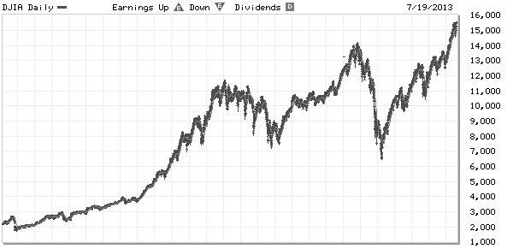
Paradigm Shifts in the Market 1988-2014
p. 32
Notes:
Paradigm Shifts in the market and Bear Markets
You have to wonder by now, what has caused all the volatility in the markets over the last 30 years. It seems that we were riding the heights of the 1990’s when the dot.com bubble burst. We were riding the Bull again until the housing bubble turned 2008 into a disaster with a 38% drop in the broad markets. According to YahooFinance.com, from the bottom of the market in March of 2009 to the half way through 2013, the S&P 500 rose from 676 to 1606, a 138% increase. What could possibly be next on this roller coaster 21st Century-market-ride and why is the volatility so steep?
If you were standing on the Dow back in 1980 when Ronald Reagan was elected and looked backwards in time you would see a gradual increase from 1932. Yet, if you stand on the Dow and look back in time from President Obama’s second inauguration you would see a dramatically different view as illustrated by the graph below from the Wall Street Journal’s Market Watch online.
The term Paradigm Shift comes to mind here. Paradigm shifts sounds like a pretty generalized term, so why bring it up? How does it relate to the way you invest for retirement? In the last 30 years a cultural trend took place in three areas: the invention of the Internet, the development of 401(k)’s, and in the acceptance of gambling. You can bet these three aspects of our culture have had dramatic effects on the way we think about investing. Remember when corporate pensions were the norm, information needed for investing was gathered largely by reading the newspaper, and gambling was considered a negative social element and distained.
Jump to the future, our time. Corporate pensions have virtually disappeared shifting the responsibility for retirement income to the employee or self-employed, investing is done at the speed of information which is now the speed of the Internet and Vegas is a family destination with gambling a cultural norm. You have to see the correlation between the three and ask yourself if the large market swings are now part of the cultural norm as well.
True killers of the market in terms of paradigms today are bear markets. In Russell Napier’s book, The Anatomy of a Bear, he tells us of two main indexes, the Dow Jones Stock Index and The DOW Jones Railroad Index, were the two main indexes at the turn of the 1900’s. During the hard financial years from 1893-1921, through seven recessions and panics, the start of World War I, and the creation of the Federal Reserve and our current tax structure, Napier tells us the government nationalized the railroads. Guess what happened to the Railroad index. It essentially vanished, because the government devalued the rail stocks by their takeover. A major paradigm shift in the market due to prolonged Bear markets.
Another event causing a deviation in the market was the creation of the Federal Reserve in 1914. The Fed was created to make our currency “elastic.” Inflating the money supply during a recession or depression to spur on business, the Fed printed more money tied very loosely to the gold standard. This generated incredible financial market changes exploding out of 1921.
If paradigm shifts like this occur in the market due to Bear trends, is it wise to invest the majority of your retirement savings into a current highly volatile market? Of course not.

Slide 38
Market Uncertainty
Question: What was the connotation of gambling in the 1950s through the 1970s? Was it positive or negative?
Question: What is the cultural temperature of gambling today? Hot or cold?
Question: In what ways do you think gambling relates to investing?

Slide 39
Market Uncertainty
Market Cycles
“Be Fearful when others are greedy, and greedy when others are fearful.” – Warren Buffett
“Averaged equity fund investor earned only 2.57%...compared to annualized inflation of 3.14% and the S&P 500 average annual return of 12.22%” (19)
Notes:
All of the largest percentage gains and losses in the history of the Dow have happened in the last 26 years. Could there be a paradigm shift in the markets? Things look dramatically different than the previous 60 years or more. Investing is done at the speed of information. Gambling as a cultural norm. Individual investors in their 401k. All changes in the last 30 years.

Slide 40
Market Uncertainty
Question: Did you profit during the Bull market of the 1990s?
Question: Did you sell out during the years 2000-2002? Did you sell investments in 2008?
Question: Have you ever been frustrated with your broker for not paying closer attention to your portfolio during downturns in the market? Upturns in the market? Explain.
Notes:
Think of retiring on your investments as opening a restaurant. There are some staff you hire out of curiosity and other staff you hire because you know they’re reliable. They can cook, keep the kitchen spotless and bring in great ideas to your menu and the style of the restaurant. But your chance of making it is only 40%. (18) Considering the crazy hours you have to spend as a restaurant owner and the sacrifice involved, you have to ask yourself is the end result worth it at a 60% chance of failure. While we aren’t suggesting that your market investments have a 60% chance of failure, the question remains. Do you want the majority of your assets exposed to failure?
Some risk needs to be taken on, but how much depends on how you stomach the volatility in the market and how much guarantees you want in your income . How you manage risk is the key question. We believe that an ABC allotment of assets helps you manage your expectations and response to market downturns.

Slide 41
Health Care Costs
Eight Challenges to Retirement Income

Slide 42
Health Care Costs
By the Numbers
$75 Billion
$2 Trillion
16.2%
$4 Trillion
20%
9%
By the Numbers
Amount the US spent on healthcare in 1970.
Amount the US spent on health care in 2005.
The percentage of healthcare spending as a part of the gross domestic product predicted for 2005 (GDP).
Amount the US is expected to spend on health care in 2015.
The percentage of healthcare spending as a part of the gross domestic product predicted for 2015 (GDP).
The percentage of healthcare spending as a part of the gross domestic product (GDP) in 1970.
p. 36
Notes:
By the Numbers
$75 Billion - The amount the US spent on healthcare in 1970. (20)
$2 Trillion - The amount the US spent on health care in 2005. (21)
16.2% - The percentage of healthcare spending as a part of the gross domestic product predicted for 2005 (GDP). (22)
$4 Trillion - The amount the US is expected to spend on health care in 2015. (22)
20% - The percentage of healthcare spending as a part of the gross domestic product predicted for 2015 (GDP). (23)
9% - The percentage of healthcare spending as a part of the gross domestic product (GDP) in 1970. (24)

Slide 43
Healthcare Issues for Retirees
Payroll tax rate increased from 1.45% to 2.35%,
New 3.8% non-Medicare tax on unearned income or passive income to pay for the national healthcare plan.
State insurance exchanges.
Mandated requirement for everyone to have health insurance or pay a penalty.
Tax penalties range from $95 per individual, $285 per family.
Medicaid will expand
Notes:
Payroll tax rate increased from 1.45% to 2.35%, the .09% is on incomes over $200,000 for singles and $250,000 for married couples.
A new 3.8% non-Medicare tax on unearned income or passive income was instituted to pay for the national healthcare plan. Exceptions to this will be capital gains on a house exceeding $250,000 for single filers and $500,000 for married couples.
By October 1st, 2013, every state will have an insurance exchange. All small businesses and persons can select a private health care plan from an organized marketplace within their region. This service will be available not just through person-to-person, but through all forms of communication: online, phone calls, mobile devices, and home devices.
A tax credit will help you lower the premium costs if you are within a 100 to 400 percent range of the federal poverty level.
A mandate will require everyone to have health insurance or pay a penalty. Must be a legitimate coverage can be through the workplace, or otherwise.
Tax penalties range from $95 per individual, $285 per family.
Medicaid will expand in some states, although others are not sure about its benefits to their state systems or marketplaces.
Rebates will include a form of reduced premium or a refund when premiums are not used to benefit the insured. The rule does not apply to self-insured in workplaces.
Cheaper drugs for people on Medicare.
Temporary help for people with pre-existing conditions. Free preventive care.

Slide 44
Long Term Care Costs
Nursing home care Increased more than 4 percent a year over the last decade.
Median hourly home health aide services is $19 an hour, $18 for homemaker services.
Median annual cost of assisted living site rose 4.3 percent per year for past 5 years.
Median cost of a private nursing home stay has jumped from $67,527 in 2012 to $83,950.
Median cost for a homemaker who assists with cleaning, cooking, and transportation is about $41,756.
p. 37
Notes:
The cost of nursing home care has increased more than 4 percent a year over the last decade.
The median hourly cost of home health aide services is $19 an hour and $18 for homemaker services. Those HM costs rose 1.4% since 2012, and less than 1% annually over the last five years.
The median annual cost of assisted living site rose 4.6% over last year and 4.3 percent annual increase of the past 5 years.
Low interest rates, unpredictable medical costs and a tough regulatory environment are some of the key reasons that insurers give for leaving the market, despite demographic trends. (25)
Medicare system has holes which can cause a couple turning 65 today to pay an average of $220,000 out of pocket medical costs before they die. (26)
According to a study by Genworth in 2012 titled, “Cost of Care Survey,” the median cost of a private nursing home stay has jumped from $67,527 in 2012 to $83,950. The reasons attributed to this dramatic increase are insurance, food, building maintenance and labor costs that are passed on to the patients.
A popular alternative to the nursing home when the level of care needed is less is an assisted living facility. The median price for those facilities is $41,400, which is a 5% increase year over year.
The Genworth study showed that 78% of adults would prefer a home-care alternative. The median cost for a homemaker who assists with cleaning, cooking, and transportation is about $41,756. If you desire more care such as a home health aide providing additional bathing and grooming care costs $44,479. (27)

Slide 45

Nursing Care Costs
National averages look like this:
$3,572 monthly base rates for assisted living facility
$262 a day, nursing home private room
$227 a day, semi-private room
$21 an hour, home health care aides
Notes:
According to a New York Life 2014 study of Long-term Care costs, the national averages look like this: (http://www.newyorklife.com/products/Long-Term-Care/nyl-costs-of-ltc-survey)
$3,572 for monthly base rates in an assisted living facility
$262 a day for a private room in a nursing home
$227 a day for a semi-private room
$21 an hour for home health care aides
Kipplinger reported in their online column the following stunning news.
“Policyholders were stunned when insurer John Hancock announced in September that it would ask state regulators for permission to boost premiums on many of its long-term-care policies by an average of 40%. For many of the insured, the proposed rate hike would come on top of a 2008 increase of 13% to 18%.” (29)

Slide 46
Long Term Care Costs
Question: Do you know someone or have a relative in the nursing home? What are the costs associated with their care?
Question: Do you believe you or your spouse will need long term care?

Slide 47
Unrealistic Expectations
Eight Challenges to Retirement Income

Slide 48

Unrealistic Expectations
Common strains on retirement savings:
Spending too much in the first couple of years.
Underestimating home repairs.
Helping adult children financially.
Taking care of an elderly parent or in-law.
Not planning for rising elder healthcare costs and long term nursing care.
Taking care of a special needs child in retirement.
p. 40
Notes:
Unrealistic Expectations
“According to research done by Fidelity Investments, nearly 4 in 10 retired households can't cover their monthly expenses. The research went on to reveal that 50% of Americans have less than $25,000 in total savings (not counting pension plans or primary residence). About 28% have less than $1,000 saved.” (33)
Common strains on retirement savings:
Spending too much in the first couple of years, trying to do all the things you’ve always wanted to do.
Underestimating home repairs and taking out home equity loans or second mortgages.
Helping adult children financially and eating into your retirement savings.
Taking care of an elderly parent or in-law and draining your funds for their extra needs.
Not planning for rising elder healthcare costs and long term nursing care.
Taking care of a special needs child in retirement requires a lot of advanced planning.
Many are unaware of how their savings relates to the creation of income in retirement and are merely hoping the money will be there when they need it. Some are counting on an income amount that is equal to or greater than their current income. Retirement specialists say that a goal of 70% to 80% of current income is realistic.

Slide 49
Developing a Retirement Income Prediction
Basic factors needed to design a retirement income prediction:
      Current retirement savings totals of all plans
      Estimated growth yield before retirement
      Estimated growth yield after retirement
      Inflation estimate
      Estimated annual savings until retirement
      Current age(s)
      Desired retirement age
      Desired age to start Social Security
      Social Security estimate
      Pension estimates
      Desired retirement income in today’s dollars
Notes:
There are some basic factors that will help design a good retirement income prediction. You would look at the following:
Current retirement savings totals of all plans
Estimated growth yield before retirement
Estimated growth yield after retirement
Inflation estimate
Estimated annual savings until retirement
Current age(s)
Desired retirement age
Desired age to start Social Security
Social Security estimate
Pension estimates
Desired retirement income in today’s dollars

Slide 50
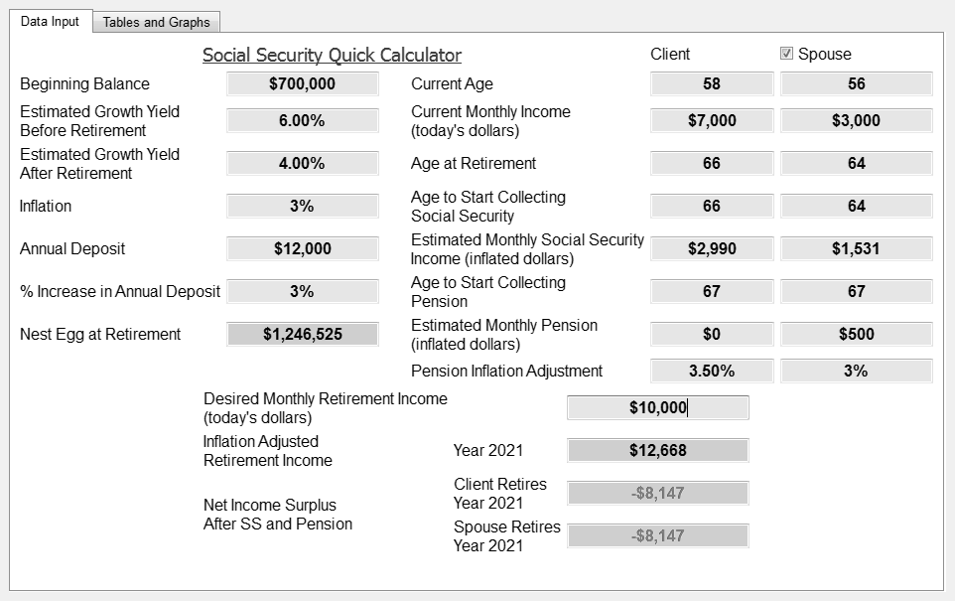
Sample Income Prediction
p. 41
Notes:
The illustration shows the basic inputs and a couple wanting to have 100 % of their current income for retirement. They’ve saved about $700,000, are still putting away $12,000 a year from their combined income of $120,000. They want to both retire at full income when he reaches age 66. The result below shows the couple running out of money when he reaches age 78.
If they tail back their expectations and work one more year and choose 70% of their income goal then they can have income stretching out well into their 90s.
You can see that managing expectations when planning for income can help you prepare for a comfortable retirement. It’s important to work with a financial planner to help work through your expectations.
Check out the Retirement Income Planning Worksheet in the Appendix to begin working on your plan.

Slide 51
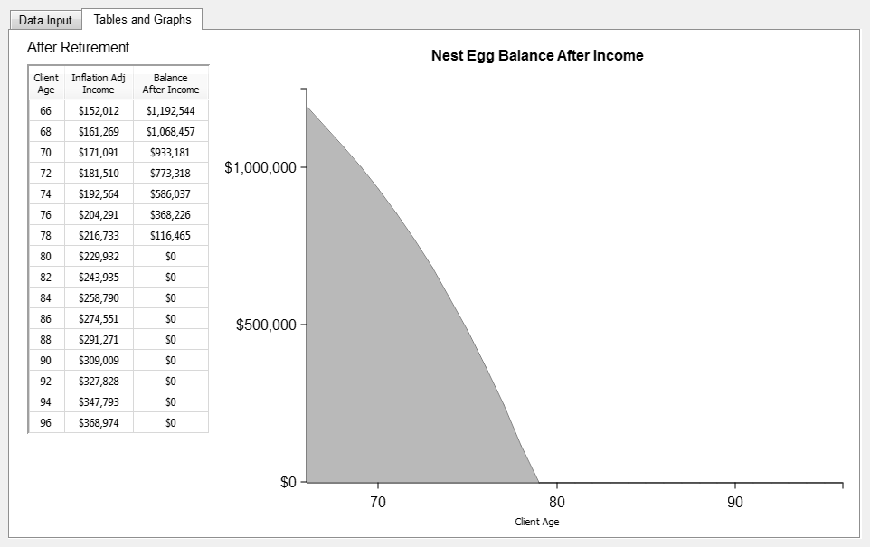
Sample Income Prediction
Notes:
The illustration shows the basic inputs and a couple wanting to have 100 % of their current income for retirement. They’ve saved about $700,000, are still putting away $12,000 a year from their combined income of $120,000. They want to both retire at full income when he reaches age 66. The result below shows the couple running out of money when he reaches age 78.
If they tail back their expectations and work one more year and choose 70% of their income goal then they can have income stretching out well into their 90s.
You can see that managing expectations when planning for income can help you prepare for a comfortable retirement. It’s important to work with a financial planner to help work through your expectations.
Check out the Retirement Income Planning Worksheet in the Appendix to begin working on your plan.

Slide 52
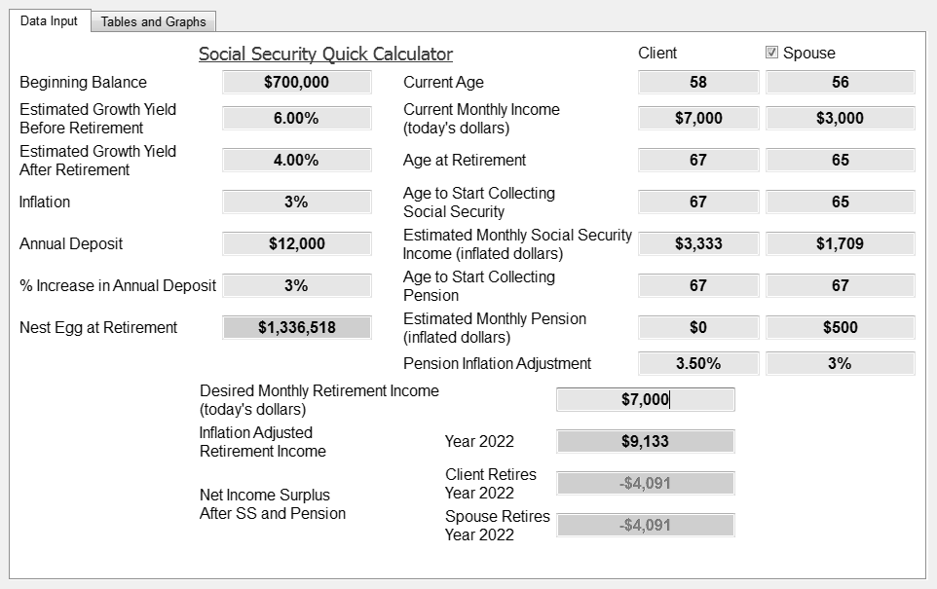
Sample Income Prediction
p. 42
Notes:
The illustration shows the basic inputs and a couple wanting to have 100 % of their current income for retirement. They’ve saved about $700,000, are still putting away $12,000 a year from their combined income of $120,000. They want to both retire at full income when he reaches age 66. The result below shows the couple running out of money when he reaches age 78.
If they tail back their expectations and work one more year and choose 70% of their income goal then they can have income stretching out well into their 90s.
You can see that managing expectations when planning for income can help you prepare for a comfortable retirement. It’s important to work with a financial planner to help work through your expectations.
Check out the Retirement Income Planning Worksheet in the Appendix to begin working on your plan.

Slide 53
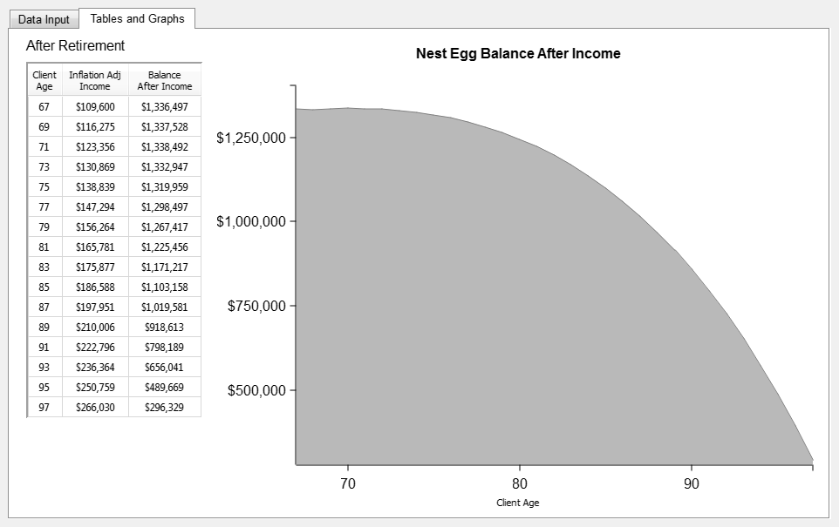
Sample Income Prediction
Notes:
The illustration shows the basic inputs and a couple wanting to have 100 % of their current income for retirement. They’ve saved about $700,000, are still putting away $12,000 a year from their combined income of $120,000. They want to both retire at full income when he reaches age 66. The result below shows the couple running out of money when he reaches age 78.
If they tail back their expectations and work one more year and choose 70% of their income goal then they can have income stretching out well into their 90s.
You can see that managing expectations when planning for income can help you prepare for a comfortable retirement. It’s important to work with a financial planner to help work through your expectations.
Check out the Retirement Income Planning Worksheet in the Appendix to begin working on your plan.

Slide 54
Retirement Budget
Retirement Budget Worksheet
 | Current | Retirement
Item | Budget | Budget
Food
Home Consumption
Outside the Home
Total Food:
p. 43
Notes:
Budgeting for Retirement
The challenge for most facing retirement is setting up realistic expectations for their lifestyle and the income that supports it. We often confuse our wants with needs and believe we really have to have something that we don’t really need. When making plans for retirement, a budget is indispensable.
A budget for retirement needs to take into consideration your current costs first and then decide if you will still have those costs when you retire. The section below shows a part of the Retirement Budget Worksheet in the Appendix. Ask yourself what is your current cost of food at home (your grocery bill), and what you think the cost will be when you retire. Will it be more or less? Will you be eating more meals at home or going out more often?
Exercise: Fill out this section of the Retirement Budget Worksheet.
Retirement Budget Worksheet
Be sure and check out our Retirement Budget Worksheet in the Appendix.

Slide 55
Unrealistic Expectations
Question: What are some examples of how poor expectations could affect your sense of fulfillment when you retire?
Question: In what ways does budgeting help correct poor expectations?

Slide 56
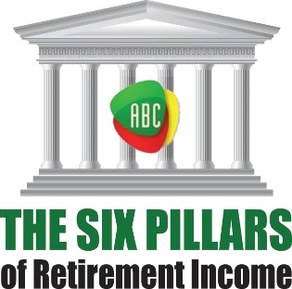
Poor Decision Making
Eight Challenges to Retirement Income
p. 44

Slide 57
Investing Temperaments
Goal Oriented
Blue
Green
Fearful
Confident
Yellow
Red
Impulsive
p. 45
Notes:
Exercise: Put an X on the lines below that best fit you.

Slide 58


Which investor temperament best describes you?
In what ways do you think your temperament affects your financial decisions?
Notes:
If think about what temperament you have as it relates to money it may help you understand how you make decisions. It would also give you an idea as to how a process can help your temperament make a decision that best fits you. Let’s take a look at four typically very different and very colorful temperaments:
Red: Someone who is most often confidently impulsive in their decision making. They have difficulty saving money, because they love to spend it. They are usually very optimistic, impulsive and a risk taker.
Green: Someone who thinks in concrete blocks. Greens need to have four reasons for choosing a path, or three reasons for deciding on an asset. They like guarantees because they want to feel certain about their direction. Very driven to save money and is highly goal oriented. Very ambitious, wanting to get it done now.
Yellow: A very easy going personality who might wait until tomorrow to make a decision. They prefer stability and fear change. Yellows are very rational and observant, able to manage a plan affectively once it’s set in place, yet don’t like to make the final decision.
Blue: Needs plenty of details and often gets paralyzed by over-analysis. Will need information, and most often take a long time to see through the details to a conclusion. Once the decision is made, Blues are always second guessing themselves. They are very cautious and somewhat fearful of the future.

Slide 59
Three Components of a
Financial Decision
Logic
Emotions
Beliefs
p. 46
Notes:
Logic, Beliefs, & Emotions
Typically there are three aspects of making decisions regarding financial planning: logic, emotion, and beliefs.
Logic is the science of reasoning. People, generally, have an innate need to reasonably work through an issue with facts and details. They need to rationally decide on a financial plan. You need to be able to look at your plan and say to yourself, “Now, that makes sense!”
Secondly, the beliefs we have about money, the market, risk, financial advisors, assets and other retirement issues significantly influence our decisions. We get our beliefs from various sources. It can be the TV, books, friends, relatives, or business associates. Some of these beliefs are true and some are just money myths that have been around for ages. Finding out the truth about an asset or a way to use an asset to accomplish your goals is the challenge.
Lastly, and probably the most difficult to work through are our emotions when it comes to money and making financial decisions. We have conscious and even subconscious beliefs about finances. You may have been brought up in a home where money was a constant source of arguments and grief, giving you an internal belief that money is painful. It would be very difficult to work through that pain when making a decision with your spouse about the future of your retirement. Making money decisions can be the most stressful decisions you have to make. That’s why it’s important to have a process in which you make small decisions along the way of developing a major financial plan.

Slide 60

Poor Decision Making
Of the three, logic, beliefs, and emotions, which do you think effects your decisions the most and why?
What are some beliefs you have about finances that have influenced your decisions in the past?

Slide 61
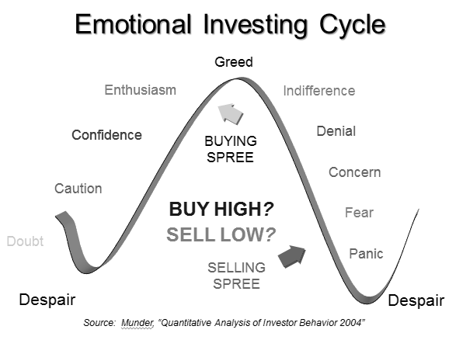
Emotional Investing
Notes:
Below is a graph from a Dalbar study in March, 2011, showing the 20 year returns through 2010. The average equities investor returned an average of 3.83%, averaged Fixed Income Investor 1.01%, and the Average Allocation Investor 2.56%. All of this while over the same period, a person who would have just bought and held onto the S&P 500 would have returned 9.14% and inflation was 2.57%.
You have to ask yourself why this would happen and the reason is a term called “emotional investing.” People have adverse reactions to the markets and pull their investments out when they probably should be buying into the market. Below illustrates the flow of emotions investing through a boom-bust cycle in the market. (34) “2011 Quantitative Analysis of Investor Behavior” Dalbar Inc., Research & Communications Division, March 2011.
Starting on the left of the graph the market moves up into a Bull market and eventually tapers off to the right ending in a market correction, maybe even a Bear market. The average investor usually buys into the market near the top when everyone is enthusiastic and sells out of the market in near panic. This of course, is the exact opposite of how to make money when investing. It is also the reason for the wide differential in 20 year returns mentioned in the Dalbar study.
Financial decisions are emotional, and those emotions can cost investors millions of dollars

Slide 62
Poor Decision Making
How do you protect yourself from buying high and selling low?

Slide 63

Process, Process, Process
Investigate
Recommend
Implement
Review & Adjust
p. 49
Notes:
Process, Process, Process
In battling emotional investing, it’s helpful to have a process to work through to protect yourself from buying high and selling low. We suggest a process of investigation, recommendation, and implementation, followed by a healthy dose of review and adjustments. This process should help you work through your emotions, challenge your beliefs, and allow you to make sense out of complicated financial matters.
If you use a financial planner, and we heavily recommend you do, then be sure to ask them about the process they want to use to help you make a financial plan. Here are the steps we suggest:
Investigation – The first step allows you and the financial planner to investigate each other, investigate your portfolio, investigate any leaks, gaps, or deficiencies in the client’s current plan, and investigate sample solutions to your needs. Establish specific, realistic financial goals and make us of any financial tools such as planning software to help in the process. You should receive brochures and/or prospectus from the financial institutions recommended, printouts from any software used, and possibly an ADV II (prospectus) for a Registered Investment Advisor, if used. This is a phase to go through and may take more than one meeting. Meetings should be 60 to 90 minutes in length.
Recommendation – The second phase of the planning process should include recommendations, which bring the specific elements of the suggested solutions to bear on the diagnosis. This may involve the use of various financial assets, tax analysis and estate planning concerns. This phase may also include income planning, protection of assets from market loss, or asset management recommendations. During this phase you should be asked to make decisions regarding asset allocation and transfers.
Implementation – The third phase begins the process of allocating assets to the proper areas by way of applications to set up accounts and transfers to and from the various financial companies. The financial planner should follow-up on the transfer of assets to make sure the assets are properly transferred which can take 2-6weeks, and sometimes longer. Once the assets are transferred you should sit down again with your advisor to review the end results.
Review & Adjust – The fourth phase is the ongoing process of reviewing accounts, making sure they are moving forward as planned to accomplish your goals. You will want to adjust as necessary, and have your advisor keep you informed of upcoming opportunities to enhance your plan.
Given the right process, your emotions will have the opportunity to be led by your beliefs, which will be challenged by the truth, leading to a logical conclusion. You need an advisor who doesn’t try to “sell” you his favorite asset, but thinks with you through a process which leads to the best financial decision for your retirement.

Slide 64
Poor Decision Making
How do you typically make a financial decision?
Who do you include in making a financial decision?
Have the advisors you have worked with in the past been more of a salesman or a process/planner type?

Slide 65
^{Four Main Goals}
^{Section Three}

Slide 66
Conserve Your Assets
Four Main Goals
p. 52

Slide 67

A plan for your retirement assets from being subject to a repeat of history.
Notes:
Read slide
So lets look at a new model, we call it the ABC planning process. Where
many of you are used to the old paradigm of pyramid investing. Let’s talk about the ABC
planning process…

Slide 68



What is your greatest priority?
What are you willing to give up?
Gains? Liquidity? Protection?
Cash
Protective Growth
Risk Growth
Potentially lower returns
Taxable or tax-deferred
Liquid
Potentially moderate returns
Tax-deferred
Offer partial withdrawals
Potentially higher returns
Taxable or tax-deferred
Offer partial withdrawals or liquid
Liquidity
Protection
Gains
Gains
Liquidity
Protection
Notes:
Now let’s take a glance at what you gain and lose in each column. There is a “Risk-Reward” for each column, which means, you stand to gain or lose something by placing assets in each scenario.
If your main goal in placing money in column A is good liquidity, you will probably have to put up with low interest rates. So, you would be capturing liquidity and losing some potential gains. If you want the protection of Column B, then you will have to consider a longer-term mindset, putting up with 10% liquidity each year. If what you want by placing money in Column C is higher potential gains, you will have to give up protection of those assets.
Said differently, in Column A you give up GAINS to get more LIQUIDITY. In column B you give up some LIQUIDITY to acquire PROTECTION from risk, and in Column C you give up POTECTION for higher potential GAINS, as illustrated.

Slide 69
Three Green Money Rules:
The ABC Planning Model
Rule #1: Protect Your Principal
Rule #2: Protect Your Gains
Rule #3: Protect Your Income

Slide 70
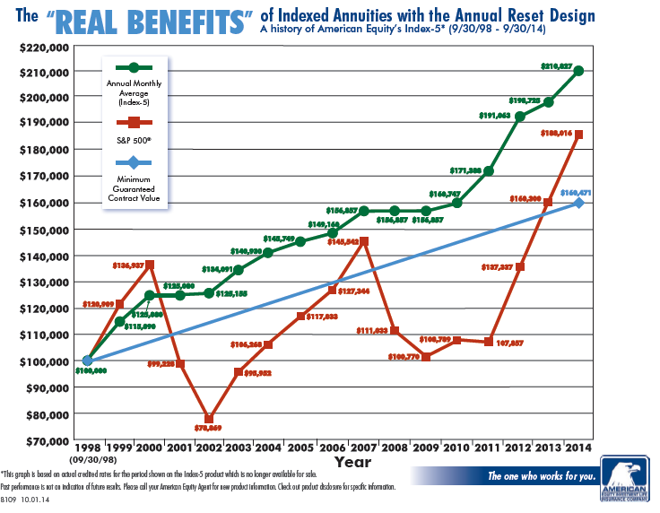
*DISCLOSURE: This is a Hypothetical Graph that reflects the actual interest crediting methods used by a specific insurance company from a time period beginning 09/30/1998 and ending on 09/30/2014. Individual results may vary and be dependent upon crediting methods, caps and participation rates. This is for illustration purposes only to show how a Fixed Index Annuity may have performed over a specific period of time.

Slide 71
Three Red Money Rules:
The ABC Planning Model
Rule #1: Must Be Tactical
Rule #2: Must Be Liquid
Rule #3: Must Be Long Term

Slide 72
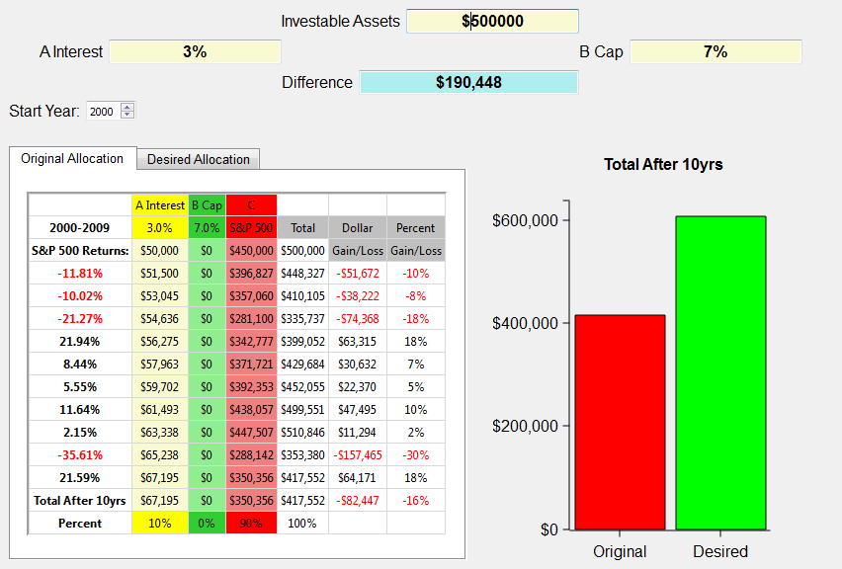
What if a bear market happens again? 2000 through 2009
Notes:
The illustration above shows the S&P 500 returns for the years 2000 through 2009 on the left. The investible assets are $500,000. This example shows a typical investor who has about 10% in cash earning an average of 3% and 90% allocated to the market represented by the S&P 500. We use the broad market index to approximate what investing in the market in general was like over that period of time. Certainly an investor could have been in more or less risk than illustrated here. Yet, the illustration shows in general terms how the market performed from 2000-2009. Notice, there are no monies allocated to Column B, which are Index Annuities.
The chart shows at the end of the ten year period this investor would have lost close to $100,000. I don’t know about you, but a 20% loss in the market is devastating when it comes to retirement! Imagine if you were 52 years old in 2000 and planning to retire when most people retire at age 62. Would you do what many have had to do, which is work another 3-5 years in hopes of recovering those assets needed to retire?
And what if it happens again? What if the next ten years aren’t any better than this decade? Can you afford to lose another 20% or possibly more? Can you continue to push off your retirement indefinitely?
When I show this graph to clients they tell me, “Yep, that’s about what happened to us.” Yet, the same clients will surprisingly stay in this broken down Wall Street model attempting to recover with a hope and a prayer.
There has to be a better way, and I believe there is.
Next slide.

Slide 73
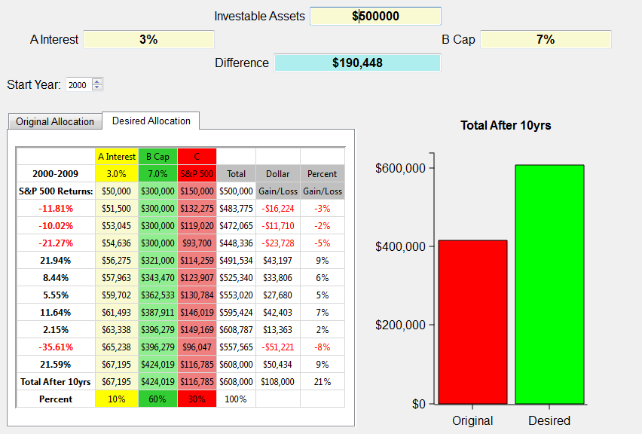
What if a bear market happens again? 2000
through 2009
$190,448
Notes:
Using the 10/60/30 ABC split, this person gains $108,000 instead of losing over $80,000! Now that’s a strategy that works for retirement years. IT does so because it obeys Warren Buffet’s first rule of investing, “Never lose any money.” BTW, that happens to be rules number 2 and 3 also. And it has to be true, especially for retirees or those heading into retirement.
Simply putting some of your money in the green money column protects you from those down years and now with the tremendous guaranteed income payouts the green money column is even more a must for retirees. We don’t want you to get totally out of the red, or growth money assets, but it’s obvious that the green money column is perfect for conservative clients looking for alternatives to Wall Street’s roller coaster rides.

Slide 74
The ABC Planning Model
.25% – 1.25%
3% – 7%
+30% – -30%
Taxable
Liquid
Bank
CDs
Savings
Checking
Tax-Deferred
Moderately Liquid
Taxable
Liquid
401k
IRA’s
Stock/Bond
10%
60%
30%
Notes:
Let’s divide assets into categories, A, B, and C, which represent three types of assets. Category A is your cash reserves. Cash assets potentially carry low returns, but the principal is guaranteed, and interest is compounded. According to the Federal Reserve the average six month CD rate from 1990-2009 was 4.37% (20 years); 2000-2009 was 3.32% (10 years); from 2005-2009 was 3.99% (5 years).(1) It is interesting to note the average inflation rate from 2000-2009 was 2.57%, which leaves the five year return averaging less than 1.5% before taxes. (2)
These accounts are typically taxable and have optimum liquidity. However, they can also be set up in various tax-advantaged strategies such as traditional IRA’s, Roth IRA’s, etc. Most often these are bank held assets like CDs, savings accounts, and money markets.
Financial advisors will often refer to this as short term money, or emergency funds. If your furnace breaks down, your roof leaks, or you have a medical emergency, category A is where you save for such an occurrence. If you are saving for an exciting vacation or a new car, this is where the money goes. It is also where you might want to keep a savings account to replace any income lost due to a prolonged illness, injury, or job loss. Commonly, financial advisors will tell you to have six months to a year of income put away for these instances. The illustration below shows Column A assets. Imagine them as “Yellow Money” accounts.
The second category is Column B, the Green Money Column, and holds Protected Growth assets. They offer potentially moderate returns, are tax-deferred and offer partial withdrawals. The principal is protected, and previous years gains are retained as interest. The annual returns on these assets vary greatly. In my own practice I have seen them yield from 0% to as high as 16%. Some include bonuses from 3% to 7%. These assets are designed to be the middle ground between CDs and the market.
I prefer using fixed indexed annuities in column B which link the interest credits to the performance of a market index, such as the S&P 500, S&P Midcap 400, DOW, Russell 2000, Euro Dow, etc. Column B money is set aside for a longer period, often 5-10 years. Annuities have strings attached for withdrawals, but can be an excellent source of income over a lifetime. In other words, don’t allocate money to the B column
Generally assets in this column offer only partial withdrawals without a penalty, yet many include riders that waive surrender fees in the event of a nursing home stay or terminal illness. Indexed annuities are designed to function as the middle ground between lower interest rates of bank CDs and savings accounts, and the potential higher returns of risk oriented market money.
This is the Fixed Principal Asset column, where the principal is protected. The ABC Model looks at Fixed Income Assets different than Wall Street does. Over the years, Wall Street has used a laddered portfolio of bonds to accomplish the goals of column B, yet a bond can lose value. From 1999 to 2009, if you were holding Lehman Brothers, Bear Stearns, ENRON, or World Com bonds, you might have thought you were safe, but found out just how much you could lose in a bond. If you are holding a California bond right now you might be a little insecure. That is why we use Fixed Principal Assets in column B rather than Fixed Income Assets.
Column C represents our Red Risk Growth assets which move up or down with the market. Investors usually chase higher returns over time, though these assets can gain or lose 30% in a year or even more. The S&P 500 lost 38% in 2008, but the average annual return from 1995-1999 was over 25%. (4) The market “giveth” and the market “taketh” away, there are no protections or limits. This money is invested in securities like stocks, bonds, mutual funds, variable annuities, options, REITs, and the like. The principal isn’t protected and last year’s gain may be lost in a downturn of the market. While these accounts are associated with a longer time horizon they are usually more liquid due to the “sellable” nature of securities, unless they are in a variable annuity which offers partial withdrawals.
The majority of the assets found in column C are in retirement accounts such as 401(k)’s, 403(b)’s, IRA’s and variable annuities. Column C monies can also be found in the form of non-qualified (after-tax) brokerage accounts, mutual funds, stocks, or bonds, held by an individual, jointly, or even in trust. You can be your own manager or hire a professional investment adviser to manage this part for you. Let’s paint these investments Red for Risk.
Sometimes it’s confusing as to which assets belong in which column. Column B has Three Green Money Rules which are: Protect your principal, retain your gains, and guarantee your income. If an asset can’t do those three things it doesn’t belong in the ABC Model’s Column B. Bonds don’t follow those rules so they must go in the next Column C. Therefore, a Fixed Indexed Annuity is probably an ideal asset for column B.

Slide 75
Notes:
Now it is time to figure out how you would allocate your assets in the ABC Model. All you will need to do is ask yourself, “What percent of my total assets do I want in each column?” We will determine in the following chapters what specific assets to use, but for now try to use percentages in each column that “feels right” to you. There is no right or wrong answers. It is up to you the investor to look at the guidelines for each column and decide.
So, what percent of your investable assets would you like in each column? Go ahead and take a shot at it.
Start with column (A) and ask yourself how much emergency money or liquidity you need. In other words, don’t worry much about return but concentrate on liquidity. How much money do you need available immediately. How much money would you need in the next six months to live on if your current income went away? You can express it in a percentage or a specific dollar amount. Your number will be personal to you.
Second, you could ask yourself how much money you want at risk in the market and what type of market risk you want. Do you want Stock-type risk or Bond-type risk? As a conservative investor you probably don’t want options or aggressive risk oriented assets. Keep it simple here. Decide how much money you want at risk, and then decide what type of risk. The more conservative you are, the more you will gravitate toward bond-type risk. The more moderate you are, you will probably have a higher percentage in this column and most of it will be in stock related assets such as mutual funds, ETF’s, or managed accounts.
Again, just ask how much money you’re willing to expose to losses. If you can’t stand the thought of losing a penny, your answer to this question is “0”! Go ahead and take a stab at it. Got your number? Let’s move on.
Once you have the percentage you want in Columns A and C simply add them together and subtract from 100 to get your B Column percent. It is that easy. You now have percentages in each column and can make adjustments. For instance, if you feel you have too much at risk simply put more in Columns A or B. Or if you feel you have too much tied up in Column B and don’t want any more risk, then simply add more to Column A. Play with the numbers until you think you have what you want.

Slide 76
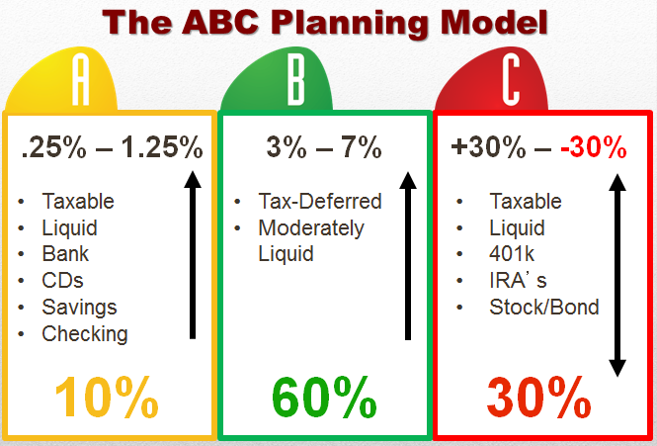
Conserve Your Assets
Question: How would the ABC Planning Model help you conserve your assets?

Slide 77
Generate Your Income
Four Main Goals
p. 55

Slide 78
What Percent of Your Income Do You Want Guaranteed?
“The 4% rule cannot be treated as a safe initial withdrawal rate in today’s low interest rate environment…”
Michael S. Finke,
Texas Tech University
“…Because of sequence of returns risk, portfolio withdrawals can cause the events in early retirement to have a disproportionate effect on the sustainability of an income strategy.”
Notes:
What percent of your income do you want guaranteed?
One of the most important decisions in planning for 30-40 years of income in retirement is the sources you will take income from. Over the years, the general practice has been to develop a conservative portfolio of stocks and bonds and withdraw a certain percent from those assets each year. The standard for withdrawals has been 4% in the industry; meaning that if you take 4% out of your retirement plans you should be able to make your money last a lifetime.
According to an article in May 2013 of the New York Times, Bill Bengen, owner of Bengen Financial Services in San Diego, created the 4% rule in 1993, when portfolio returns averaged around 8%. Mr. Bengen suggested a portfolio of 60% large-cap stocks and 40% intermediate-term government bonds. He examined every 30-year period since 1926. However, with interest rates falling below 2-3 percent on fixed assets it severely dampens the results on 40% of the assets in Mr. Bengen’s model.
More recent studies show that the 4% rule in today’s economy is definitely in question. In the abstract from Michael S. Finke’s “The 4 Percent Rule is Not Safe in a Low-Yield World,” the professor from the Texas Tech University in Lubbock, Texas said the following on January 15th, 2013:
“Using historical averages to guide simulations for failure rates for retirees spending an inflation-adjusted 4% of retirement date assets over 30 years results in an estimated failure rate of about 6%. This modest projected failure rate rises sharply if real returns decline. As of January 2013, intermediate-term real interest rates are about 4% less than their historical average. Calibrating bond returns to the January 2013 real yields offered on 5-year TIPS, while maintaining the historical equity premium, causes the projected failure rate for retirement account withdrawals to jump to 57%. The 4% rule cannot be treated as a safe initial withdrawal rate in today’s low interest rate environment…
…Because of sequence of returns risk, portfolio withdrawals can cause the events in early retirement to have a disproportionate effect on the sustainability of an income strategy. We simulate failure rates if today's bond rates return to their historical average after either 5 or 10 years and find that failure rates are much higher (18% and 32%, respectively for a 50% stock allocation) than many retirees may be willing to accept. The success of the 4% rule in the U.S. may be an historical anomaly, and clients may wish to consider their retirement income strategies more broadly than relying solely on systematic withdrawals from a volatile portfolio.”
If the 4% rule is flawed then what are the alternatives? Again, this is where the ABC Planning Model comes in to play. Choosing a percent of assets to allocate to Category B allows you to guarantee the income for that portion of your portfolio. So, in essence, you guarantee a portion of your income using Category B strategies and take withdrawals on your Category C assets. Doing so doesn’t put such a strain on your assets in the market in the event of a severe downturn or continued or revisited low interest rates.

Slide 79
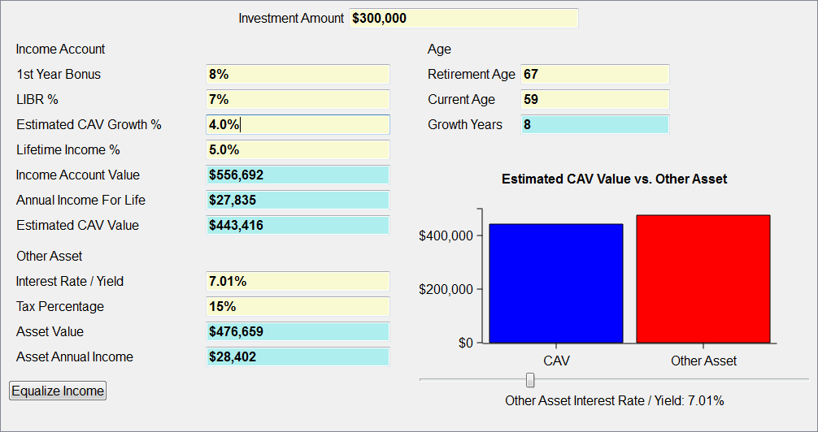
ABC Snapshot
Income Rider vs.
p. 56
Notes:
One such strategy is using a Fixed Indexed Annuity’s Guaranteed Withdrawal Benefit rider, which can guarantee income over the course of your retirement years. The example below shows an investment amount of $300,000 for a person age 59 looking to start guaranteed withdrawals at age 67. The annuity receives an 8% bonus and a roll-up rate (LIBR%) of 7%. At age 67 the Annual Income for Life is guaranteed to be $27,835. The question is for any other asset, what would the after tax return have to be, guaranteed now and for the rest of the person’s life? The answer is 6.91%. What asset do you know today that would guarantee an after tax return of 6.91% for the rest of this person’s life? The answer is simple: none.
In retirement planning, guaranteeing a portion of your income is useful when considering downturns in the market and the unreliability of the 4% rule.

Slide 80
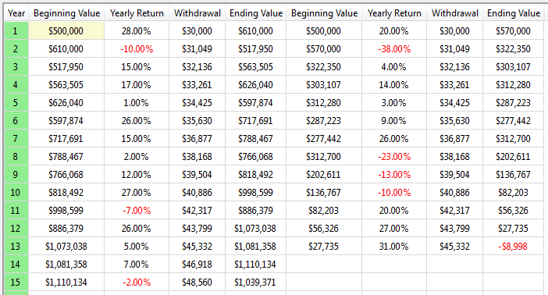
ABC Snapshot
Sequence of Returns
Notes:
This sequence of returns illustrates a $500k account in the market with a hypothetical index. Withdrawing $30k a year and inflating that by 3.5%. Two different sets of indexes. One has over $1 million after 15 years and one runs out of money in 13 years. That’s why the sequence of returns matters more than averaging returns.

Slide 81
Generate Your Income
Question: What percent of your retirement income would you want guaranteed?
Question: What percent of your retirement income are you comfortable with fluctuating?

Slide 82
Guard Against Inflation
Four Main Goals
p. 57

Slide 83
Guard Against Inflation
At just 3.5% inflation over 10 years:
A car that costs $25,000 today will cost $35,265
That $1,180 summer getaway today will cost $1,665
A $250,000 home today will cost $352,650
A Nursing home bill of $8,000 a month will cost $11,285
A loaf of bread at $1.45 will cost $2.05
Notes:
Effects of Inflation
The importance of guarding against the devastating effects of inflation should be obvious to all who are planning for 30-40 years of retirement income.
At just 3.5% inflation over 10 years:
A car that costs $25,000 today will cost $35,265
That $1,180 summer getaway (1) today will cost $1,665
A $250,000 home today will cost $352,650
A Nursing home bill of $8,000 a month will cost $11,285
A loaf of bread at $1.45 will cost $2.05
At just 3.5% inflation over 20 years:
A car that costs $25,000 today will cost $49,745
That $1,180 summer getaway (1) today will cost $2,348
A $250,000 home today will cost $497,447
A Nursing home bill of $8,000 a month will cost $15,918
A loaf of bread at $1.45 will cost $2.89
At just 3.5% inflation over 30 years:
A car that costs $25,000 today will cost $70,170
That $1,180 summer getaway (1) today will cost $3,312
A $250,000 home today will cost $701,698
A Nursing home bill of $8,000 a month will cost $22,454
A loaf of bread at $1.45 will cost $4.07
At just 3.5% inflation over 40 years:
A car that costs $25,000 today will cost $98,981
That $1,180 summer getaway (1) today will cost $4,672
A $250,000 home today will cost $989,815
A Nursing home bill of $8,000 a month will cost $31,674
A loaf of bread at $1.45 will cost $5.74
While you might not be buying that new car or house at age 95 to 100, the above serves as an illustration of how lifestyles could be dramatically altered if inflation is not accounted for.
Generally, there are two ways to hedge against inflation in the ABC Planning Model. First, you can put inflation protection on the income riders in Category B. Many of these assets give you an ability to take a little less now and inflate it over the course of your retirement.
Second, is to make sure your Category C money is allocated in such a way as to provide you with the amount of volatility you can tolerate and the returns to hedge against inflation. The Red money column is your growth money and should be tactically managed by professionals who watch your money each day, especially while you are on that summer get-away. Investing is done at the speed of information and you need a portfolio manager who adapts with the ever increasing changes in the market. This should help you avoid the low lows of a Bear market in retirement. Again, finding a good financial advisor is a key to making your red money work for you instead of just hoping your current set of mutual funds will somehow make it to the end.

Slide 84
Guard Against Inflation
At just 3.5% inflation over 40 years:
A car that costs $25,000 today will cost $98,981
That $1,180 summer getaway (1) today will cost $4,672
A $250,000 home today will cost $989,815
A Nursing home bill of $8,000 a month will cost $31,674
A loaf of bread at $1.45 will cost $5.74
Notes:
Effects of Inflation
The importance of guarding against the devastating effects of inflation should be obvious to all who are planning for 30-40 years of retirement income.
At just 3.5% inflation over 10 years:
A car that costs $25,000 today will cost $35,265
That $1,180 summer getaway (1) today will cost $1,665
A $250,000 home today will cost $352,650
A Nursing home bill of $8,000 a month will cost $11,285
A loaf of bread at $1.45 will cost $2.05
At just 3.5% inflation over 20 years:
A car that costs $25,000 today will cost $49,745
That $1,180 summer getaway (1) today will cost $2,348
A $250,000 home today will cost $497,447
A Nursing home bill of $8,000 a month will cost $15,918
A loaf of bread at $1.45 will cost $2.89
At just 3.5% inflation over 30 years:
A car that costs $25,000 today will cost $70,170
That $1,180 summer getaway (1) today will cost $3,312
A $250,000 home today will cost $701,698
A Nursing home bill of $8,000 a month will cost $22,454
A loaf of bread at $1.45 will cost $4.07
At just 3.5% inflation over 40 years:
A car that costs $25,000 today will cost $98,981
That $1,180 summer getaway (1) today will cost $4,672
A $250,000 home today will cost $989,815
A Nursing home bill of $8,000 a month will cost $31,674
A loaf of bread at $1.45 will cost $5.74
While you might not be buying that new car or house at age 95 to 100, the above serves as an illustration of how lifestyles could be dramatically altered if inflation is not accounted for.
Generally, there are two ways to hedge against inflation in the ABC Planning Model. First, you can put inflation protection on the income riders in Category B. Many of these assets give you an ability to take a little less now and inflate it over the course of your retirement.
Second, is to make sure your Category C money is allocated in such a way as to provide you with the amount of volatility you can tolerate and the returns to hedge against inflation. The Red money column is your growth money and should be tactically managed by professionals who watch your money each day, especially while you are on that summer get-away. Investing is done at the speed of information and you need a portfolio manager who adapts with the ever increasing changes in the market. This should help you avoid the low lows of a Bear market in retirement. Again, finding a good financial advisor is a key to making your red money work for you instead of just hoping your current set of mutual funds will somehow make it to the end.

Slide 85

Two Choices
Green Money Guarantees
Red Money Hedge
Of the two choices, which would you prefer to use to battle inflation and why?
Notes:
While you might not be buying that new car or house at age 95 to 100, the above serves as an illustration of how lifestyles could be dramatically altered if inflation is not accounted for.
Generally, there are two ways to hedge against inflation in the ABC Planning Model. First, you can put inflation protection on the income riders in Category B. Many of these assets give you an ability to take a little less now and inflate it over the course of your retirement.
Second, is to make sure your Category C money is allocated in such a way as to provide you with the amount of volatility you can tolerate and the returns to hedge against inflation. The Red money column is your growth money and should be tactically managed by professionals who watch your money each day, especially while you are on that summer get-away. Investing is done at the speed of information and you need a portfolio manager who adapts with the ever increasing changes in the market. This should help you avoid the low lows of a Bear market in retirement. Again, finding a good financial advisor is a key to making your red money work for you instead of just hoping your current set of mutual funds will somehow make it to the end.

Slide 86
Limit Taxation
Four Main Goals
p. 59

Slide 87

Four Choices
Limit taxation on your Social Security - use pre-tax dollar plans first.
If taking Social Security benefits before Full Retirement Age, limit income from pretax plans.
Make good use of Roth IRAs and other tax-free assets.
Diversify your retirement income sources.
Notes:
Getting More Spendable Income
The fourth goal is to limit taxation on you retirement income. Optimizing your tax results when setting up your income stream will result in more spendable income as years progress and tax rates increase. Creating more spendable income will allow you to keep your standard of living higher as you progress into retirement.
For example, if you have $500,000 in your 401(k) today and you convert to an IRA at 59 ½ you won’t get taxed on the transfer, but you’ll be passing on a tax liability as years progress. Just think of your $500,000 averaging 6% in the market over the next 10 to 15 years. That would be good right? Maybe, maybe not. In 10 years it will be $895,424 and at 15 years it will total $1,198,279 of all taxable money. Are tax rates going up or down? So, most likely you will have more money exposed to higher tax brackets. Your tax liability at $500,000 may be $150,000, but in 10 years if tax rates were to rise just 10 percent you could owe $358,170 and in 15 years $479, 312. And that’s if tax rates only increase 10 percent.
So, strategizing to pay fewer taxes is incredibly important to the quality of life you wish to experience during your retirement.
Here are a few suggestions for developing more spendable income.
Limit the taxation on your Social Security by using pre-tax dollar plans first.
Between 50% - 85% of your Social Security benefits may end up being taxed if you don’t keep an eye on income levels in any given year. It may be wise to draw income from your IRA’s and other pre-tax dollar accounts first, while letting your Social Security benefits earn delayed credits until your age 70. Then draw from Social Security and your after-tax and tax free accounts starting at age 70.
If taking Social Security benefits before Full Retirement Age, limit income from pretax plans.
Withdrawals from pre-tax retirement plans such as 401(k)’s or IRAs are taxable dollars. If you are receiving Social Security benefits on or before full retirement age, or even before age 70, try to limit your withdrawals from your pre-tax retirement plans.
Make good use of Roth IRAs and other tax-free assets.
The contributions to Roth IRAs are not tax-deductible, yet when you take money out of your Roth after 5 years it is tax-free to you and your heirs. We live in a time of historically low tax rates and it may make sense to begin to “Roth” some of your pre-tax retirement accounts starting at age 59 1/2. You could make use of 6 to 7 years of rollovers from your pre-tax accounts to Roth IRAs before you reach full retirement age for Social Security. This could create tax-free income in retirement and make managing taxation of Social Security benefits more plausible in later years. Remember that you will pay tax on your liquidation of pre-tax retirement accounts to create a Roth. It is best to consult a tax expert on these issues.
Diversify your retirement income sources.
One of the best ways to manage taxation during retirement is to diversify your sources of income whenever possible. Taking distributions from taxable (pre-tax retirement plans), tax-free (Roth IRAs and Municipal-bonds), and non-taxable (life insurance retirement plans) sources can help keep you in lower marginal income tax brackets.

Slide 88

Six Pillars of Retirement Income

Slide 89
Pillar #1:
Personal Retirement Accounts
Six Pillars of Retirement Income

Slide 90

Personal Retirement Accounts
Qualified/
Pre-Tax Dollar Plans:
401(k)
403(b)
457
KEOUGH
Simple IRA
SEP IRA
IRA
Notes:
Qualified plans: 401k, 403b, 457, Simple IRA, SEP IRA, IRA
The first Pillar of retirement income is the one you have focused on for most of your working career. It’s the investing foundation you have made into your pre-tax dollar accounts at work or your IRAs. We use the term “qualified” for all retirement plans that were created with monies deducted from wages and self-employment income and thus have not to this point been taxed. So, all the monies sitting in these accounts are taxable. These include 401(k), 403(b), 457, KEOUGH, Simple IRA, SEP IRA, IRA plans that are all funded with monies you deducted from your tax return while working. Employer sponsored qualified retirement accounts are known as Defined Contribution Plans.

Slide 91
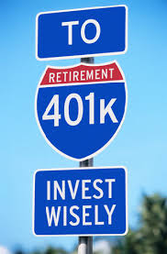
Defined Contribution Plans
401(k) Advantages:
Tax-deduction
Tax-deferral
Payroll deduction
Company matching
Loan structure
Notes:
Defined Contribution Plans
The defined contribution plan was created in 1978 Congress amended Section 401(k) of the IRS code. “It took effect in 1980, and by 1983 more than half of large companies were setting up 401(k) plans, a little more than 17,000. Half way through the 1980’s there were less than 8 million people investing in 401(k)’s with about $100 billion invested. By 2006, there were seventy million participants and more than $3 trillion invested.” (2)
The 401(k) plan is a defined contribution plan where the worker deducted earnings from their wages and deposited them into an account set up by their employer. Often, but not always, the employer matched the employee’s deposits up to a percentage of monthly earnings. The 401(k) and all of the plans like it, the 457, 403(b), SEP IRA, and such, were designed to transfer the risk for funding retirement from the employer to the employee. It was also designed to open up more opportunity for employees to save for retirement past what their employee could afford to do through company pensions, otherwise known as defined benefit plans.
401(k) plans and those like them are called defined contribution plans because it is the employee’s contribution, which is the focus of the plan. The defined benefit plan is named so because the employer on the payment or benefit focuses on the employee’s retirement.
Advantages
These pre-tax, employer sponsored plans were designed for the wealth accumulation of the employee with a view toward retirement. The employee would choose a percent of their earnings to deduct from their paycheck, say 5%, and the employee would match up to a percentage, say 3%. Thus, any monies you put into the account up to your matching would double when the employer put in their amount. You could put in more, but the employer wasn’t obligated to match past their stated percent. It became the wealth accumulation vehicle for a generation of Boomers.
One of the advantages of this strategy is that you could reduce your taxable income by the amount of your deductions up to certain limits stipulated by the IRS. If you were making $60,000 a year and deducted 5% from your paycheck, you could deduct the $3,000 from your taxes right off the top. That strategy could have easily saved you $300 to $450 in taxes if your net tax rate was 10% to 15%. It might have even put you in a different marginal tax bracket.
Of course, along with the benefit of tax-deduction came the benefit of tax-deferred growth. You wouldn’t be paying any taxes on your pre-tax dollar plans as they accumulated value. This means that the money normally directed toward taxes would stay in the account and grow as well. Tax-deferred growth is a powerful force in saving for retirement over the long haul.

Slide 92
Defined Contribution Plans
401(k) Disadvantages:
Compliance
DRAC
Limited Choices
20% Withholding
Limited Beneficiary Options
RMD Errors
Notes:
Disadvantages
While the 401(k) and other plans like it have been powerful retirement savings vehicles, there are at least six notable disadvantages.
Compliance: Is your 401(k) compliant and will it remain compliant throughout your retirement. The IRS website lists the top ten reasons for 401(k) failures as far as the tax code is concerned. The top one is always the same. It involves the inability for the employer whose managing the plan to follow its own rules. If a plan is ever found non-compliant the IRS gives plenty of warning, but in some cases the plan fails and all the funds deposited become taxable.
Roth Accounts: Roth accounts in 401(k) plans are called DRAC’s, or Designated Retirement Accounts. The problem is they don’t follow some of the beneficial rules of a Roth created outside of a 401(k) plan.
“The IRS also considers the Roth beginning date for any Roth contributions as January 1st of the year in which the account was opened. For example, if you opened a Roth on November 15th of 2010, the start date of the “non-exclusion” period would be January 1st of 2010. The client could then start taking tax-free withdrawals from the account January 1st, 2015. Opening a contributory Roth account begins the 5-year “non-exclusion” period for all ensuing Roth accounts, unless they’re in a 401(k). If a Roth is a DRAC, then each new Roth opened inside other 401(k) plans with subsequent employers start a new 5-year period before tax-free money can be withdrawn. (3)
Another problem with a DRAC is that it has to follow the same required minimum distribution rules of the plan it’s a part of. Meaning that you would have to start taking RMDs out of your Roth at age 70 ½. If the Roth is outside the 401(k) plan there are no RMDs necessary.
Limited Choices: 401(k) plans and other employer sponsored plans are limited to the investment options inside the employer’s plan. While there might be some great options inside the plan, it is safe to say that there is a world of investment options outside a company sponsored plan that may better meet the needs and wants of individual investors.
20% Withholding Trap: If you are at the point of withdrawing monies from your employer’s plan to another plan you may fall into the 20% withholding trap. This happens if you decide to take the money and deposit it into your personal account and not transferring it to another pre-tax dollar plan like an IRA with the new company’s name on the check or transfer form. The employer’s plan will deduct 20% and send it into Uncle Sam. You may eventually get it back when you file your tax return in the following year.
Limited Beneficiary Options: Most people aren’t aware of who is listed on their employer-sponsored plans as primary beneficiaries, let alone secondary, or tertiary beneficiaries. Often the paperwork for the employer plan only gives you one option for a primary beneficiary. What happens if you and your primary beneficiary die in a tragic car accident? Interesting question.
RMD Errors: Probably the most common error in dealing with employer sponsored retirement plans is with required minimum distributions or RMDs. In today’s world, most people have had more than one job during the course of their wage-earning career and may carry two to four different kinds of pre-tax retirement plans into retirement. They might have a 401(k), 457, 403(b) and an IRA. Most people believe if they have more than one kind of plan when it comes to taking RMDs at age 70 ½ they can take a distribution from one plan to cover the requirement from all plans. Nothing is further from the truth.
You must take a RMD from each type of plan to satisfy the requirement. Otherwise it could cause a 50% penalty!

Slide 93
Withdrawals
Pre-59 ½:
Hardship
Non-hardship
72t Rule
Separation From Service – Age 55+
Post-59 ½:
No 10% Penalty
Notes:
Pre-59 ½ Withdrawals
In most instances when monies are withdrawn from your employer-sponsored plans you will have to pay, not only normal income tax, but you will also incur a 10% excise penalty from the IRS. There are ways around the penalty such as:
Hardship withdrawals: According to the IRS, plans may, but are not required to provide for hardship withdrawals. The hardship withdrawal must meet a need that is “immediate and heavy.” Immediate and heavy might be certain medical expenses, costs relating to the purchase of a home, tuition and educational expenses, monies necessary to prevent an eviction from a primary residence, some funeral expenses, and certain expenses for repairs on your personal residence. (4)
Non-Hardship withdrawals: While the IRS allows for pre-59 ½, non-hardship withdrawals, most plans don’t have the clause written into the plan either by design or ignorance. Your company can always amend the rules to allow for non-hardship withdrawals for little expense and effort allowing a major benefit for employees. While you will still owe normal income tax on your withdrawal, you will avoid the 10% penalty.
Typically there are restrictions that limit non-hardship withdrawals. They won’t allow amounts greater than your vested balance and the company may cap or limit you on how much you can withdraw.
72t withdrawals: The 10% tax penalty for pre-59 ½ distributions from retirement plans is found in IRS Code §72(t) (5). However Code §72(t)(2) lists exceptions to the 10% tax one of which are distributions received in substantially equal periodic payments. The 72t rule is explained from the IRS below:
“If distributions are made as part of a series of substantially equal periodic payments over your life expectancy or the life expectancies of you and your designated beneficiary, the §72(t) tax does not apply. If these distributions are from a qualified plan, not an IRA, you must separate from service with the employer maintaining the plan before the payments begin for this exception to apply. If the series of substantially equal periodic payments is subsequently modified (other than by reason of death or disability) within 5 years of the date of the first payment, or, if later, age 59½, the exception to the 10% tax does not apply. In that case, your tax for the modification year is increased by the amount that would have been imposed (but for the exception), plus interest for the deferral period.” (6)
Separation from service, age 55 or older: In the calendar year in which you have separated from your employer who is sponsoring your 401(k), you can withdraw funds without the customary 10% penalty prior to age 59 ½.
Post 59 ½ Withdrawals
After age 59 ½ there are no penalties for distributions from pre-tax dollar retirement plans. You will still have to pay regular income tax on any distributions paid directly to you and the 20% withholding trap still applies for employer sponsored plans.
You can transfer or rollover your employer sponsored plans into a personal IRA and take advantage of more investment options and beneficiary choices without the hindrance or expenses incurred in employer plans. You won’t be taxed in the transfer, but as you set up your income plan, know that withdrawals are taxed as regular income.

Slide 94
Qualified Retirement Plans as a Pillar of Retirement Income
Red or Green money source of income
4% rule is questionable
Combine with other Red & Green money sources
Coordinated with other income
Great for wealth accumulation
One of the largest sources for income
Sequence of returns is key
Notes:
Qualified Retirement Plans as a Pillar of Income
Obviously, qualified retirement plans are a major source of income in your golden years. Structured carefully with the help of a competent financial advisor, these funds should last a lifetime.
Can be set-up as Red or Green money sources of income
The 4% rule is questionable
Should be used in combination with other Red & Green money sources
Withdrawals should be coordinated with other assets and Social Security
Use first in coordination with Social Security if possible
Great for wealth accumulation
One of the largest sources for income
Sequence of returns in the market is key
Income can be structured with guarantees
Pre-59 ½ withdrawal penalties
72t rules and non-hardship withdrawals can eliminate 10% penalty
Monies are taxed as ordinary income when distributed
Can be withdrawn to create a Roth IRA (taxable event)
Withdrawals after taxes can be deposited into a LIRP
Must take RMDs at age 70 ½

Slide 95
Qualified Retirement Plans as a Pillar of Retirement Income
Can be structured with guarantees (IRA)
Pre-59 ½ withdrawal penalties
72t rules and non-hardship withdrawals
Monies are taxed as ordinary income
Can be withdrawn to create a Roth IRA (taxable event)
Withdrawals after taxes can be deposited into a LIRP
Must take RMDs at age 70 ½
Notes:
Qualified Retirement Plans as a Pillar of Income
Obviously, qualified retirement plans are a major source of income in your golden years. Structured carefully with the help of a competent financial advisor, these funds should last a lifetime.
Can be set-up as Red or Green money sources of income
The 4% rule is questionable
Should be used in combination with other Red & Green money sources
Withdrawals should be coordinated with other assets and Social Security
Use first in coordination with Social Security if possible
Great for wealth accumulation
One of the largest sources for income
Sequence of returns in the market is key
Income can be structured with guarantees
Pre-59 ½ withdrawal penalties
72t rules and non-hardship withdrawals can eliminate 10% penalty
Monies are taxed as ordinary income when distributed
Can be withdrawn to create a Roth IRA (taxable event)
Withdrawals after taxes can be deposited into a LIRP
Must take RMDs at age 70 ½

Slide 96
Personal Retirement Accounts
Question: If you have a 401(k) plan or similar qualified plan, in what ways were you planning to use it for income? (Withdrawals or a guaranteed stream of income)
Question: In what ways do you plan to lessen the tax burden of your pre-tax dollar plans?
Question: Have you done a beneficiary review of your qualified plans?

Slide 97
Pillar #2:
Defined Benefit Plans: Corporate Pensions
Six Pillars of Retirement Income

Slide 98
Defined Benefit Plans: Corporate
Pension Plans
Company takes on risk & management
Qualified or Non-Qualified
Company guarantees benefit
Notes:
Definition of DBP
The cornerstone of employer sponsored retirement plans for many years has been the Defined Benefit Plan, commonly referred to as a pension plan. The DBP is an employer sponsored retirement plan, but different than the DCP in that the employee benefits are figured out based on a company’s formula composed of salary history and length of employment. The investment risk is taken on by the company along with the management of the portfolio. There are usually restrictions on when and how you receive benefits without penalties. A defined benefit plan can be both qualified and non-qualified.
Different from DCP, payouts don’t depend totally on the returns of the invested funds and the employers may have to dip into the company’s assets in the event of a funding shortfall. In a DBP the employer guarantees there employee will receive a specific benefit regardless of the performance of the underlying assets in the plan.

Slide 99

Disappearing Pensions
From 1980 through 2015, the proportion of private wage and salary workers participating in DB pension plans fell from 38 percent to 24 percent
Notes:
Disappearance of DBPs
Defined benefit plans on the whole are disappearing as a staple of corporate America. The risk for funding employees’ retirements has been shifted away from the employee and put squarely on the backs of the employee. The Social Security website reports:
“The percentage of workers covered by a traditional defined benefit (DB) pension plan that pays a lifetime annuity, often based on years of service and final salary, has been steadily declining over the past 25 years. From 1980 through 2008, the proportion of private wage and salary workers participating in DB pension plans fell from 38 percent to 20 percent (Bureau of Labor Statistics 2008; Department of Labor 2002). In contrast, the percentage of workers covered by a defined contribution (DC) pension plan—that is, an investment account established and often subsidized by employers, but owned and controlled by employees—has been increasing over time. From 1980 through 2008, the proportion of private wage and salary workers participating in only DC pension plans increased from 8 percent to 31 percent (Bureau of Labor Statistics 2008; Department of Labor 2002). More recently, many employers have frozen their DB plans (Government Accountability Office 2008; Munnell and others 2006). Some experts expect that most private-sector plans will be frozen in the next few years and eventually terminated (Aglira 2006; Gebhardtsbauer 2006; McKinsey & Company 2007).” (7) (http://www.bls.gov/ncs/ebs/benefits/2015/ownership/civilian/table02a.pdf)
Government options for help
Pension Benefit Guarantee Corporation is a U.S. government agency which helps protect 40 million Americans in more than 26,000 defined benefit pension plans. Created through the Employee Retirement Income Security Act of 1974, the PBGC is not funded by general tax revenues, but collects insurance premiums from employers that sponsor insured pension plans, earnings from investments, plus receives monies from pension plans it takes over. Their stated mission is to “encourage the continuation and maintenance of private-sector defined benefit pension plans, provide timely and uninterrupted payment of pension benefits, and keep pension insurance premiums at a minimum.”
You can find out more about the Pension Benefit Guarantee Corporation by visiting www.pbgc.gov. It’s a great place to research potential pension benefits.

Slide 100
Corporate Defined Benefit Plans as a Pillar of Income
Green Money guaranteed income source
Many corporations and government pensions are either being terminated, reduced or restructured
Can be a lump sum or annuity payment
Should be used in combination with other Red and Green money income sources
Taxation depends on the qualified/non-qualified status of the plan
Is calculated by a formula using your work and wage history
Lump sum can be set-up as Red or Green money sources of income
Notes:
Corporate Defined Benefit Plans as a Pillar of Income
As a pillar of retirement income the DBP is definitely showing some cracks and is not nearly what it used to be for retirees.
DBP’s are a Green Money guaranteed income source
Many corporations and government pensions are either being terminated, reduced or restructured
Can be a lump sum or annuity payment
Should be used in combination with other Red and Green money income sources
Taxation depends on the qualified/non-qualified status of the plan
Is calculated by a formula using your work and wage history
Lump sum can be set-up as Red or Green money sources of income
The 4% rule is questionable
Withdrawals should be coordinated with other assets and Social Security
Sequence of returns in the market is key
Lump sums can fund guaranteed income streams
Pre-59 ½ withdrawal penalties may apply
Most monies are taxed as ordinary income when distributed
After taxes, lump sums can be transferred to a Roth IRA
After taxes, lump sums can be deposited into a LIRP
Lump sums transferred to IRAs must take RMDs at age 70 ½

Slide 101
Corporate Defined Benefit Plans as a Pillar of Income
The 4% rule is questionable
Withdrawals should be coordinated with other assets and Social Security
Sequence of returns in the market is key
Lump sums can fund guaranteed income streams
Pre-59 ½ withdrawal penalties may apply
Most monies are taxed as ordinary income when distributed
After taxes, lump sums can be transferred to a Roth IRA
After taxes, lump sums can be deposited into a LIRP
Lump sums transferred to IRAs must take RMDs at age 70 ½
Notes:
Corporate Defined Benefit Plans as a Pillar of Income
As a pillar of retirement income the DBP is definitely showing some cracks and is not nearly what it used to be for retirees.
DBP’s are a Green Money guaranteed income source
Many corporations and government pensions are either being terminated, reduced or restructured
Can be a lump sum or annuity payment
Should be used in combination with other Red and Green money income sources
Taxation depends on the qualified/non-qualified status of the plan
Is calculated by a formula using your work and wage history
Lump sum can be set-up as Red or Green money sources of income
The 4% rule is questionable
Withdrawals should be coordinated with other assets and Social Security
Sequence of returns in the market is key
Lump sums can fund guaranteed income streams
Pre-59 ½ withdrawal penalties may apply
Most monies are taxed as ordinary income when distributed
After taxes, lump sums can be transferred to a Roth IRA
After taxes, lump sums can be deposited into a LIRP
Lump sums transferred to IRAs must take RMDs at age 70 ½

Slide 102
Defined Benefit Plans: Corporate
Question: What percent of your retirement income does a pension represent?
Question: Do you believe the government is doing enough to back pensions? Are they doing too much?
Question: How did your parents set up their retirement income? Was it mainly funded by pension income?

Slide 103
Pillar #3:
Defined Benefit Plans: Personal Pensions
Six Pillars of Retirement Income

Slide 104
Defined Benefit Plans: Personal
Annuities
Guaranteed Withdrawal Benefits
Guaranteed Death Benefits
Guaranteed Roll-up Rates
MYGA/Fixed
SPIA
SPDA/FPDA
VA/FIA
Notes:
Much like a corporate pension plan, annuities provide a pension-type payment geared for the long haul in retirement. Using these assets can help provide income from your retirement savings much the same way a company would provide a pension. The difference is, instead of your employer investing and managing your deposits, you work together with an insurance company to manage your growth. Then, when you need income, you turn on a pension-type monthly payment from your annuity contract. Annuities have a number of payment options which are often better than your employer would be able to offer.
So, annuities are a sort of “personal pension plan” that gives you a wide range of investing options, from fixed principal guarantees, to growth and value type funds, to guaranteed withdrawal benefits, and even a straight annuity-pension type payment.
Annuities
Technically, an annuity is a contract with an insurance company for a payment either now or in the future. If you purchase an annuity payment that begins right away, it is called an “immediate annuity.” If you purchase a future payment, then the annuity is called a “deferred annuity” because and your premium is held on deposit with the insurance company. Gains in an annuity contract grow tax-deferred and are taxed as ordinary income upon withdrawal.
You can purchase a Single Premium Deferred Annuity (SPDA) which is paid for with essentially one lump sum or a sum paid in over a year’s period of time. Or you can make payments over years into a Flexible Premium Deferred Annuity (FPDA). They call the deposits into an annuity “premiums” because you are purchasing a guaranteed payment. Technically, they are not deposits as in a Certificate of Deposit or an investment as in a stock or mutual fund. Annuities can be either Category B, Green Money assets, such as fixed or fixed indexed annuities, or they can be Category C, Red Money assets, such as variable annuities.

Slide 105

Types of Deferred Annuities
Variable Annuity
Fixed Annuity
Fixed Indexed Annuity
Notes:
Variable Annuities
Many have characterized variable annuities (VA) as a group of mutual funds wrapped in an insurance blanket. While the VA carries some guarantees from an insurance company, like a death benefit or even a guaranteed income benefit, the principal is at risk, so it is definitely a Red Money asset. A variable annuity puts the risk of the principal on the investor. In comparison a fixed annuity puts the risk of the protecting the principal on the insurance company.
When purchasing a variable annuity, the insurance company deposits your premium into a separate account and offers you the option to choose from a variety of side accounts which are similar mutual funds. They are not technically mutual funds, yet are managed in much the same way as mutual funds outside the VA. For example, with in the structure of the VA you are offered portfolio options like American Funds, T. Rowe Price, Janus, Fidelity, ING, etc. Variable annuities offer a wide range of investing strategies to suit the risk tolerance like growth funds, value funds, emerging market funds, domestic funds, retirement target funds and bond funds. There are the normal management fees and internal fund expenses inside these funds along with other fees and expenses unique to variable annuities. These expenses range from 1.25% to 5% depending on the options you might choose, like an enhanced death benefit or income benefit.
While variable annuities are a risk oriented asset, they are popular because they provide income and death benefit protections other Red risk assets can’t match.
Fixed Annuities
Protection of principal is the main characteristic of a fixed annuity, putting the risk for protecting the principal back on the insurance company. A fixed annuity is like a CD with an insurance company, though not protected by FDIC. They, along with VAs, are protected by each state’s guarantee association up to a certain limit. Check with your state insurance department to find the limits on this protection. Unlike a variable annuity, a fixed annuity guarantees principal and credits interest to your account, normally on an annual basis.
In a traditional fixed annuity the insurance company issuing the annuity declares a rate it will credit for the year, much like a bank announces its interest rate on CD’s. It is compounded and tax-deferred. There is usually a “base rate” in the traditional fixed annuity that is carried throughout the contract years, though the company can go to its guaranteed rate at the anniversary dates of the policy. The traditional fixed annuity is often enhanced by a first year interest bonus.
Similar to traditional fixed rate annuity is the multi-year guaranty annuities. These annuities fix an interest rate for the entire contract term. For example, you might have a 3 year contract that credits a guaranteed 3% rate interest each year.
Fixed Indexed Annuities
The uniqueness of a fixed indexed annuity (FIA) is found in how the insurance company determines the amount of interest to credit. An FIA’s interest rate is tied to an index such as the S&P 500. If the index goes up, the owner of the annuity is credited with a portion of the increase in the index. The interest credited is protected and the gain can’t be lost as in a variable annuity. If the index goes down, both the principal and previous years credited interest is retained.
The four year graph below illustrates how an FIA credits interest over a period of four years. There are several different modes available in FIAs to link interest credited to the performance of a market index. The crediting method illustrated below is known as “annual point-to-point.” The insurance company looks at the 12 month period between contract anniversary dates to determine the amount the market has increased. They set a cap on the gain at the beginning of the contract year and credit any gains in the market up to the cap. If the market loses ground for the year, the contract is credited with no interest, yet protects the previous year’s gains. There are many different crediting methods insurance companies use. Be sure to ask your advisor about the options available for your retirement plan.
Notice at the bottom of the illustration there are some additional aspects of an FIA to be sure and cover with your agent. Each insurance company structures the annuities differently and there are many options to choose from.

Slide 106
FIA’s: A Simple Four Year Graph
10%+
10%+
5%
10%
0%
5%
5% cap
Year One
Year Two
Year Three
Year Four
5%
-40%
15%
Items to Consider:
___Surrender Duration ___Liquidity Options ___Caps ___Income Riders ___Crediting Methods ___Other
Notes:
This four year graph shows a simple, base-model chassis of an index annuity. Let’s say that the market goes up 10% in the first year. The annuity company will cap your earnings in some manner, so let’s say the cap is 4%. Now, if the market went down the next year 40%, how much would you lose? Zero! So, would you be upset if the market went down 40% an you got zero? Of course not. Zero is your hero. In fact the 4% stays in the account unless you pull money out. In the third year, if the market went up 4% and the cap was still 4%, the company would give you 4% compounded on top of the first year’s earnings. In the fourth year, if the market went up a whopping 15%, and the cap was still at 4%, you would throw in another 4%. Now you are up 12 plus percent because of compounding while the market isn’t even back to where it started in year one.
Sounds too good to be true doesn’t it. So, let’s take a look at some negative aspects of the annuity. Once you deposit money in an annuity you will have limited liquidity, usually 10% a year of the account value, after the first year. The length of term can be anywhere from 3 to 16 years. You can choose a ladder of maturities that never go over 10 years or even less if you’d like. That’s why you develop liquidity in Columns A and C of the ABC Model. You need to find out about caps and other riders that can limit or enhance your earning power, which is something we discuss on an individual basis.

Slide 107
Personal Defined Benefit Plans as a Pillar of Income
A Green Money guaranteed income source
Can be set-up as an annuity payment or guaranteed withdrawal
Should be used in combination with other Red and Green money income sources
Taxation depends on the qualified/non-qualified status of the annuity
Is calculated by a formula using your age, a roll-up rate, and a withdrawal rate
The 4% rule does not apply
Notes:
Annuities as a Pillar of Income
As a pillar of retirement income the DBP, personal pension in an annuity could be an extremely valuable part of every retiree’s income plan. The question you would want to ask is what part of your retirement income you would want guaranteed for life. That’s the amount you want in this particular pillar.
Personal pension plan annuities are a Green Money guaranteed income source
Can be set-up as an annuity payment or guaranteed withdrawal
Should be used in combination with other Red and Green money income sources
Taxation depends on the qualified/non-qualified status of the annuity
Is calculated by a formula using your age, a roll-up rate, and a withdrawal rate
The 4% rule should not apply here because the withdrawals or annuity payments can be guaranteed for life
Withdrawals should be coordinated with other assets and Social Security
“Sequence of market returns” is irrelevant because of the income guarantees
Lump sums from other sources can be used to fund personal pension plans
Pre-59 ½ withdrawal penalties apply
Taxation is on a LIFO basis (Last In, First Out). Any gains are taxed as ordinary income when distributed
After taxes, lump sums can be transferred to a Roth IRA personal pension plan
Non-Qualified assets are tax-deferred in a personal pension plan

Slide 108
Personal Defined Benefit Plans as a Pillar of Income
Withdrawals coordinated with other assets and Social Security
“Sequence of market returns” is irrelevant because of the income guarantees
Lump sums from other sources used to fund personal pension plans
Pre-59 ½ withdrawal penalties apply
Taxation is on a LIFO basis (Last In, First Out).
Taxed as ordinary income
After taxes, lump sums can be transferred to a Roth IRA personal pension plan
Non-Qualified assets are tax-deferred in a personal pension plan
Notes:
Annuities as a Pillar of Income
As a pillar of retirement income the DBP, personal pension in an annuity could be an extremely valuable part of every retiree’s income plan. The question you would want to ask is what part of your retirement income you would want guaranteed for life. That’s the amount you want in this particular pillar.
Personal pension plan annuities are a Green Money guaranteed income source
Can be set-up as an annuity payment or guaranteed withdrawal
Should be used in combination with other Red and Green money income sources
Taxation depends on the qualified/non-qualified status of the annuity
Is calculated by a formula using your age, a roll-up rate, and a withdrawal rate
The 4% rule should not apply here because the withdrawals or annuity payments can be guaranteed for life
Withdrawals should be coordinated with other assets and Social Security
“Sequence of market returns” is irrelevant because of the income guarantees
Lump sums from other sources can be used to fund personal pension plans
Pre-59 ½ withdrawal penalties apply
Taxation is on a LIFO basis (Last In, First Out). Any gains are taxed as ordinary income when distributed
After taxes, lump sums can be transferred to a Roth IRA personal pension plan
Non-Qualified assets are tax-deferred in a personal pension plan

Slide 109
Defined Benefit Plans: Personal
Question: What percent of your retirement income would you want from Green Money sources?
Question: What are the positives of using an annuity as an income stream?
Question: What are the negatives of using an annuity as an income stream?

Slide 110
Pillar #4:
After-Tax Accounts
Six Pillars of Retirement Income

Slide 111
After-Tax Accounts
Non-Qualified Assets
Stocks
Bonds
REITS
Mutual Funds
ETFs
Annuities
Options
Green & Red Money
Notes:
Non-Qualified Account
The fourth pillar of retirement income comes from your non-qualified retirement savings accounts. These are non-qualified because you had already paid taxes on the monies originally invested in the accounts. They can be set-up in brokerage accounts, trust accounts, annuities, stock accounts, mutual funds, ETFs, REITS, etc.
The monies that are set up in brokerage accounts, trust accounts and mutual fund accounts are generally subject each year to capital gains and income taxes depending on the types of assets which are held and the sale of those assets as they are managed.
The monies that are set up in annuities are tax-deferred and will only be taxed when distributions are taken. The tax depends on how you receive a distribution from the annuity. If you simply withdraw money from your cash value in your annuity then it is taxed on a LIFO basis (Last In, First Out). LIFO means the interest is taxed first and then principal as it comes out of your annuity. If you use a method of annuitization, similar to the Defined Benefit Plan pension payment, then you will receive a tax-favored payout where only a portion of your payment is taxable each year.
Generally, there are three ways income is derived from a stock, bond or mutual fund portfolio, dividends, capital gains or ordinary income. For the most part, bonds spin off interest income which is either tax-free through municipal bonds or taxable at ordinary income marginal rates. Stocks, mutual funds and other securities usually are taxed as capital gains or dividends.
Non-Qualified Assets
There are many different types of assets used in after-tax accounts. Many people planning for retirement income use stocks, especially preferred stocks, as a way to collect a steady stream dividend income. The challenge with individual stocks is the volatility of the asset rises and falls with the market, so your cash value invested changes over time.
Bonds are a great source of income in retirement. Interest income is taxed at ordinary income tax rates, except for tax-free municipal bonds. Most people aren’t aware that bonds are a “red money” asset in which they can lose value if the underlying company or governing body goes into default. Also, bond values have an inverse relationship to interest rates. If rates rise, bond prices go down.
Other assets commonly used in non-qualified accounts are mutual funds, ETFs, and REITs. Some trade options as a way of generating income in retirement. These are all “red money” assets.
Many people are learning the value of non-qualified fixed and fixed indexed annuities, “green money” assets, as a way to generate a steady stream of income without risking principal. These assets are best known for their protection of principal. These annuities can offer guaranteed withdrawal benefits that enhance the income generated without risking principal. Annuities are to be used as long term assets for retirement purposes.
Others have chosen variable annuities because of their upside potential in market value. Variable annuities also can have guaranteed withdrawal benefits and are thought of as long term retirement assets as well. They generally have fees associated with their death benefits, internal expenses, and guaranteed withdrawal benefits. Variable annuities are a “red money” asset because of the risk to an investor’s principal.

Slide 112

Types of Income
Dividend Income
Capital Gains Income
Ordinary Income
Notes:
When considering how to structure income and choosing assets it’s important to know how they are each taxed. There are three types of income: Dividend Income, Capital Gains Income and Ordinary Income

Slide 113
Dividend Income
Ordinary Income Tax Rate | “Unqualified” or Ordinary Dividend Tax Rate | Qualified Dividend Tax Rate
15% | 15% | 0%
25% | 25% | 15%
28% | 28% | 15%
33% | 33% | 15%
35% | 35% | 15%
39.6% | 39.6% | 20%
Three Types of Income
Notes:
Dividend Income
Dividend income is income which comes from stocks or mutual funds that invest in stocks. Dividends represent a share of corporate profits, are usually paid out quarterly, and are taxed generally in one of two ways, both of which depend on how long you held the asset. First, "Qualified dividends" are taxed at long-term capital gains rates. Second, "unqualified dividends" are taxed at your ordinary income tax rates. Dividends are qualified if you have "held the stock for more than 60 days during the 121-day period that begins 60 days before the ex-dividend date," according to the Internal Revenue Service publication 550.
The table below shows the how your income tax rates and dividend tax rates relate to each other. For example, if your ordinary income tax rate is 33%, your unqualified/ordinary dividends will be taxed at the same rate. Yet, if you have qualified dividends they will be taxed at the 15% rate.

Slide 114
Capital Gains Income
Tax Rates:
Short-Term Capital Gains
Held one year or less taxed at ordinary income tax rates.
Tax Rate on Long-Term Capital Gains
Assets held longer than one year taxed at a special long-term capital gains rate. The rate that applies depends on which ordinary income tax bracket you fall under.
Capital Gains Income
Stock Purchase Price $100/Share
Stock Liquidation Price $300/Share
Capital Gain $200/Share
Zero percent rate if your total income (including capital gain income) places you in the ten or fifteen percent tax brackets.
20% rate if your total income (including capital gain income) places you in the twenty-five percent tax bracket or higher.
Three Types of Income
Notes:
Capital Gains Income
Capital gains occur when a capital asset like a stock, mutual fund or ETF is sold for more than its purchase price. They are often taxed at a lower rate and under current law most long-term gains are taxed no higher than 20%. A capital loss occurs when the underlying asset is sold for less than its purchase price. The rules are complicated and make it difficult for most people to estimate their tax liability.
Tax Rate on Short-Term Capital Gains
Capital gain income from assets held one year or less is taxed at the ordinary income tax rates in effect for the year, ranging from 10% to 39.6%.
Tax Rate on Long-Term Capital Gains
Capital gain income from assets held longer than one year are generally taxed at a special long-term capital gains rate. The rate that applies depends on which ordinary income tax bracket you fall under.
Zero percent rate if your total income (including capital gain income) places you in the ten or fifteen percent tax brackets.
20% rate if your total income (including capital gain income) places you in the twenty-five percent tax bracket or higher.

Slide 115
Ordinary Income from Annuity
Taxable Amount as Withdrawn
Last In First Out
Amount of Increase
After-Tax Deposit in
Annuity
Non-Taxable Amount as Withdrawn
First In Last Out
Three Types of Income
Notes:
Income from Annuities
Monies that are deposited in annuities are taxed in two different ways. If the payment you receive is a withdrawal from a deferred annuity’s cash value account it is taxed under the LIFO (Last In, First Out) rule. The interest is accounted for first and then the principal. For example if you deposited $100,000 in an annuity and gained $10,000 or interest, then a withdrawal of $10,000 would be all taxable. However, a withdrawal of $15,000 would contain $10,000 of interest and $5,000 of principal and you would only pay tax on the $10,000.
If you are taking payments through one of the annuitization options in your contract, then the payment’s interest and principal are spread out through the life of the payments. Essentially, each payment would contain a taxable amount of interest and a non-taxable amount of principal.

Slide 116
After-Tax Accounts as a Pillar of Income
Red or Green money sources of income
The 4% rule is questionable
Used in combination with other Red & Green money sources
Use in coordination with Social Security
Great for wealth accumulation
One of the largest sources for income
Notes:
After-Tax Retirement Accounts as a Pillar of Income
As a pillar of retirement income the After-Tax Retirement Accounts are probably the second biggest resource for a retirement income stream:
Can be set-up as Red or Green money sources of income
The 4% rule is questionable
Should be used in combination with other Red & Green money sources
Use last in coordination with Social Security if possible
Great for wealth accumulation
One of the largest sources for income
Sequence of returns in the market is key, unless set-up in a personal pension plan
Income can be structured with guarantees
No pre-59 ½ withdrawal penalties
Taxation is on capital gains, interest, and dividends as they occur or withdrawn from annuity
Withdrawals after taxes can be deposited into a LIRP
No RMDs at age 70 ½

Slide 117
After-Tax Accounts as a Pillar of Income
Sequence of returns is key, unless set-up in a personal pension plan
Income can be structured with guarantees
Pre-59 ½ withdrawal penalties may or may not apply
Taxation is on capital gains, interest, and dividends as they occur or withdrawn from annuity
Withdrawals after taxes can be deposited into a LIRP
No RMDs at age 70 ½
Notes:
After-Tax Retirement Accounts as a Pillar of Income
As a pillar of retirement income the After-Tax Retirement Accounts are probably the second biggest resource for a retirement income stream:
Can be set-up as Red or Green money sources of income
The 4% rule is questionable
Should be used in combination with other Red & Green money sources
Use last in coordination with Social Security if possible
Great for wealth accumulation
One of the largest sources for income
Sequence of returns in the market is key, unless set-up in a personal pension plan
Income can be structured with guarantees
Pre-59 ½ withdrawal penalties may or may not apply
Taxation is on capital gains, interest, and dividends as they occur or withdrawn from annuity
Withdrawals after taxes can be deposited into a LIRP
No RMDs at age 70 ½

Slide 118
After-Tax Accounts
Question: How important is controlling taxation on your after-tax accounts?

Slide 119
Pillar #5:
Tax-Free Accounts
Six Pillars of Retirement Income

Slide 120
Tax-Free Accounts
Muni Bonds
Roth IRAs
Stocks
Bonds
REITS
Mutual Funds
ETFs
Annuities
Options
Green & Red Money
LIRPs
Notes:
Tax Free accounts like Muni bonds or Roth IRAs, which can be invested in various assets, and Life Insurance Retirement Plans can be effective in holding off the tax burden while in retirement.

Slide 121
Municipal Bonds
A state, municipality or county issues Municipal Bonds, to fund capital expenditures.
They are exempt from federal taxes and, if you live in the state where your bond is issued, from state and local taxes as well.
Governing bodies issue muni-bonds to fund the construction of highways, bridges, schools and other public works.
People with high income tax brackets seeking ways to limit taxation on investments.
Income from municipal bonds is included in the calculation for taxation of Social Security benefits.
Only as secure as the governing body that issues them.
Notes:
Muni-Bonds
A state, municipality or county issues Municipal Bonds, to fund capital expenditures. Also known as “muni-bonds” or “munis” they are exempt from federal taxes and if you live in the state where your bond is issued, from state and local taxes as well.
Governing bodies issue muni-bonds to fund the construction of highways, bridges, schools and other public works. People with high income tax brackets seeking ways to limit taxation on investments choose these potentially tax-free holdings.
The income from municipal bonds is included in the calculation for taxation of Social Security benefits. They are also only as secure as the governing body that issues them. The Wall Street Journal in an article date March 2, 2011 reports, “A consulting firm founded by economist Nouriel Roubini said there could be close to $100 billion of municipal-bond defaults over the next five years as state and local government-debt problems damp the U.S. economic recovery.” (9)

Slide 122
Roth IRAs
2016: For married couples, filing jointly who make less than $184,000 a year, you can contribute after-tax dollars to a Roth IRA up to $5,500 if you’re under age 50 and $6,500 if you’re over age 50. You can contribute a reduced amount up if you make between $184,000 and $194,000. If you make over $194,000 you cannot contribute to a Roth IRA.
For singles that make less than $117,000 a year, you can contribute after-tax dollars to a Roth IRA up to $5,500 if you’re under age 50 and $6,500 if you’re over age 50. You can contribute a reduced amount up if you make between $117,000 and $132,000. If you make over $132,000 you cannot contribute to a Roth IRA.
Notes:
Roth IRA
The Roth IRA can be a very useful tool in managing your tax bills during retirement. Monies deposited in a Roth IRA are tax-free once the account has passed it’s “non-exclusion” period of 5 years. You can withdraw money prior to the end of five years on a FIFO (First In, First Out) basis. That means your principal is accounted for first and you won’t get any tax-free earnings on that portion. Whatever monies you leave in a Roth after the 5-year period is all tax-free. Tax-free to you and your heirs! (10)
The Roth beginning date for any Roth contributions during any given year always go back to January 1st of the year the deposit was made. For example, if you deposited money in September, the IRS would look back to January 1st of that year to start “non-exclusion” period of 5 years ticking. You could then take tax-free withdrawals at the end of the 5-year period.
Contributory: For married couples, filing jointly who make less than $183,000 a year, you can contribute after-tax dollars to a Roth IRA up to $5,500 if you’re under age 50 and $6,500 if you’re over age 50. You can contribute a reduced amount up if you make between $183,000 and $193,000. If you make over $188,000 you cannot contribute to a Roth IRA.
For singles that make less than $116,000 a year, you can contribute after-tax dollars to a Roth IRA up to $5,500 if you’re under age 50 and $6,500 if you’re over age 50. You can contribute a reduced amount up if you make between $116,000 and $131,000. If you make over $131,000 you cannot contribute to a Roth IRA.
Conversions: There are no income limits on converting qualified monies to Roth IRAs. The IRS code allows you to convert your traditional IRA to a Roth IRA by:
Rollover – If within 60 days you contribute a distribution paid in your name from your traditional IRA to a Roth IRA.
Trustee-to-trustee transfer – If you have the trustee of institution whose holding your traditional IRA transfer your monies directly to the trustee of the new institution setting up your new Roth IRA.
Same trustee transfer – If your traditional and Roth IRAs are held at the same institution you simply ask the trustee to transfer the amount you want in the Roth IRA from the traditional IRA.
Note: A conversion to a Roth IRA results in taxation of any untaxed amounts in the traditional IRA. (11)
Illustration: As an example, let’s use a married couple who are both age 62. Their AGI is $90,000 and their net tax rate is about 16%. So, any distributions on an IRA would currently be taxed at a net of about 16%. The wife has a $60,000 IRA in which her financial advisor suggests she converts to a Roth IRA. In doing so, their net tax rate would increase to 20% and the tax on the IRA would be around $12,000.
Estimating a 5% growth rate on both the IRA and the Roth IRA, in the sixth year, the Roth cash value is estimated at $80,405 that is all tax-free. If she took 4% withdrawals from this account she would receive $3,216 per year, tax-free. If she had left the monies growing taxable in her IRA she would have the same cash value, yet it would all be taxable. She could receive the same annual payments, but after taxes it would only be $2,702, assuming tax rates hadn’t increased. They could liquidate the IRA and realize a $16,885 tax, much more than the taxes paid at the creation of the Roth IRA. The tax could be much greater if the rates went up.
Illustration using an annuity: As an example, let’s use a married couple who are both age 62. Their AGI is $90,000 and their net tax rate is about 16%. So, any distributions on an IRA would currently be taxed at a net of about 16%. If the wife has a $60,000 IRA in which her financial advisor suggests she converts to a Roth IRA using a fixed indexed annuity with a Guaranteed Withdrawal Benefit (GWB) and a bonus of 8% on the premium and the income account. The Income Account is a non-cash account used to calculate the amount of guaranteed withdrawals at any age. The Income Account (LIBR) growth percent is 6.5% and we estimate the index credits growing at a 4% rate for the Cash Account Value. The results are very interesting and illustrated on the next page.
In the sixth year, the Roth cash value is estimated at $86,838 that is all tax-free. With the GWB the income payments at 5% for would generate $4,727 of tax-free annual income. If she had left the monies growing taxable in her IRA she would have an after tax value of $69,148 which would spin after tax income at 5% of about $3,457. That is nearly a 37% increase in spendable income in retirement.
http://www.savingtoinvest.com/roth-ira-contribution-and-income-limits-plus-conversion-or-rollover-rules/

Slide 123
Roth IRAs
Conversions: There are no income limits on converting qualified monies to Roth IRAs.
  Rollover – 60 day rule.
  Trustee-to-trustee transfer – The trustee of the institution whose holding your traditional IRA transfers your money directly to the trustee of the new Roth IRA institution.
  Same trustee transfer – If your traditional and Roth IRAs are held at the same institution you simply ask the trustee to transfer the amount you want in the Roth IRA from the traditional IRA.
Note: A conversion to a Roth IRA results in taxation of any untaxed amounts in the traditional IRA. (11)
Notes:
Roth IRA
The Roth IRA can be a very useful tool in managing your tax bills during retirement. Monies deposited in a Roth IRA are tax-free once the account has passed it’s “non-exclusion” period of 5 years. You can withdraw money prior to the end of five years on a FIFO (First In, First Out) basis. That means your principal is accounted for first and you won’t get any tax-free earnings on that portion. Whatever monies you leave in a Roth after the 5-year period is all tax-free. Tax-free to you and your heirs! (10)
The Roth beginning date for any Roth contributions during any given year always go back to January 1st of the year the deposit was made. For example, if you deposited money in September, the IRS would look back to January 1st of that year to start “non-exclusion” period of 5 years ticking. You could then take tax-free withdrawals at the end of the 5-year period.
Contributory: For married couples, filing jointly who make less than $178,000 a year, you can contribute after-tax dollars to a Roth IRA up to $5,500 if you’re under age 50 and $6,500 if you’re over age 50. You can contribute a reduced amount up if you make between $178,000 and $188,000. If you make over $188,000 you cannot contribute to a Roth IRA.
For singles that make less than $112,000 a year, you can contribute after-tax dollars to a Roth IRA up to $5,500 if you’re under age 50 and $6,500 if you’re over age 50. You can contribute a reduced amount up if you make between $112,000 and $127,000. If you make over $127,000 you cannot contribute to a Roth IRA.
Conversions: There are no income limits on converting qualified monies to Roth IRAs. The IRS code allows you to convert your traditional IRA to a Roth IRA by:
Rollover – If within 60 days you contribute a distribution paid in your name from your traditional IRA to a Roth IRA.
Trustee-to-trustee transfer – If you have the trustee of institution whose holding your traditional IRA transfer your monies directly to the trustee of the new institution setting up your new Roth IRA.
Same trustee transfer – If your traditional and Roth IRAs are held at the same institution you simply ask the trustee to transfer the amount you want in the Roth IRA from the traditional IRA.
Note: A conversion to a Roth IRA results in taxation of any untaxed amounts in the traditional IRA. (11)
Illustration: As an example, let’s use a married couple who are both age 62. Their AGI is $90,000 and their net tax rate is about 16%. So, any distributions on an IRA would currently be taxed at a net of about 16%. The wife has a $60,000 IRA in which her financial advisor suggests she converts to a Roth IRA. In doing so, their net tax rate would increase to 20% and the tax on the IRA would be around $12,000.
Estimating a 5% growth rate on both the IRA and the Roth IRA, in the sixth year, the Roth cash value is estimated at $80,405 that is all tax-free. If she took 4% withdrawals from this account she would receive $3,216 per year, tax-free. If she had left the monies growing taxable in her IRA she would have the same cash value, yet it would all be taxable. She could receive the same annual payments, but after taxes it would only be $2,702, assuming tax rates hadn’t increased. They could liquidate the IRA and realize a $16,885 tax, much more than the taxes paid at the creation of the Roth IRA. The tax could be much greater if the rates went up.
Illustration using an annuity: As an example, let’s use a married couple who are both age 62. Their AGI is $90,000 and their net tax rate is about 16%. So, any distributions on an IRA would currently be taxed at a net of about 16%. If the wife has a $60,000 IRA in which her financial advisor suggests she converts to a Roth IRA using a fixed indexed annuity with a Guaranteed Withdrawal Benefit (GWB) and a bonus of 8% on the premium and the income account. The Income Account is a non-cash account used to calculate the amount of guaranteed withdrawals at any age. The Income Account (LIBR) growth percent is 6.5% and we estimate the index credits growing at a 4% rate for the Cash Account Value. The results are very interesting and illustrated on the next page.
In the sixth year, the Roth cash value is estimated at $86,838 that is all tax-free. With the GWB the income payments at 5% for would generate $4,727 of tax-free annual income. If she had left the monies growing taxable in her IRA she would have an after tax value of $69,148 which would spin after tax income at 5% of about $3,457. That is nearly a 37% increase in spendable income in retirement.

Slide 124
Life Insurance Retirement Plans (LIRP)
In his blog on July 7th, 2013, titled “What’s a LIRP and Why You Should Own One,” Ike Ikokwu of the Huffington Post says, “Some of the many uses of a LIRP include:
Creating a self-completing retirement plan.
Providing supplemental retirement income for corporate executives and every day employees.
Avoiding the threat of higher income taxes in the future..."The Real Fiscal Cliff".
Addressing estate tax issues at death and paying off debts.
Guaranteeing what you want to happen financially in life will happen, whether or not you are here to see it happen.
Notes:
Life Insurance Retirement Plans (LIRP)
Growing in recent popularity are Life Insurance Retirement Plans where monies are deposited in a life insurance product, with the interest linked to indexes in the market. The funds grow tax-deferred and are pulled out via a zero-net cost loan structure.
These plans offer the benefits of being able to withdraw income prior to age 59 ½, with no limit on deposits into the plan unlike qualified pre-tax dollar retirement plans. Monies used for these plans are after-tax dollars, which can turn into a stream of tax-free income. The income in the form of a loan, if not paid back, is taken from the death benefit heirs will receive. The death benefit is tax-free in most instances.
In his blog on July 7th, 2013, titled “What’s a LIRP and Why You Should Own One,” Ike Ikokwu of the Huffington Post says, “Some of the many uses of a LIRP include:
Creating a self-completing retirement plan.
Providing supplemental retirement income for corporate executives and every day employees.
Avoiding the threat of higher income taxes in the future..."The Real Fiscal Cliff".
Addressing estate tax issues at death and paying off debts.
Guaranteeing what you want to happen financially in life will happen, whether or not you are here to see it happen.
Becoming your own bank and making more efficient purchasing decisions.
Providing access to funds that may be earmarked for retirement purposes.
Having multiple investments uses on the same investment dollar.
Paying for college education without being disqualified from financial aid.
Addressing long-term care needs later in life.
Creating a tax-free income stream at retirement.”(12)
The LIRP can be an effective tax-free retirement strategy, but must be set up correctly by an experienced financial planner familiar with life insurance solutions.

Slide 125
Life Insurance Retirement Plans (LIRP)
Becoming your own bank and making more efficient purchasing decisions.
Providing access to funds that may be earmarked for retirement purposes.
Having multiple investments uses on the same investment dollar.
Paying for college education without being disqualified from financial aid.
Addressing long-term care needs later in life.
Creating a tax-free income stream at retirement.”
Notes:
Life Insurance Retirement Plans (LIRP)
Growing in recent popularity are Life Insurance Retirement Plans where monies are deposited in a life insurance product, with the interest linked to indexes in the market. The funds grow tax-deferred and are pulled out via a zero-net cost loan structure.
These plans offer the benefits of being able to withdraw income prior to age 59 ½, with no limit on deposits into the plan unlike qualified pre-tax dollar retirement plans. Monies used for these plans are after-tax dollars, which can turn into a stream of tax-free income. The income in the form of a loan, if not paid back, is taken from the death benefit heirs will receive. The death benefit is tax-free in most instances.
In his blog on July 7th, 2013, titled “What’s a LIRP and Why You Should Own One,” Ike Ikokwu of the Huffington Post says, “Some of the many uses of a LIRP include:
Creating a self-completing retirement plan.
Providing supplemental retirement income for corporate executives and every day employees.
Avoiding the threat of higher income taxes in the future..."The Real Fiscal Cliff".
Addressing estate tax issues at death and paying off debts.
Guaranteeing what you want to happen financially in life will happen, whether or not you are here to see it happen.
Becoming your own bank and making more efficient purchasing decisions.
Providing access to funds that may be earmarked for retirement purposes.
Having multiple investments uses on the same investment dollar.
Paying for college education without being disqualified from financial aid.
Addressing long-term care needs later in life.
Creating a tax-free income stream at retirement.”(12)
The LIRP can be an effective tax-free retirement strategy, but must be set up correctly by an experienced financial planner familiar with life insurance solutions.

Slide 126
Tax-Free Accounts as a Pillar of Income
Red or Green money sources of income
The 4% rule is questionable
Should be used in combination with other Red & Green money sources
LIRPs can be used to limit taxation on Social Security
Great for wealth accumulation
Source of tax-free income stream
Notes:
Tax-Free Account as a Pillar of Retirement Income
Obviously, tax-fee accounts are incredibly useful in planning your retirement income. If the accounts are set up correctly, they can help manage the tax liabilities in your plan both now and in the future.
Can be set-up as Red or Green money sources of income
The 4% rule is questionable
Should be used in combination with other Red & Green money sources
LIRPs can be used to limit taxation on Social Security
Great for wealth accumulation
Source of tax-free income stream
Withdrawals should be coordinated with other assets and Social Security
Sequence of returns in the market is key
Income can be structured with guarantees
Pre-59 ½ withdrawal penalties
No RMDs at age 70 ½

Slide 127
Tax-Free Accounts as a Pillar of Income
Withdrawals should be coordinated with other assets and Social Security
Sequence of returns in the market is key
Income can be structured with guarantees
Pre-59 ½ withdrawal penalties
No RMDs at age 70 ½
Notes:
Tax-Free Account as a Pillar of Retirement Income
Obviously, tax-fee accounts are incredibly useful in planning your retirement income. If the accounts are set up correctly, they can help manage the tax liabilities in your plan both now and in the future.
Can be set-up as Red or Green money sources of income
The 4% rule is questionable
Should be used in combination with other Red & Green money sources
LIRPs can be used to limit taxation on Social Security
Great for wealth accumulation
Source of tax-free income stream
Withdrawals should be coordinated with other assets and Social Security
Sequence of returns in the market is key
Income can be structured with guarantees
Pre-59 ½ withdrawal penalties
No RMDs at age 70 ½

Slide 128
Tax-Free Accounts
Question: If you believe taxes are going up, would you consider tax-free options for your retirement income to help lessen the tax burden?
Question: In what ways would converting some of your pre-tax dollar plans help you in retirement?
Question: What are some of the concerns you have about municipal bonds?
Question: What are some of the concerns you have about Roth IRAs?
Question: What are some of the concerns you have about a LIRP?

Slide 129
Pillar #6:
Social Security
Six Pillars of Retirement Income

Slide 130
Maximizing Social Security
Attend Maximizing Social Security workshop to find out more details of how and when to take your benefits to fit your plan.

Slide 131
Putting It All Together

Slide 132
Putting It All Together
How do all your assets fit together with entitlements to fund the quality of life you want in retirement?
Notes:
Let’s put it all together. Read the question on the slide.

Slide 133
CONTACT INFORMATION
Dave Vick
dave@vickassociates.com
480-758-4582
Vick & Associates, Inc.
8700 E. Vista Bonita Drive
Suite 240
Scottsdale, AZ 85255

