Slide 1

Welcome
7 Steps to Retirement Security
Presented by:
First Lastname

Slide 2
Disclaimer
The information in this presentation is for general use and, while we believe the information is reliable and accurate, it is important to remember individual situations may be entirely different. Therefore, information should be relied upon only when coordinated with professional tax and financial advice. You need to take into account your health and legacy goals.
Neither the information presented or any opinion expressed constitutes a representation by us or a solicitation of the purchase or sale of any insurance or securities products and services.
The information provided is not intended as tax or legal advice and may not be relied on for the purposes of avoiding any Federal or State tax penalties. AFES, Tom Hegna, their employees or representatives are not authorized to give tax or legal advice. Individuals are encouraged to seek advice from their own tax and legal counsel. They are also encouraged to seek advice from their own financial advisor and their family.
The examples shown are hypothetical. Rates can and do change often. Rates may depend on your age, health, and gender. Please ask your financial advisor to run an illustration based on your information.

Slide 3

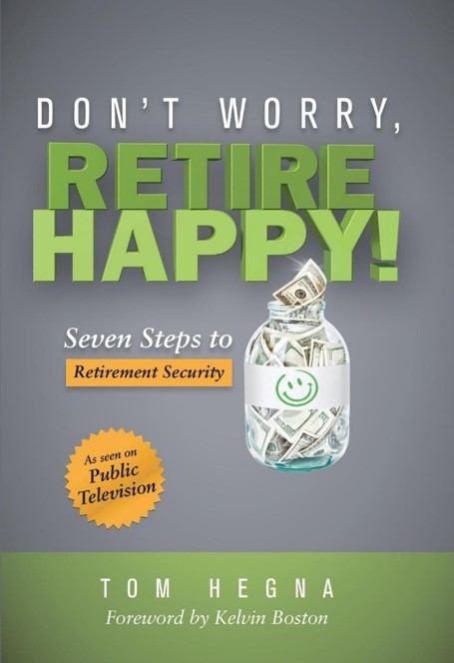
Yes You Can -
RETIRE HAPPY!
Seven Steps to
Retirement Security
Notes:
Background info:
Kelvin Boston from the popular television series, Moneywise with Kelvin Boston, approached Tom Hegna in 2012 about possibly doing a television special on retirement. They knew there was a simple and optimal way to approach retirement planning but how could they reach people and let them know that happily ever after could exist? With this presentation, you will find out why retirement planning is an exciting and happy time in your life

Slide 4






RETIREMENT
When everyday
is Saturday!
Notes:
Let me ask you a question….
What day of the week do you go play golf, work on your boat, get your hair done, or enjoy your hobby?

Slide 5


7 Steps to Retirement Security
1
HAVE A PLAN FOR RETIREMENT
2
MAXIMIZE SOCIAL SECURITY BENEFITS
3
CONSIDER A HYBRID RETIREMENT
4
PROTECT SAVINGS FROM INFLATION
5
SECURE GUARANTEED RETIREMENT INCOME
6
PLAN FOR LONG-TERM MEDICAL COSTS
7
ABC PLANNING MODEL

Slide 6
STEP 1
HAVE A PLAN!
Notes:
Retirement Blueprint
A retirement plan is the “blueprint” to get you from where you are now financially to where you want to be in the future. Too many people think they can just wing it and be ok. However there is too much uncertainty-uncertainty related to income and expenses in retirement, uncertainty regarding longevity, uncertainty surrounding pension benefits and social security and uncertainty around inflation and other risks.
People don’t plan to fail-they simply fail to plan. A plan can help you protect your hard earned savings from these and other risks.

Slide 7

Those who have planned for retirement are three times more likely to be confident they will have sufficient income in retirement as compared to those who have not planned.
Source: The Hartford Investments and Retirement Survey, December 2009
Notes:
Retirement Blueprint
In 2009 the Hartford Life Insurance Company conducted a study titled “The Hartford Investments and Retirement Survey” in which they aimed to better understand the retirement needs, concerns and perceptions of US consumers age 45 or older. The study found 1 in 2 people found financial planning too complex or difficult, and many people (35.5%) would rather not spend more time on financial planning. However…
The Hartford concluded that “those who have a plan for retirement are not only in a better place financially, but also have a more positive outlook about their retirement future than those who don’t have a plan.”
So why do so few people have a plan for retirement?

Slide 8
Retirement Income – Your Parents vs. You
PAST
PRESENT
NEST
EGG
SOCIAL
SECURITY
PENSION
NEST EGG
SOCIAL
SECURITY
PENSION

Slide 9

Two key questions
What do I NEED my retirement income to do?
What do I WANT my retirement income to do?
Notes:
When developing your plan, you need to ask yourself two simple questions…
What do I NEED my retirement income to do?
What do I WANT my retirement income to do?
The answer to the first question should be the same for everyone – your retirement income must cover your basic living expenses. Looking at your current expenses, determine how much income you will need to address these expenses in retirement. Pay special attention to those expenses which may be reduced or eliminated all together, such as clothing, commuting and professional fees.
The second question may be a little more difficult to find out…

Slide 10



In retirement, you may want to…
HAVE YOU DONE THAT YET?
Buy a Boat
Join the Country Club
See the World
Notes:
Ask your client….
Have you done all of the things you said you were going to do in retirement - join the country club, buy a boat, travel the world?
Many will reply no, because they feel the need to keep the money “just in case.”

Slide 11

Don’t live a
“just in case”
Retirement!
Notes:
Just in case retirement
Don’t live a just in case retirement! These are the people who don’t touch their money during retirement, and when they pass away the kids use Mom & Dad’s money to join the country club, buy a boat or travel around the world.

Slide 12

How Much Income Do I Need to Replace?
100%
80%
70%
50%
Notes:
How Much Income Do You Need to Replace?
When determining your income needs in retirement, figure out your actual expenses. While there are a number of replacement assumptions made in the media, the truth it can be possible for many people to live comfortably in retirement on 70% or less of their pre-retirement income.
When you have a retirement plan is that it gives you the confidence to enjoy their retirement.

Slide 13
STEP 2
MAXIMIZE SOCIAL SECURITY BENEFITS
Notes:
Retirement Blueprint
A retirement plan is the “blueprint” to get you from where you are now financially to where you want to be in the future. Too many people think they can just wing it and be ok. However there is too much uncertainty-uncertainty related to income and expenses in retirement, uncertainty regarding longevity, uncertainty surrounding pension benefits and social security and uncertainty around inflation and other risks.
People don’t plan to fail-they simply fail to plan. A plan can help you protect your hard earned savings from these and other risks.

Slide 14
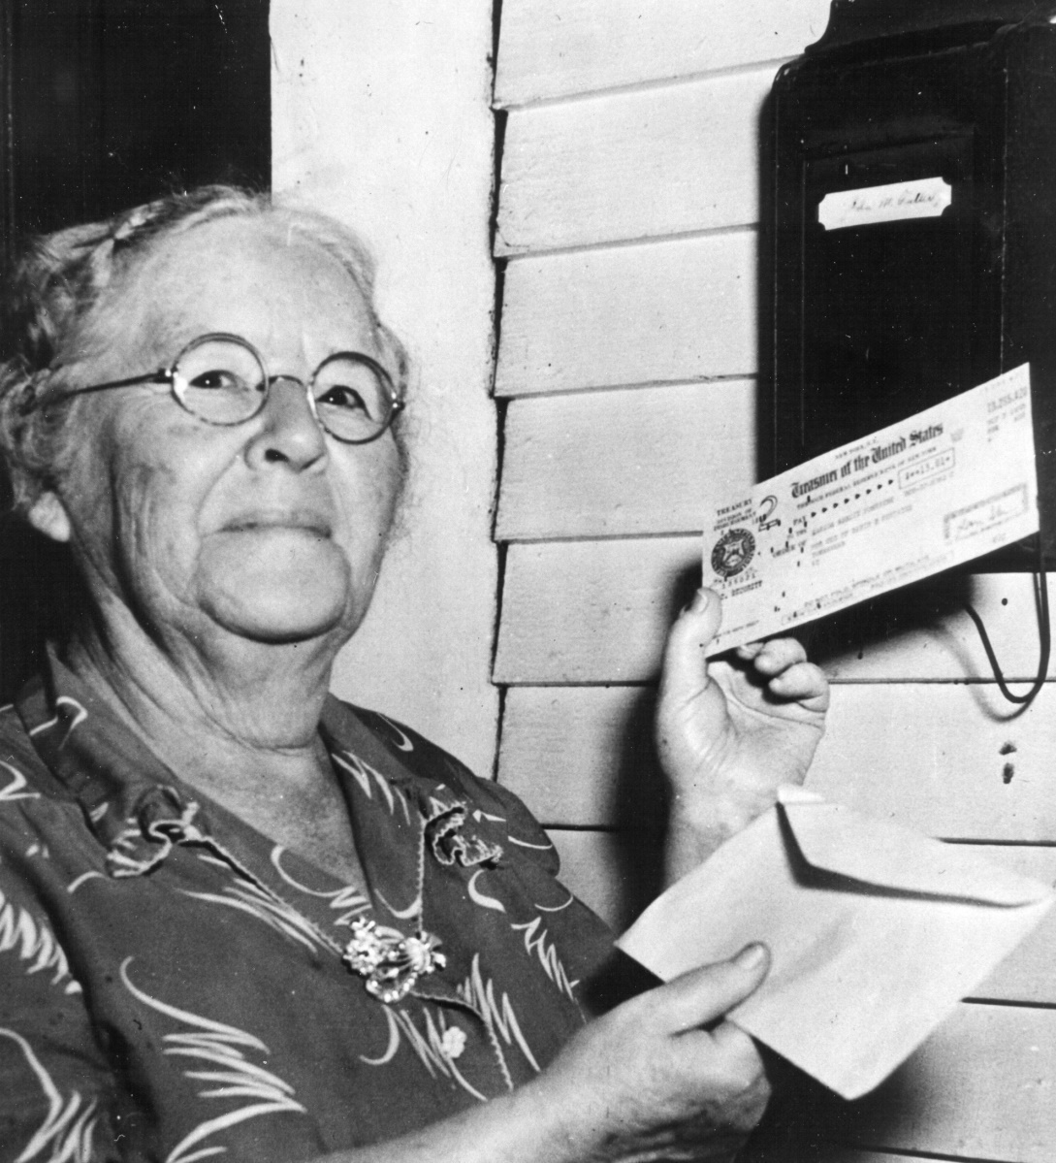
First Beneficiary of Social security
Very first recipient in 1940
Paid in $24.75 total over 3 years
Received $22.54 monthly benefit
Lived to age of 100
Total Benefits Received = $22,889
Ida May Fuller
Notes:
Anyone know who Ida May Fuller is?....
We should’ve seen the forshadowing 80 years ago……

Slide 15

Understanding YOUR Benefit
Married individuals can claim Social Security benefits based on:
Personal Earnings record, or
Spouses Earnings record
If electing based on spouse’s earnings record:
Spousal benefit is up to 50% of their spouse’s Social Security benefit
Cannot claim spousal benefit until spouse files for benefits
Source: SSA.gov as of October 2014
Notes:
There are additional benefit options available from Social Security for a lot of different family situations. Lets take a look at married couples first. Married individuals can claim benefits based either on their own earnings record or the earnings record of their spouse. If an individual elects to receive a benefit based on their spouse’s earnings record, the benefit can be as high as 50% of the spouse’s earnings record. Please note that you cannot claim a spousal benefit until your spouse has filed for benefits.
In addition, you may also be eligible for benefits based on a former spouse’s record in certain situations. In order to qualify for benefits from a divorced spouse, you (1) must have been married for at least 10 years (2) you are not remarried (3) your retirement benefit is less than the benefit you would be eligible to receive based on your ex-spouse’s record and (4) your ex-spouse has enough credits to qualify for retirement benefits. Even if your spouse has not applied for their retirement benefits, you can still apply for benefits based on their record as long as your ex qualifies and you have been divorced for at least two years.
Let’s take a look at some of the potential ways to maximize Social Security benefits for a married couple…

Slide 16
When can I receive my social security?
Born | FRA
1937 or earlier | 65
1938 | 65 and 2 months
1939 | 65 and 4 months
1940 | 65 and 6 months
1941 | 65 and 8 months
1942 | 65 and 10 months
1943-1954 | 66
1955 | 66 and 2 months
1956 | 66 and 4 months
1957 | 66 and 6 months
1958 | 66 and 8 months
1959 | 66 and 10 months
1960 and later | 67
You receive your Full Social Security Benefits on you Full Retirement Age (FRA)
You may begin your benefits as early as 62, at a reduced amount
You may delay your benefits up until 70, for a higher amount
Notes:
*If you were born on January 1st of any year you should refer to the previous year. (If you were born on the 1st of the month, we figure your benefit (and your full retirement age) as if your birthday was in the previous month.)
(Called "full retirement age" or "normal retirement age.")

Slide 17
Difference in Benefit Amounts
Monthly Benefit Amounts Differ Based on the Age You Decide to Start Receiving Benefits.
This example assumes a benefit of $1,000 at a full retirement age of 66
MONTHLY BENEFIT AMOUNT
FRA
AGE YOU CHOOSE TO START RECEIVING BENEFITS
Source: Social Security Administration
Notes:
Social Security Benefit
On the corresponding chart, you can see if you decide to take your benefit at 62, you can receive up to $750
BUT…. The longer a person waits to receive benefits, the higher their benefit amount will be – until they reach age 70, when the benefit will no longer be increased
Assuming that a person reaches full retirement age at 66, and their full benefit amount would be $1,000 per month, they could essentially increase their Social Security income by more than 30% if they delay benefit receipt until age 70.

Slide 18
Difference in Benefit Amounts
Monthly Benefit Amounts Differ Based on the Age You Decide to Start Receiving Benefits
This example assumes a benefit of $1,000 at a full retirement age of 66
8%
INCREASE /
YEAR
MONTHLY BENEFIT AMOUNT
If you delay Social Security beyond your full retirement age
AGE YOU CHOOSE TO START RECEIVING BENEFITS
Source: Social Security Administration
Notes:
Social Security Benefit
Lets Look at that same chart again…
The different in waiting can be significant!
As you can see on this chart, the difference can be up to $570
What is the break-even point? Rule of thumb: break even is around 80 if you wait till age 70

Slide 19

COST OF A WRONG DECISION
The wrong decision can leave up to
$250,000
of your money with the Government.
http://time.com/money/3772044/4-retirement-mistakes-that-can-cost-you-250000-or-more/?xid=timetwitter
Notes:
For example, if a 62-year-old man and his 59-year-old wife earning $75,000 and $50,000 respectively each take benefits at 62, they stand to collect just over $1 million in joint benefits, according to estimates by Financial Engines’ Social Security calculator. But if the wife takes the benefit based on her earnings at age 63, her husband files at age 66 for spousal benefits based on his wife’s work record and then switches to his own benefit at age 70, their projected lifetime benefit jumps to roughly $1,250,000. Or to put it another way, by taking benefits as soon as possible, this couple may be giving up $250,000 in lifetime benefits.

Slide 20

Survivor Benefits -3 key points
1. What Am I Eligible For?
If you are widowed, you may collect the greater of your own benefits or 100% of your deceased spouses benefits
2. Survivor Benefits May Begin At Age 60
Survivor benefits reduced if received before full retirement age – up to 28.5%
Exceptions for widowers with children who are under 16
100%
OF BENEFITS
3. Survivor Can Switch To Their Own Benefits Later
Advantageous if your own benefits are greater when your full retirement age reached
if survivor is at full retirement age
Source: SSA.gov as of October 2014
Notes:
Lets take a look at Survivor Benefits…
Surviving spouse can receive or step up to the benefit of the deceased spouse
The surviving spouse is eligible to receive benefits from Social Security, provided the deceased worker had enough credits to qualify for a retirement benefit and the surviving spouse is age 60 or older. In order to be eligible for Social Security survivor’s benefits, a widow or widower must have been married to the deceased worker at the time of his/her death and for at least 9 months prior to the worker’s death.
Survivor benefits are reduced if the surviving spouse has not yet reached full retirement age. A surviving spouse may be under age 60 and still receive a benefit if they are caring for a dependent child under the age of 16
If you and your spouse are both receiving Social Security benefits and your spouse passes away, the deceased spouse’s benefit will stop. You can then switch to your Social Security survivors benefit if it is a higher amount than your retirement benefit. If you get remarried after becoming widowed, you will no longer be eligible for a survivor’s benefit unless you are age 60 or older or age 50 and disabled.
Let’s look at an example
Source: SSA.gov as of October 2014

Slide 21
Social Security Base Amounts
Total income ranges determine how much of your Social Security Benefits are taxed:…
0% taxed if income….
Single | < $25,000
Married* | < $32,000
50% taxed if income…
Single | $25 - 34,000
Married* | $32 - 44,000
85% taxed if income…
Single | > $34,000
Married* | > $44,000
* Married, joint filing
Source: SSA.gov as of February 2014
Notes:
Social Security Earnings Restrictions
The Internal Revenue Service has set Base Amount thresholds for determining whether you owe income tax on your Social Security Benefits. If the total income that the IRS uses for this purpose is above these thresholds, you could owe taxes on your Social Security benefits.
If your IRS filing status is single, and your total income is below $25,000, or if you are Married, Filing Joint and your total income is below $32,000 you don’t owe any taxes on your Social Security Benefits.
If your IRS filing status is single, and your total income is between $25,000 and $34,000, or if you are Married, Filing Joint and your total income is between $32,000 and $44,000, you owe income tax on up to 50% of your Social Security Benefits.
Many people are not aware that all tax free bond interest count toward income levels.
If your IRS filing status is single, and your total income is above $34,000, or if you are Married, Filing Joint and your total income is above $44,000, you owe income tax on up to 85 % of your Social Security Benefits.
Source: SSA.gov as of October 2014

Slide 22

Social Security Calculators
Run the numbers
www.ssa.gov/myaccount
OR
We can run a detailed calculation in our one-on-one meeting

Slide 23
STEP 3
CONSIDER A HYBRID RETIREMENT
Notes:
In step 3 we take a look at a “hybrid” retirement. A hybrid retirement occurs when a retiree finds a full- or part-time position after leaving their primary career. Maybe they serve as a consultant in the field from which they just retired or they start a small business doing something completely different. Today’s retirees have more post-retirement career options than any previous generation. The rise of internet technology has introduced a number new business opportunities, many of which can be done from the comfort of your home.

Slide 24

“Retirement at 65 is ridiculous. When I was 65, I still had pimples.”
- George Burns
Notes:
Considering a Hybrid Retirement
A hybrid retirement can provide a “middle ground” between full-time work and full-time retirement. The late comedian George Burns was quoted as saying “Retirement at 65 is ridiculous. When I was 65, I still had pimples.”
Let’s consider the story of Bill and Brianna Boomer. They both “retired” at age 65 and then decided to try a hybrid retirement for a few years. Brianna accepted a position working part-time at a department store while Bill, after a career in manufacturing, discovers a number of companies are willing to pay for his expertise. Working at home as a consultant, Bill is able to bring some additional income while working on his schedule. While he feels retired, it also helps him stay engaged with work he enjoys.
Besides being financially beneficial, brain scientists are adamant about the benefits of continuing to stay engaged with work which is stimulating and helps you stay connected to the outside world.
Source: SSA.gov as of October 2014

Slide 25

Benefits of a Hybrid Retirement
Increased earnings
Increased savings
Increased Social Security benefits

Slide 26
STEP 4
PROTECT YOUR SAVINGS FROM INFLATION
Notes:
First lets take a look at what inflation actually is…

Slide 27
Retirement Income Concerns - Inflation
What might $10,000 buy in the future?
Hypothetical Inflation Rate
Years From Now | 0% | 1% | 2% | 4% | 6% | 8% | 10%
1 | $10,000 | $9,901 | $9,804 | $9,615 | $9,434 | $9,259 | $9,091
5 | $10,000 | $9,515 | $9,057 | $8,219 | $7,473 | $6,806 | $6,209
10 | $10,000 | $9,053 | $8,203 | $6,756 | $5,584 | $4,632 | $3,855
15 | $10,000 | $8,613 | $7,430 | $5,553 | $4,173 | $3,152 | $2,394
20 | $10,000 | $8,195 | $6,730 | $4,564 | $3,118 | $2,145 | $1,486
25 | $10,000 | $7,798 | $6,095 | $3,751 | $2,330 | $1,460 | $923
30 | $10,000 | $7,419 | $5,521 | $3,083 | $1,741 | $994 | $573
35 | $10,000 | $7,059 | $5,000 | $2,534 | $1,301 | $676 | $356
Notes:
What is Inflation?
One risk that will almost certainly affect every retirement portfolio is inflation, which can decimate purchasing power over time. For example, if you get $10,000 per month from your nest egg, the purchasing power at 4% inflation will be cut by more than half in 20 years and by more than two-thirds in 30 years. However, there have been some periods, such as the late 1970s, when inflation soared into the double digits.
Inflation is extremely problematic for retirees who are on fixed incomes and who are depending on their retirement savings to help make ends meet. High inflation can erode
both your income and your portfolio if you do not plan for it. The U.S. has experienced a period of relative price stability and low inflation for the past 25 years or so. Even so, prices of food, gas, stamps, and other items you buy have gone up significantly over this same period.
Source: SSA.gov as of October 2014

Slide 28

The point being…
At 3%, it can cut the value of your money in
every 24 years.
half
So, if you’re 55 today, you an expect to see the prices
not once but almost twice during retirement.
double

Slide 29
STEP 5
SECURE MORE GUARANTEED INCOME
Notes:
This is one of my favorite topics to discuss with retirees and the focus of my first book, Paychecks and Playchecks: Retirement Solutions for Life.

Slide 30

Securing at least a base level of
lifetime income should be every
retiree’s priority - at least if they
want to live happily ever after.
Source: TIME magazine - Lifetime Income Stream Key to Retirement Happiness, July 2012
Notes:
Read Slide

Slide 31



RETIREMENT INCOME
ANNUITIES
Sources of Guaranteed Income During Retirement
SOCIAL SECURITY
Guaranteed
Income
PENSIONS
Notes:
There are many sources of Guaranteed Income During Retirement…

Slide 32

The success of your retirement is really not about your assets…
Assets can be lost, stolen, swindled, sued, divorced or decimated in a market crash.
It’s about income!
Your Retirement Paycheck
Notes:
Assets vs Income
Retirement can be simpler than you might think. See, the Success of your Retirement is really NOT about your assets…
Assets can be lost, stolen, swindled, sued, divorced or decimated in a market crash. The ultimate success of your retirement is determined by INCOME, and I would add – GUARANTEED LIFETIME INCOME!
Guarantees of Lifetime Income Annuities are subject to the claims paying ability of the insurer.

Slide 33

Why do YOU need to Secure Guaranteed Income?
Longevity Risk
Deflation Risk
Market Risk
Withdrawal Rate Risk
Sequence of Returns Risk
Long Term Care Risk
Mortality Risk (Death)
Inflation Risk
Regulatory Risk
Taxation Risk
RISK
Notes:
Let’s take a look at the key risks to your clients in retirement. Tom briefly discusses each of the risks on the Left side of the page. Let’s take a closer look at order of returns risk since that one is not clearly understood by many people.

Slide 34
So which RISK is #1?
Deflation Risk
Why? Because it is NOT just a Risk. It is a RISK MULTIPLIER of the other Risks!
Inflation Risk
Mortality Risk
Longevity Risk is HANDS DOWN the #1 Risk in Retirement!
Longevity Risk
LONGEVITY
RISK
Long Term Care Risk
Market Risk
Sequence of Returns Risk
Withdrawal Rate Risk
Notes:
So which Retirement Risk is the #1 risk? Hands down it is LONGEVITY risk. Why? Because Longevity is NOT just a risk. It is a Risk Multiplier of the other risks. See, the longer you live, the more likely we will see inflation, the more likely the market will crash, the more likely you will take out too much money, the more likely you will need Long Term Care! So the Retirement Research I have studied comes to one main conclusion – To retire successfully, you MUST take longevity risk off the table.

Slide 35



How do you take Longevity Risk OFF the table?
Traditional Investments such as Stocks, Mutual Funds, Managed Money, Real Estate, and CD’s
CANNOT
Do It!
An Annuity with guaranteed lifetime income CAN Do It!
Notes:
Life Insurance Companies are uniquely situated to offer products that can take longevity risk OFF the table

Slide 36

What Is A Lifetime Income Annuity?
A personal “pension-like” stream of guaranteed lifetime income from a financial institution.
A GUARANTEED
Paycheck for Life!
Notes:
Read Slide

Slide 37
Annuity Payout Rates
Age | Life Only | Life w/Guarantee
65 | 6.4% | 5.8%
75 | 8.8% | 7.1%
85 | 14.4% | 9.6%
Source: www.immediateannuities.com (July 2016)
Notes:
An annuity is the only product that you can purchase that they will pay you a higher payout rate based on your age. If you were to go in purchase a Certificate of Deposit, would the banking institution pay you more based on your age? How are insurance companies able to afford these payout rates?
Here is an example of payout rates as of December, 2014. Contact a financial professional to get live rates as they are subject to change.

Slide 38

Retirement Income Concerns
Managing Income
WHAT ARE LONGEVITY CREDITS?
Notes:
What are longevity credits, exactly? Basically, they are a financial reward that increases the longer you live. Now the industry refers to these as “Longevity Credits”, I just want you to understand that these credits are included in the pricing of annuity payouts, so payouts do not increase after the policy is purchased.
These have nothing to do with stocks or interest rate returns. Instead, it is an actuarial calculation by the insurance company, based on your age and gender that adds a credit from the entire risk pool of everyone who buys the same type of lifetime income annuity.
This may sound a little confusing, but it really is not. Life insurance companies know when people are going to die. Now they do not know when you are going to die, but they know
almost exactly how long 100 people just like you will live as group. Because of that, the insurance companies can pay each person as though they knew when each person is going
to die. Because some people will die early and will not collect income for that long, they can pay the entire pool a little more than a traditional investment. I know what some of you are thinking: “What if I’m one of the first ones to go? I don’t want my money to disappear when I die.” But consider this: does your money have to disappear when you die? Not at all - you can do joint life. Joint life with your spouse, a Joint and Survivor Guaranteed Income policy Or in a sense joint life with your kids, or your grandkids by choosing A Guaranteed Income with a period certain of 5 – 30 years, Guaranteed Income for Life with 5-30 years certain, or Guaranteed Income for Life with cash refund. Less than 10% of lifetime income annuities sold are life-only – the money disappears when you die. Almost everyone wants a guarantee that their money will outlast them somehow. These guarantees are available with annuities, but they will reduce your income payments. The older you are, the longer you live, and the fewer guarantees you choose, the more mortality credits you will be paid and the higher your annual income payment will be.

Slide 39




Benefits of Risk Pooling and LONGEVITY Credits
Suppose five 90 year-old women take a vacation together every year …
$500
The five women each place $100 in a mason jar.
Notes:
Let me use this little example to explain the concept of longevity credits. Lets say that five 90 year old ladies go on vacation together each year. One year, one of them said, Hey, let’s each put $100 into this jar. We will seal the jar, and bring it on vacation with us next year and those of us still alive will split the money! The other ladies said, Helen, that is a great idea. So they each put $100 into the jar. So what do you think happened the next year?
They forgot where they put the jar! (just kidding)

Slide 40

Explaining LONGEVity Credits
Unfortunately one of the ladies died that year.
They meet to vacation.
Now the four ladies split the $500. They now each have $125.
25%
Rate of Return
Question:
How much was invested in the market?
What interest rate did it earn?
Notes:
No, unfortunately one of the ladies died. So the 4 other ladies opened the jar and split the $500. They each got $125! Now that was a 25% return on their $100 from just a year ago. I have two questions for you. How much of that money was invested in the stock market? Zero. What interest rate did the money earn? Zero. Well then how did they have a 25% return on their money in just one year? Longevity Credits! They got paid longevity credits. So the ladies looked at each other, they said, Hey, this is a pretty good deal. I think we should put the money back in the jar and do it again next year. And that is exactly what they did.
This is not to give the impression that annuity policyholder payments increase upon the death of other annuitants in the risk pool. Remember that these longevity credits are worked out ahead of time by the insurance company, and they’re not affected by anything that happens after the contract is issued. The contractual payments are exactly what the policyholder will receive, no matter what the subsequent longevity experience.

Slide 41

Explaining LONGEVITY Credits
They decide to “let it ride”
The next year one more lady dies.
Now the 3 ladies split the $500. They each get $167.
67%
A Rate of Return
All of this is based on mortality credits.
Notes:
The next year one more lady died. So now the other 3 ladies split the $500. They each get $167 that was a 67% percent return on their original $100 of two years ago. How did they do that? Longevity credits.
It is ALL about longevity credits. Common sense tells us one should probably own a lifetime income annuity because of these longevity credits. Our little example here is just meant to show how living one year longer before purchasing an immediate annuity can make a difference in the life time income of an annuitant.

Slide 42
Components of Lifetime Income Payout
Lifetime income annuities deliver higher payouts because, in addition to distributing gains and principal, they subsidize those who die late with the capital of those who die early.
Components of Lifetime Income Payout
Male age 65, $100,000 investment
$7,000
…but only an insurancemortality pool.
…but only a life insurance company can manufacture longevity credits
$6,000
$5,000
Payout
$4,000
$3,000
Investment Advisors Can Manufacture This Payout…
$2,000
$1,000
$0
65
66
67
68
69
70
71
72
73
74
75
76
77
78
79
80
81
82
83
84
85
86
87
88
89
90
91
92
93
94
95
96
97
98
99
100
Age
Investment Growth
Return of Principal
Longevity Credits
Notes:
Lifetime Income Annuities
Lifetime Income Payouts consist of 3 major things…
1. Investment Growth,
2. Return of Principal
3. Longevity Credits.
ONLY AN INSURANCE COMPANY CAN MANUFACTURE THESE LONGEVITY CREDITS!
Lets move on to Step 6

Slide 43
HAPPY FACTOR
Notes:
This is one of my favorite topics to discuss with retirees and the focus of my first book, Paychecks and Playchecks: Retirement Solutions for Life.

Slide 44
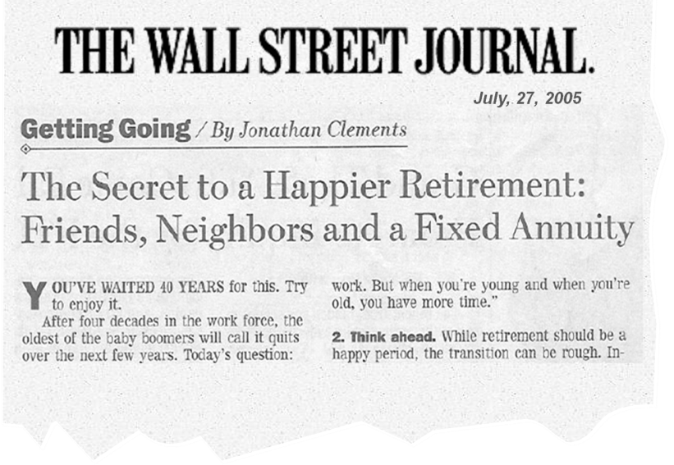

Investment Solutions | What others are saying
Strategies outlined in a new study could sharply lengthen the amount of time a nest egg survives in retirement.
The study, soon to be released by the University of Pennsylvania's Wharton Financial Institutions Center, finds that so-called income annuities can assure retirees of an income stream for life at a cost as much as 40% less than a traditional stock, bond and cash mix.
The Case for 'Income Annuities'
By Jeff D. Opdyke
August 8, 2007
Notes:
Read slide

Slide 45

Investment Solutions | What others are saying
A new study in a land of grumps reveals that retirees with a guaranteed lifetime income stream can find true happiness.
Lifetime Income Stream Key to Retirement Happiness
Securing at least a base level of lifetime income should be every retiree’s priority—at least if they want to live happily ever after.
By Dan Kadlec
July 30, 2012
Notes:
Read slide

Slide 46

Investment Solutions | What others are saying
“If you observe, people always live forever when there is an annuity to be paid to them…
The annuity is a very serious business; it comes over and over every year, and there is no getting rid of it.”
Volume I, Chapter II
Sense and Sensibility
By Jane Austen
1811
Notes:
Read slide

Slide 47
STEP 6
PLAN FOR LONG TERM MEDICAL COSTS

Slide 48

House Fire Stat
3%
The odds of your home burning down
Barry Rand, "Challenges of Long-Term Care," AARP Bulletin, November 2013.
Notes:
Here are some interesting statistics: The odds of your home burning down between now and the day you die are about 3 out of 100 (3%), but nearly every homeowner has homeowner’s insurance.

Slide 49
Car Accident Stat
18%
The odds of your totaling your car
Barry Rand, "Challenges of Long-Term Care," AARP Bulletin, November 2013.
Notes:
The odds of you totaling your car between now and the day you die are about 18 out of 100 (18%), yet nearly every automobile owner carries auto insurance.

Slide 50

Long-Term Health Stat
72%
The odds of someone 65 or older needing some form of long-term care
Barry Rand, "Challenges of Long-Term Care," AARP Bulletin, November 2013.
Notes:
The odds that you will need some form of long-term care between now and the day you die are about 72 out of 100 (72%). However, less than 30% of Americans over the age of 45 have purchased long-term care insurance. Source: The 2010 Sourcebook for Long Term Care Insurance
2010 (data compiled by Millman

Slide 51
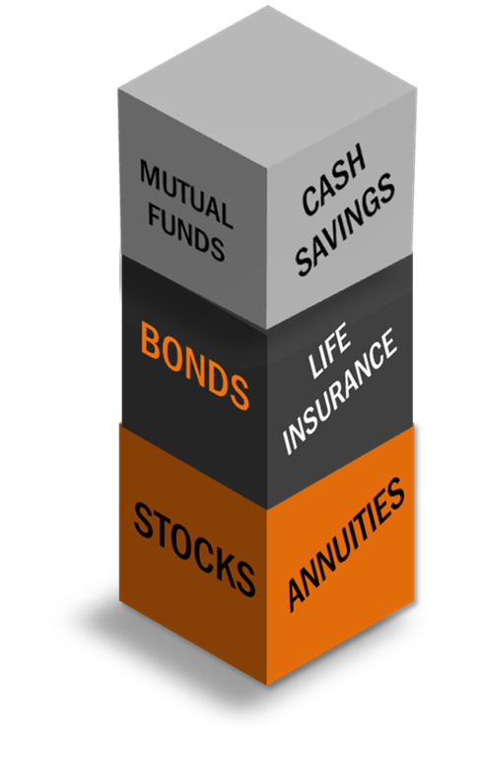
A Seemingly Complete Retirement Portfolio
Diversified
Meeting Objectives
Positioned for the Long-term
Asset allocation and diversification do not assure a profit or protect against loss.
Hypothetical example for illustrative purposes only.
Notes:
See, you could have done a great job with your stocks and bonds and annuities.

Slide 52

No Long-Term Care Insurance
Hypothetical example for illustrative purposes only.
Notes:
But an unplanned long term care event could literally wipe you out.

Slide 53
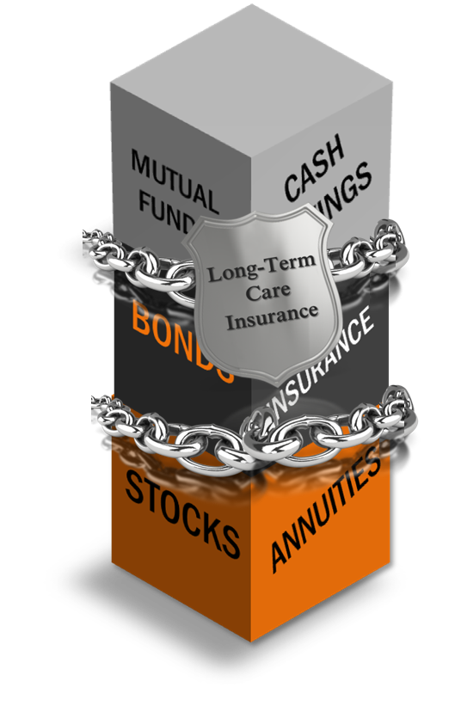
Long-Term Care Insurance Risk Management Tool
LTCi is a shield of protection to help preserve assets and income for a long life.
Investments and savings may be kept intact.
Assets can be preserved to pass over to a spouse or to children.
Funds can be used as wanted not as needed
Hypothetical example for illustrative purposes only.
Notes:
Think of LTCi as simply a shield that can help protect your assets. So you are able to spend your money the way you want to instead of the way you have to.

Slide 54
STEP 7
ABC PLANNING MODEL

Slide 55

The ABC Model Defined
A conservative investor’s dilemma
Is your money safe from market loss?
Are you beating CD’s?
How do you balance liquidity, growth and protection?
Investors want “downside protection, designed to protect them from being poor, and “upside potential”, designed to give them a chance at being rich.
- Mier Stratman
Notes:
As a conservative investor, is your money safe from market losses?
Are you beating CD’s?
Do you, the conservative planner, know how to allocate your money to avoid the volatility which costs you sleepless nights?
How do you currently determine which assets to use and why you might use them?

Slide 56
“Corrections” and “Bear Markets”
GLOBAL STOCK PRICES (January 1, 1980—January 22, 2016)
Type of Decline | Number | Avg. Return | Avg. Time from Peak to Trough | Avg. Time from Trough to Recovery
Correction | 12 | -13.7% | 87 Days | 121 Days
Bear Market | 7 | -33.4% | 373 Days | 798 Days
Source: Vanguard, Markets & Economies 1/28/16
https://personal.vanguard.com/us/insights/article/market-correction-vanguard-perspective-012016
Notes:
Remember from Week 1:
Corrections and bear markets: What does Vanguard think? Date: January 28, 2016
From their high on May 21, 2015, global stock prices lost about 19% of their value through January 20, 2016. The setback qualifies as a "correction," which is conventionally defined as a decline of 10% or more. The term "bear market" typically refers to a decline of 20% or more lasting at least two months.
Corrections are common
Stock market downturns—corrections and bear markets—are relatively common. Since 1980, the global stock market* has experienced 12 corrections and 7 bear markets—on average, an attention-grabbing downturn every 2 years or so. Over the past 36 years, stock prices have spent almost 30% of the trading days in corrections or bear markets.
(Note: This analysis considers price returns only. In a total return analysis, returns would be higher, and recoveries quicker, because of reinvested dividends.)
Note: Vanguard analysis based on the MSCI World Index from January 1, 1980, through December 31, 1987, and the MSCI AC World Index thereafter. Both indexes are denominated in U.S. dollars. Our count of corrections excludes corrections that turn into a bear market. We count corrections that occur after a bear market has recovered from its trough even if stock prices haven't yet reached their previous peak.
Depths and duration have varied
Some corrections are swift, others grind lower slowly. The time from a market trough to recovery has been similarly unpredictable. Consider a few observations from the global stock market data:
The average number of days from the start of a correction to its bottom was 87 days. The fastest decline was 28 days, while the slowest was 124 days.
The average number of days from a correction’s trough to recovery was 121 days. The speediest rally was 46 days, the slowest 359 days.
Bear markets have generally taken longer to reach a bottom and longer to recover.
The average number of days from the start of a bear market to its bottom was 373 days. The fastest decline was 60 days, while the slowest was 926 days.
The average number of days from a bear market trough to recovery was 798 days. The quickest recovery was 85 days, the slowest 1,928 days.
Disclaimer Notes:
All investing is subject to risk, including the possible loss of the money you invest.
Past performance is no guarantee of future returns. The performance of an index is not an exact representation of any particular investment, as you cannot invest directly in an index.<
Investments in bonds are subject to interest rate, credit, and inflation risk.
Diversification does not ensure a profit or protect against a loss.
Please remember that all investments involve some risk. Be aware that fluctuations in the financial markets and other factors may cause declines in the value of your account. There is no guarantee that any particular asset allocation or mix of funds will meet your investment objectives or provide you with a given level of income.

Slide 57
ABC Model of investing Cash - protected growth - risk growth
A
B
C
.25% – 1%
3% – 7%
+30% – -30%
Potentially lower returns
Taxable or tax-deferred
Liquid
Potentially moderate returns
Tax-Deferred
Offer partial withdrawals
Potentially higher returns
Taxable or tax-deferred
Offer partial withdrawals or liquid
10%
40%
50%
Notes:
Now let’s take a few minutes for you to do your own ABC allocation based on what you’ve learned about your own risk tolerance, time horizon and goals. Take a few minutes to decide what percentage you want in each column then write it down in your notes.

Slide 58
PASS THE “HAPPY FACTOR” TO CHILDREN & GRANDCHILDREN
Notes:
A simple way to allocate your money in 3 buckets…you’ll immediately understand they purpose of your money

Slide 59

Making the Most of Legacy Gifts to Grandchildren
Notes:
A great use of life insurance is to leave a legacy.

Slide 60




Legacy Gifts to Grandchildren
Leverage your legacy assets and instantly increase gifts set aside for your grandchildren.
Annie is 62, has 6 grandchildren and a $100,000 CD she wants to use for grandchildren legacy gifts.
With the CD, if Annie died at age 62, each grandchild would receive $16,666 ($100,000 ÷ 6).*
Robbie 6
Karen 5
Steve 5
Nancy 4
Suzy 2
Donald 1
IS THERE A BETTER WAY?
WHAT IF SHE COULD INSTANTLY DOUBLE HER LEGACY GIFTS?
* Some states also require state taxes to be paid, resulting in an additional tax expense which was not included in this example.
Notes:
Annie is 62 years old and has four children, all grown and married, and 6 grandkids. While her estate is set to be divided equally among her children, she wants to leave each grandchild a nice sum of money. Annie has a $100,000 CD that she doesn’t need for retirement income.
Annie plans use the $100,000 CD to fund legacy gifts for her grandchildren. The $100,000 grows at a hypothetical 2% annually and Annie will pay taxes on this gain each year. Upon her death, the balance would be divided equally among her grandchildren.
After speaking with her Insurance Agent, Annie discovered a better option that would allow her to a) instantly double what her grandchildren would receive today and b) establish a greater legacy well into the future.

Slide 61
A better option
Rather than paying taxes each year on the CD gains and if Annie didn’t need access to these funds now, Annie could establish her legacy now and ensure larger, tax-free gifts. With a permanent life policy,
Annie can immediately turn the $100,000 asset into $220,000 in guaranteed death benefit that would be passed generally income-tax free to her beneficiaries, grandchildren.
 |  | LEGACY WITH CD |  | LEGACY WITH SPUL
Age at Death | Beginning of Year Value | Potential Bequest at End of Year | Per Grandchild | Face Value | Per Grandchild | Legacy Difference
62 | $100,000 | $101,700 | $16,950 | $220,000 | $36,667 | 116%
67 | $108,794 | $110,643 | $18,441 | $220,000 | $36,667 | 99%
72 | $118,361 | $120,373 | $20,062 | $220,000 | $36,667 | 83%
77 | $128,770 | $130,959 | $21,827 | $220,000 | $36,667 | 68%
82 | $140,094 | $142,475 | $23,746 | $220,000 | $36,667 | 54%
87 | $152,414 | $155,005 | $25,834 | $220,000 | $36,667 | 42%
2X
The legacy
to grandkids
now
Life Expectancy
With Permanent Life Insurance, Annie more than doubles her legacy gift to each grandchild in the first year!
New Grandchild? Annie can simply add him as a beneficiary to the existing policy, which will now be split 7 ways.
All examples are hypothetical. Rates are subject to change, and payout will vary with age and life expectancy. Actual amounts are dependent upon interest rates in effect at time of policy issue. This hypothetical example is for illustrative purposes only. Guarantees are subject to the claims paying ability of the issuer. Remember that life insurance and annuities are not FDIC insured. For more details on any example please contact Tom at www.tomhegna.com.
Notes:
Today it would purchase $184,000 or $30,667 per grand child
With Permanent Life Insurance, Annie more than doubles her legacy gift to each grandchild in the first year, -- and can expect significantly higher bequests to her grandchildren through her life expectancy!
With Life Insurance, Annie can choose to purchase six individual policies with each grandchild designated the sole beneficiary OR purchase a single policy with six equal beneficiaries.
Best of all, when a new grandson is born, Annie has the option to either purchase an additional policy or simply add him as a beneficiary to the existing policy, effectively dividing the face value of the policy seven ways.

Slide 62

Protecting Social Security Benefits
Notes:
Many seniors forget to plan for the loss of a Social Security Check when one of them dies.

Slide 63
Social Security income AFTER Spouse’s Death
Monthly
Benefit
Husband $2,000
Wife $1,000
Total $3,000
Would you miss the loss of one Social Security Check?
What happens if the Husband dies?
Surviving spouse receives the greater of their own benefit, or 100% of their deceased spouse’s benefit, providing they were married for 10 years.
Monthly
Benefit
Husband $ 0
Wife $2,000
Total $2,000
Can you prepare now for this potential loss later?
Loss of $1,000
monthly income!
Hypothetical Example of Social Security monthly income based on 2011 Benefit
Notes:
Go over slide
Generally, a surviving spouse (beginning at age 62) is entitled to collect the greater of their own benefit, or a widow’s or widower’s benefit equal to 100% of their spouse’s benefit, providing they were married for 10 years.
Well there is a way to prepare now. Conventional wisdom says that a young family needs life insurance on a working spouse to help replace the lost income if the spouse dies unexpectedly. What about life insurance to replace retirement income that will cease at the death of a spouse, such as Social Security?
Permanent Cash Value Life Insurance can provide cash at death (generally income tax free) to provide income for the surviving spouse.
People age 60+ is the fastest-growing segment buying new life insurance policies. This is why you should consider permanent life insurance earlier.
Many people buy permanent life insurance while they are still working, knowing that the death benefit can be used when they retire to help replace the lost income, whether that be from Social Security or any other source.
(Lets look at our example….talk through or white board it)

Slide 64
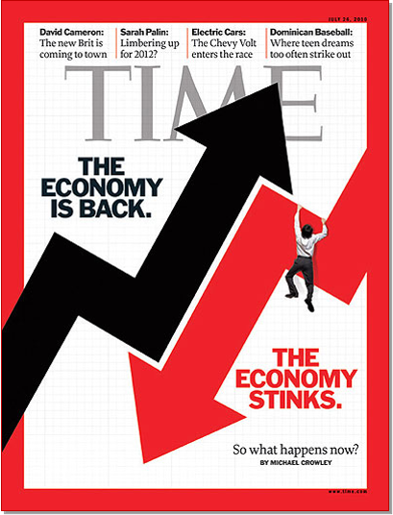
Notes:
See I can’t tell you if we are going to have inflation or deflation. I can’t tell you that the market will go up or down. But I can tell you that if your client owns a whole life policy – that doesn’t really matter. If they own a fixed annuity, that doesn’t matter. And if they covered their basic expenses with guaranteed lifetime income, and optimized their portfolio to protect against inflation, that doesn’t matter!

Slide 65

7 Steps to Retirement Security
1
BUILD YOUR ABC PLAN
2
WORK A LITTLE LONGER, SAVE A LITTLE MORE
3
COVER YOUR BASIC EXPENSES WITH GUARANTEED LIFETIME INCOME
4
OPTIMIZE THE REST OF YOUR PORTFOLIO TO PROTECT YOU FROM INFLATION
5
MAXIMIZE YOUR SOCIAL SECURITY BENEFITS
6
HAVE A PLAN FOR LONG-TERM CARE
7
USE LIFE INSURANCE TO TRANSFER WEALTH
Notes:
Ok, thinking about these 7 key pieces of retirement security… you may be thinking how can we put this all together.

Slide 66
ACTION STEPS
01
02
03
Notes:
Write down in your workbook the three action steps you are committed to taking.

Slide 67


POSSIBLE ACTION STEPS
Compare Social Security options to maximize benefits
Calculate how much money you’ll need for retirement (Retirement Red Line income planning software)
Discuss options to increase guaranteed income for life
Learn more about annuities and guaranteed income for life
Review your investment portfolio to see if there are opportunities to balance risk and reward.
Make a long-term health care plan
Talk to your family about money and your future
REMEMBER TO Schedule:
One-On-One Meeting
Notes:
Here are some possible action steps.

Slide 68

Thank you
Your future self is counting on you.
Contact Us!
123 Any Street, City, ST 12345
000-555-212
COMPANY / CONTACT NAME
Company@gmail.com
Notes:
Schedule meetings right now if possible.
Insert your contact information.

