Slide 1
Wall Street’s On Fire:
Ten Reasons to Move Your Money

Slide 2


Ten Reasons
to Move Money

Slide 3
When Should We Invest in the Market?
“The way to make money is to buy when blood is running in the streets.” John D. Rockefeller
“We simply attempt to be fearful when others are greedy and to be greedy when others are fearful” Warren Buffett

Slide 4
#1 What’s Coming Next?
When?
  Napier –by end of 2016
How deep?
  20% by definition
How long?
  6 months min.
  Ave. major Bear – 17 yrs.
Market Cycle

Slide 5
#1 What’s Coming Next?
The question is not when, how deep, or how long.
It’s “do you have a plan to manage this type of risk in your retirement years?”
Market Cycle

Slide 6
#1 What’s Coming Next?
DO YOU
HAVE A PLAN!!

Slide 7
#1 What’s Coming Next?
Are we closer to the point of Maximum Financial Opportunity or Risk?
Maximum Financial Risk

Slide 8
#1 What’s Coming Next?
Are we closer to the point of Maximum Financial Opportunity or Risk?
Maximum Financial Opportunity

Slide 9
#1 What’s Coming Next?
Are we closer to the point of Maximum Financial Opportunity or Risk?
Where are you?

Slide 10
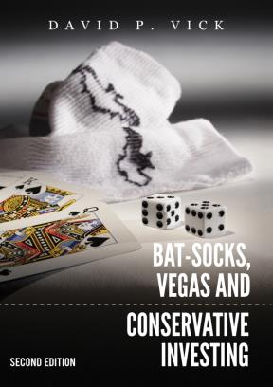
#2 The Next Swing Down:
A Little or A Lot

Slide 11
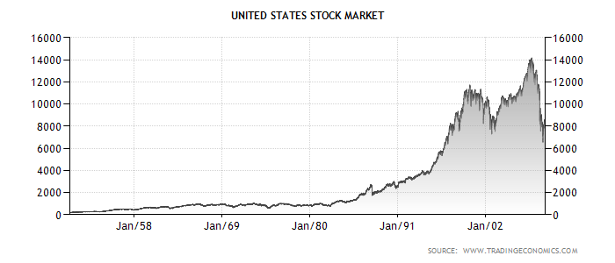
What the Heck Just Happened?
Investing Paradigm Shifts
Welcome to the M Times
Notes:
Paradigm shifts and what the heck just happened
Standing on Dow, day RR was elected, looking back 30 years,
Bottom of Dow in 1932…27 years before it comes back
Looking back at Dow.
Now year President Obama took office…what do I see? Wall

Slide 12
Looking back from Reagan
Notes:
What the heck just happened.
Questions, is it a paradigm shift of our society, our culture, our investing mentality?
M times…looks like an M, bottom in March of 09
Is that the norm? Don’t kknow
Go back in history…gambling in 1950s, 60s…positive or negative
Today, what is the outlook…positive, most popular shows on cable TV Gambling
Celebrity apprentice…Gambling Champion
Look at page 19 in your workbook
Person to read definition of investing…how does that feel…all of it back with return, or some of it…downside?
Person to read gambling…think of your 401k…which definition most resembles the 401k? That’s where we are.
Look at stats in book…
What the heck just happened?

Slide 13
Welcome to the M Times
Looking backward from Obama
Notes:
What the heck just happened.
Questions, is it a paradigm shift of our society, our culture, our investing mentality?
M times…looks like an M, bottom in March of 09
Is that the norm? Don’t kknow
Go back in history…gambling in 1950s, 60s…positive or negative
Today, what is the outlook…positive, most popular shows on cable TV Gambling
Celebrity apprentice…Gambling Champion
Look at page 19 in your workbook
Person to read definition of investing…how does that feel…all of it back with return, or some of it…downside?
Person to read gambling…think of your 401k…which definition most resembles the 401k? That’s where we are.
Look at stats in book…
What the heck just happened?

Slide 14
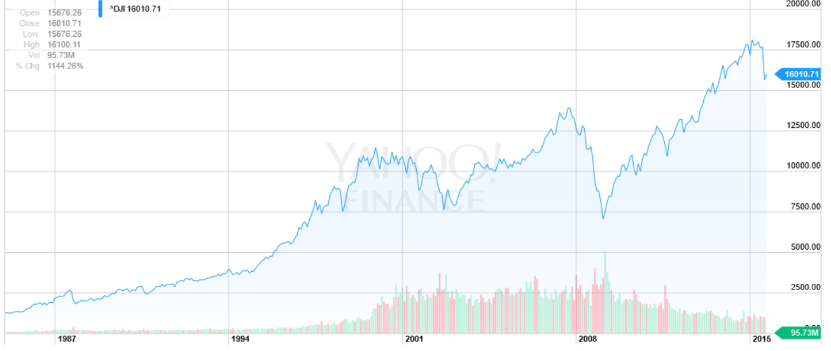
W
hat’s Next?
Notes:
Looking at the DOW graph since 2009 we see the point of volatility made even clearer. The graph now looks like a W with the DOW now over 17000. The question is What’s Next? We know there’ll be a correction, but when? Will it be small or large? What’s the trend? What do you think?

Slide 15
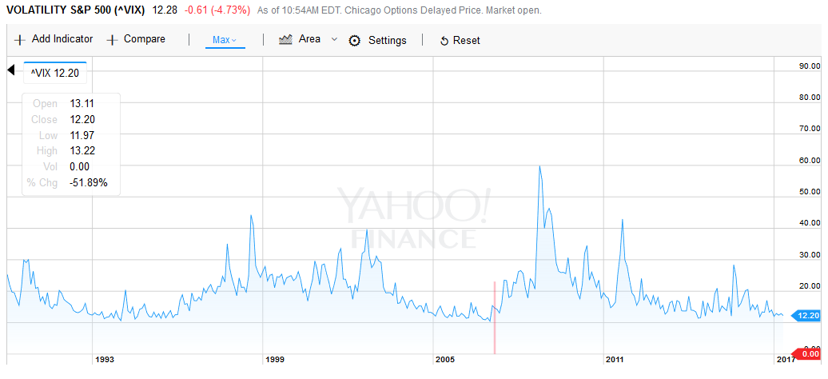
#3 Watch the VIX (Fear Index)
VIX is high, it’s time to… BUY!
VIX is low, it’s time to… GO!
VIX – Sept 2008 89.53
VIX – Apr 1st, ‘12 17.15
VIX – Apr 1st, ‘16 15.70
VIX – Apr 1st, ‘17 12.89
Below 20 = Complacency
Above 30 = Real Fear
Notes:
Go to YahooFinance and search for the VIX (http://finance.yahoo.com/q?s=^VIX&ql=1) to find the latest numbers and insert
We’ve been trading in complacency for over 5 years. When is the right time to take “GO”?

Slide 16
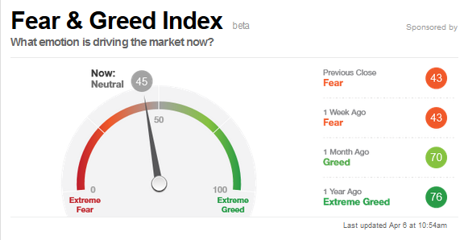


#3 Watch the Fear & Greed Index
Seven Fear & Greed Indicators:
Market Volatility
Junk Bond Demand
Put & Call Options
Safe Haven Demand
Stock Price Breadth
Stock Price Strength
Market Momentum
http://money.cnn.com/data/fear-and-greed/
Notes:
Go to http://money.cnn.com/data/fear-and-greed/ to get the latest factors.
Seven Fear & Greed Indicators
How we calculate the index More »
Put and Call Options
Extreme Greed
During the last five trading days, volume in put options has lagged volume in call options by 38.86% as investors make bullish bets in their portfolios. This is among the lowest levels of put buying seen during the last two years, indicating extreme greed on the part of investors.
Last changed Mar 30 from a Greed rating
Updated Apr 6 at 11:03am
Market Momentum
Greed
The S&P 500 is 4.28% above its 125-day average. This is further above the average than has been typical during the last two years and indicates greed on the part of investors.
Last changed Mar 20 from an Extreme Greed rating
Updated Apr 6 at 11:04am
Market Volatility
Neutral
The CBOE Volatility Index (VIX) is at 12.14. This is a neutral reading and indicates that market risks appear low.
Last changed Apr 5 from a Fear rating
Updated Apr 6 at 11:04am
Junk Bond Demand
Neutral
Investors in low quality junk bonds are accepting 1.89 percentage points in additional yield over safer investment grade corporate bonds. While this spread is historically high, it is in-line with recent price history and indicates that investors are not showing significant fear or greed in the corporate bond market.
Last changed Mar 30 from a Greed rating
Updated Apr 6 at 11:04am
Stock Price Strength
Fear
The number of stocks hitting 52-week highs exceeds the number hitting lows but is at the lower end of its range, indicating fear.
Last changed Mar 21 from a Neutral rating
Updated Apr 6 at 11:03am
Stock Price Breadth
Extreme Fear
The McClellan Volume Summation Index measures advancing and declining volume on the NYSE. During the last month, approximately 0.31% more of each day's volume has traded in advancing issues than in declining issues. This indicates that market breadth is improving, though the McClellan Oscillator is still towards the lower end of its range for the last two years.
Last changed Mar 13 from a Fear rating
Updated Apr 6 at 11:03am
Safe Haven Demand
Extreme Fear
Bonds have outperformed stocks by 2.37 percentage points during the last 20 trading days. This is close to the weakest performance for stocks relative to bonds in the past two years and indicates investors are fleeing risky stocks for the safety of bonds.
Last changed Mar 20 from a Fear rating
Updated Apr 6 at 11:03am

Slide 17
#3 Watch the Fear & Greed Index
We simply attempt to be fearful when others are greedy and to be greedy when others are fearful”
Warren Buffett
Seven Fear & Greed Indicators:
Market Volatility
Junk Bond Demand
Put & Call Options
Safe Haven Demand
Stock Price Breadth
Stock Price Strength
Market Momentum
http://money.cnn.com/data/fear-and-greed/

Slide 18
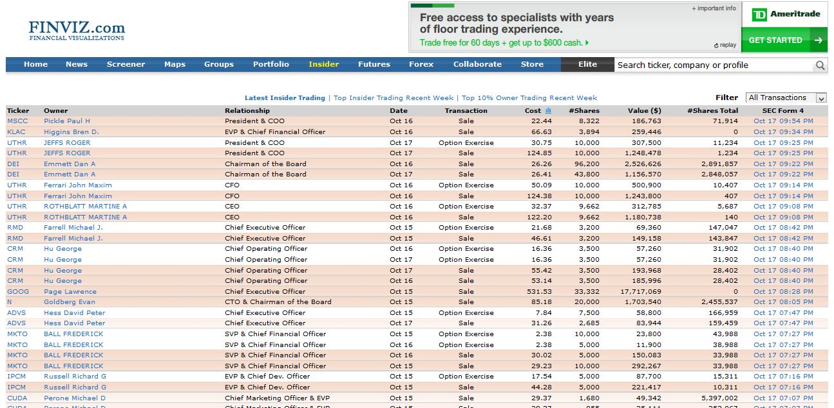
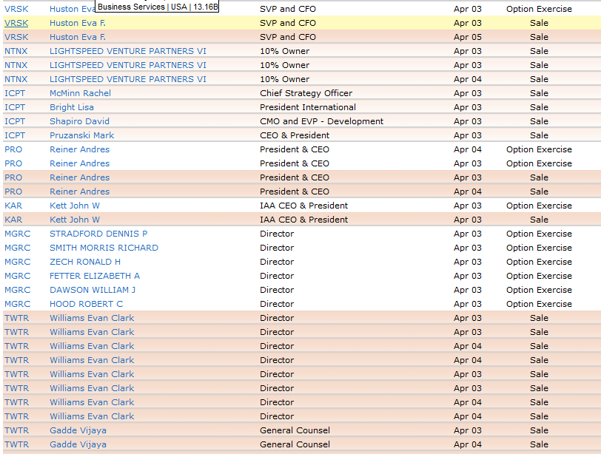
#4 What Are Insiders Doing?

Slide 19
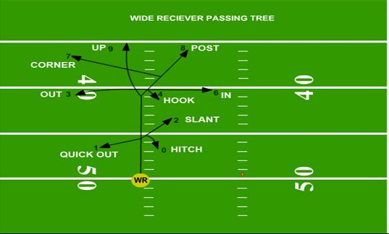
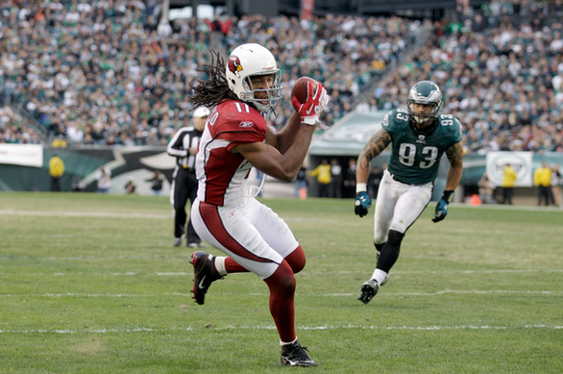
#5 Getting Separation

Slide 20
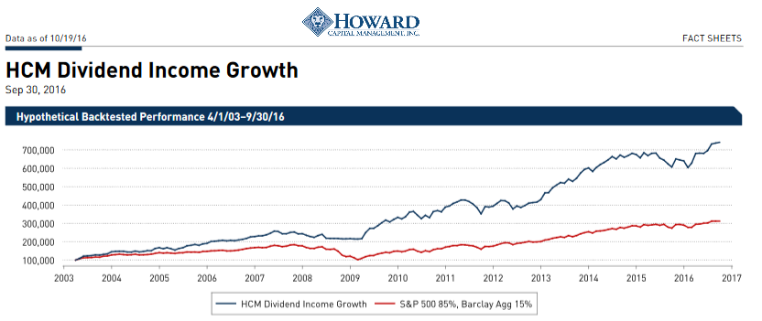
#5 Getting Separation

Slide 21
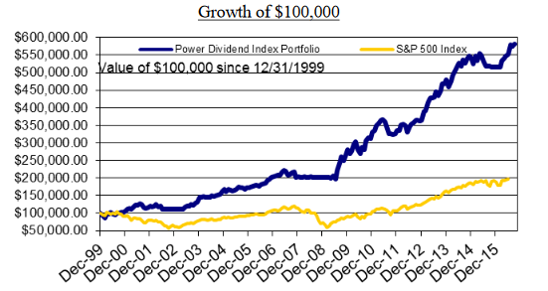

#5 Getting Separation

Slide 22
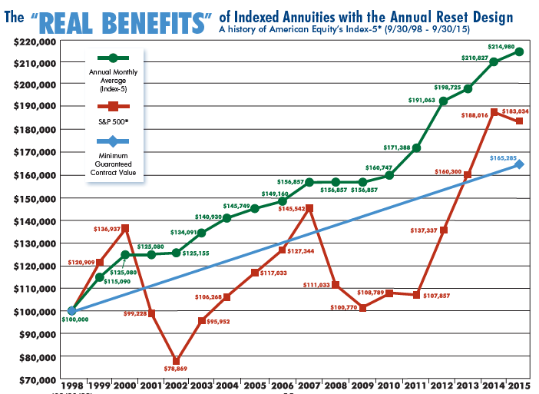
Getting Separation

Slide 23

#6 A Picture Paints a Thousand Words

Slide 24

The Golden Gate Bridge is Beautiful

Slide 25

Speed Limit on the Golden Gate Bridge is 45 mph

Slide 26
What if there were no guardrails, would you still go 45 mph?
What if the fog rolls in? Would you still go 45 mph?

Slide 27
Managed Money is like putting guardrails on Investments…
…so when the markets get foggy, you can proceed with confidence!

Slide 28
FIAs are like putting guardrails on investments…
…so when the markets get foggy, you can proceed with confidence!

Slide 29
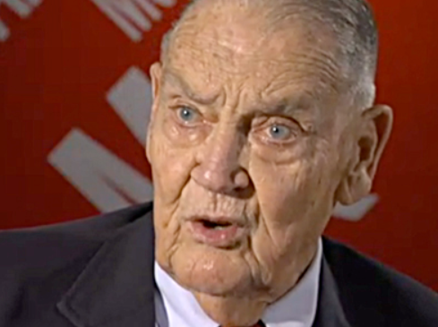
#7 JACK BOGLE WARNS:
Prepare For Two Massive Market Declines In The Next Decade
Notes:
JACK BOGLE WARNS: Prepare For Two Massive Market Declines In The Next Decade
Matthew Boesler
Apr. 1, 2013, 5:38 PM
Read more: http://www.businessinsider.com/jack-bogle-warns-of-two-50-percent-market-declines-in-next-10-years-2013-4#ixzz3LiV9KI9E
Jack Bogle is the founder and chairman of mutual-fund giant Vanguard Group and is widely credited for popularizing index funds, a staple for buy-and-hold investors.
Today, he was on CNBC, and he had a bit of a startling prediction.
CNBC anchor Scott Wapner put the question to Bogle: "You say, 'prepare for at least two declines of 25-30 percent, maybe even 50 percent, in the coming decade.' For a buy-and-hold guy, that's a little concerning, don't you think?"
Bogle replied:
Not at all. They come and go. The market goes up, and the market goes down. It's never failed to recover from one of those 50 percent declines.
I went through one in 1973-1974, I went through one in 2001, 2002, 2003; I went through another one 2008-2009. They're kind of scary – often terrifying – but it's typical.
Why it doesn't bother me is if you hang on through the cycle, that's the only way to invest. Trying to guess when it's going to go way up or way down is simply not a productive way to put your money to work.
Bogle's comments don't represent any sort of shift in his philosophy – he remains as big a proponent of buy-and-hold investing as ever.
Of course, if Bogle is right about two 50-percent declines in the next decade, it's going to be a trying experience for the buy-and-hold crowd.
Read more: http://www.businessinsider.com/jack-bogle-warns-of-two-50-percent-market-declines-in-next-10-years-2013-4#ixzz3LiV3Ytyv

Slide 30
#7 JACK BOGLE’S WARNING
Bogle told CNBC…
“But I also tell them they should expect at least a few 25 percent to 30 percent drops along the way, and maybe even a 50 percent drop in the coming decade.”
http://www.businessinsider.com/jack-bogle-warns-of-two-50-percent-market-declines-in-next-10-years-2013-4 Apr. 1, 2013

Slide 31
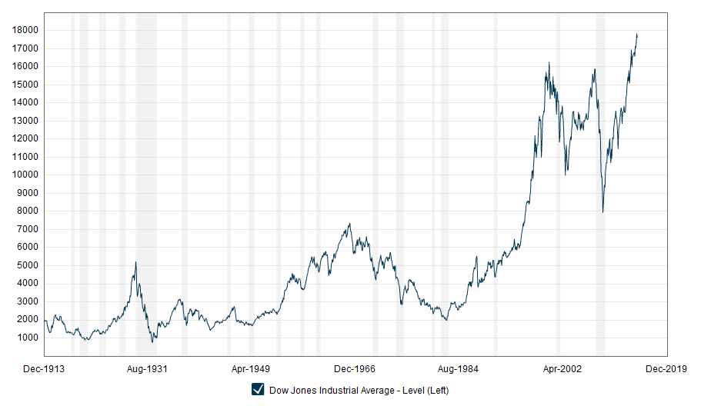
#7 JACK BOGLE’S WARNING
Stiff upper lip? What if you were retiring…
“The market is going to do what it wants,” he explained. “So you’ve just got to keep a stiff upper lip.”

Slide 32

#8 Playing with House Money
What system do you have to take your own money off the table and play with the market’s money?
Do you want to be “all in” all the time?
Or do you want to take some money off the table?

Slide 33
#8 Playing with House Money
Like going to Vegas, determine how much of your retirement money you can’t afford to lose and don’t take it to Vegas with you.
$100k?
$300k?
$500k?
$750k?

Slide 34
#9 The Income Challenge
Inc. Rider Roll-up Rate
$100k*6%
5 Yrs
$134,000
6%
Withdrawal
$6,000
Guaranteed
Return
$100k*7%
5 Yrs
$140,000
4%
Withdrawal
$5,600
No Guarantees
Return
$100k*0%
5 Yrs
$100,000
6%
Withdrawal
$6,000
Guaranteed

Slide 35


#10 Freeing Up Retirement Assets
60 Year old with $650,000 needs to grow at 7.5% for the next 6 years to hit $1M
66 year old
$1,000,000
4% WD Rate
$40,000/yr.
Free up $350,000
Studies showing an 18%-44% Failure rate
66 year old $1,000,000
$650,000
6.2% WD Rate
$40,000/yr.

Slide 36

The ABC Planning Model

Slide 37
If you can answer this question effectively, you will significantly increase your protection!
Where do bond alternatives fit into a your portfolio of assets?

Slide 38



.25% – 1.25%
3% – 7%
+30% – -30%
Taxable
Liquid
Bank
CDs
Savings
Checking
Tax-Deferred
Moderately Liquid
Taxable
Liquid
401k
IRA’s
Stock/Bond
10%
50%
40%

Slide 39



What is your greatest priority?
What are you willing to give up?
Gains? Liquidity? Protection?
Cash
Protective Growth
Risk Growth
Potentially lower returns
Taxable or tax-deferred
Liquid
Potentially moderate returns
Tax-deferred
Offer partial withdrawals
Potentially higher returns
Taxable or tax-deferred
Offer partial withdrawals or liquid
Liquidity
Protection
Gains
Gains
Liquidity
Protection

Slide 40
GREEN Money

Slide 41

Three Green Money Rules:
Rule #1: Protect Your Principal
Rule #2: Protect Your Gains
Rule #3: Protect Your Income

Slide 42
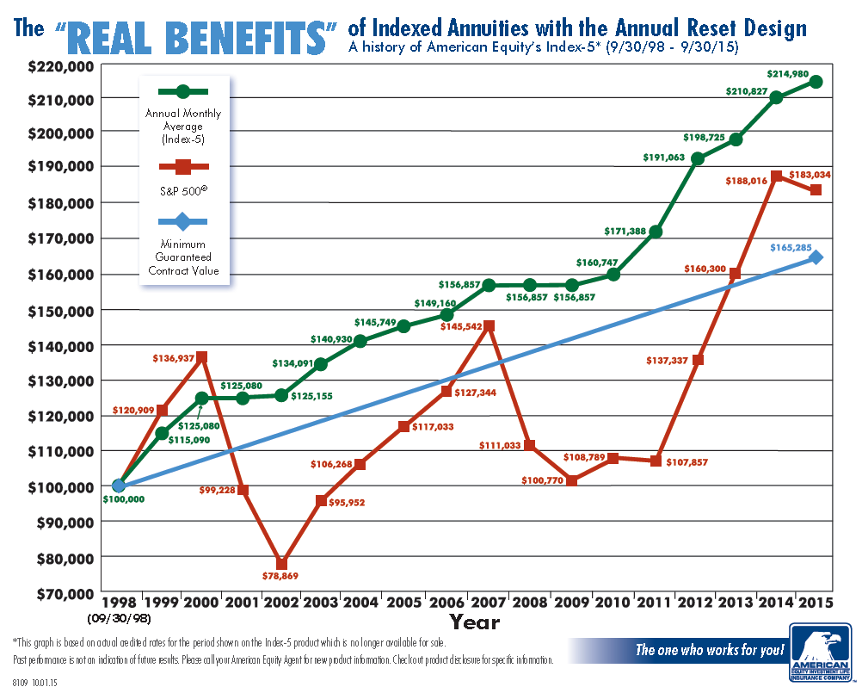


Slide 43
RED Money

Slide 44
Three Red Money Rules:
Rule #1: Must Be Tactical
Rule #2: Must Be Liquid
Rule #3: Must Be Long Term

Slide 45
What is Tactical?
Most people have been lead to believe…
THERE IS ONLY ONE WAY TO INVEST
Invest In The “Market”
And Live With The Inevitable Ups and Downs

Slide 46
What is Tactical?
But, There Are Actually TWO,
Very Distinct And Different Ways To Invest:
                Strategic
                Tactical

Slide 47
What is Tactical?
                Strategic
                Traditional Approach
                Common To Mutual Funds
                “Buy And Hold”

Slide 48
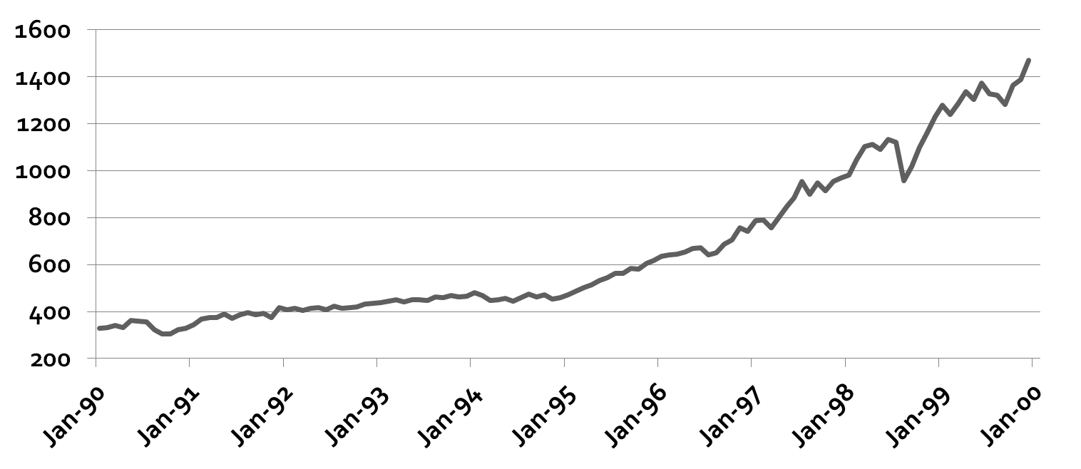
Strategic: An Illustration
S & P 500 Index
Decade Of the 1990’s
(14.53% Annualized Return)
$423,000
$100,000

Slide 49
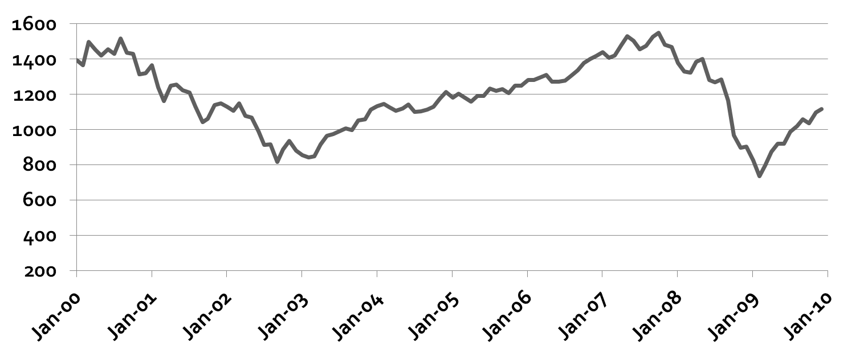
Strategic: An Illustration
S & P 500 Index
Decade Of The 2000’s
(-2.23% Annualized Return)
$100,000
$79,000

Slide 50
So Then What Is
Tactical Managed Money?

Slide 51
Tactical Managed Money Is…
  ACTIVE PROFESSIONAL Money Management

Slide 52
Tactical Managed Money Is…
  ACTIVE PROFESSIONAL Money Management
  Constant Attention By A Professional Manager

Slide 53
Tactical Managed Money Is…
  ACTIVE PROFESSIONAL Money Management
  Constant Attention By A Professional Manager
  Flexibility To Use Multiple Asset Classes

Slide 54
Tactical Managed Money Is…
  ACTIVE PROFESSIONAL Money Management
  Constant Attention By A Professional Manager
  Flexibility To Use Multiple Asset Classes
  Trends And Indicators, NOT Timing

Slide 55
Tactical Managed Money Is…
  ACTIVE PROFESSIONAL Money Management
  Constant Attention By A Professional Manager
  Flexibility To Use Multiple Asset Classes
  Trends And Indicators, NOT Timing
  Ultimate Asset Protection: Cash

Slide 56
Tactical Managed Money Is…
  ACTIVE PROFESSIONAL Money Management
  Constant Attention By A Professional Manager
  Flexibility To Use Multiple Asset Classes
  Trends And Indicators, NOT Timing
  Ultimate Asset Protection: Cash
  Asset Preservation & Asset Appreciation

Slide 57
Tactical Managed Money Is…
The Basic Goal of
Tactical Managed Money:
Capture Upside or Positive Performance
Avoid “Drawdowns” or Negative Performance

Slide 58
Tactical: An Illustration
S&P 500 Index Fund
2000 Through 2014

Slide 59
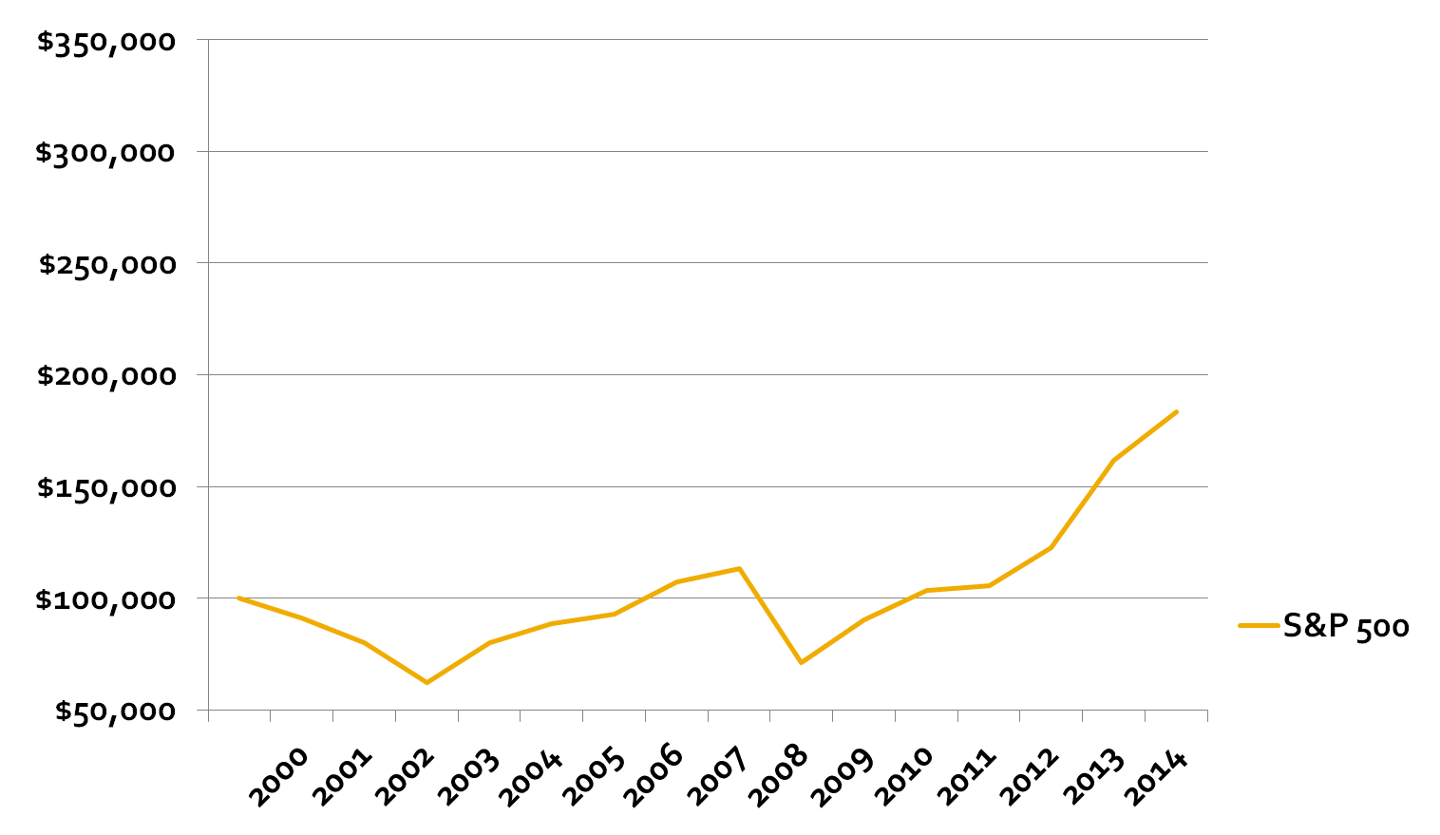
Tactical: An Illustration
S&P 500 Buy & Hold
        $183,578

Slide 60
Tactical: An Illustration
S&P 500: 80% Participation / Avoidance
        $297,999
        $183,579

Slide 61
Tactical: An Illustration
S&P 500: 90% Participation / Avoidance
        $374,310
        $297,999
        $183,579

Slide 62
But The “BIG” Question…
Can It Really Be Done?

Slide 63
Yes It Can Be Done…
And It Has Been Done!

Slide 64
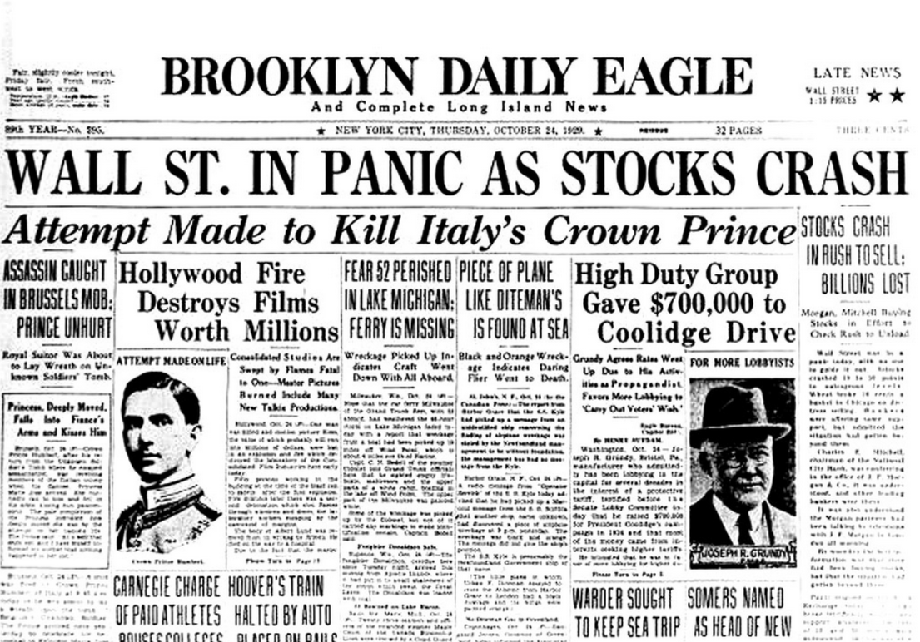

What if it happened again?

Slide 65
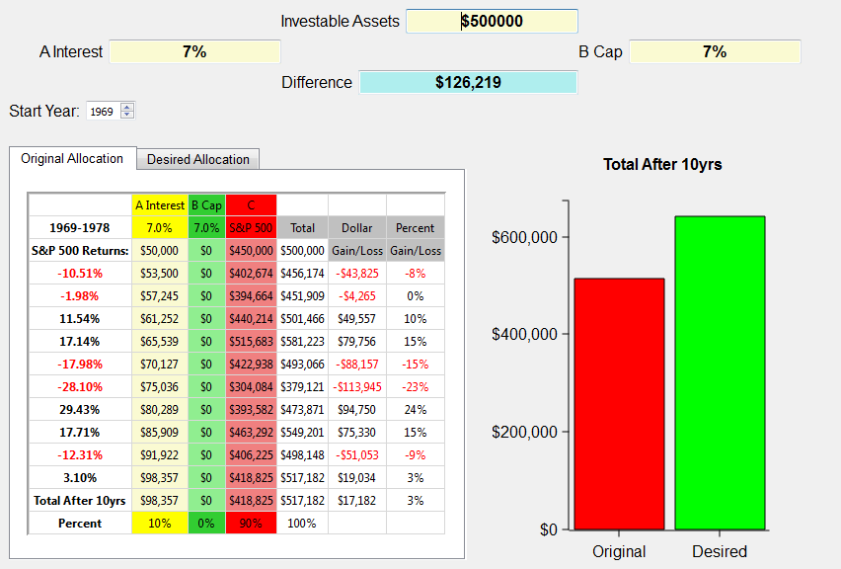
What if a bear market happens again? 1969 through 1978
Notes:
The illustration above shows the S&P 500 returns for the years 1969 through 1978 on the left. The investible assets are $500,000. This example uses the same criteria for caps in the index annuities, but uses the 7% average CD rate for the decade. Wouldn’t you love that again! We use the broad market index to approximate what investing in the market in general was like over that period of time..
The chart shows at the end of the ten year period this investor would have gained a little over $17,000. Look at all the red years in that decade! 5 out of 10 years were negative!
So, let’s take a look at the ABC allotment.

Slide 66
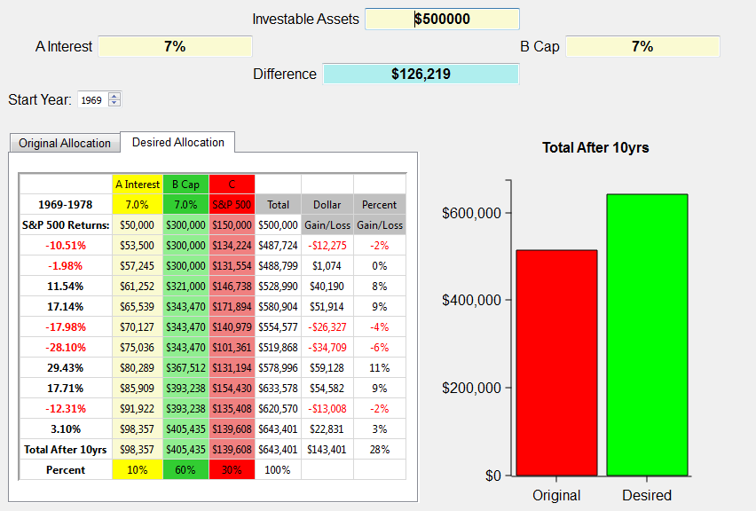
What if a bear market happens again? 1969 through 1978
$126,219
Notes:
The ABC allotment of 10/60/30 grows to over $143,000, which is a $126,219 difference! That’s with 5 out 10 years negative! Very positive toward the ABC bear market strategy for retirement.
Now let’s take a look at a really nasty decade. One we’re all familiar with.
Next slide.

Slide 67
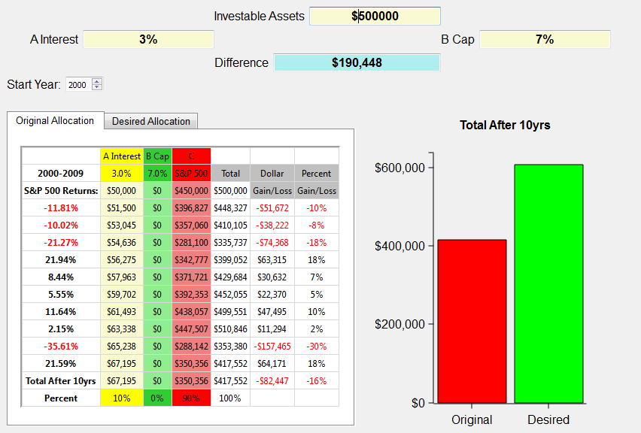
What if a bear market happens again? 2000 through 2009
Notes:
The illustration above shows the S&P 500 returns for the years 2000 through 2009 on the left. The investible assets are $500,000. This example shows a typical investor who has about 10% in cash earning an average of 3% and 90% allocated to the market represented by the S&P 500. We use the broad market index to approximate what investing in the market in general was like over that period of time. Certainly an investor could have been in more or less risk than illustrated here. Yet, the illustration shows in general terms how the market performed from 2000-2009. Notice, there are no monies allocated to Column B, which are Index Annuities.
The chart shows at the end of the ten year period this investor would have lost close to $100,000. I don’t know about you, but a 20% loss in the market is devastating when it comes to retirement! Imagine if you were 52 years old in 2000 and planning to retire when most people retire at age 62. Would you do what many have had to do, which is work another 3-5 years in hopes of recovering those assets needed to retire?
And what if it happens again? What if the next ten years aren’t any better than this decade? Can you afford to lose another 20% or possibly more? Can you continue to push off your retirement indefinitely?
When I show this graph to clients they tell me, “Yep, that’s about what happened to us.” Yet, the same clients will surprisingly stay in this broken down Wall Street model attempting to recover with a hope and a prayer.
There has to be a better way, and I believe there is.
Next slide.

Slide 68
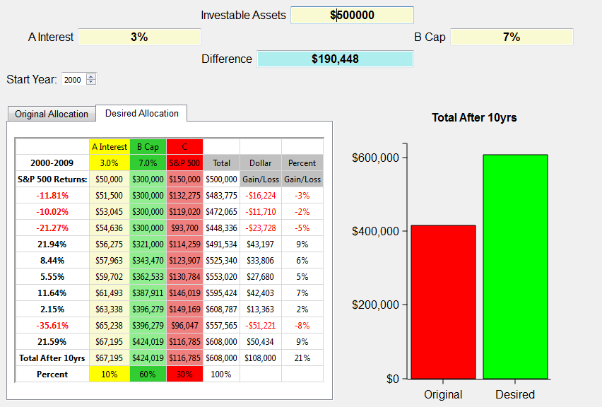
What if a bear market happens again? 2000 through 2009
$190,448
Notes:
Using the 10/60/30 ABC split, this person gains $108,000 instead of losing over $80,000! Now that’s a strategy that works for retirement years. IT does so because it obeys Warren Buffet’s first rule of investing, “Never lose any money.” BTW, that happens to be rules number 2 and 3 also. And it has to be true, especially for retirees or those heading into retirement.
Simply putting some of your money in the green money column protects you from those down years and now with the tremendous guaranteed income payouts the green money column is even more a must for retirees. We don’t want you to get totally out of the red, or growth money assets, but it’s obvious that the green money column is perfect for conservative clients looking for alternatives to Wall Street’s roller coaster rides.

Slide 69

Top Ten Reasons Clients Should Move Money Today!
What’s coming next?
The Next Swing Down
Watch the VIX
What are Insiders doing?
Getting Separation

Slide 70
Top Ten Reasons Clients Should Move Money Today!
A Picture Paints a Thousand Words
Bogle’s Warning.
Playing with “house money.”
The Income Challenge
Freeing Up Money

Slide 71
Thanks again for being with us today!
THANK YOU
Notes:
Thanks them for the evening and wish them well.

